Slide 1
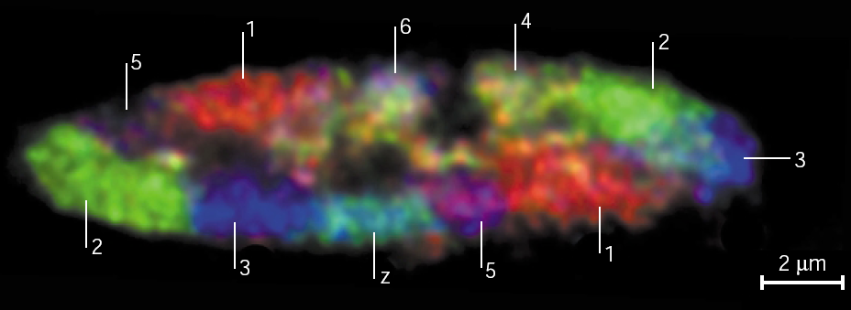

Chromosome Geography Lecture

Slide 2
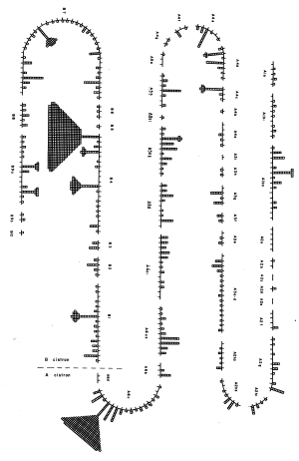
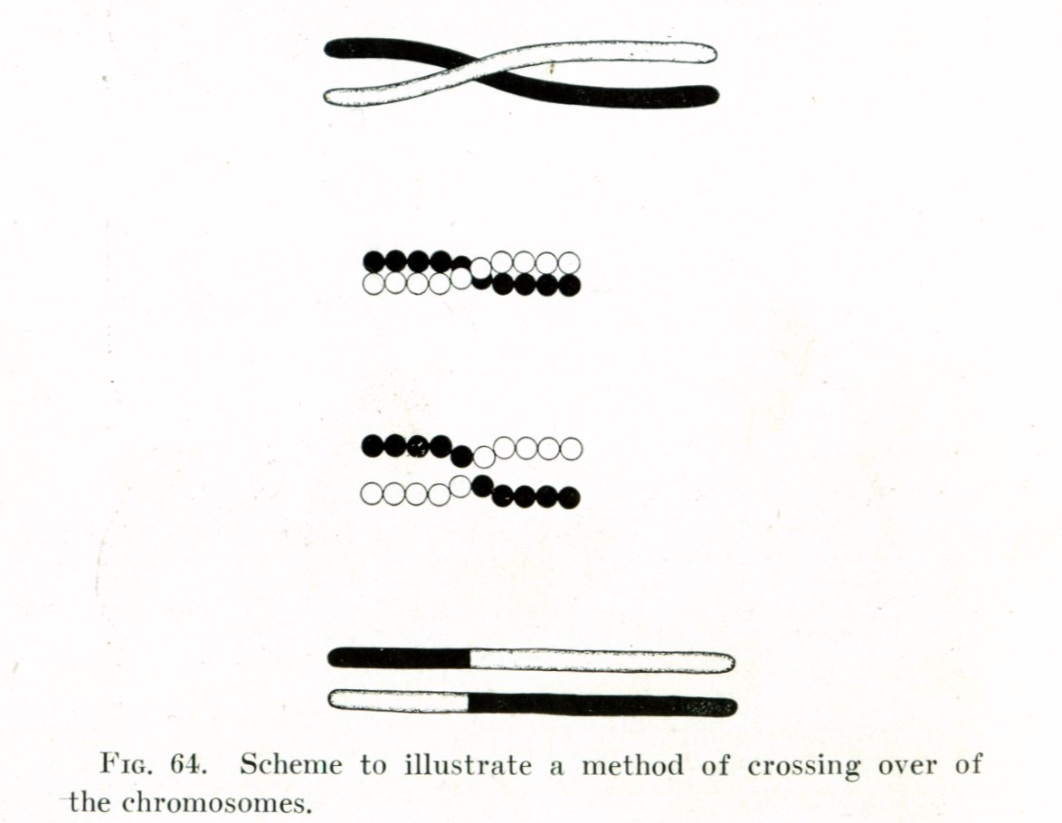
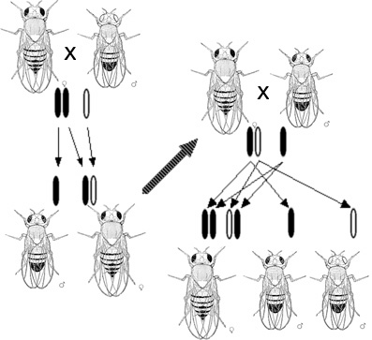
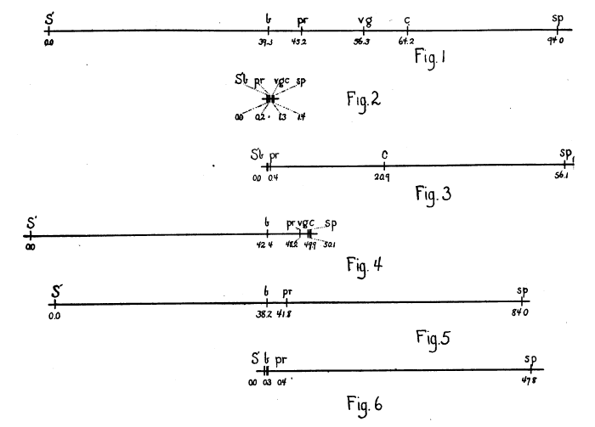
Chromosome Geography @ Caltech
Sturtevant and Morgan
Benzer

Slide 3
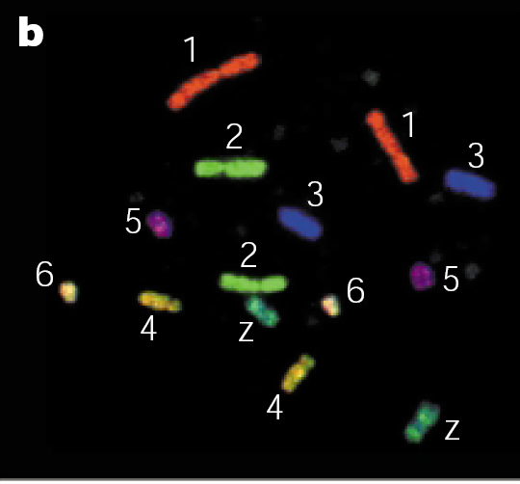
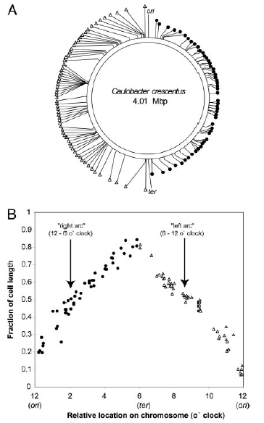
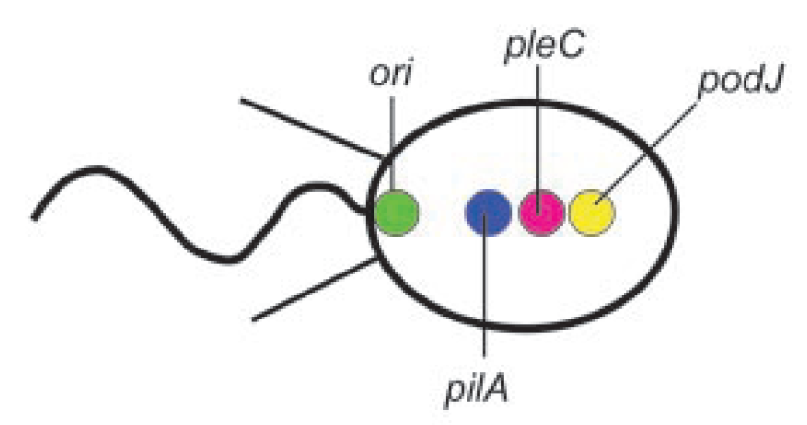
Chromosome Geography: Genomic vs. physical position
Cremer and Cremer
Lucy Shapiro

Slide 4
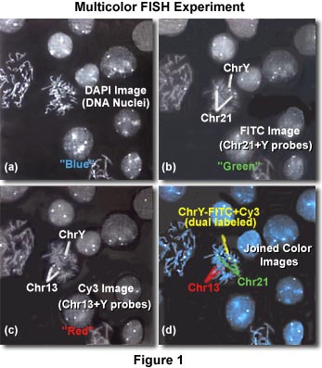
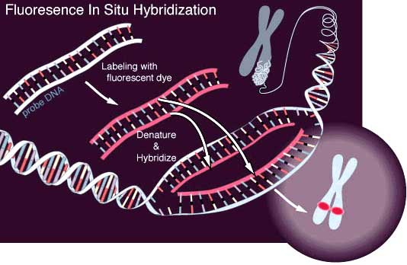
Fluorescence In-Situ Hybridization (FISH)
http://www.microscopyu.com/articles/fluorescence/insitu/brennerinsitu.html

Slide 5
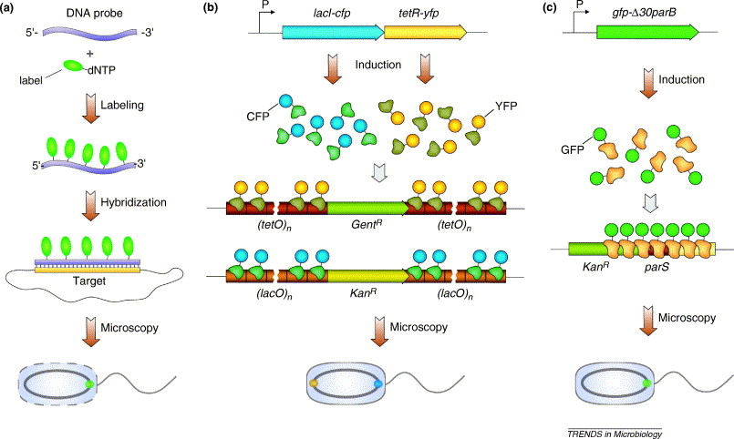
Schemes for Mapping Chromosome Geography
Gitai et al, 2005

Slide 6
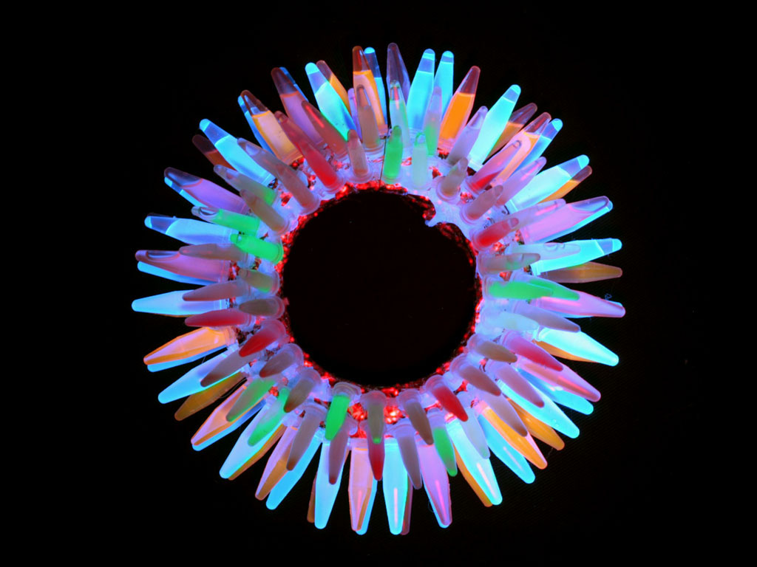
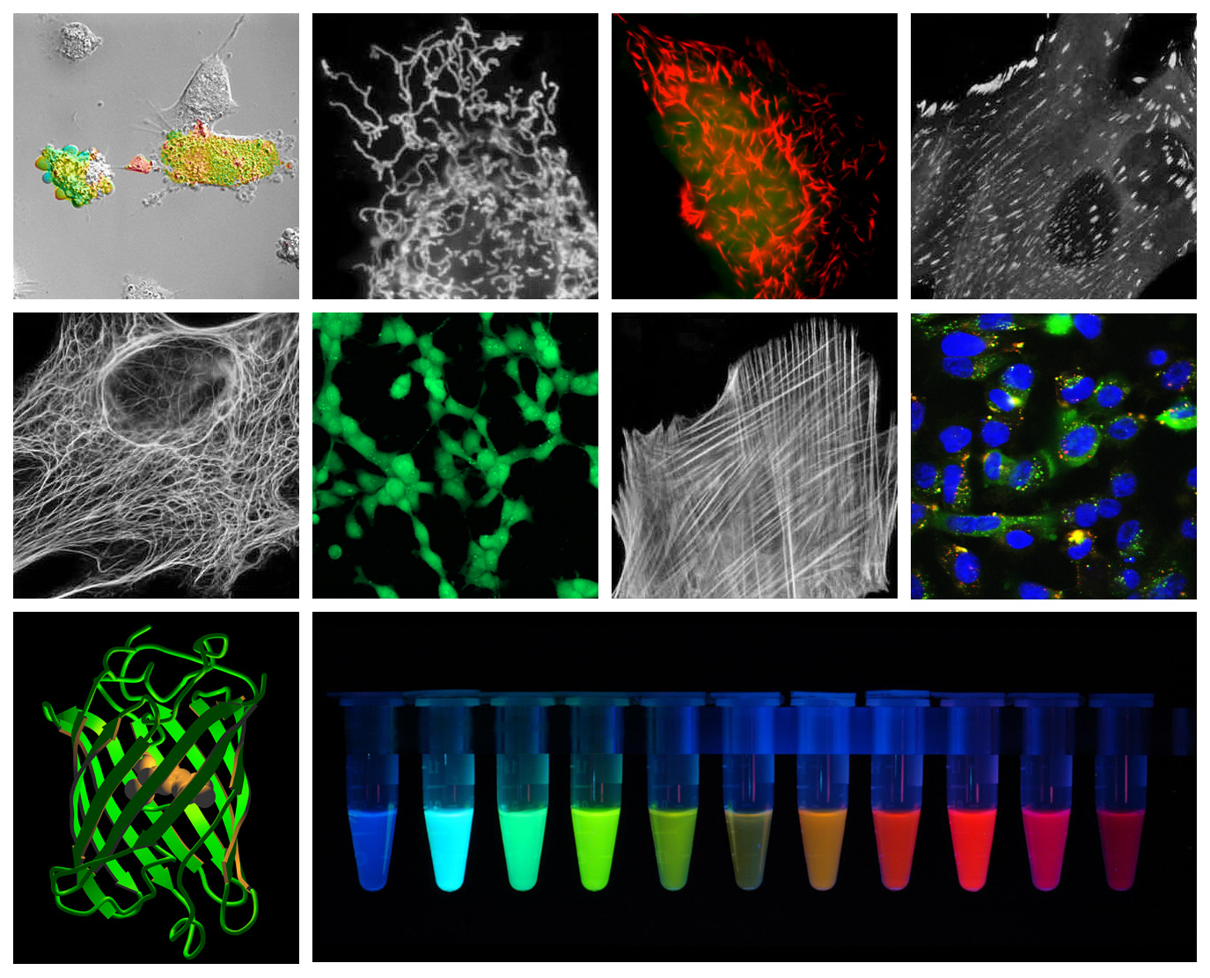
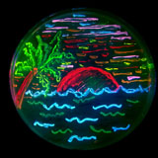
Fluorescent Proteins
http://www.tsienlab.ucsd.edu/Images/General/IMAGE%20-%20Wreath%202002.jpg

Slide 7
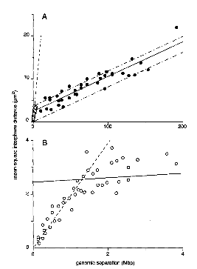
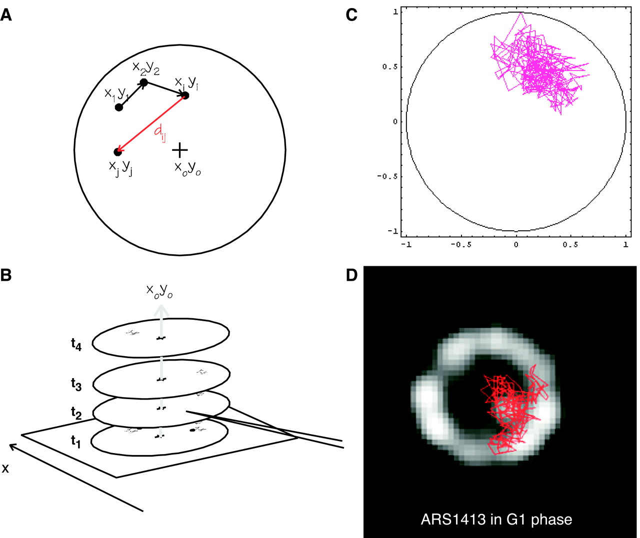
Quantifying the Geography
Gasser, Science 2002
Yokota et al, 1995

Slide 8
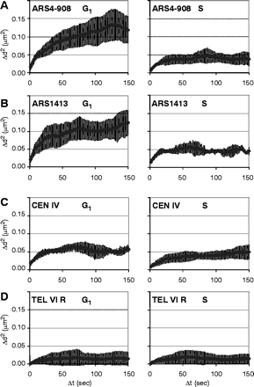
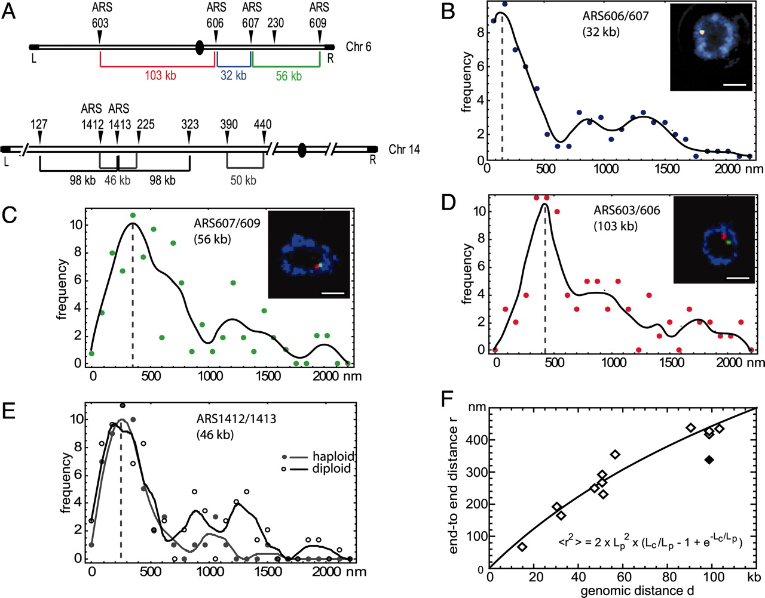
Quantifying the Geography
Heun, Gasser, Science 2001
Bystricky, Gasser, PNAS 2004

Slide 9
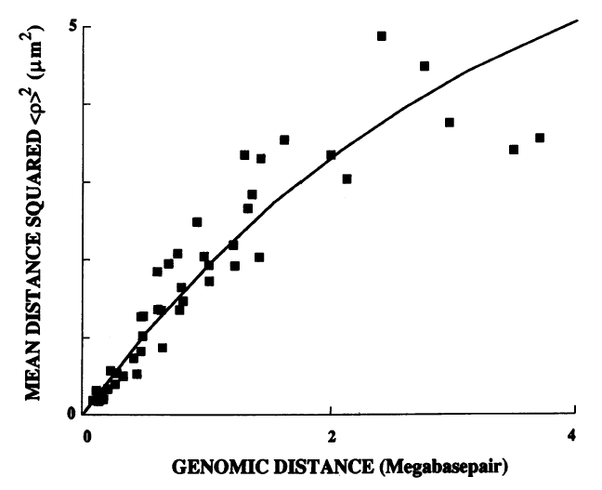
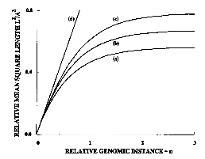
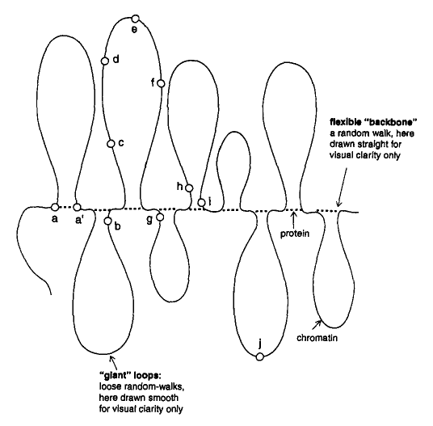
Quantifying the Geography
Sachs et al.

Slide 10
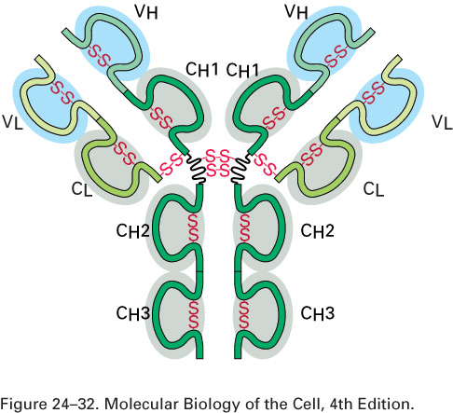
The Immune System

Slide 11
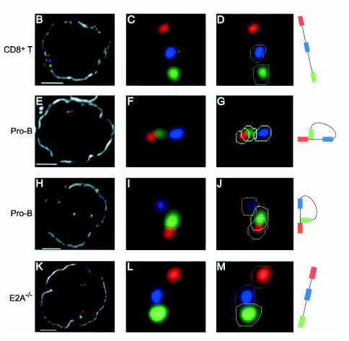
The Immune System
Kees Murre, UCSD

Slide 12
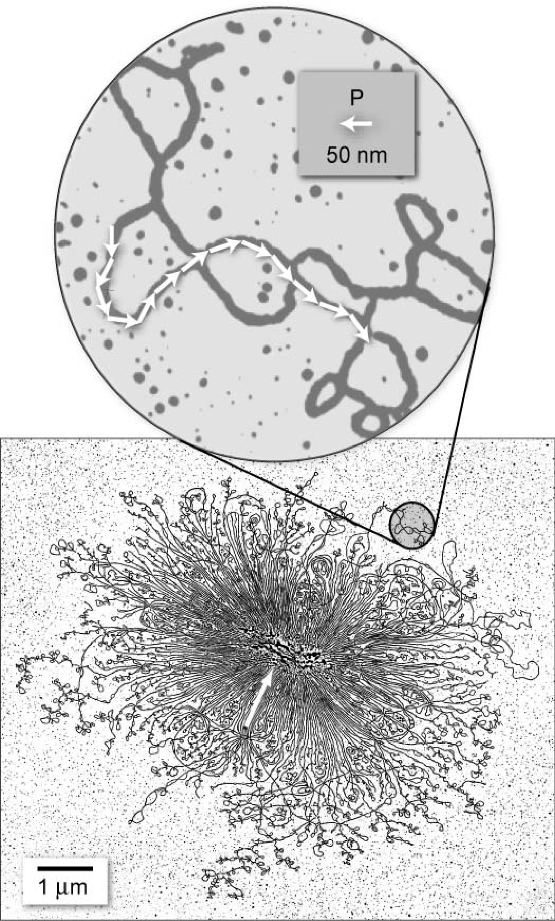
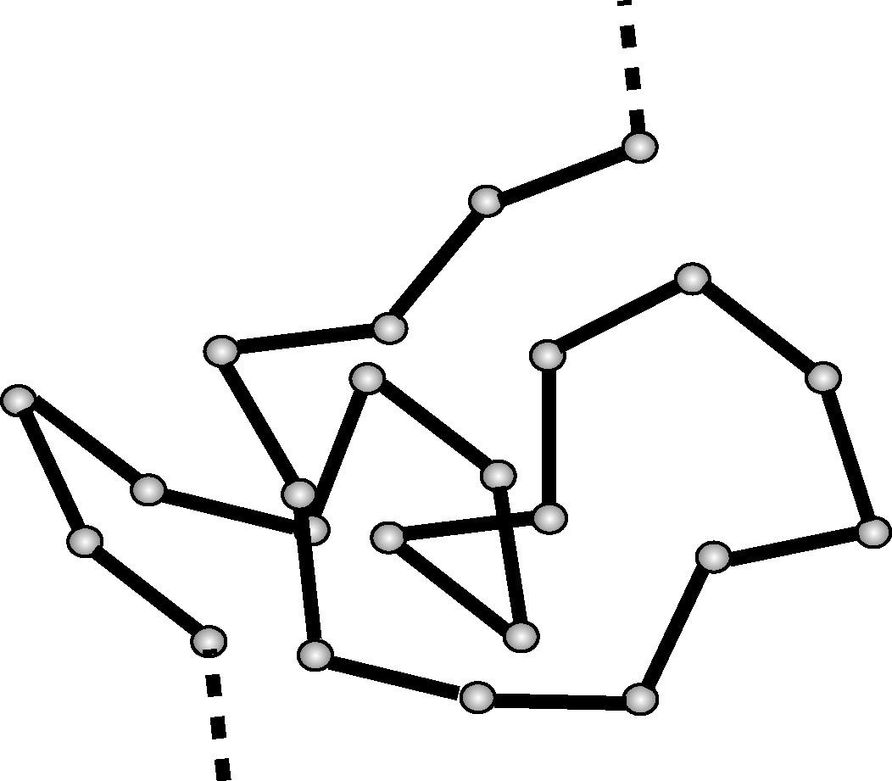
The Chromosome as a Polymer Blob
b=2P

Slide 13
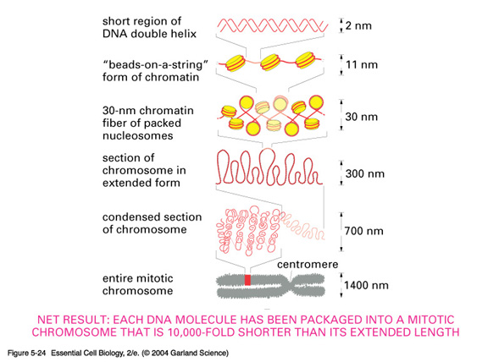
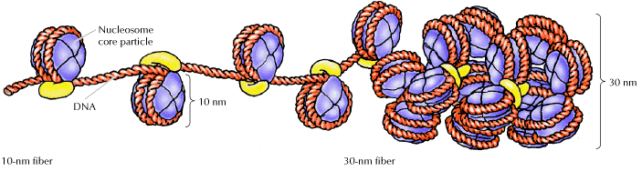
Higher Order Structure

Slide 14
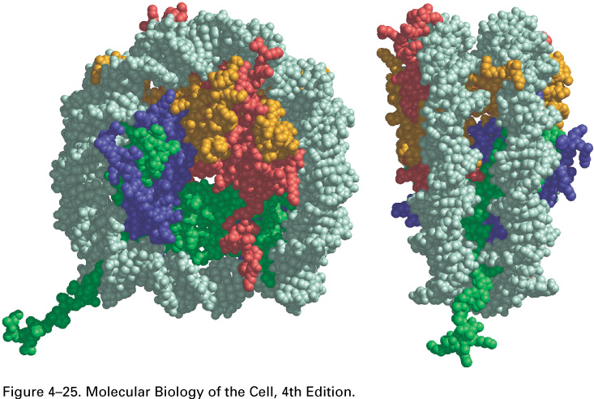
Atomic-Level Structure of the Nucleosome

Slide 15
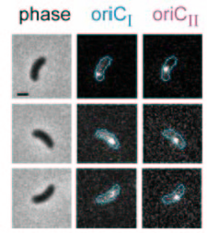
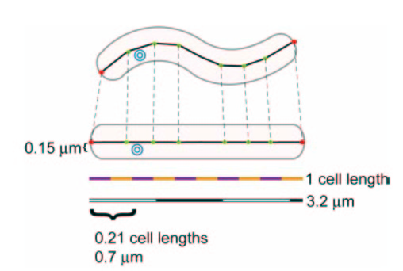
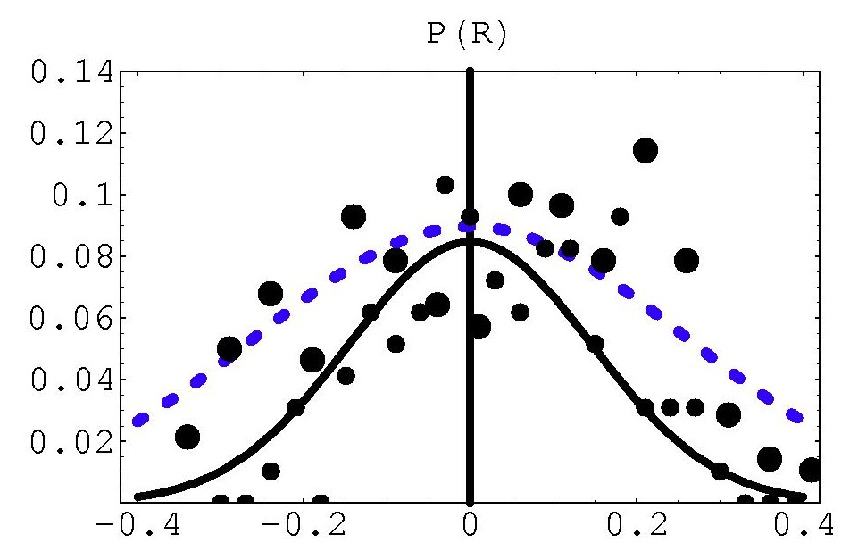
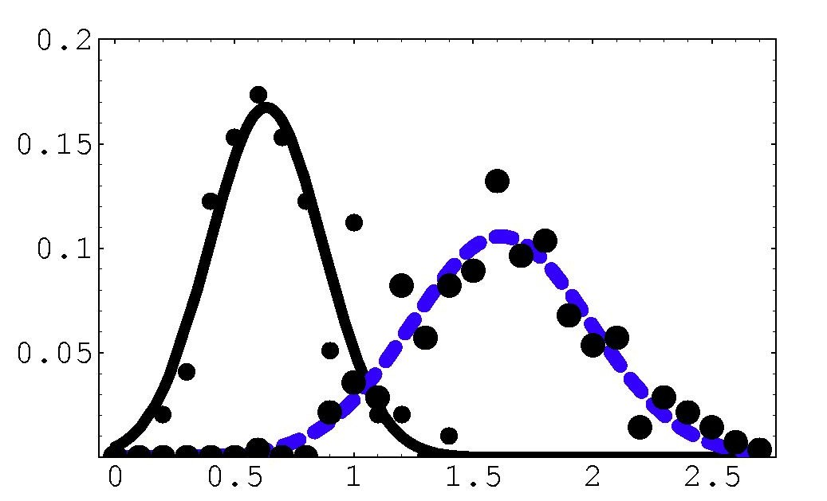
Chromosome Geography in Vibrio
y
x
oriCI
oriCII
Probability
Probability
x
(Theriot et al.)
Replication origins are confined!
y

Slide 16
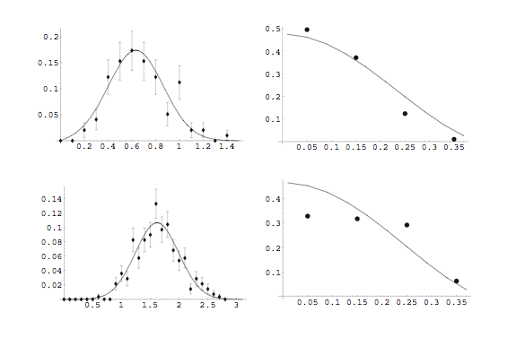
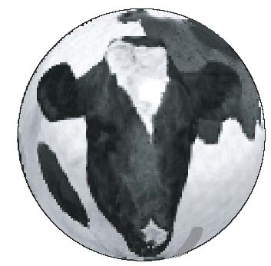

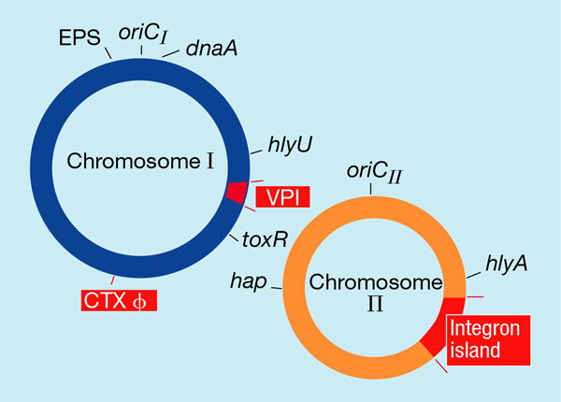
Vibrio Distributions: theory and experiment
Long axis
Perpendicular direction
Model:
0.8μm
oriCI
oriCII

