Slide 1
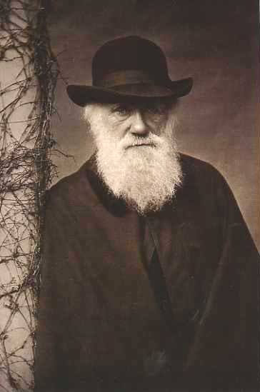
My Favorite (Current) Evolution Stories – An Emphasis on What We Know and How We Know It
Rob Phillips
California Institute of Technology
A Special Lecture: Darwin 200
Feb. 12, 2009

Slide 2
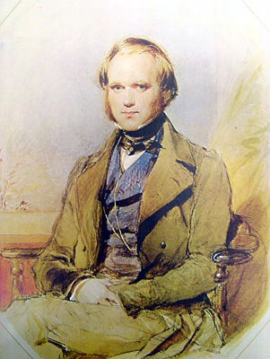
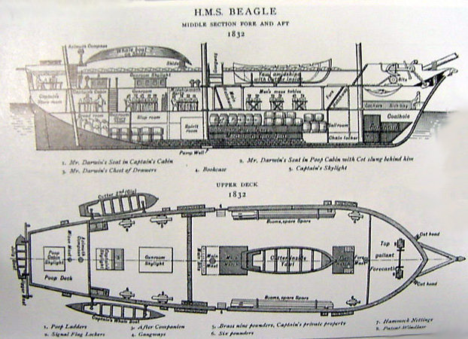
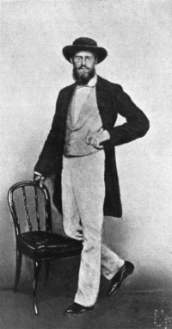
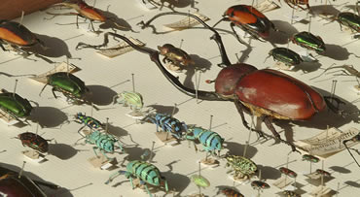
Biology’s Greatest Idea
In physics we often celebrate the unity of phenomena. In biology, a compelling and exciting alternative is to embrace the diversity of phenomena.
Fascinating essay of T. Dhobzhansky entitled: ``Nothing in biology makes sense except in the light of evolution.’’ - the phrase has become hackneyed, but the idea has not.
Darwin found data led to inescapable conclusion, ``it was like confessing a murder’’ he wrote.
Lagrange on Newton: he was "the most fortunate, for we cannot find more
than once a system of the world to establish.” The same can be said of Darwin
and Wallace.
Notes:
Charles Darwin and Alfred Russel Wallace were great adventurers, especially Wallace who wandered through South America and the Malay Archipelago trying to make sense of the diversity of life, the distribution of species, etc. In both cases, their observations led them unequivocally to a view of life in which there is incessant change.

Slide 3
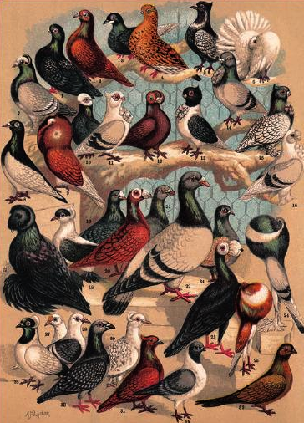
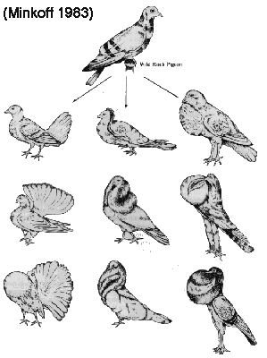
The Ingredients of Evolution: Heritable Variation
One ingredient for evolution is variation, differences between the parents and their offspring.
Though Darwin is famous for finches, if you read ``The Origin of Species’’ you will see that it starts by talking about domestication of animals and how breeders exploit variation (Darwin was way into pigeons).
The ``struggle for existence’’ - you do the numbers on a bacterial culture!
Notes:
What are the ingredients of evolution? The first ingredient is the fact of variation. That is, offspring differ from their parents. This is so obvious as to be almost a triviality. On the other hand, when coupled with the second ingredient of evolution, namely, selection, it forms a potent and pitiless engine leading to the emergence of novelty.

Slide 4
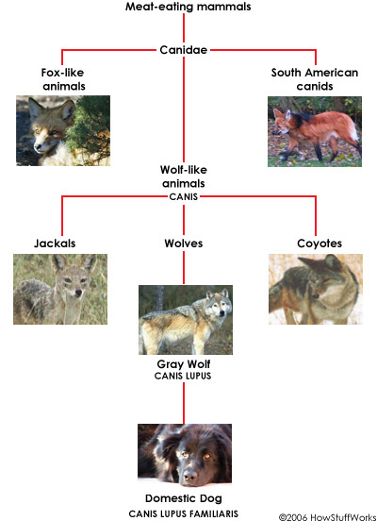
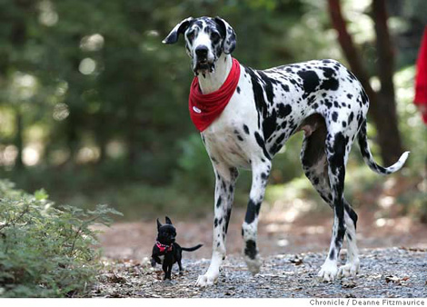
Are You Living With Wolves? The Wonder of Artificial Selection
A classic story of artificial selection is provided by man’s best friend.
All dogs descended from only one of the more than 20 canine species: WOLVES.

Slide 5
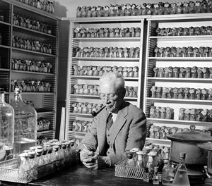
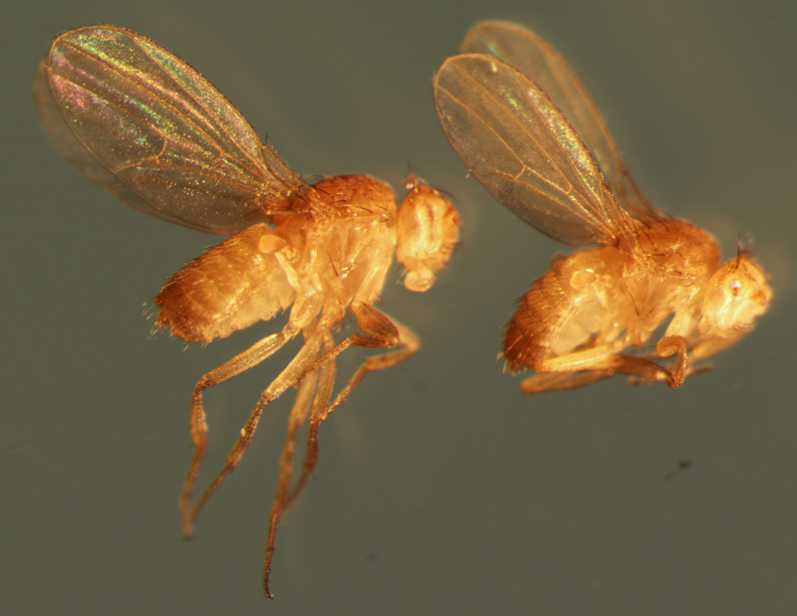
Biology’s Uniquely Beautiful Approach to Heritable Variation: Genetics
Genetics, as discovered by Mendel, provided the mechanistic underpinnings for the observed variations in organisms.
Controlled study of variation in fruit flies (Drosophila melanogaster)provided a host of interesting insights into development and heredity.
Female (left) and male (right) flies with the mutation eyeless
Notes:
Genetics explains the ``particulate’’ nature of inheritance.

Slide 6
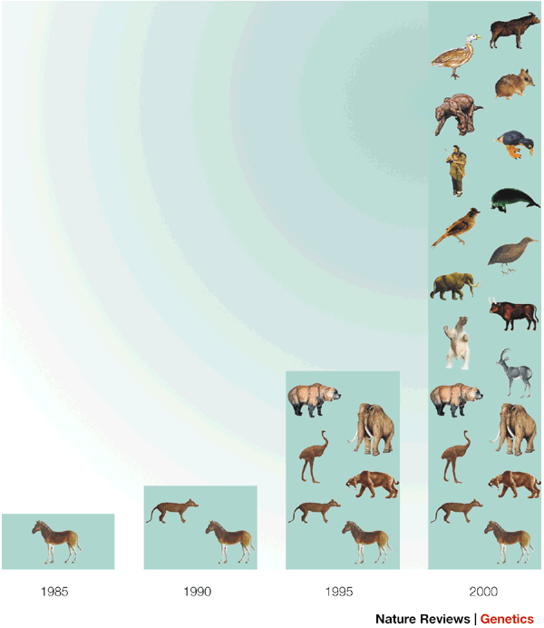
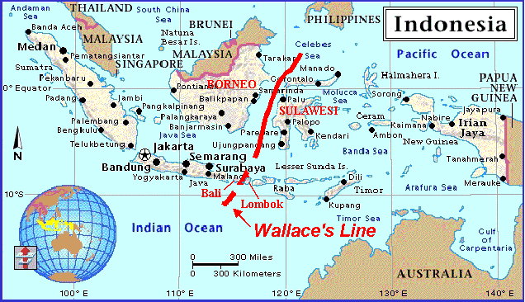
Evolution: How Do We Know? !!!!!!!!!!
The family tree of life - the classification of organisms (both living and extinct) makes most sense when viewed as a family tree.
Vestigial structures - whales, snakes, humans with tails
Biogeography - distributions of species reveal patterns that only make sense in light of evolution. See the Wallace line.
Fossils (The Earth is replete with vast evidence of the long history of life)
Molecules as documents of evolutionary history (comparing sequences and structures from different organisms). Also, now DNA from extinct organisms.
Evolution in real time (Peter and Rosemary Grant and the Galapagos finches, antibiotic resistance, flu each year, etc.)
Notes:
The claim made in the case of these mice is that there is a strong selective pressure resulting from predation. Mice with the “right” color have a better chance of not being eaten by predatory owls. The particular difference has to do with mutations in the melanocortin-1 receptor.

Slide 7
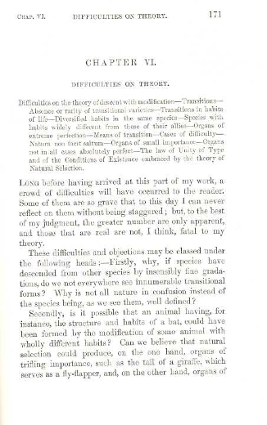
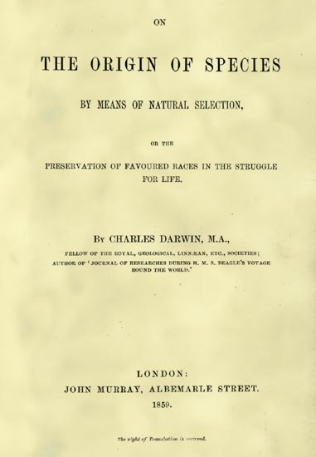
Darwin’s Chapter 6: How Science is Done!
Chapter 6 of ``The Origin of Species’’ outlines the challenges to the idea of variation by natural selection.
“Difficulties on Theory” - Darwin emphasized perfectly correctly the role of skeptical thinking in science.
Notes:
Scientists are interested in discovering how nature works. As a result, the standards for accepting a particular idea are very high. In Darwin’s case, he made every effort to poke holes in his conclusions. Chapter 6 of “The Origin of Species” is a beautiful example of this kind of careful thinking.

Slide 8
Biological Diversity and Adventure: Who Is Out There?
Key lesson: field biologists have undertaken adventures to the farthest corners of
the world to look for previously unknown forms of life. From Van Leeuwenhoek
to Darwin to Stetter, each new round of exploration tells us about new
“biological dark matter”.

Slide 9
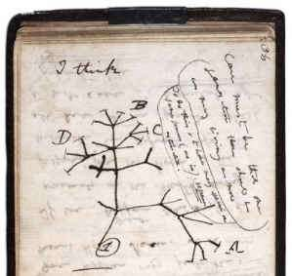
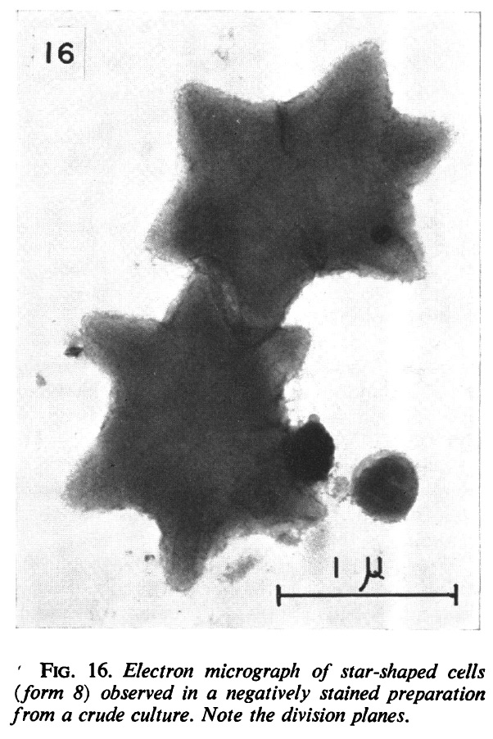
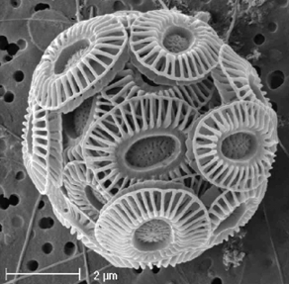
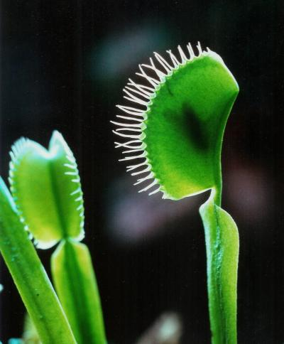
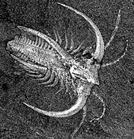
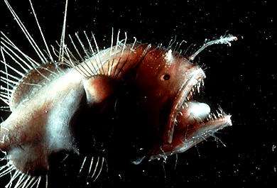
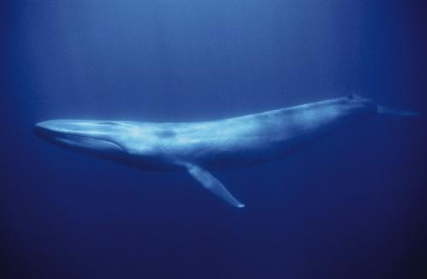
Universal Tree of Life
Diversity of living organisms is enormous.
Notes:
RP and JT to share this slide. Maybe swapping back and forth on the organisms at the bottom.
JT to take the lead with RP interrupting

Slide 10
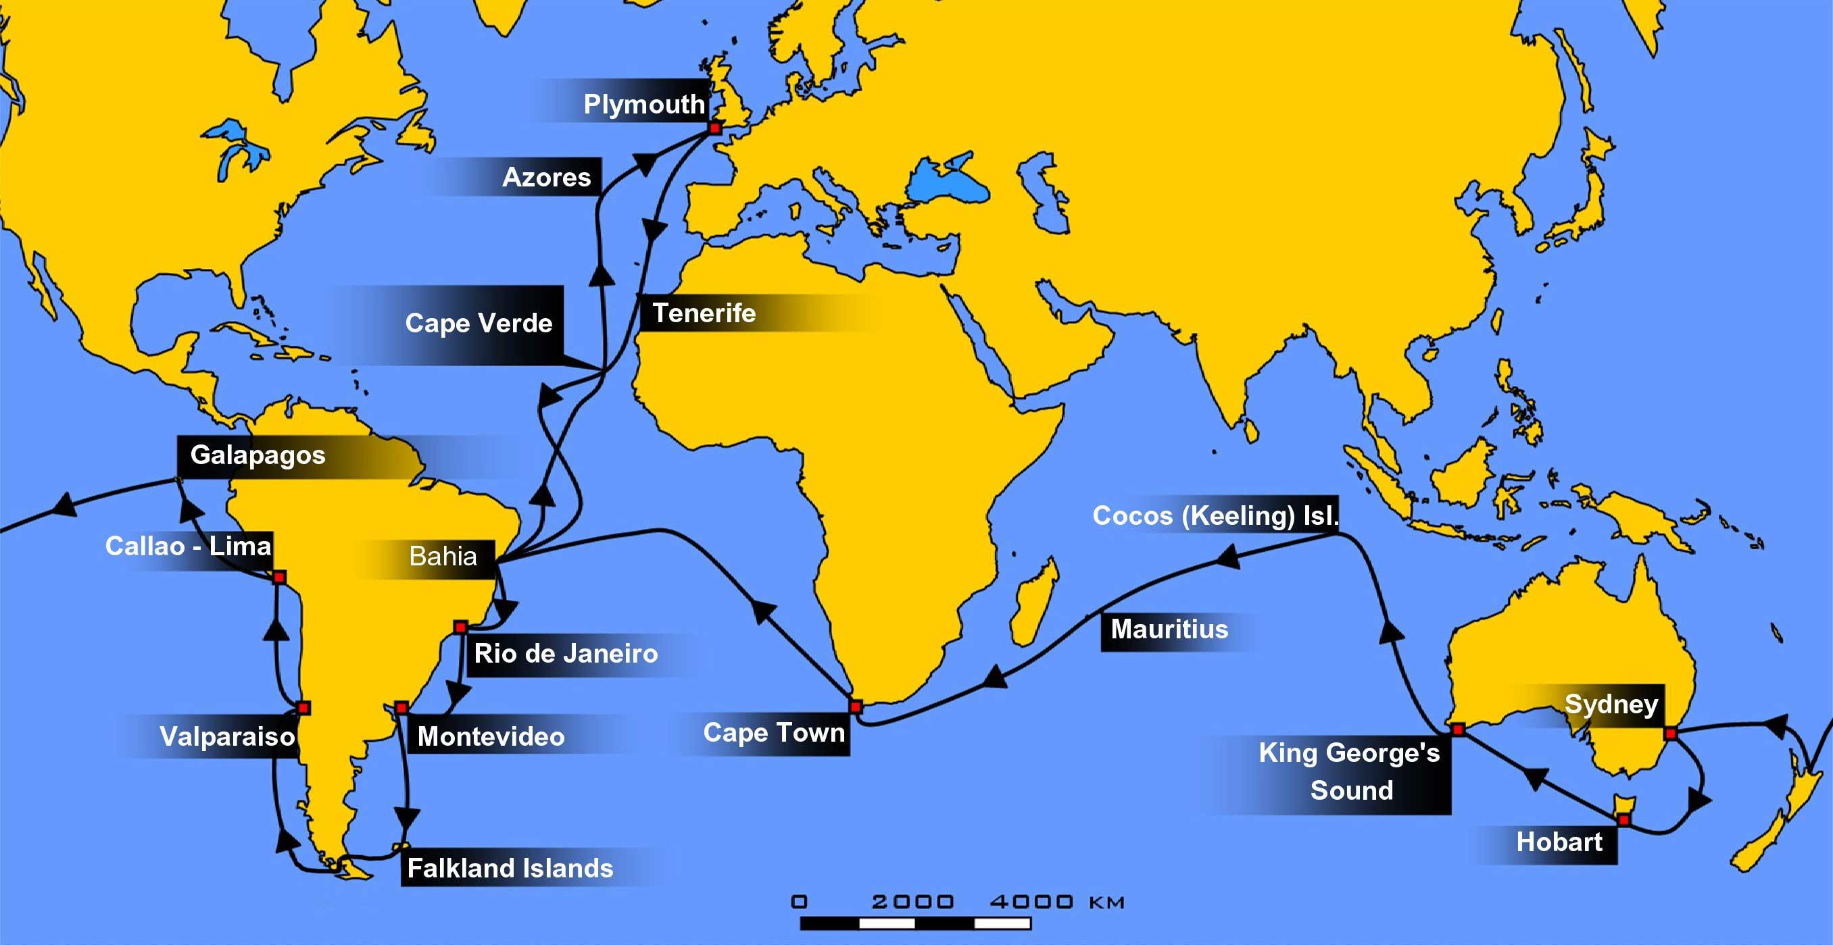
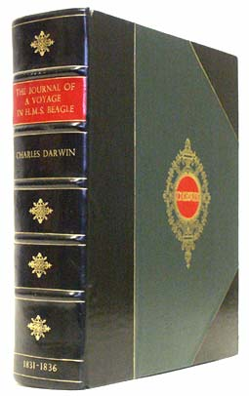
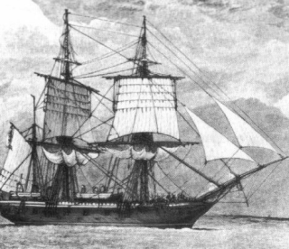
Darwin’s Five Year Adventure: The Diversity of Life

Slide 11
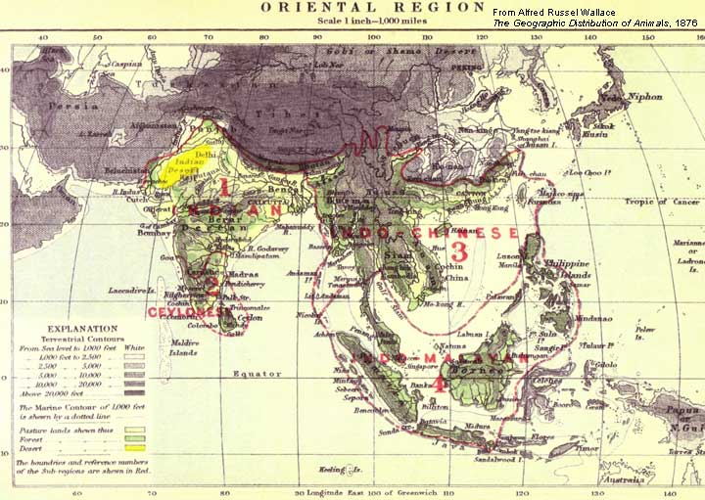
Wallace’s Adventures
This map from Wallace's 1876 book shows his Oriental biogeographic region, broken into four subregions (outlined in red). "Wallace's Line" is indicated by the arrow.

Slide 12
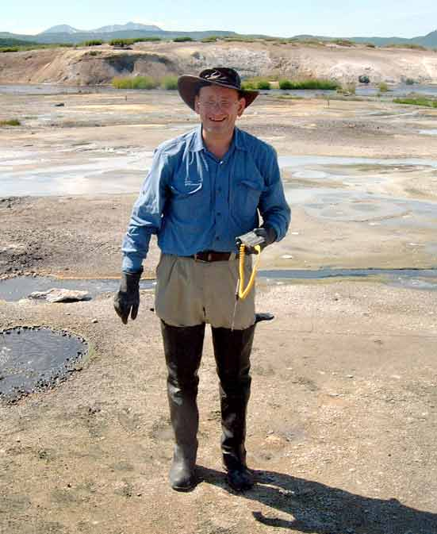
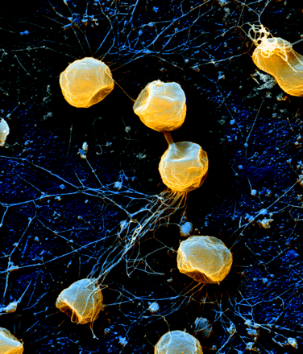
Biological Diversity and Adventure: Who Is Out There?
Karl Stetter has spent his life searching for new and bizarre classes of extremophiles.
The archaeon Pyrococcus furiosus (“rushing fireball”) was named for its ability to swim very rapidly at temperatures above 80|SDC. Up to 70 flagella per cell have been observed on its surface. These flagella are multifunctional structures; they are used not only for swimming but also for adhesion to various surfaces to establish biofilms. Cells shown here adhere to sand grains from the natural habitat, the coast of Vulcano Island, Italy. In addition, flagella can aggregate into compact cables, establishing cell-cell connections. The image is a scanning electron micrograph of superimposed back-scattered and secondary electron signals.

Slide 13
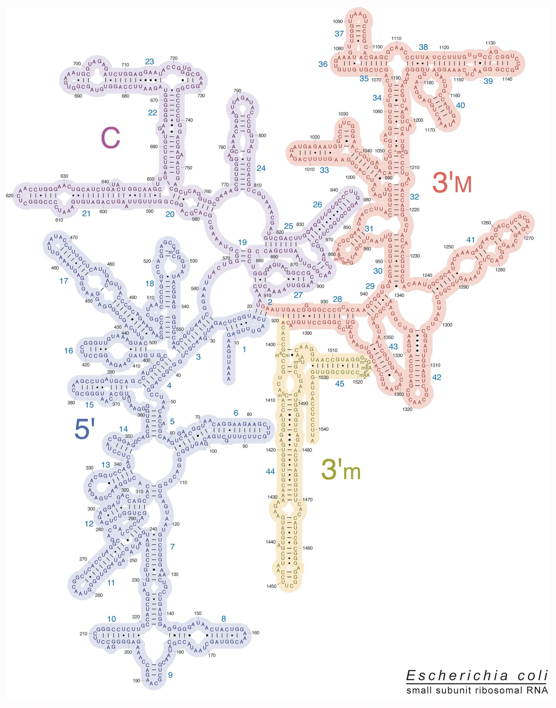
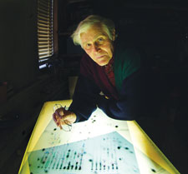
Biological Diversity and Adventure: Who Is Out There?
Carl Woese has used the ribosomal RNA associated with the small ribosomal subunit to provide a molecular measure of relatedness.

Slide 14
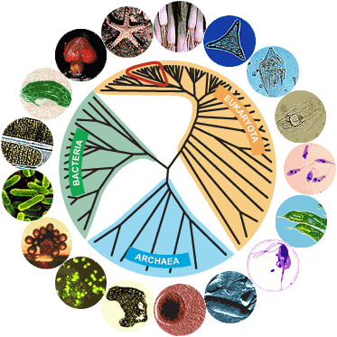
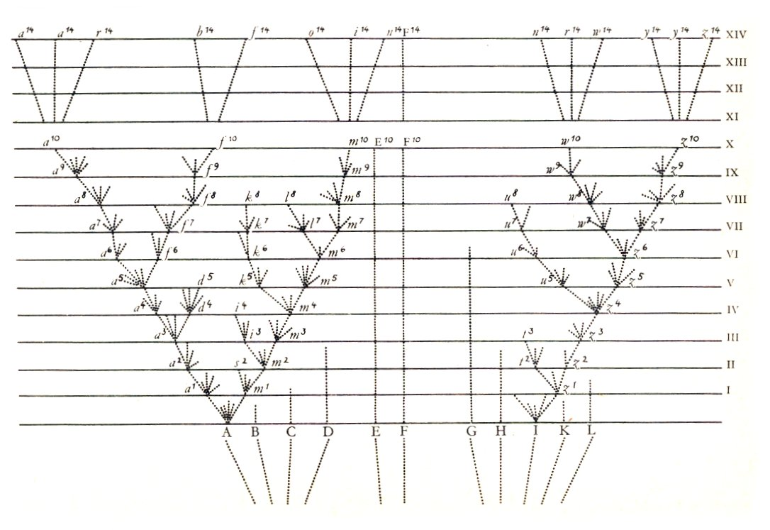
Ribosomes and the Tree of Life
The idea: compare RNA sequences for small subunit from different organisms as basis for comparing species and examining their relatedness.
A beautiful use of this idea by Carl Woese - molecular analysis of the tree of life.
For the engineers in the house: build me extremophiles!
Within the last 30 years we have discovered a previously unknown domain of life!
Only figure in Darwin’s ``Origin’’

Slide 15
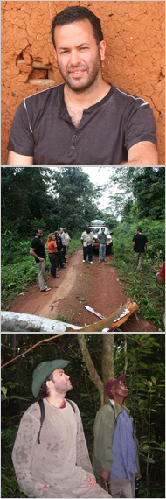
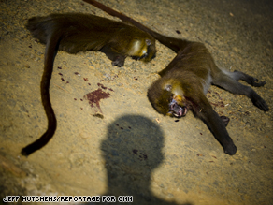
Biological Diversity and Adventure: Who Is Out There?

Slide 16
A Fossil Story: From Fins to Limbs and Back Again
Key Lesson: Fossils are one of the key windows of evidence into evolution.
Since the time of Darwin, the imperfections of the fossil record have been filled
in and several of the great transitions (fins to limbs, limbs to fins) have been
elucidated with great fossil finds.

Slide 17
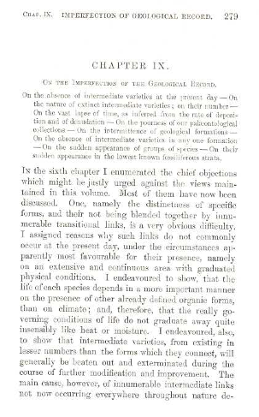
Darwin’s Chapter 9: The Fossil Record
Chapter 9 of ``The Origin of Species’’ outlines Darwin’s worries about the fossil record.
Not surprisingly, there has been enormous and continual progress on this front in the time since.
Biggest qualitative message: life has changed over time!
Notes:
Darwin’s fascinating and profound book reports an astonishing variety of experiments and observations as well as concepts, explanations and hypotheses. One of the most satisfying features of the book is the constant self-critical analysis aimed at trying to find out whether or not evolution as a fact is true and whether or not the hypothesis of evolution deserved to be elevated to the status of theory. In Darwin’s time, the fossil record was notoriously incomplete. In the time since, much of the uncertainty that worried Darwin has been eliminated.

Slide 18
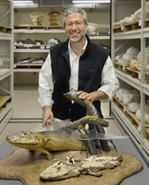
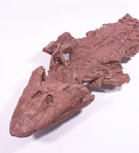
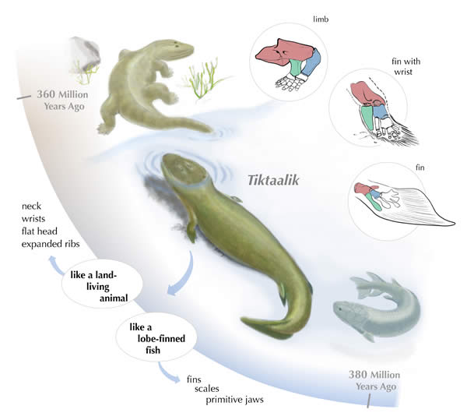
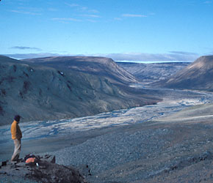
How Do We Know?: From Fins to Limbs
Shubin calls Tiktaalik ``a mosaic of primitive fish and derived amphibian’’.
Another example of filling in the transitional forms that are demanded by the theory of evolution.
Note: there was a predictive element - they were looking for this in a place where they expected to find it. Theories make falsifiable predictions.
Fossil hunting in Arctic Canada

Slide 19
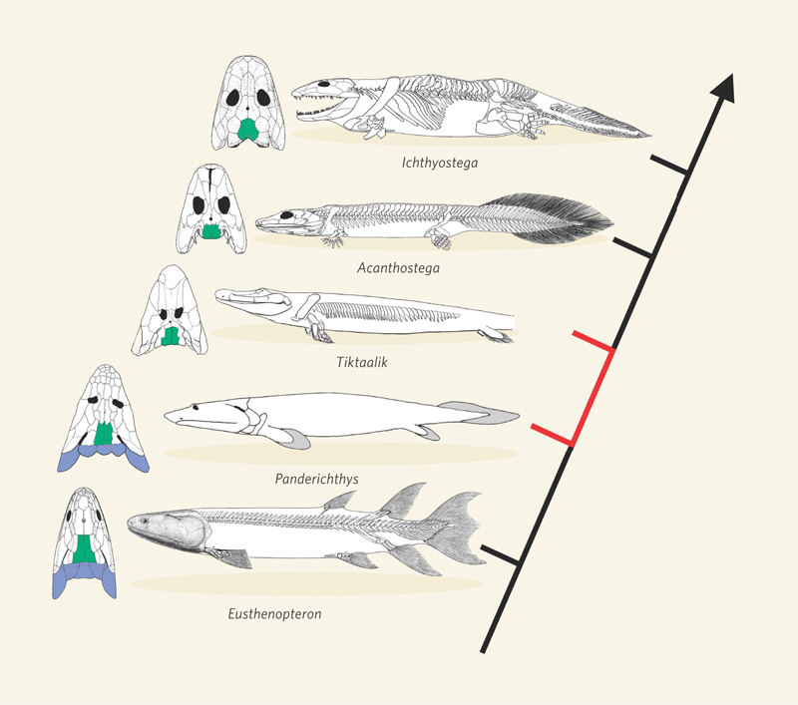
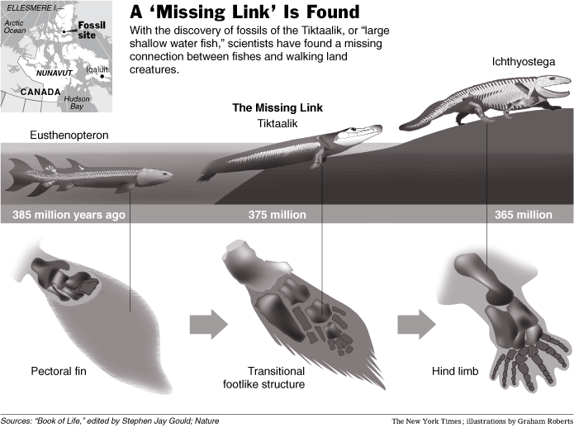
How Do We Know?: From Fins to Limbs
The lineage leading to modern tetrapods includes several fossil animals that form a morphological bridge between fishes and tetrapods. Five of the most completely known are the osteolepiform Eusthenopteron16; the transitional forms Panderichthys17 and Tiktaalik1; and the primitive tetrapods Acanthostega and Ichthyostega. The vertebral column of Panderichthys is poorly known and not shown. The skull roofs (left) show the loss of the gill cover (blue), reduction in size of the postparietal bones (green) and gradual reshaping of the skull. The transitional zone (red) bounded by Panderichthys and Tiktaalik can now be characterized in detail. These drawings are not to scale, but all animals are between 75 cm and 1.5 m in length. They are all Middle–Late Devonian in age, ranging from 385 million years (Panderichthys) to 365 million years (Acanthostega, Ichthyostega). The Devonian–Carboniferous boundary is dated to 359 million years ago18.
See the book “Gaining Ground” by Jennifer Clack

Slide 20
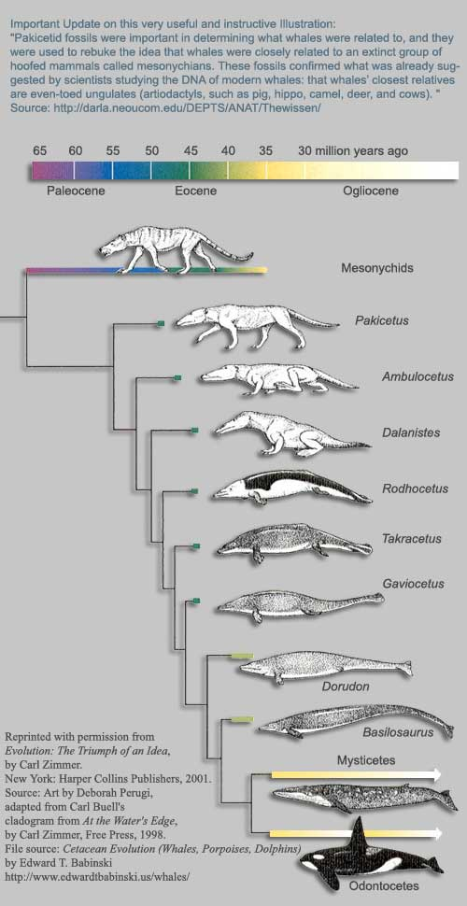
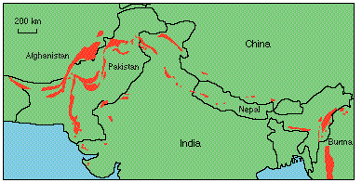
How Do We Know? Back Into the Water
http://darla.neoucom.edu/DEPTS/ANAT/Thewissen/
Perhaps even more intriguing than animals leaving the water is mammals going back in.
Amazing record in the ancient seas at the interface between India and the Asian continent.
The transitional forms are instructive and very complete. Claims about missing transitional forms are oversold.
See the video on Philip Gingerich.

Slide 21
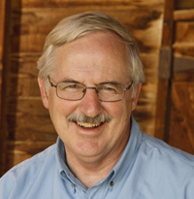
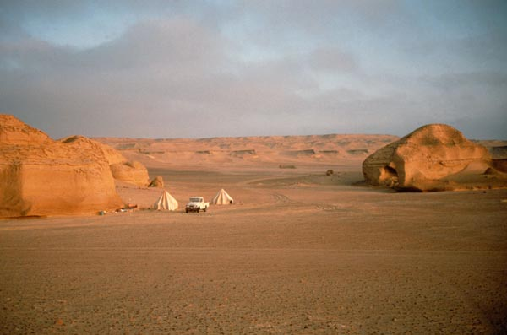
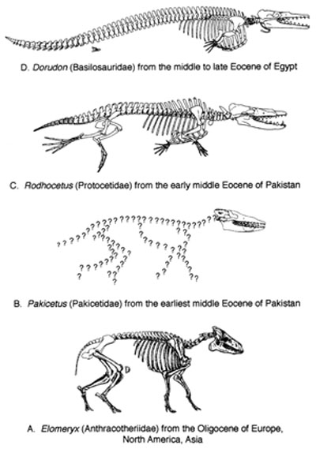
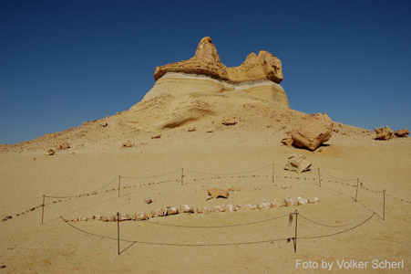
Work of Philip Gingerich
http://en.wikipedia.org/wiki/Wadi_Al-Hitan
http://www-personal.umich.edu/~gingeric/PDGwhales/Whales.htm

Slide 22
Egyptian Whale With Hind Limbs and Feet
Figure 5. Virtually complete skeleton of Dorudon atrox excavated in Wadi Hitan, Egypt. Note the retention of hind limbs, feet, and toes like those found in Basilosaurus. This find is described in Uhen (1996, 2004). The skeleton is approximately 5 m long. Photograph ©1998 Philip Gingerich. Figure may be reproduced for non-profit educational use.

Slide 23
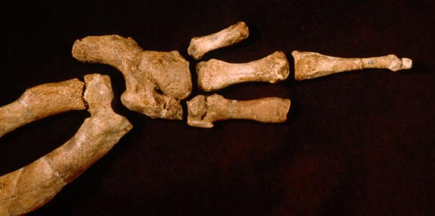
A Closer Look at the Limbs
Figure 4. Ankle, foot, and toes of Basilosaurus isis excavated in Wadi Hitan, Egypt. This find was described in Gingerich et al. (1990). The foot as shown is approximately 12 cm long. Photograph ©1991 Philip Gingerich. Figure may be reproduced for non-profit educational use.

Slide 24
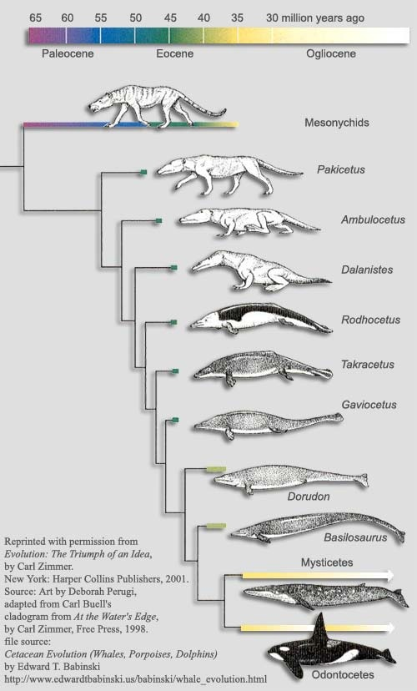
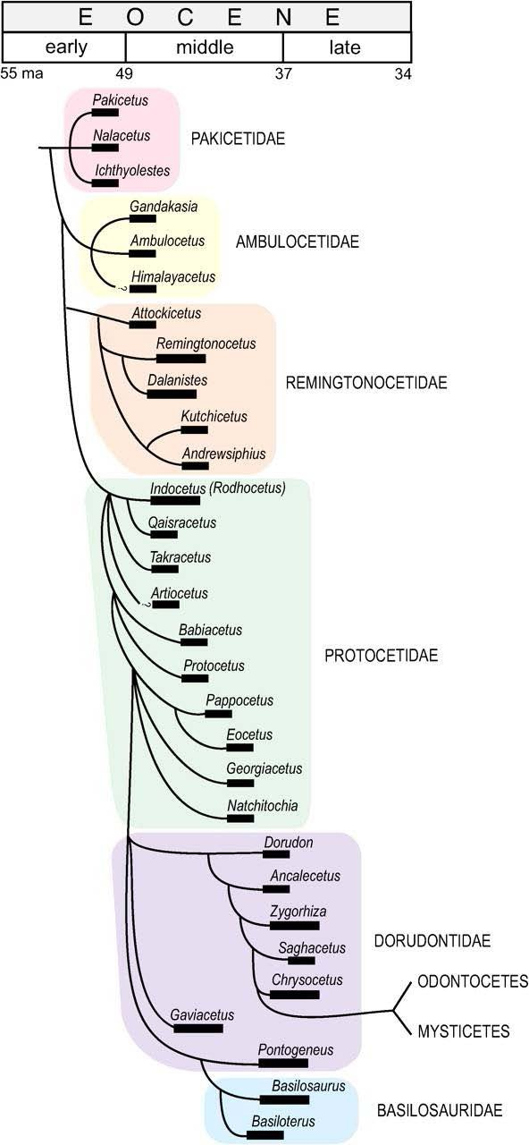
How Do We Know? Missing Transitional Forms?

Slide 25
Evolution By Molecules and Genome Science
Key lesson: Molecules are one of the most important documents that we have of
evolutionary history (and everything else). Genome science makes it possible to
look over evolutionary times in the same way that new generations of telescopes
allow us to look farther back in the history of the universe.

Slide 26
Molecules as Documents of Evolutionary History
A Comparison of Animal Hemoglobins by Tryptic Peptide Pattern
Emile Zuckerkandl, Richard T. Jones, and Linus Pauling

Slide 27
Modern Molecular Analysis of Evolution
Sequence comparisons as a tool for exploring relatedness.
This page: rudimentary sequence comparison of alpha chain of hemoglobin from different species. Pauling undertook this analysis in the early 60s.
A similar story unfolded using cytochrome C as the basis of the comparison.
Linus Pauling in his office in Crellin
Notes:
One of the exciting thrusts of research in the molecular era has been the reconciliation of what was already know from studies of macroscopic form and the fossil record with molecular measures of relatedness.

Slide 28
Stopwatches for the Very Fast and the Very Slow
(Dickerson, Scientific American, 1972)
(Berman et al.)
Molecules as stopwatches. Proteins are strings of amino acids. By comparing the same protein in different species, we can clock the timescale associated with evolutionary divergence.

Slide 29
How Do We Know: Molecular Evidence
Eyeless mutant on right
Eye development is one of the most beautiful examples of commonality of origins.
Comparison of Pax6 (i.e. mouse) and eyeless (i.e. flies) sequences we can see the relation between these genes.
Interestingly, expression of Pax6 in flies results in development of eye tissues where they don’t normally belong.
Mouse Pax6 gene used to drive formation of eyes
Eyes on wings and legs
Notes:
The subject of eyes have been central to evolutionary thinking since the time of Darwin himself since he wondered about the series of continuous steps that could allow for the evolution from light sensitive cells to eyes themselves. Studies on our old friend Drosophila resulted in a serious of glorious discoveries about how eyes develop. In particular, it was found that there are master regulator genes that are found in widely different species. These genes are so deeply related that the mouse gene can be used to drive the formation of ectopic eyes in flies.

Slide 30
Evolution in Real Time: From Microbes to Darwin’s Finches
Key lesson: Many current studies have revealed evolution taking place in real
time. Two of the most impressive studies involve detailed observations over more
than 20 years of two totally different situations: Darwin’s finches and E. coli.
Evolution happens much faster than Darwin thought!

Slide 31
Evolution in Real Time: The Beak of the Finch
Peter and Rosemary Grant have spent since 1973 going to the Galapagos and making measurements on the birds and their habitat.
Their observations reveal that measurable differences occur on the year time scale induced by environmental perturbations such as the amount of rain.

Slide 32
Evolution in Real Time: From Microbes to Darwin’s Finches
In their natural laboratory, the 100-acre island called Daphne Major, the Grants and their assistants watched the struggle for survival among individuals in two species of small birds called Darwin's finches. The struggle is mainly about food -- different types of seeds -- and the availability of that food is dramatically influenced by year-to-year weather changes. – From PBS “Evolution” series.

Slide 33
Evolution in Real Time: From Microbes to Darwin’s Finches
Science. 2004 Sep 3;305(5689):1462-5.
Fig. 1. (A) Previous studies suggest that G. difficilis is the most basal species of the genus Geospiza, and the rest of the species form two groups: ground and cactus finches, with distinct beak morphologies. (B) At stage (st.) 26, Bmp4 is strongly expressed in a broad distal-dorsal domain in the mesenchyme of the upper beak prominence of G. magnirostris and at significantly lower levels in G. fortis and G. conirostris. No Bmp4 was detected in the mesenchyme of G. difficilis, G. fuliginosa, and G. scandens.(C) At stage 29, Bmp4 continues to be expressed at high levels in the distal beak mesenchyme of G. magnirostris. Broad domains of Bmp4 expression are detectable around prenasal cartilages of G. fuliginosa and G. fortis. A small domain of strong Bmp4 expression is also found in the most distal mesenchyme of G. conirostris, and weaker expression is seen in G. scandens and G. fortis (red arrows). Scale bars: 1 mm in (B) and 2 mm in (C).

Slide 34
Richard Lenski Long Term Evolution Experiment
The inexorable rhythm of the project is as follows:
1. Every day, the cultures are propagated;
2. Every 75 days (500 generations), mixed-population samples are frozen away; and
3. Mean fitness, relative to the ancestor, is estimated using the mixed-population samples.

Slide 35
Richard Lenski Long Term Evolution Experiment
These 12 flasks contain separate populations of E. coli, all evolved from a single ancestor. Only the bacteria in flask A-3 evolved the ability to eat citrate.

Slide 36
Evo-Devo
Key lesson: Developmental pathways are one of the primary substrates for
evolutionary change. Molecular methods have resulted in the ability to perturb
these developmental pathways and dissect the agents of evolutionary change.

Slide 37
Chance Caught on a Wing: Decision Making and Evolution
(Prud’homme, Gompel and Carroll, et al., Nature, 2006)
(Prud’homme, Gompel and Carroll, PNAS, 2007)
(Berman et al.)
DNA molecules as “documents of evolutionary history” - these sequences are a stopwatch!

Slide 38
Fun Case Studies: Color of Wings
Different species of fly have different patterns of coloration on their wings.
Fantastic conclusion - changes not induced by changes in protein coding regions. Rather, it is all in the ``regulation and feedback’’ circuits.
Gompel, Carroll et al.

Slide 39
Fun Case Studies: Changes in Body Plan in Fish
Stickleback fish separated after last ice age more than 10,000 years ago.
Morphologically, fresh water and salt water versions all differ. Some of the interesting features include pelvic reduction and the nature of their armor.
Fantastic conclusion - changes not necessarily induced by changes in protein coding regions.
These studies merge genetics with molecular analysis and evolutionary biology. Stunning window onto how novelty is generated in body plans.
David Kingsley group, Stanford University

Slide 40
Horizontal Gene Transfer
Key lesson: Genes are transferred between different species. This clouds both
the species concept and the interpretation of molecular phylogeny. The Darwin
viewpoint was built upon vertical transfer. Woese and others are calling for a
vigorous investigation of the significance of horizontal processes.

Slide 41
Horizontal Gene Transfer
Microbes swap genes.
The pilus permits this transfer.

Slide 42
Horizontal Gene Transfer
Science 14 March 2008:
Vol. 319. no. 5869, pp. 1533 – 1536
Direct Visualization of Horizontal Gene Transfer
Ana Babic,1,2* Ariel B. Lindner,1,2 Marin Vulic,1,2{dagger} Eric J. Stewart,1,2{dagger} Miroslav Radman1,2,3{ddagger}
Fig. 2. Representative example of conjugational DNA transfer without visible cell contact between donors and recipients. Recipients and donors were plated on the nutrient-agarose slab without previously being in contact and were observed by time-lapse fluorescence microscopy. (A) Phase contrast images. (B) Overlay of fluorescence images of recipients (green cells) and donors (red cells) at 0, 5, and 10 min after plating on LB-agarose in a cavity slide.

Slide 43
Horizontal Gene Transfer

Slide 44
Insights Into Human Evolution
Key lesson: Darwin hesitated on this most delicate and ultimate of questions. In
the time since, advances on all of the important quarters for determining
evidence for evolution have painted an enlightening picture of human evolution
that is consonant with everything else we know about the subject.

Slide 45
Chromosome Structure
Our last example will center on the interesting properties of human chromosome 2.
This slide shows some of the key landmarks on chromosomes such as telomeres and centromeres.

Slide 46
Genes and DNA: What Have We Learned?
Chromosome geography revealed by banding patterns.
These patterns reveal similarities between human and primate DNA.
(Berman et al.)
``The origin of man: a chromosomal pictorial
legacy’’ Science, 215, 1525 (1982).

Slide 47
What We Have Learned From Whole Genome Sequences
Human chromosome number 2 has the stamp of a fusion of an earlier two chromosomes.
``The origin of man: a chromosomal pictorial
legacy’’ Science, 215, 1525 (1982).
Homo sapiens
“Chromosome 2 is unique to the human lineage of evolution, having emerged as a result of head-to-head fusion of two acrocentric chromosomes that remained separate in other primates. The precise fusion site has been located in 2q13–2q14.1 (ref. 2; hg 16:114455823 – 114455838), where our analysis confirmed the presence of multiple subtelomeric duplications to chromosomes 1, 5, 8, 9, 10, 12, 19, 21 and 22 (Fig. 3; Supplementary Fig. 3a, region A). During the formation of human chromosome 2, one of the two centromeres became inactivated (2q21, which corresponds to the centromere from chimp chromosome 13) and the centromeric structure quickly deterioriated (42).”
Inactivated centromere
Telomere sequences
Active centromere
``Generation and annotation of the DNA sequences
of human chromosomes 2 and 4’’, Nature, 2005,
Hillier et al.

