Slide 1
Light and Life: Building a Cell Part 1
(Behrenfeld, Falkowski et al., Science, 1998)
APh/BE161: Physical Biology of the Cell
Winter 2009
“Lecture # 1” – will take several days
Rob Phillips
Notes:
Themes: what experiments are worth changing your life for (need to find the winners for photosynthesis), quantitative data demands quantitative models, the great ideas of biology.

Slide 2
Logic of Lecture
“Who am I? Why am I here?”
Who are you? Why are you here? - the diversity question.
A few words on what this course is? Style and approach (graduate course in spirit and all that implies – “I don’t know”, all learning together, open-ended homeworks, trying to find the right questions to ask) – thinking, estimating and calculating biological phenomena. Often start with a) data from some experiment to change your life for and b) show and tell. This is followed by model building and analysis.
Photosynthesis: show and tell - drinking from a powerpoint firehose.
Course logistics: when, grades, TAs, expectations, website, etc.
162?????????????????????????????????

Slide 3
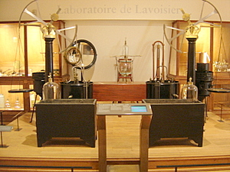
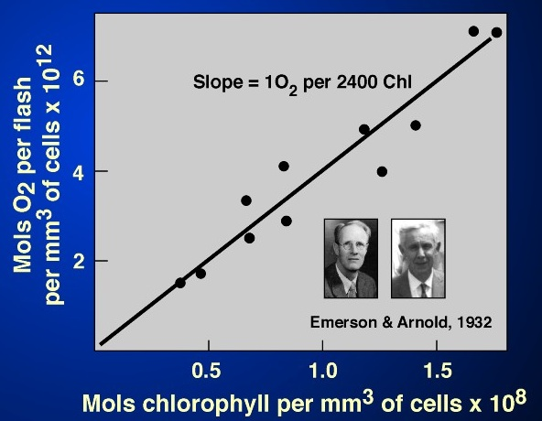
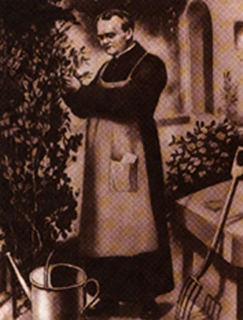
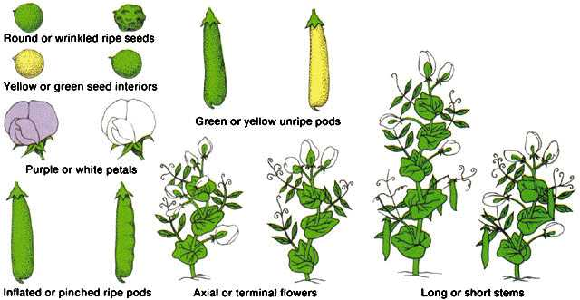
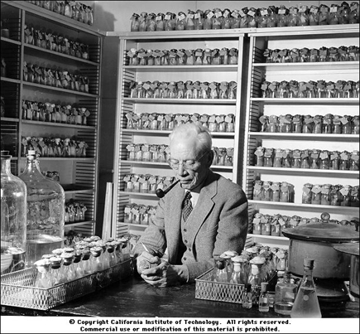
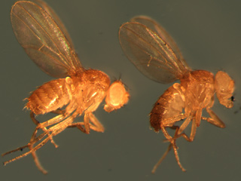
Does Quantitative Insight Lead to Biological Discovery? Not Just Crossing “t”s and Dotting “i”s
“… no one has concentrated on the number of different forms that appear among the offspring of hybrids... No one has counted them. But doing all this counting and sorting appears to be the only way by which we can finally solve a question whose importance cannot be overestimated.” – Gregor Mendel
Photosynthesis: photons,
light collection and electron
transfer
Photosynthesis: carbon
and oxygen stoichiometry
Genetics and counting
The first map of a chromosome
Notes:
Luria-Delbruck, Hodgkin-Huxley

Slide 4
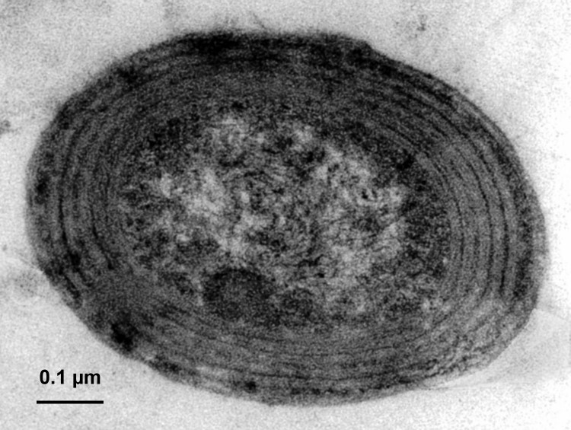
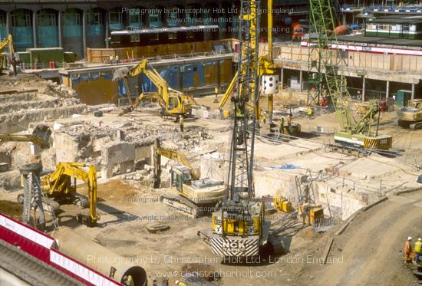
First Theme: Building a Cell

Slide 5
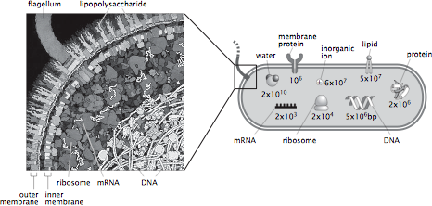
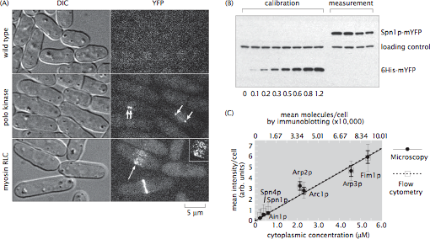
Order of Magnitude Biology: Why the Numbers?
The plan: figure out the number of molecular actors of various kinds in the drama of a cell.
Reasons why: stoichiometrically correct descriptions of biosynthetic pathways, understanding of binding, regulation and cooperativity, dissection of mechanism, etc.
(Smith et al.)
(Wu and Pollard, Science, 2005)
The approach: simple order of magnitude estimates followed by description of how numbers are measured and what their significance is.
Estimating and measuring the numbers serve complementary purposes.

Slide 6
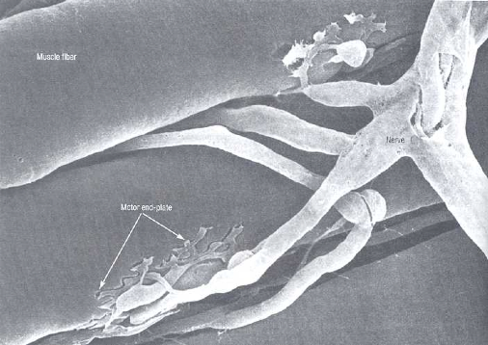
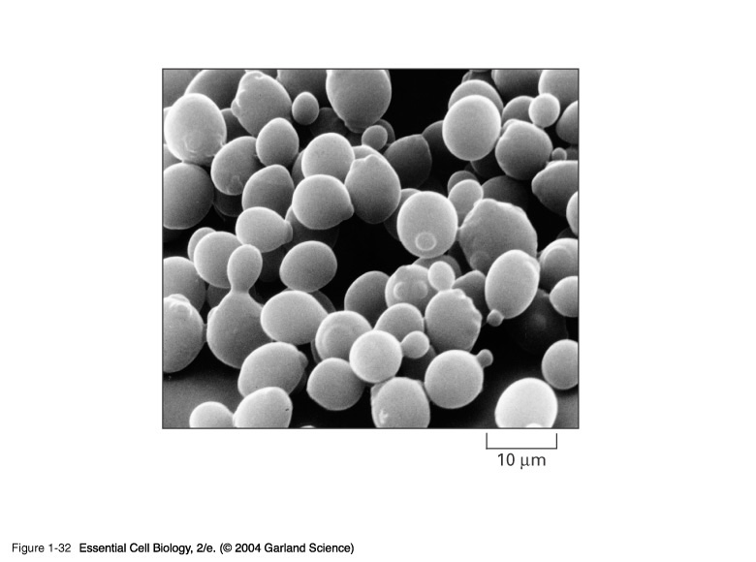
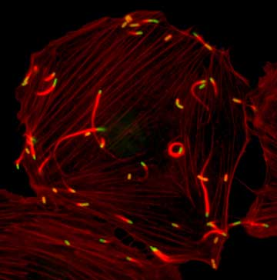
Living Organisms are Made of Cells
Why bother? One of the great insights in the history of biology. Cells as the minimal living unit bring us to the heart of some of the great biological mysteries.
``If in some cataclysm, all of scientific knowledge were to be destroyed, and only one sentence passed on to the next generation of creatures, what statement would contain the most information in the fewest words? I believe it is the atomic hypothesis.. that all things are made of atoms’’ - Richard Feynman
Cells are the fundamental units of living organisms.
“Omnis cellula e cellula” - every cell from a pre-existing cell. Rudolf Virchow.
Cells are extremely diverse!

Slide 7
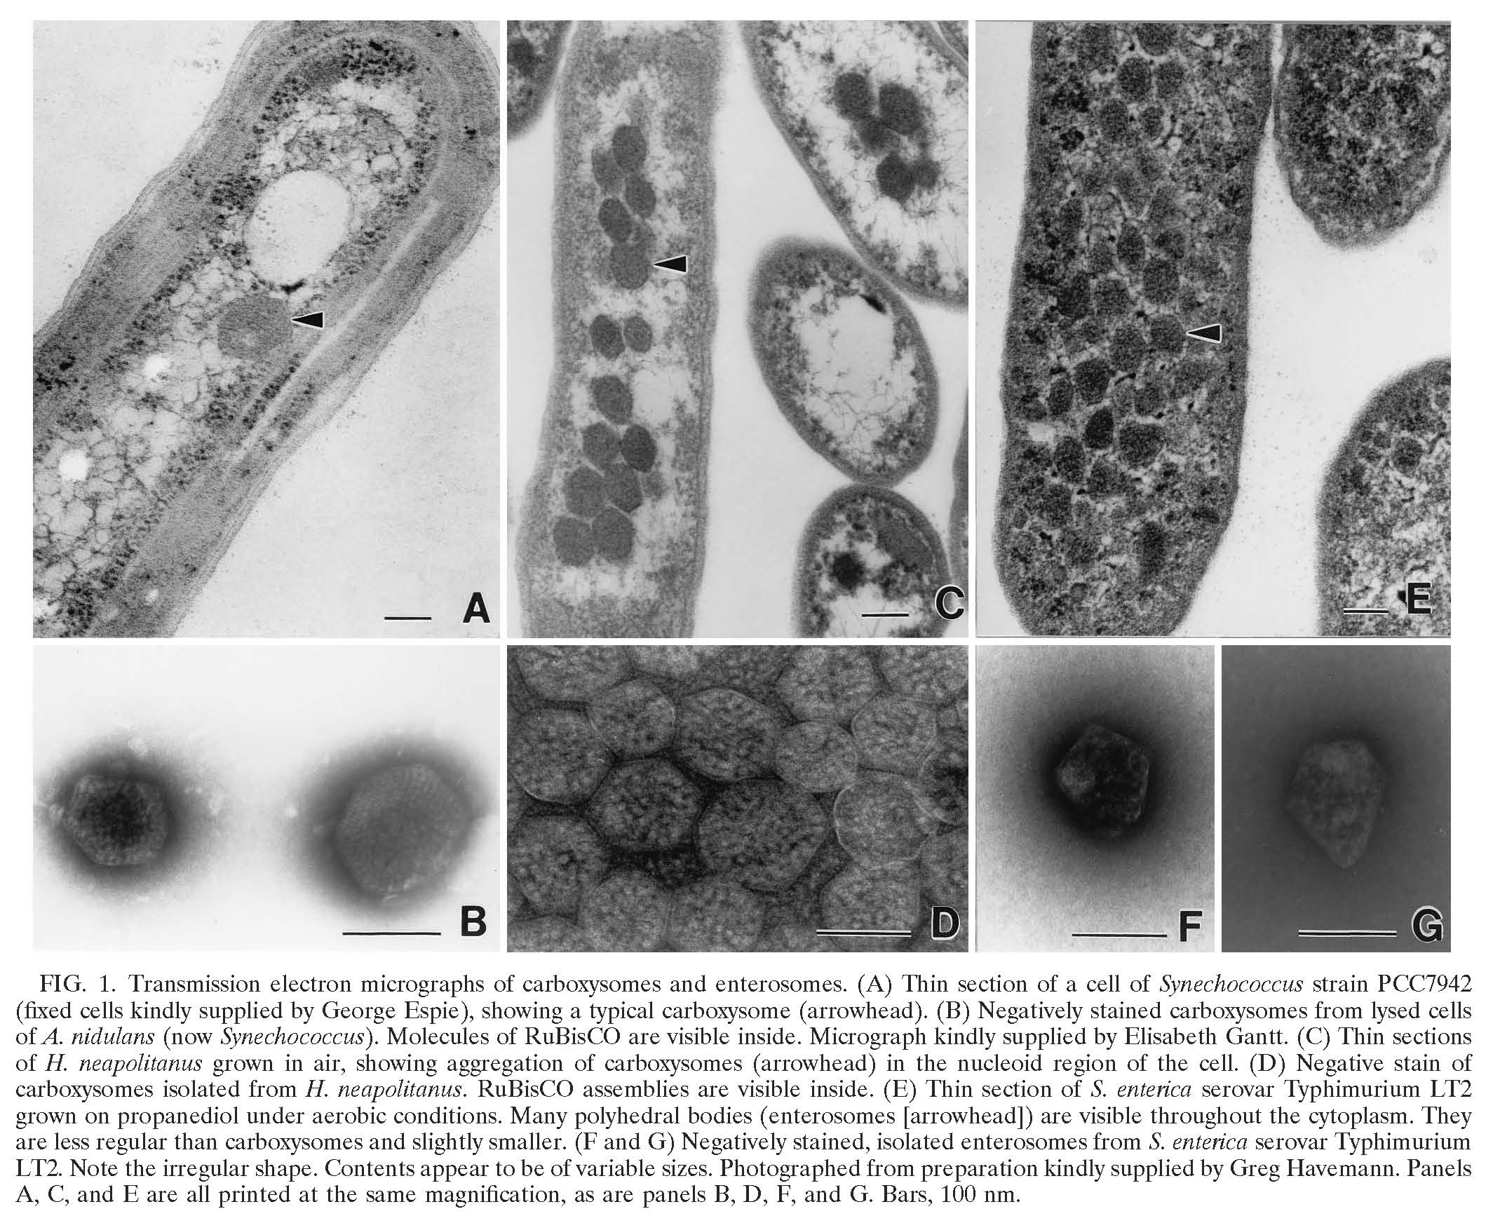
Architecture of Cyanobacteria
Every time I show you a picture of a cell, ask yourself how the architecture works.
For cyanobacteria, we are going to examine several remarkable specializations related to their ability to perform photosynthesis.
(Cannon et al.)

Slide 8
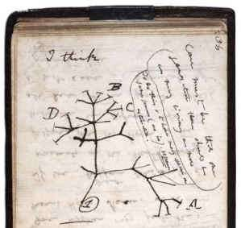
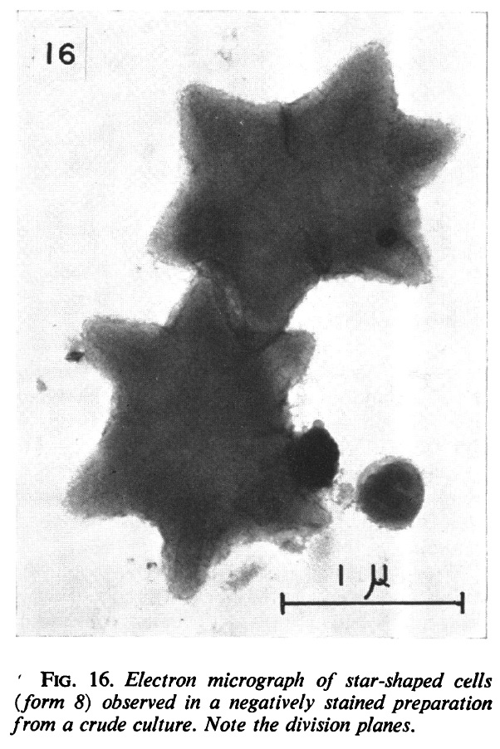
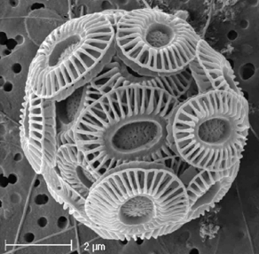
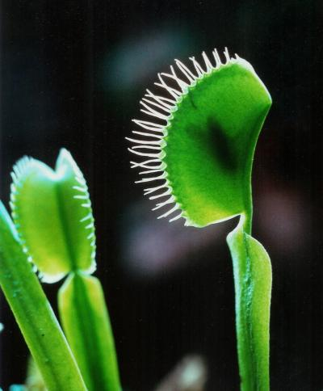
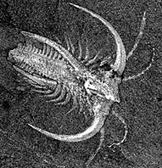
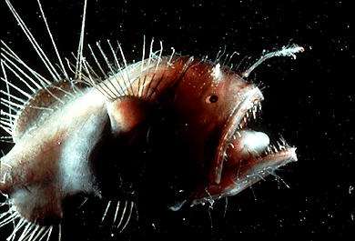
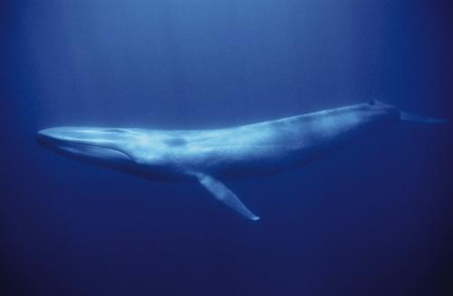
A Tension: General Ideas or Embracing the Diversity
There is a great charm in both finding the unity of things and in celebrating their differences.
The diversity of living organisms is thrilling and astonishing.
Darwin’s notebook shows him with the realization of the single biggest unifying idea in biology: descent with modification from a common ancestor.
Diversity of life gives us a gold mine of beautiful puzzles.

Slide 9
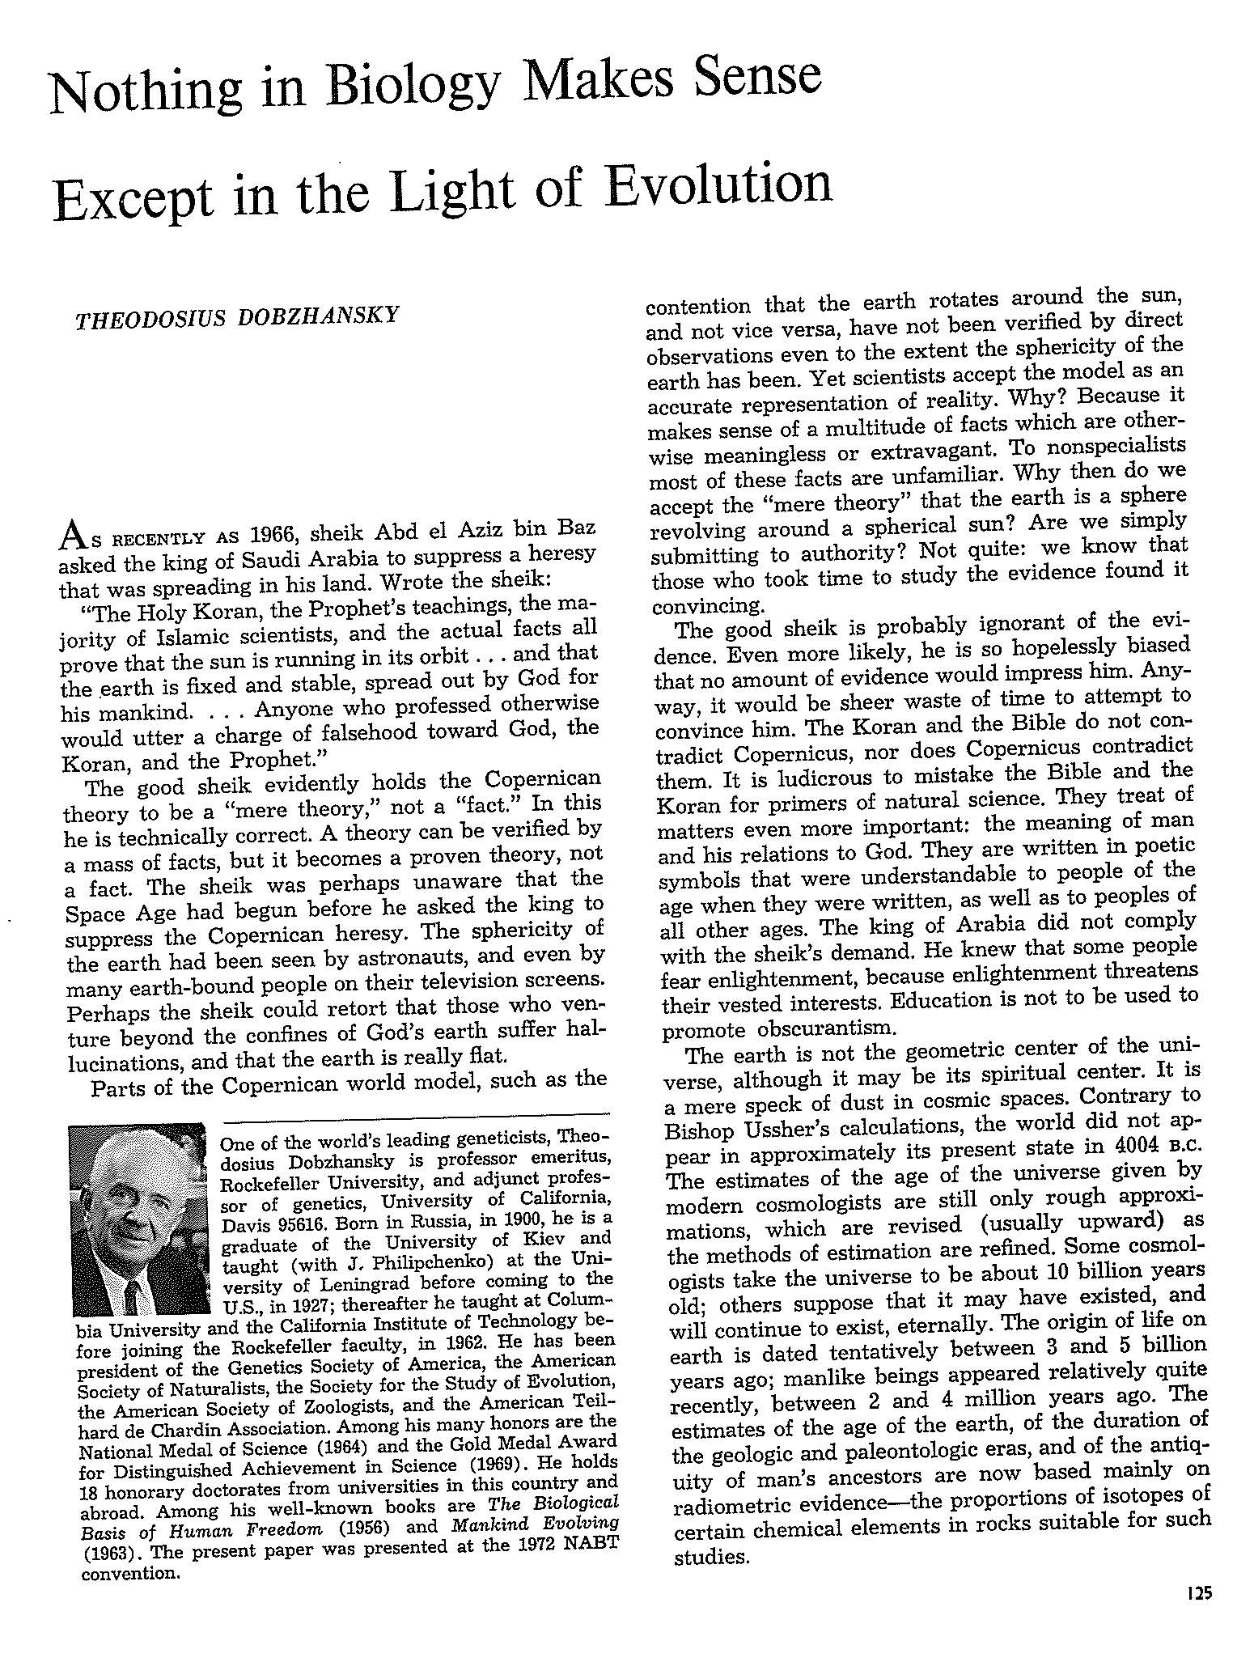
“Nothing in Biology Makes Sense Except in the Light of Evolution”
And that so includes the study of: a) how to build a cell, b) photosynthesis – our first two big themes.

Slide 10
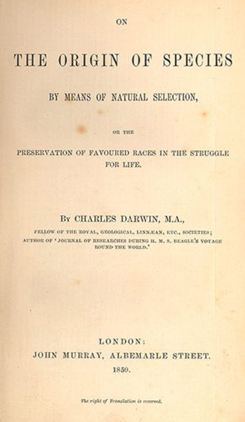
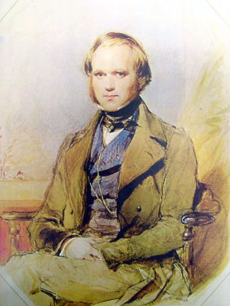
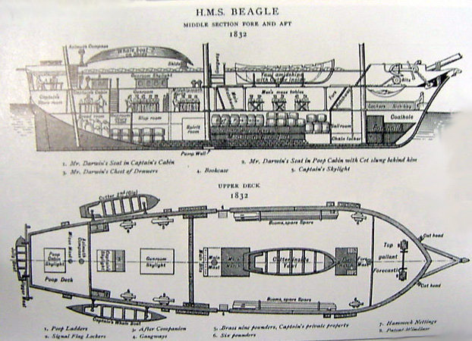
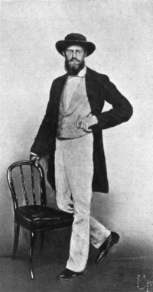
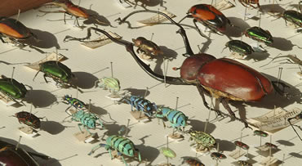
Biology’s Greatest Idea
It is a great moment to reflect on evolution: 200th birthday of Darwin, 150th anniversary of his great work “On the Origin of Species”
Fascinating essay of T. Dhobzhansky entitled: ``Nothing in biology makes sense except in the light of evolution.’’ - the phrase has become hackneyed, but the idea has not.
Darwin found data led to inescapable conclusion, ``it was like confessing a murder’’ he wrote.
Darwin’s “species question” already helps us think about the photosynthetic process.
Lagrange on Newton: he was "the most fortunate, for we cannot find more
than once a system of the world to establish.” The same can be said of Darwin
and Wallace.
Notes:
Charles Darwin and Alfred Russel Wallace were great adventurers, especially Wallace who wandered through South America and the Malay Archipelago trying to make sense of the diversity of life, the distribution of species, etc. In both cases, their observations led them unequivocally to a view of life in which there is incessant change.

Slide 11
Darwin’s Only Figure: Extinctions and Evolution
The theory of evolution is built up on many different threads of evidence and one of the most important of those threads is the frequent extinctions revealed in the fossil record.
Species have typical lifetimes measured in millions of years.
Darwin’s one and only drawing in “On the Origin of Species” highlights extinctions.

Slide 12
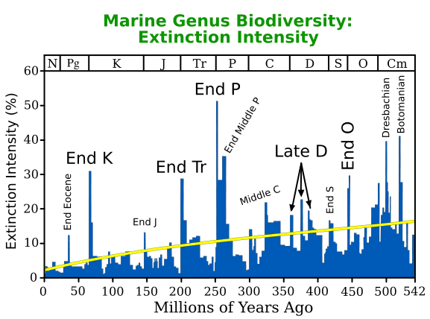
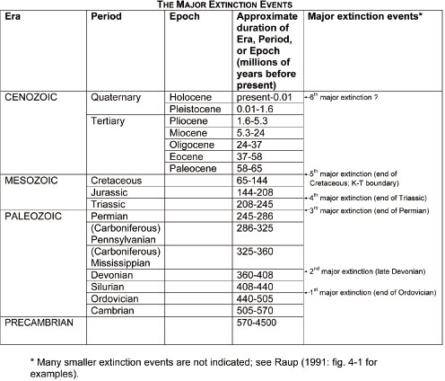
The Great Extinctions
The history of life on Earth has been punctuated by massive extinction events, some of which are famous (i.e. end of dinosaurs), but some of which are much more impressive (i.e. end Permian).
For the famous dinosaur-ending extinction, a leading hypothesis argues for damage to the ability of photosynthetic organisms to collect sufficient light, with this effect propagating viciously through ecosystems.
See “Extinction: Bad Genes or Bad Luck” by David Raup or “Extinction” by Doug Erwin

Slide 13
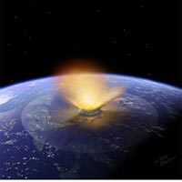
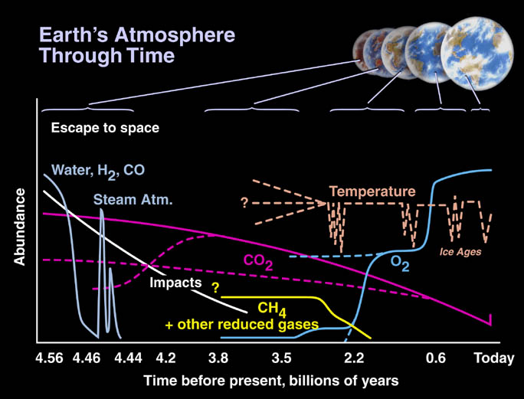
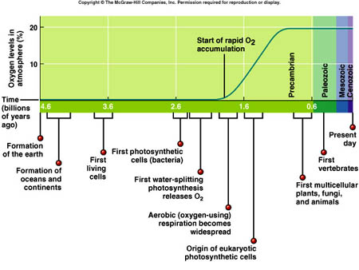
Losing Light and Life
The leading hypothesis on the K-T extinction event is an asteroid impact in Central America though others argue for increased volcanism.
One common feature in these different scenarios is a change in the light reaching Earth with a concomitant impact on photosynthetic organisms.
I bring this up here as an attempt to drive home the importance of photosynthesis to life on Earth.
For those with an interest in the history of Earth, photosynthesis is also a huge player in the composition of the atmosphere.
http://science.nasa.gov/headlines/y2002/images/exo-atmospheres/ATM_Time_Earths.jpg

Slide 14
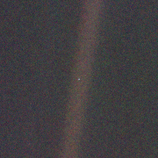
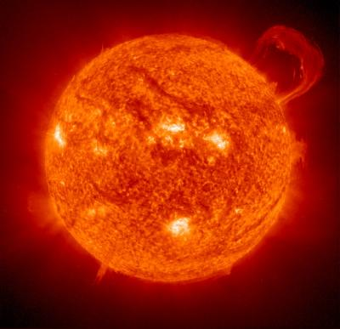
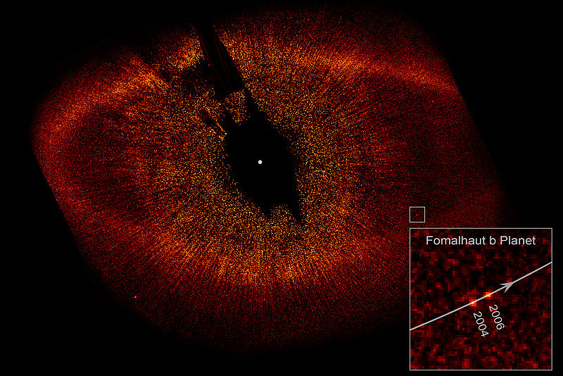
Our Pale Blue Dot: Eating the Sun
“Look again at that dot. That's here. That's home. That's us. On it everyone you love, everyone you know, everyone you ever heard of, every human being who ever was, lived out their lives. The aggregate of our joy and suffering, thousands of confident religions, ideologies, and economic doctrines, every hunter and forager, every hero and coward, every creator and destroyer of civilization, every king and peasant, every young couple in love, every mother and father, hopeful child, inventor and explorer, every teacher of morals, every corrupt politician, every "superstar," every "supreme leader," every saint and sinner in the history of our species lived there-on a mote of dust suspended in a sunbeam.” - Carl Sagan, seen in Al Gore movie
And, every cell (at least my favorite hypothesis) and the 10^45 genomes that have ever existed.
Such pictures make me think of the amazing way that life has learned to eat the sun.
(see the book by Oliver Morton with that title)
Notes:
Picture taken by Voyager 1 from a distance of 6 x 10^9 kilometers

Slide 15
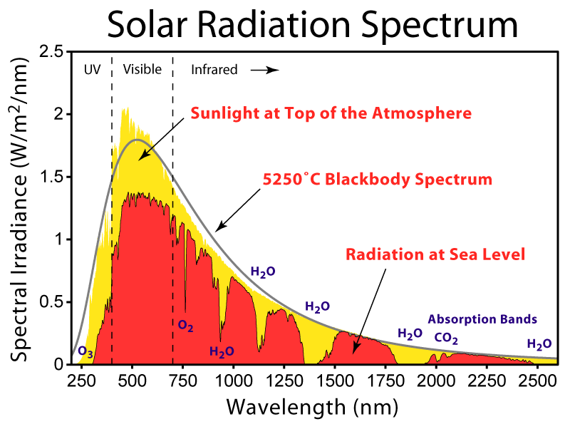
Sunlight and the Earth
This curve allows us to see how the incident radiation from the sun is partitioned amongst different wavelengths.
We should carry some important numbers around in our heads and one of them is 1200 W/m² as the power available from sunlight.
"The world looks so different after learning science. For example, trees are made of air, primarily. When they are burned, they go back to air, and in the flaming heat is released the flaming heat of the sun which was bound in to convert the air into tree … These things are beautiful things, and the content of science is wonderfully full of them. They are very inspiring, and they can be used to inspire others.” - Richard Feynman

Slide 16
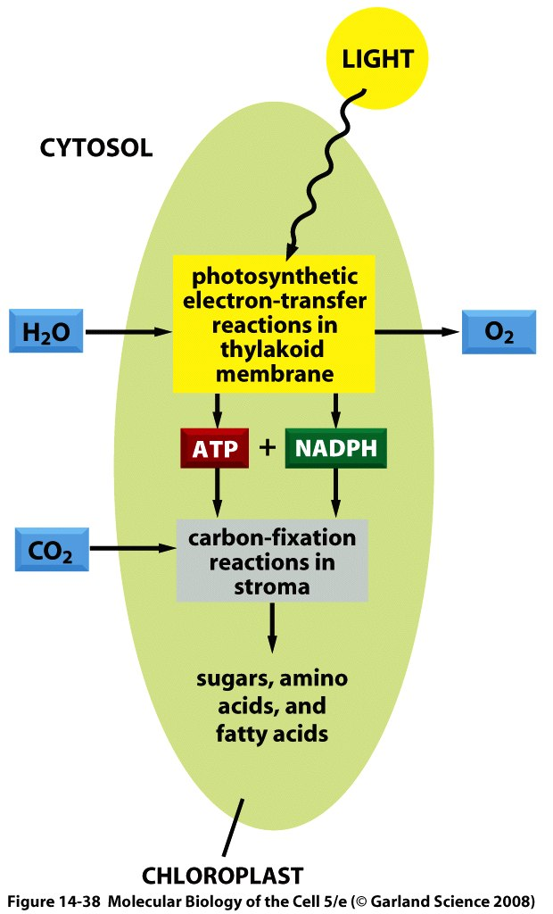
What Do We Know About Eating the Sun and How Do We Know It?
The stoichiometric equation for photosynthesis tells us the key idea of the process.
Energy of sunlight is converted into useful chemical bond energy in the form of sugar.
Broadly speaking, the process can be conceptually divided into a part having to do with harvesting light, a part having to do with shuttling electrons and protons and a part having to do with fixing atmospheric carbon.
Our plan: we will start with an overview in words and cartoons and then make some calculations on several key parts of the story.

Slide 17
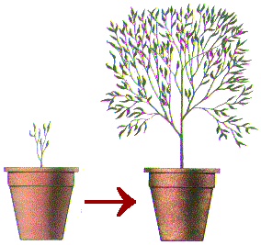
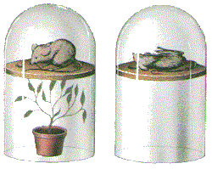
Key Themes and Key Experiments
The amazing story of photosynthesis passes through the conservation of matter, the discovery of the existence and nature of gases, the conservation of energy, the nature of microbes, the biochemical basis of metabolism and beyond.
This subject is characterized by a long history of quantitative measurement.
(Govindjee)

Slide 18
Gases and the Pneumochemists
Van Helmont – measurement of mass change in soil during growth. He thought that the key mass transaction was the water. Ironic since he is one of the founders of the study of gases.
The great “pneumochemists” – Lavoisier, Priestley, de Saussure, Ingenhousz, Senebier and others – the idea: measure the gases required for and liberated by photosyntheis.
Boussingault – measured ratio of CO₂ taken up and O₂ released.
Outcome: a stoichiometrically correct equation for the photosynthetic transaction that properly acknowledges the roles of water and CO₂.

Slide 19
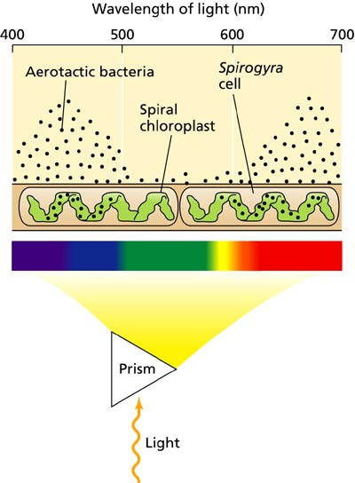
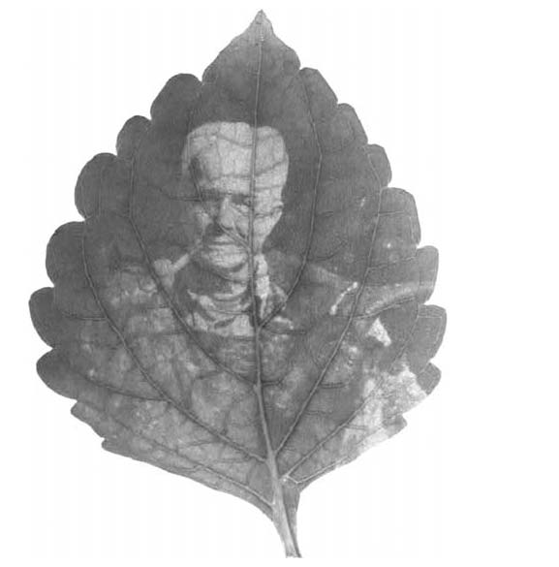
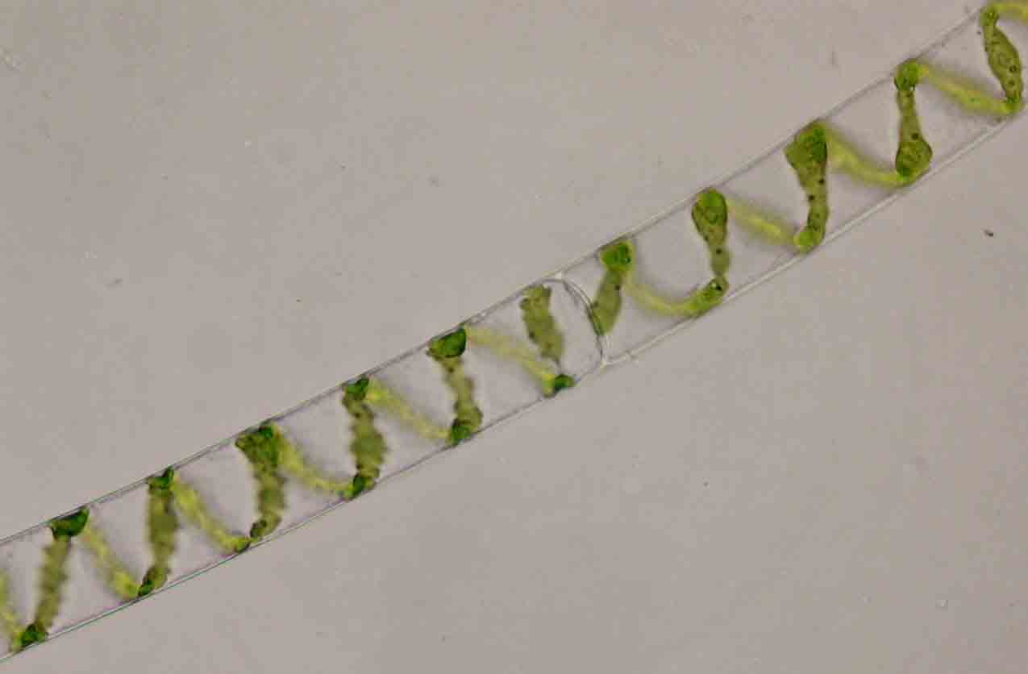
Light in Photosynthesis
A variety of interesting experiments demonstrated that light is required for photosynthesis.
Experiment of T. W. Engelmann – expose Spirogyra (challenged on wiki) (filamentous, green algae) to light of different wavelengths and see where bacteria aggregate. Answer: at places where chlorophyl absorbs. Bacteria provide a “living graph” of absorption spectrum.
Starch production in leaves can be stained. Where starch is synthesized controlled by light exposure.

Slide 20
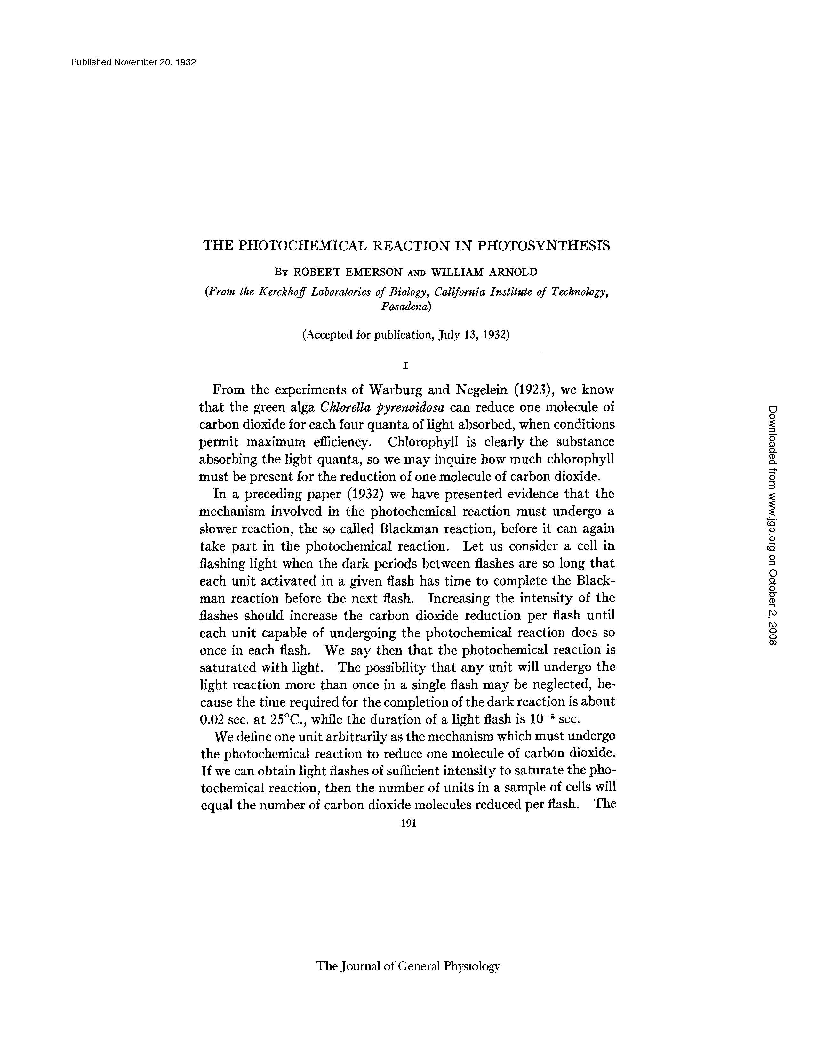
Light in Photosynthesis: Emerson and Arnold and Flashing Experiments
A final example: clever, precision measurements of Emerson and Arnold by flashing lights of known intensity for known time periods.

Slide 21
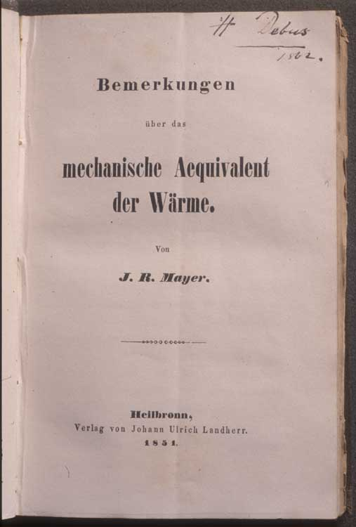
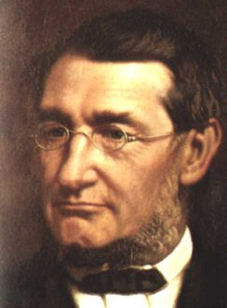
The Conservation of Energy and Photosynthesis
Though we all take the conservation of energy for granted, it was an idea that was hard won.
Julius Robert Mayer articulated the idea and proposed that photosynthesis is a concrete example with energy from sunlight converted into chemical bond energy.
Big themes that passed through photosynthesis: mass conservation, energy conservation, nature of gases, light and life.

Slide 22
Logic of Lecture
Logical flow of lecture: we have talked about the history of our understanding of photosynthesis (very broad brush strokes) and the themes that emerged.
Now, we turn to simple estimates about the overall photosynthetic productivity on the Earth and the nature of the cells that do this photosynthesis.

Slide 23
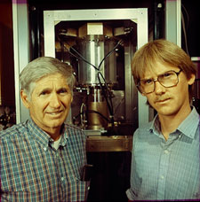
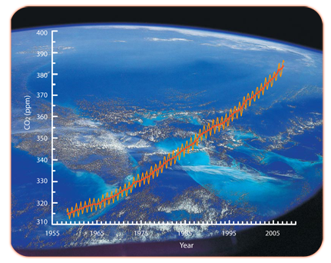
Use the Earth’s breathing to formulate an estimate
Building a cell with photons.
My daughter’s biochemistry book (and many others) tells me: every year, the earth’s plants convert 6 x 10^16 grams of carbon to organic compounds.
The point of this estimate is to see how light, CO₂ and H₂O are used to make cells.
(Behrenfeld, Falkowski et al., Science, 1998)
David Keeling spent his entire career making ever more precise measurements of CO2.
In his interviews, he mentions that he initially made two interesting discoveries, one of which is less famous, but extremely relevant to our story.

Slide 24
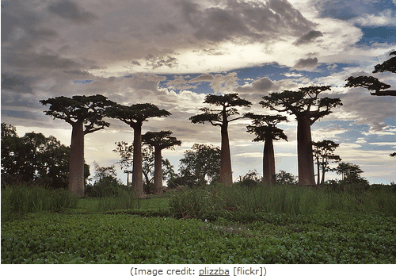
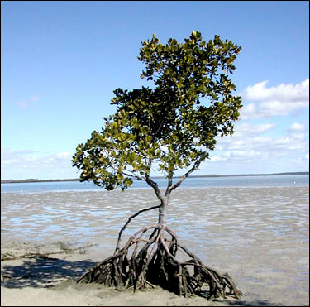
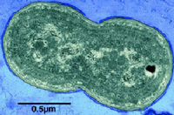
Who Does Photosynthesis and How Much?
Baobob tree
Mangrove tree
Synechococcus
Arabidopsis thaliana
Chlamydomonas
Corn (maize)
60:40 split between land and ocean in net primary production.

Slide 25
Who Does Photosynthesis and How Much? A Wonderful Example!
One of my favorite marine organisms is Emiliana huxleyi, a single-celled, eukaryote that performs photosynthesis to make a living.
These organisms also have a peculiar morphology (mineral shell) that scatters light and gives characteristic appearance to the ocean from space known as a “bloom”.
Reminder: one of biology’s “great ideas” that is easy to take for granted is the cell theory, the idea that all living organisms are made up of cells and: “Omnis cellula e cellula” - every cell from a pre-existing cell. Rudolf Virchow

Slide 26
Thinking the Numbers vs Measuring Them
What are the numbers, how should we think about them?
An ode to estimation (and an argument with the class)!
“If arithmetic, mensuration and weighing be taken away from any art, that which remains will be not much.” - Plato
Notes:
“If arithmetic, mensuration and weighing be taken away from any art, that which remains will be not much.” - Plato

Slide 27
The Numbers: A First Look at RuBisCO and CO₂
Comments on estimates, playing with numbers, sanity checks, Fermi problems, etc.
How many molecules of CO₂ in the atmosphere, how many carbons fixed by photosynthesis each year, how many rubisco molecules, etc.?
These 10^39 carbons are fixed by rubisco molecules operating at a rate of roughly one carbon fixed per second (average night and day, plants and microbes).
Notes:
Rubisco, net carbon fixation, etc.

Slide 28
Calvin and Benson: “The Path of Carbon in Photosynthesis” – the role of RuBisCO
The concept: where are the radioactive carbons? NOTE: as usual, when examining these classic experiments, I am struck by how blunt their instruments were and nevertheless, the reach of those discoveries. Radioactivity + chromatography.
The discovery: rubisco (among other things), the machine responsible for taking atmospheric CO₂ and carrying out the first steps in carbon fixation.
Books claim “rubisco is the most abundant protein on earth”. Is it true? Such assertions cannot be made without some sort of justification! Let’s check the numbers.
http://users.rcn.com/jkimball.ma.ultranet/BiologyPages/Chromatography_paper.html#Autoradiography

Slide 29
Inventories and Budgets for Some of the Most Abundant Organisms on Earth
Prochlorococcus
We think about the microbes that are responsible for 40% of the overall photosynthesis on Earth.
Ocean water census tells us between 10,000 and 100,000 cyanobacteria per mL. This yields estimate of roughly 10²⁶ cyanobacteria doing 10% (ish) of the overall carbon fixation. Conclusion: 10⁴ rubisco per cyanobacterium.
Using relatively few facts: 1 pg in 1fL with 30% of the mass ``dry’’. 30,000 Da “typical” protein tells us 3 x 10⁶ proteins.
(Iancu et al, JMB, 2007)

Slide 30
Photosynthetic Membranes!
Prochlorococcus
One of the intriguing features of these organisms is their membrane disposition. Membrane area is roughly 5 microns². This means that the number of lipids in the outer leaflet of the bilayer is roughly 10⁷, yielding a total of roughly 10⁸. Membrane management: interesting and challenging.
Thylakoid membrane
in Synechocystis
(Liberton et al.)

Slide 31
Logic of Lecture
Next: how light is captured and energy is stored by photosynthetic organisms.

Slide 32
Electron Microscopy Images of Chloroplasts
We already talked about cyanobacteria. Most familiar photosynthetic organisms are plants. They have internal organelles devoted to photosynthetic process (these organelles are thought to be endosymbionts – how do we know?).
Chloroplast structure is rich and fascinating, and features a complex membrane system dividing the chloroplast into three distinct spaces.
Thylakoid membranes are a challenge to our understanding of biological membrane morphology.

Slide 33
Models of Chloroplast Structure
Hierarchical description of the structure of chloroplasts.
This schematic shows the three membrane-bound spaces as well as the thylakoid membrane system.
Note from RP: the formation of maintenance of these membrane structures is fascinating and mysterious.
From Alberts, MBoC5: This photosynthetic organelle contains three distinct membranes (the outer membrane, the inner membrane, and the thylakoid membrane) that define three separate internal compartments (the intermembrane space, the stroma, and the thylakoid space). The thylakoid membrane contains all the energy-generating systems of the chloroplast, including its chlorophyll. In electron micrographs, this membrane seems to be broken up into separate units that enclose individual flattened vesicles (see Figure 14-35), but these are probably joined into a single, highly folded membrane in each chloroplast. As indicated, the individual thylakoids are interconnected, and they tend to stack to form grana.

Slide 34
Comparison of Mitochondria and Chloroplasts: Energy Factories of the Cell
Mitochondria and chloroplasts share several interesting features.
Foremost, they are both thought to be endosymbionts and have their own DNA to prove it.
Complex membrane morphologies provide the seat of membrane machines responsible for ATP generation, electron transfer (and charge separation) and light harvesting (chloroplasts).
From Alberts et al., MBoC5: A chloroplast is generally much larger than a mitochondrion and contains, in addition to an outer and inner membrane, a thylakoid membrane enclosing a thylakoid space. Unlike the chloroplast inner membrane, the inner mitochondrial membrane is folded into cristae to increase its surface area.

Slide 35
Molecules Responsible for Absorption of Light
Chlorophyll characterized by a porphyrin ring and a hydrophobic tail which anchors the molecule to the membrane.
The porphyrin ring is host to the electronic states that participate in the interaction with light.

Slide 36
Absorption Spectra of Biological Pigments
The spectrophotometer permits the measurement of absorption as a function of the incident wavelength.
Note that chlorophyll appears green because it absorbs strongly in the blue and the red.
We will be interested in examining the quantum mechanical underpinnings of absorption spectra.

Slide 37
Pigments in Different Organisms
Chlorophylls and other biological pigments are quite diverse (and can be used to help us classify organisms – think about it, how do you decide on evolutionary relatedness?).
This table is in case you want to think about these molecules more deeply. (see “Plant Physiology” by Lincoln Taiz and Eduardo Zeiger.
http://4e.plantphys.net/article.php?ch=7&id=67

Slide 38
Photon Flux Calculation
The question: How many photons are reaching a molecule each second and what might this tell us about the nature of the photosynthetic reactions?

Slide 39
How Light Energy Is Funneled Away to Perform Charge Separation
One of the key outcomes of the Emerson-Arnold experiments was the realization that the molecular apparatus came with numbers that had an odd ratio.
From Alberts et al., MBoC5: The antenna complex is a collector of light energy in the form of excited electrons. The energy of the excited electrons is funneled, through a series of resonance energy transfers, to a special pair of chlorophyll molecules in the photochemical reaction center. The reaction center then produces a high-energy electron that can be passed rapidly to the electron-transport chain in the thylakoid membrane, via a quinone.

Slide 40
The Molecular Machines of Photosynthesis
Figure 14-47 The structure of photosystem II in plants and cyanobacteria.
The structure shown is a dimer, organized around a two fold axis (red dotted arrows). Each monomer is composed of 16 integral membrane protein subunits plus three subunits in the lumen, with a total of 36 bound chlorophylls, 7 carotenoids, two pheophytins, two hemes, two plastoquinones, and one manganese cluster in an oxygen-evolving water-splitting center. (A) The complete three-dimensional structure of the dimer. (B) Schematic of the dimer with a few central features indicated. (C) A monomer drawn to show only the non-protein molecules in the structure, thereby highlighting the protein-bound pigments and electron carriers; green structures are chlorophylls. (Adapted from K.N. Ferreira et al., Science 303:1831-1838, 2004. With permission from AAAS.)

Slide 41
Schematic of the Electron Transfer Process
(A) The initial events in a reaction center create a charge separation. A pigment-protein complex holds a chlorophyll molecule of the special pair (blue) precisely positioned so that both a potential low-energy electron donor (orange) and a potential high-energy electron acceptor (green) are immediately available. When light energizes an electron in the chlorophyll molecule (red electron), the excited electron is immediately passed to the electron acceptor and is thereby partially stabilized. The positively charged chlorophyll molecule then quickly attracts the low-energy electron from the electron donor and returns to its resting state, creating a larger charge separation that further stabilizes the high-energy electron. These reactions require less than 10-6 second to complete. (B) In the final stage of this process, which follows the steps in (A), the photosynthetic reaction center is restored to its original resting state by acquiring a new low-energy electron and then transferring the high-energy electron derived from chlorophyll to an electron transport chain in the membrane. As will be discussed subsequently, the ultimate source of low-energy electrons for photosystem II in the chloroplast is water; as a result, light produces high-energy electrons in the thylakoid membrane from low-energy electrons in water.
Schematic of the charge transfer process after optical excitation.

Slide 42
Schematic of the Electron Transfer Process
Dynamics of the electron transfer process.

Slide 43
Measuring the Rate of Electron Transfer: the Case of Azurin
Protein engineering permits construction of donor-acceptor pairs at different distances from each other.
Measure the rate of electron transfer as a function of distance.
(From our own Prof. Harry Gray – see his papers in PNAS)

Slide 44
“Changes in Redox Potential During Photosynthesis”
The energetics of the light-induced reactions have been worked out.
The redox potential for each molecule is indicated by its position along the vertical axis. Note that photosystem II passes electrons derived from water to photosystem I. The net electron flow through the two photosystems in series is from water to NADP+, and it produces NADPH as well as ATP. The ATP is synthesized by an ATP synthase that harnesses the electrochemical proton gradient produced by the three sites of H+ activity that are highlighted in Figure 14-48. This Z scheme for ATP production is called noncyclic photophosphorylation, to distinguish it from a cyclic scheme that utilizes only photosystem I (see the text).

Slide 45
Logic of Lecture
Next: A few words on the chemistry of carbon fixation in photosynthetic organisms.

Slide 46
The Overall Process of Photosynthesis
Harvest light.
Move charges.
Make organic matter (sugars, starch and beyond).

Slide 47
Carbon Fixation and the Calvin Cycle
Figure 14-40 The carbon-fixation cycle, which forms organic molecules from CO2 and H2O.
The number of carbon atoms in each type of molecule is indicated in the white box. There are many intermediates between glyceraldehyde 3-phosphate and ribulose 5-phosphate, but they have been omitted here for clarity. The entry of water into the cycle is also not shown.

Slide 48
Different Photosynthetic Specializations
(A) Comparative leaf anatomy in a C3 plant and a C4 plant. The cells with green cytosol in the leaf interior contain chloroplasts that perform the normal carbon-fixation cycle. In C4 plants, the mesophyll cells are specialized for CO2 pumping rather than for carbon fixation, and they thereby create a high ratio of CO2 to O2 in the bundle-sheath cells, which are the only cells in these plants where the carbon-fixation cycle occurs. The vascular bundles carry the sucrose made in the leaf to other tissues. (B) How carbon dioxide is concentrated in bundle-sheath cells by the harnessing of ATP energy in mesophyll cells.

