Slide 1
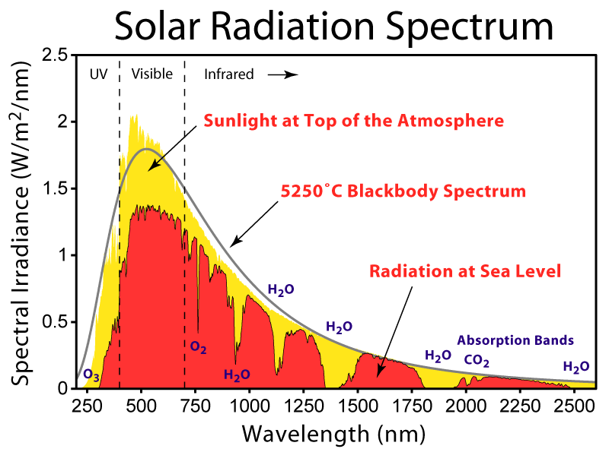
Photosynthesis Recap
APh/BE161: Physical Biology of the Cell
Winter 2009
Recap on Photosynthesis
Rob Phillips
Notes:
Themes: what experiments are worth changing your life for (need to find the winners for photosynthesis), quantitative data demands quantitative models, the great ideas of biology.

Slide 2
Concerns from last lecture
Big picture: why are we doing this? A) photosynthesis – will explain shortly, b) more generally, interaction of light with matter is central to biological phenomena and the tools we use in microscopy and spectroscopy to query biological systems.
Details of the “electronic structure” calculations. Notation. Implementation. Goals.
Problem 3 – HW1b
Plan for today – review of how we replace the very complicated set of chemical reactions associated with photosynthesis with cartoons which are meant to capture essential features. Then, review of HOMO-LUMO gap idea and then attempts to calculate it using molecular orbitals (gotten by adding up atomic orbitals).

Slide 3
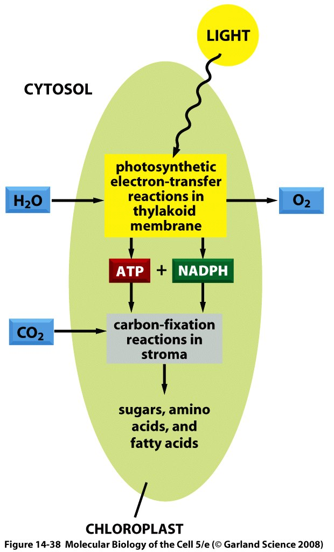
The Overall Process of Photosynthesis
Harvest light.
Move charges (charge management).
Make organic matter (sugars, starch and beyond).

Slide 4
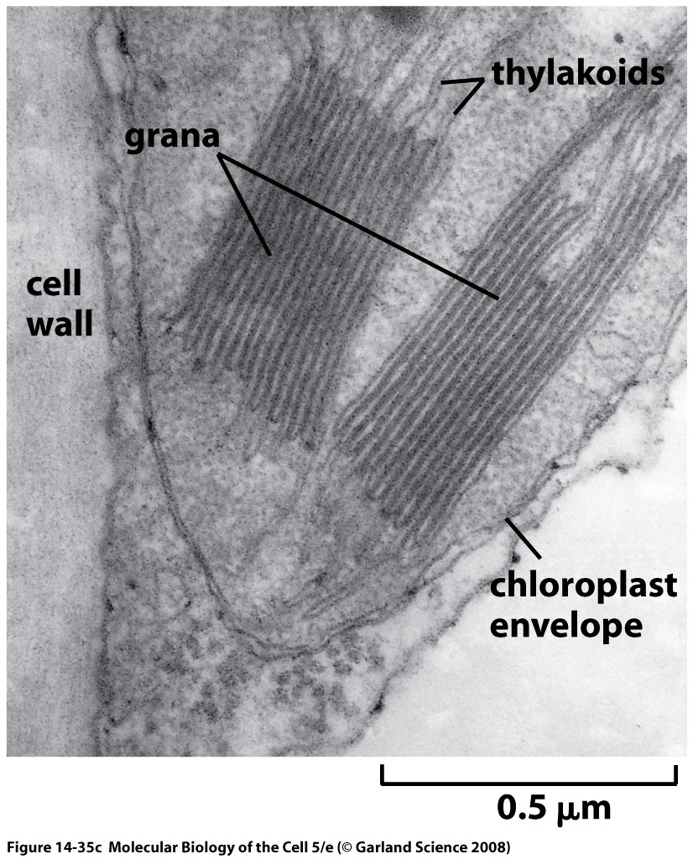
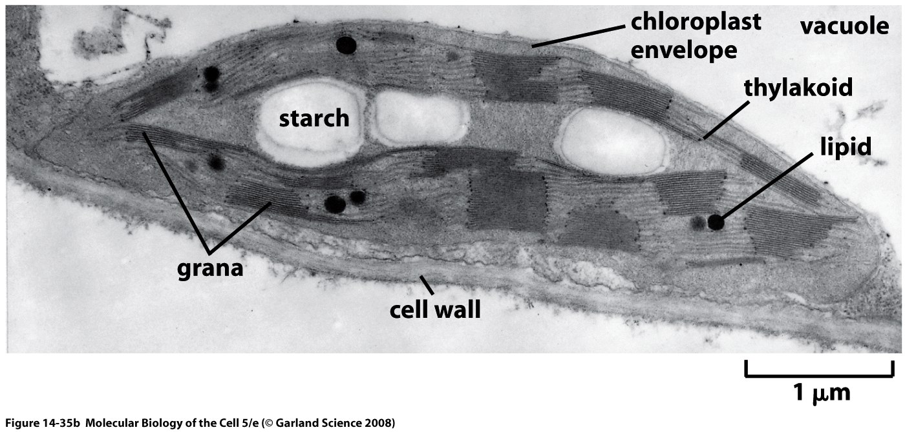
Electron Microscopy Images of Chloroplasts
We already talked about cyanobacteria. Most familiar photosynthetic organisms are plants. They have internal organelles devoted to photosynthetic process (these organelles are thought to be endosymbionts – how do we know?).
Chloroplast structure is rich and fascinating, and features a complex membrane system dividing the chloroplast into three distinct spaces.
Thylakoid membranes are a challenge to our understanding of biological membrane morphology.

Slide 5
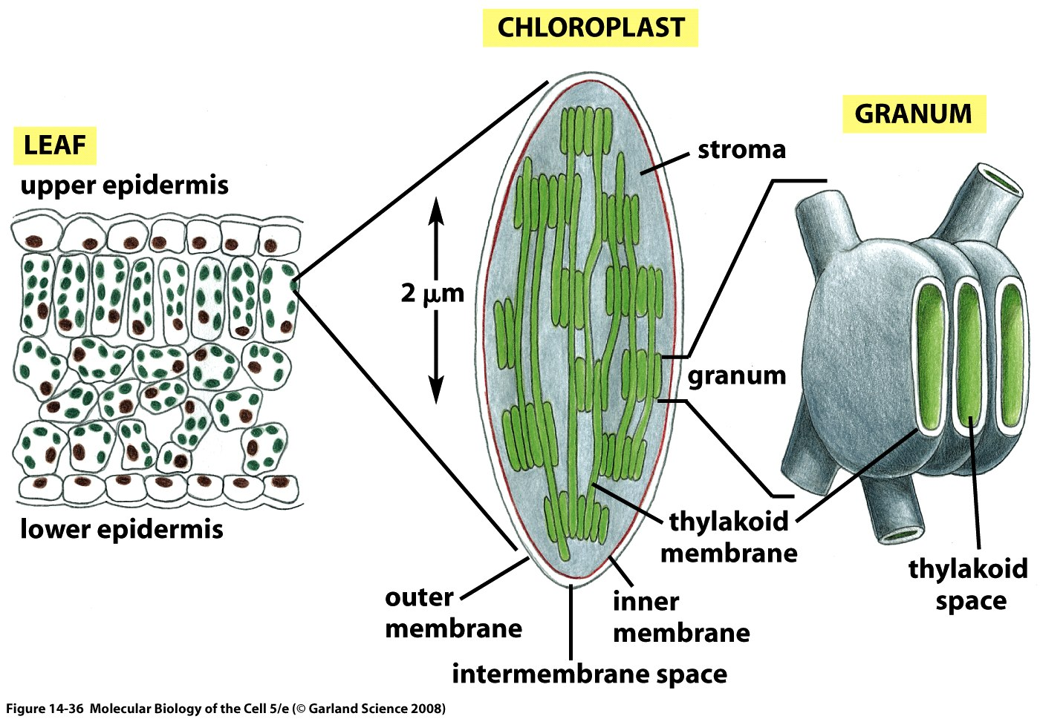
Models of Chloroplast Structure
Hierarchical description of the structure of chloroplasts.
This schematic shows the three membrane-bound spaces as well as the thylakoid membrane system.
Note from RP: the formation of maintenance of these membrane structures is fascinating and mysterious.
NOTE: not clear how this works in cyanobacteria
From Alberts, MBoC5: This photosynthetic organelle contains three distinct membranes (the outer membrane, the inner membrane, and the thylakoid membrane) that define three separate internal compartments (the intermembrane space, the stroma, and the thylakoid space). The thylakoid membrane contains all the energy-generating systems of the chloroplast, including its chlorophyll. In electron micrographs, this membrane seems to be broken up into separate units that enclose individual flattened vesicles (see Figure 14-35), but these are probably joined into a single, highly folded membrane in each chloroplast. As indicated, the individual thylakoids are interconnected, and they tend to stack to form grana.

Slide 6
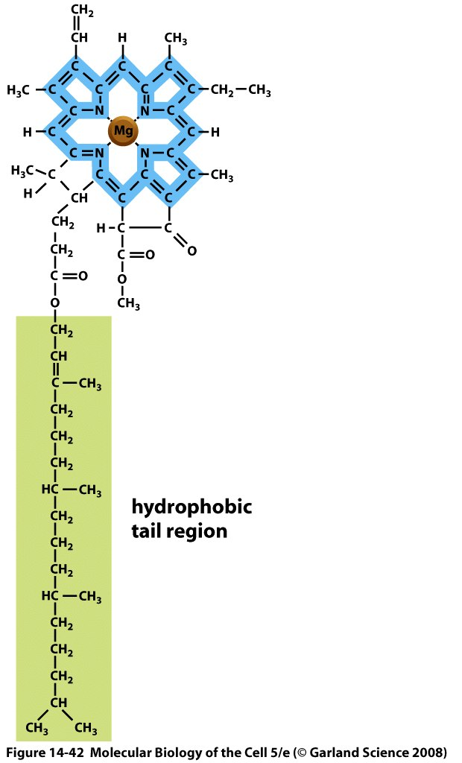
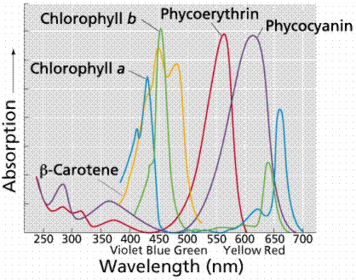
Molecules Responsible for Absorption of Light
Chlorophyll characterized by a porphyrin ring and a hydrophobic tail which anchors the molecule to the membrane.
The porphyrin ring is host to the electronic states that participate in the interaction with light.

Slide 7
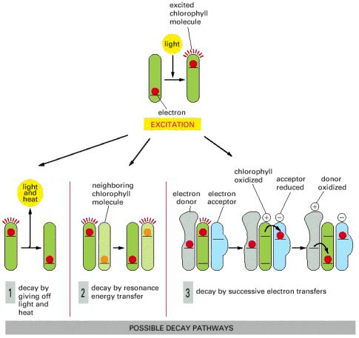
Fate After Light Is Captured?
Question: What do these diagrams mean?
What is the dynamics of the system once a photon has been absorbed?
Our current calculations: trying to understand what these diagrams mean.
The light energy absorbed by an isolated chlorophyll molecule is completely released as light and heat by process 1. In photosynthesis, by contrast, chlorophylls undergo process 2 in the antenna complex and process 3 in the reaction center, as described in the text.

Slide 8
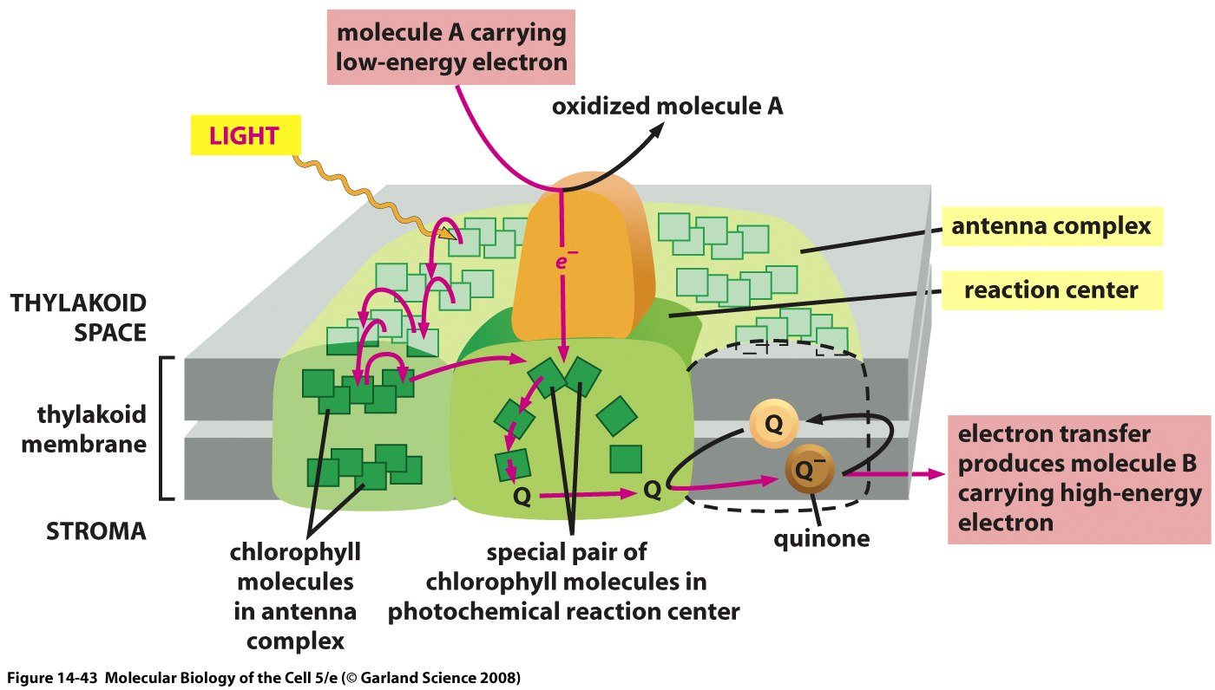
How Light Energy Is Funneled Away to Perform Charge Separation: Photosystems
One of the key outcomes of the Emerson-Arnold experiments was the realization that the molecular apparatus came with numbers that had an odd ratio.
Two key components: 1) antenna complex and 2) photochemical reaction center.
From Alberts et al., MBoC5: The antenna complex is a collector of light energy in the form of excited electrons. The energy of the excited electrons is funneled, through a series of resonance energy transfers, to a special pair of chlorophyll molecules in the photochemical reaction center. The reaction center then produces a high-energy electron that can be passed rapidly to the electron-transport chain in the thylakoid membrane, via a quinone.

Slide 9
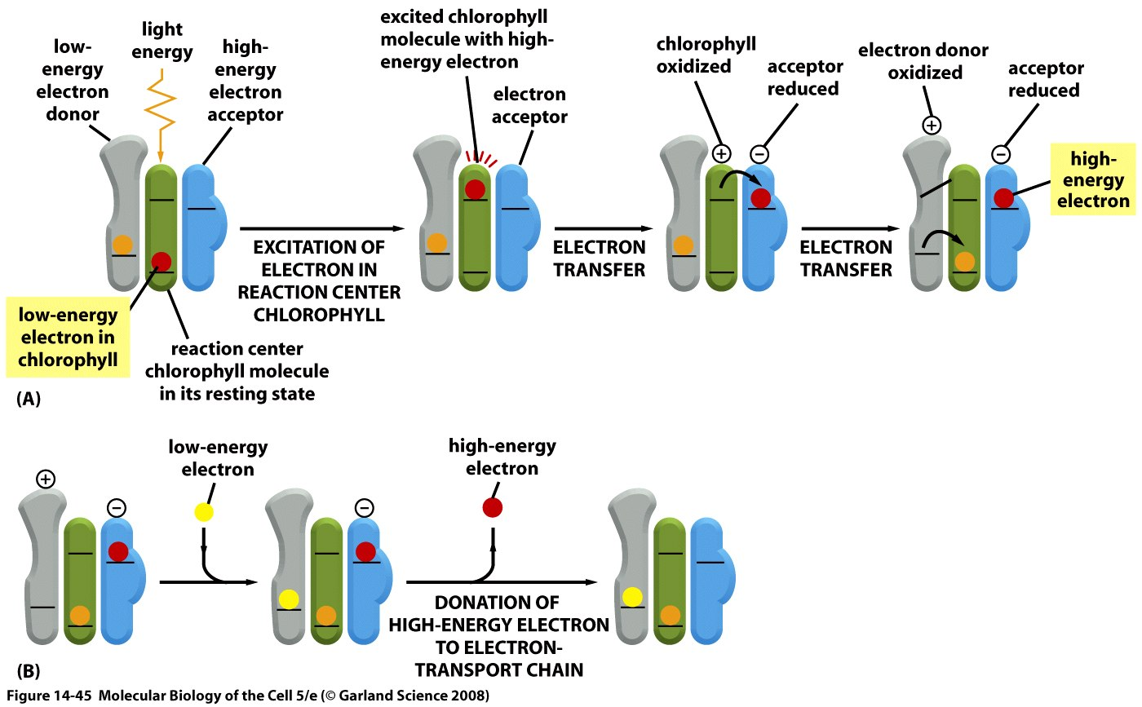
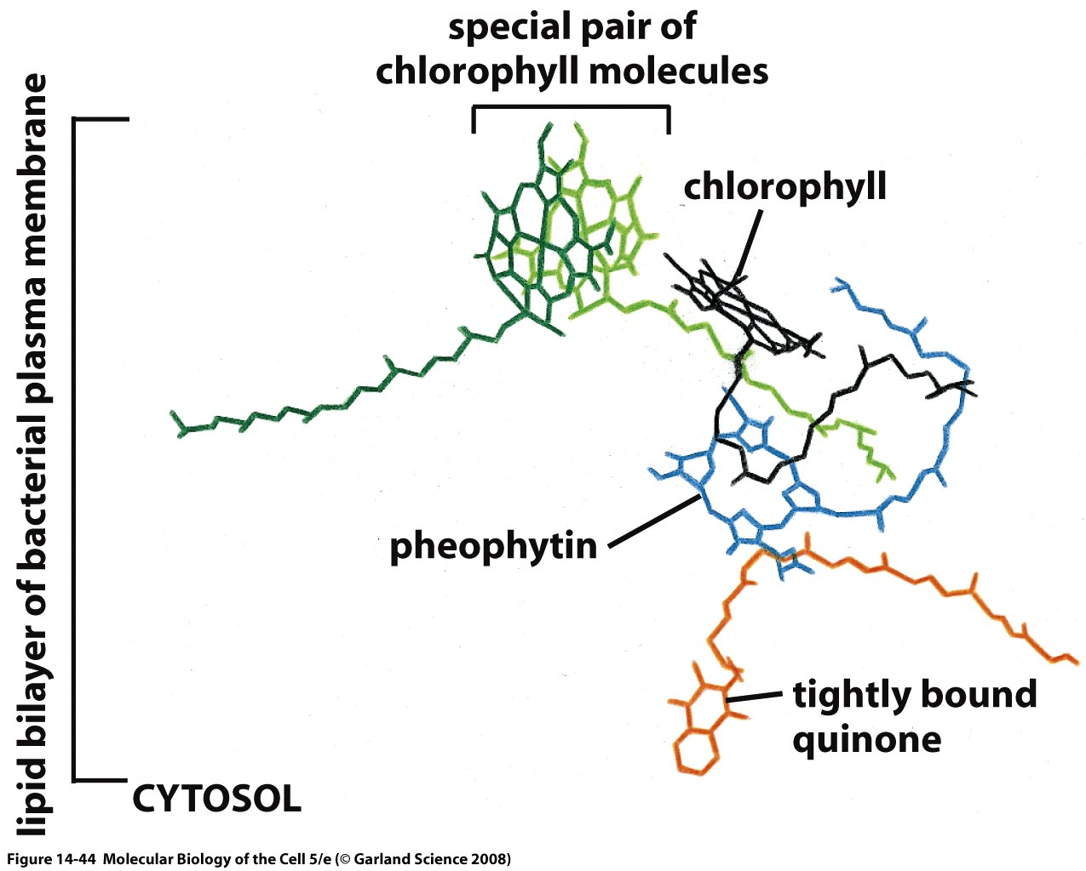
Schematic of the Electron Transfer Process
(A) The initial events in a reaction center create a charge separation. A pigment-protein complex holds a chlorophyll molecule of the special pair (blue) precisely positioned so that both a potential low-energy electron donor (orange) and a potential high-energy electron acceptor (green) are immediately available. When light energizes an electron in the chlorophyll molecule (red electron), the excited electron is immediately passed to the electron acceptor and is thereby partially stabilized. The positively charged chlorophyll molecule then quickly attracts the low-energy electron from the electron donor and returns to its resting state, creating a larger charge separation that further stabilizes the high-energy electron. These reactions require less than 10-6 second to complete. (B) In the final stage of this process, which follows the steps in (A), the photosynthetic reaction center is restored to its original resting state by acquiring a new low-energy electron and then transferring the high-energy electron derived from chlorophyll to an electron transport chain in the membrane. As will be discussed subsequently, the ultimate source of low-energy electrons for photosystem II in the chloroplast is water; as a result, light produces high-energy electrons in the thylakoid membrane from low-energy electrons in water.
Schematic of the charge transfer process after optical excitation.

Slide 10
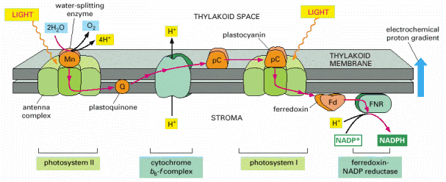
Schematic of the Electron Transfer Process: Part 2
Schematic of the charge transfer process after optical excitation.
Figure 14-46. Electron flow during photosynthesis in the thylakoid membrane. The mobile electron carriers in the chain are plastoquinone (which closely resembles the ubiquinone of mitochondria), plastocyanin (a small copper-containing protein), and ferredoxin (a small protein containing an iron-sulfur center). The cytochrome b6-f complex resembles the b-c1 complex of mitochondria and the b-c complex of bacteria (see Figure 14-71): all three complexes accept electrons from quinones and pump H+ across the membrane. The H+ released by water oxidation into the thylakoid space, and the H+ consumed during NADPH formation in the stroma, also contribute to the generation of the electrochemical H+ gradient. This gradient drives ATP synthesis by an ATP synthase present in this same membrane (not shown here).

Slide 11
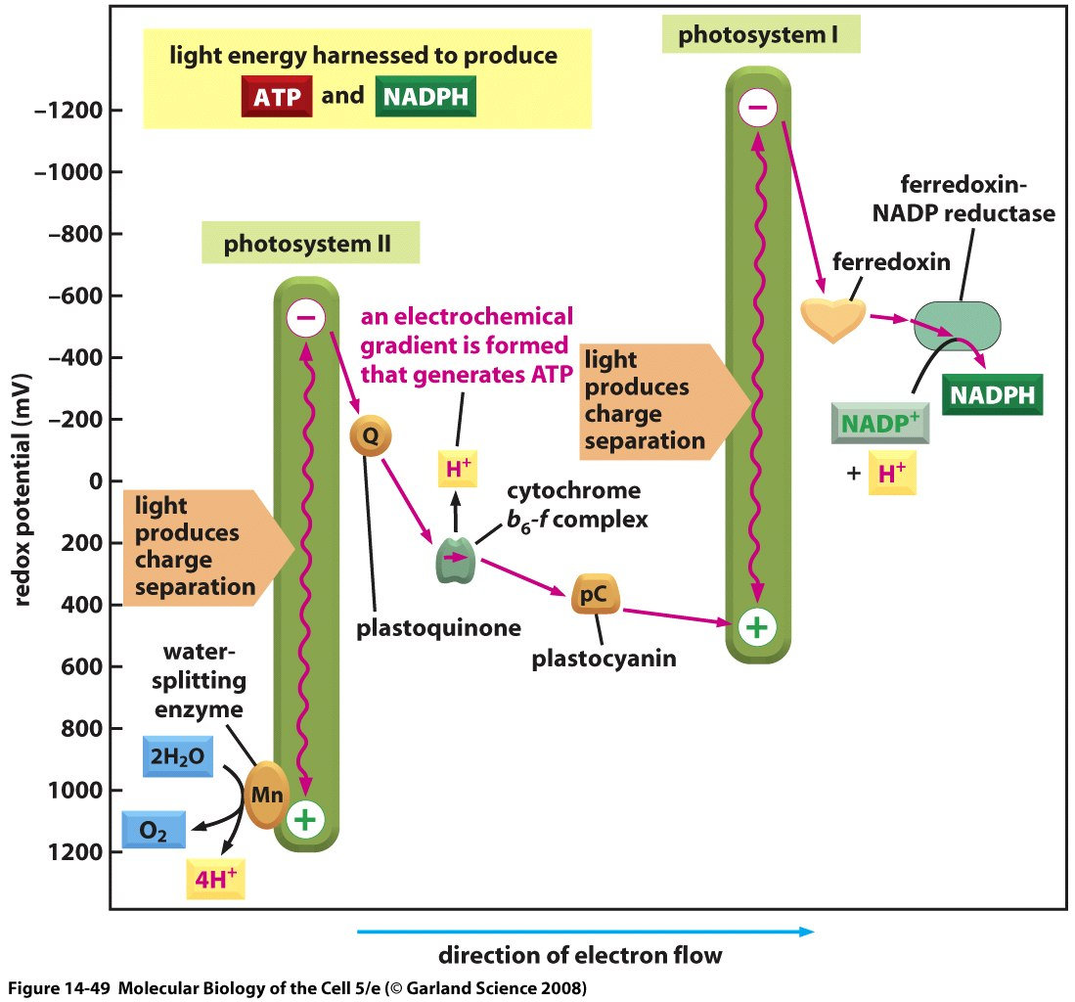
“Changes in Redox Potential During Photosynthesis”
The energetics of the light-induced reactions have been worked out.
The redox potential for each molecule is indicated by its position along the vertical axis. Note that photosystem II passes electrons derived from water to photosystem I. The net electron flow through the two photosystems in series is from water to NADP+, and it produces NADPH as well as ATP. The ATP is synthesized by an ATP synthase that harnesses the electrochemical proton gradient produced by the three sites of H+ activity that are highlighted in Figure 14-48. This Z scheme for ATP production is called noncyclic photophosphorylation, to distinguish it from a cyclic scheme that utilizes only photosystem I (see the text).

Slide 12
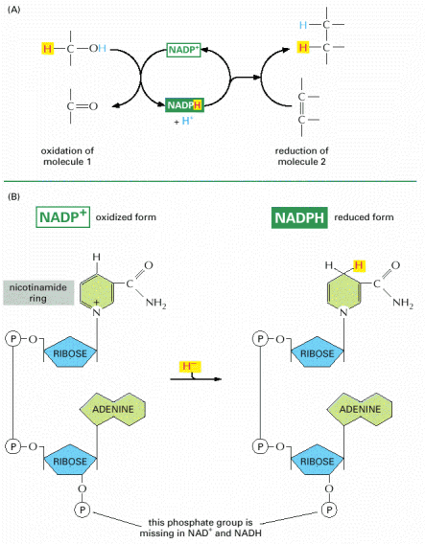
Energy Currency of the Cell: Oxidation-Reduction Reactions
Figure 2-60. NADPH, an important carrier of electrons. (A) NADPH is produced in reactions of the general type shown on the left, in which two hydrogen atoms are removed from a substrate. The oxidized form of the carrier molecule, NADP+, receives one hydrogen atom plus an electron (a hydride ion), and the proton (H+) from the other H atom is released into solution. Because NADPH holds its hydride ion in a high-energy linkage, the added hydride ion can easily be transferred to other molecules, as shown on the right. (B) The structure of NADP+ and NADPH. The part of the NADP+ molecule known as the nicotinamide ring accepts two electrons together with a proton (the equivalent of a hydride ion, H-), forming NADPH. The molecules NAD+ and NADH are identical in structure to NADP+ and NADPH, respectively, except that the indicated phosphate group is absent from both.

Slide 13
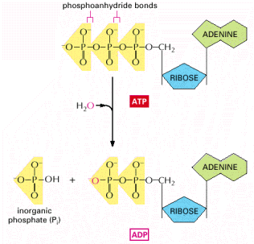
Energy Currency of the Cell: ATP
Figure 2-57. The hydrolysis of ATP to ADP and inorganic phosphate. The two outermost phosphates in ATP are held to the rest of the molecule by high-energy phosphoanhydride bonds and are readily transferred. As indicated, water can be added to ATP to form ADP and inorganic phosphate (Pi). This hydrolysis of the terminal phosphate of ATP yields between 11 and 13 kcal/mole of usable energy, depending on the intracellular conditions. The large negative ΔG of this reaction arises from a number of factors. Release of the terminal phosphate group removes an unfavorable repulsion between adjacent negative charges; in addition, the inorganic phosphate ion (Pi) released is stabilized by resonance and by favorable hydrogen-bond formation with water.

Slide 14
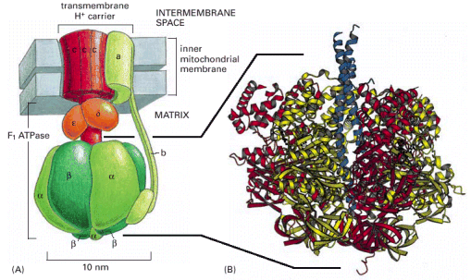
Harnessing the Proton Gradient to Make ATP
Figure 14-15. ATP synthase. (A) The enzyme is composed of a head portion, called the F1 ATPase, and a transmembrane H+ carrier, called F0. Both F1 and F0 are formed from multiple subunits, as indicated. A rotating stalk turns with a rotor formed by a ring of 10 to 14 c subunits in the membrane (red). The stator (green) is formed from transmembrane a subunits, tied to other subunits that create an elongated arm. This arm fixes the stator to a ring of 3α and 3β subunits that forms the head. (B) The three-dimensional structure of the F1 ATPase, determined by x-ray crystallography. This part of the ATP synthase derives its name from its ability to carry out the reverse of the ATP synthesis reaction—namely, the hydrolysis of ATP to ADP and Pi, when detached from the transmembrane portion. (B, courtesy of John Walker, from J.P. Abrahams et al., Nature 370:621–628, 1994. © Macmillan Magazines Ltd.)

Slide 15
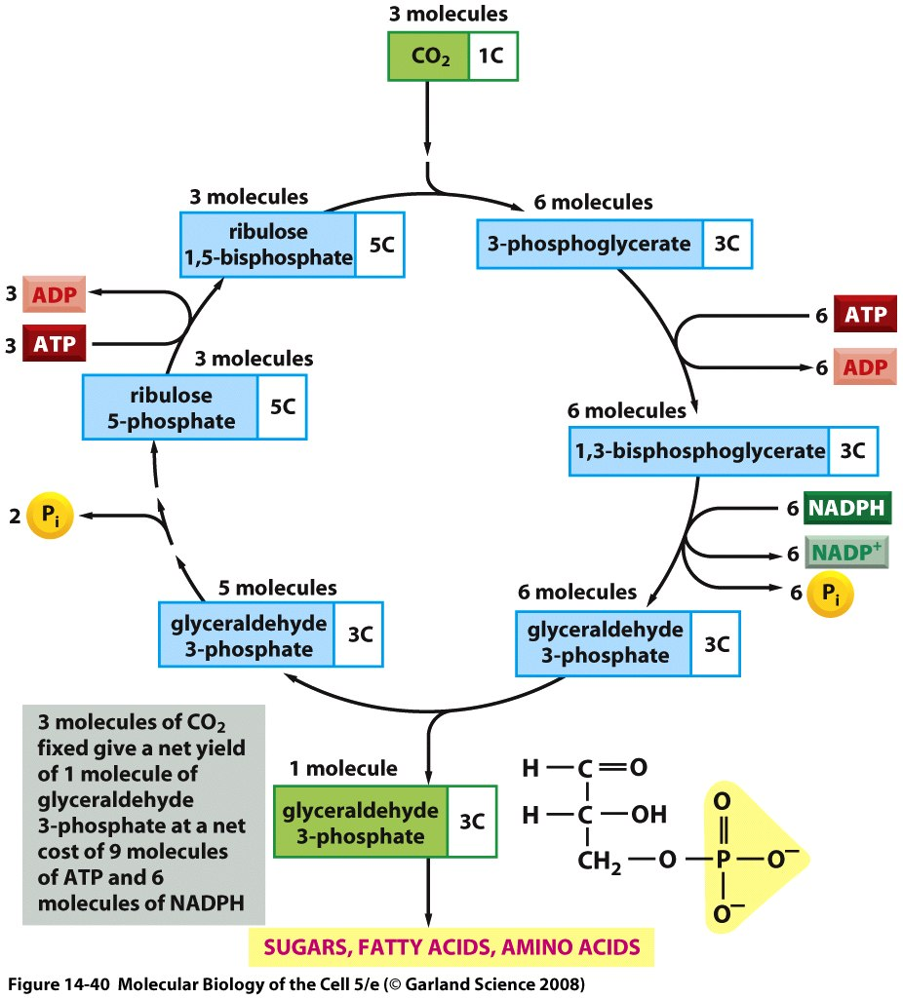
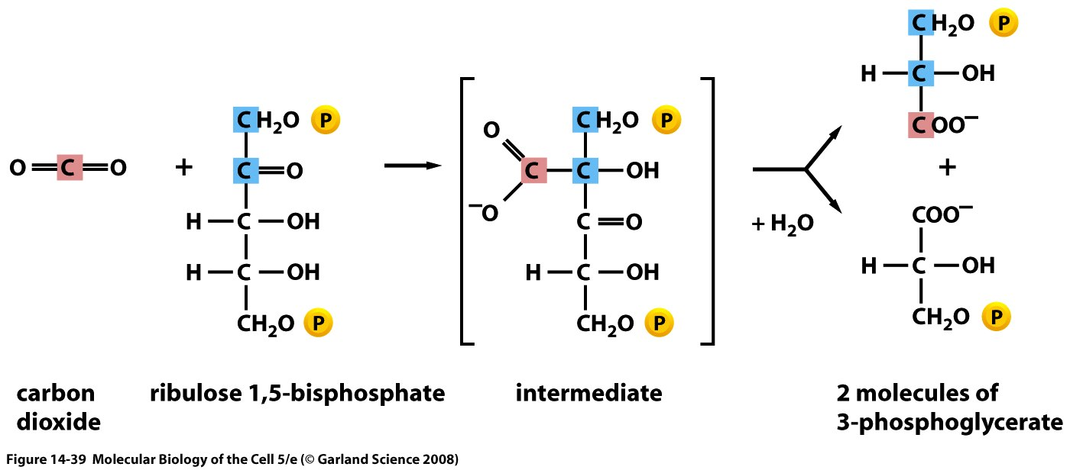
Carbon Fixation and the Calvin Cycle
Figure 14-40 The carbon-fixation cycle, which forms organic molecules from CO2 and H2O.
The number of carbon atoms in each type of molecule is indicated in the white box. There are many intermediates between glyceraldehyde 3-phosphate and ribulose 5-phosphate, but they have been omitted here for clarity. The entry of water into the cycle is also not shown.

