Slide 1
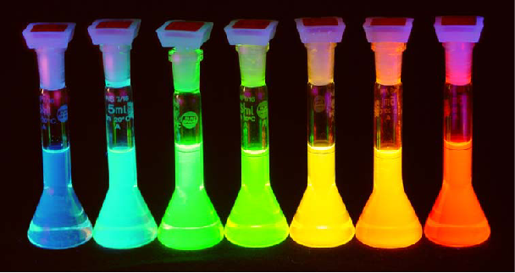
Quantum Mechanics and Artifical and Natural Spectroscopy
(Berman et al.)
Notes:
Abstract: Tightly bent DNA is a fact of life. One intriguing example is DNA packing. Whether in the 50nm confines of a viral capsid or the micron-scale dimensions of the eukaryotic nucleus, genomic DNA is often bent on scales comparable to the persistence length itself. A second intriguing example concerns the ubiquitous role of DNA looping in transcriptional regulation. This talk will examine quantitative models of the problems described above with special reference to the types of predictions deduced from these models. I will also describe both in-vitro and in-vivo experiments aimed at probing the mechanics of tightly bent DNA and its biological implications.

Slide 2
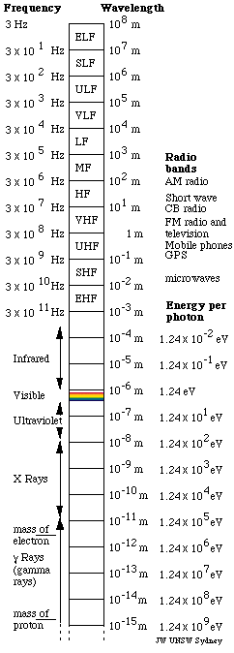
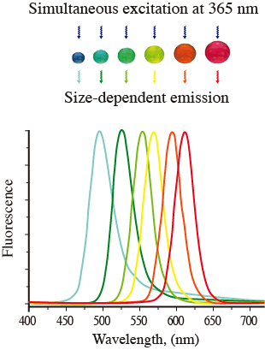
Quantum Mechanics and Artifical and Natural Spectroscopy
(Berman et al.)
http://www.aist.go.jp/aist_e/aist_today/2006_21/pict/p22_2.png
Notes:
Abstract: Tightly bent DNA is a fact of life. One intriguing example is DNA packing. Whether in the 50nm confines of a viral capsid or the micron-scale dimensions of the eukaryotic nucleus, genomic DNA is often bent on scales comparable to the persistence length itself. A second intriguing example concerns the ubiquitous role of DNA looping in transcriptional regulation. This talk will examine quantitative models of the problems described above with special reference to the types of predictions deduced from these models. I will also describe both in-vitro and in-vivo experiments aimed at probing the mechanics of tightly bent DNA and its biological implications.

Slide 3
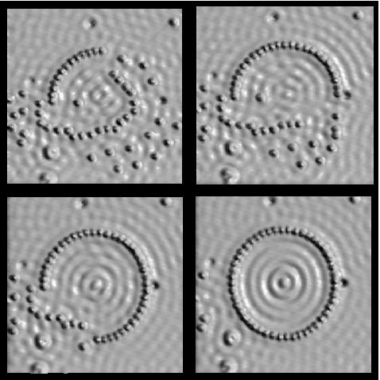
Quantum Mechanics and Artifical and Natural Spectroscopy
(Berman et al.)
Notes:
Abstract: Tightly bent DNA is a fact of life. One intriguing example is DNA packing. Whether in the 50nm confines of a viral capsid or the micron-scale dimensions of the eukaryotic nucleus, genomic DNA is often bent on scales comparable to the persistence length itself. A second intriguing example concerns the ubiquitous role of DNA looping in transcriptional regulation. This talk will examine quantitative models of the problems described above with special reference to the types of predictions deduced from these models. I will also describe both in-vitro and in-vivo experiments aimed at probing the mechanics of tightly bent DNA and its biological implications.

Slide 4
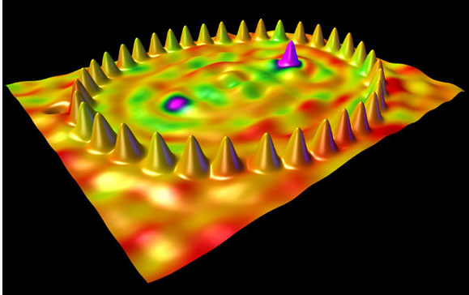
Quantum Mechanics and Artifical and Natural Spectroscopy
(Berman et al.)
Notes:
Abstract: Tightly bent DNA is a fact of life. One intriguing example is DNA packing. Whether in the 50nm confines of a viral capsid or the micron-scale dimensions of the eukaryotic nucleus, genomic DNA is often bent on scales comparable to the persistence length itself. A second intriguing example concerns the ubiquitous role of DNA looping in transcriptional regulation. This talk will examine quantitative models of the problems described above with special reference to the types of predictions deduced from these models. I will also describe both in-vitro and in-vivo experiments aimed at probing the mechanics of tightly bent DNA and its biological implications.

Slide 5
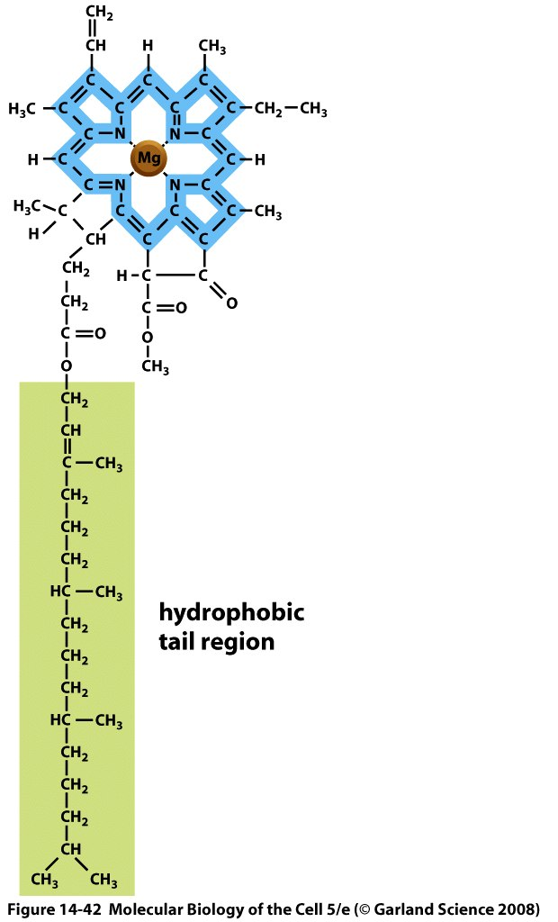
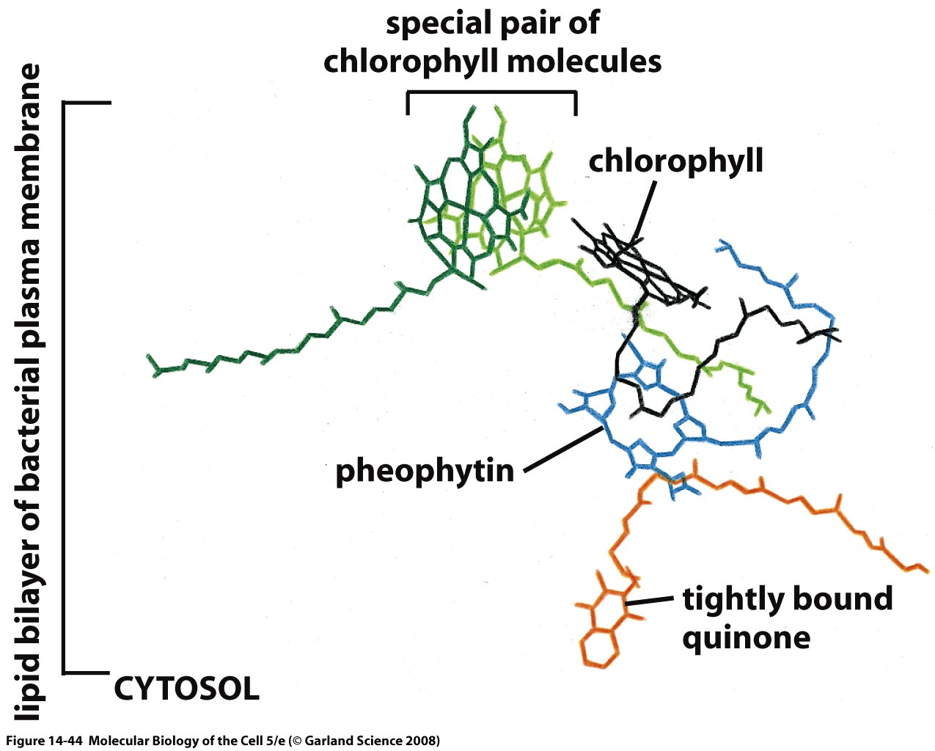
Molecules Responsible for Absorption of Light
Chlorophyll characterized by a porphyrin ring and a hydrophobic tail which anchors the molecule to the membrane.
The porphyrin ring is host to the electronic states that participate in the interaction with light.

Slide 6
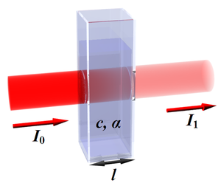
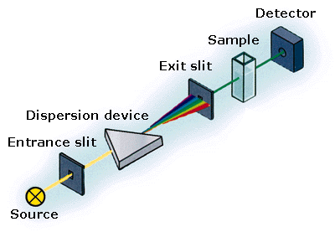
Beer’s Law

Slide 7
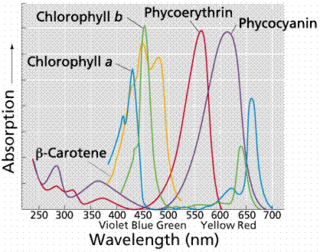
Absorption Spectra of Biological Pigments
The spectrophotometer permits the measurement of absorption as a function of the incident wavelength.
Note that chlorophyll appears green because it absorbs strongly in the blue and the red.
We will be interested in examining the quantum mechanical underpinnings of absorption spectra.

Slide 8
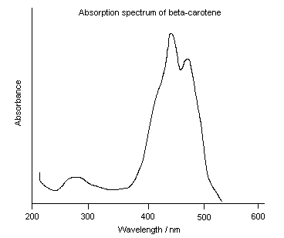
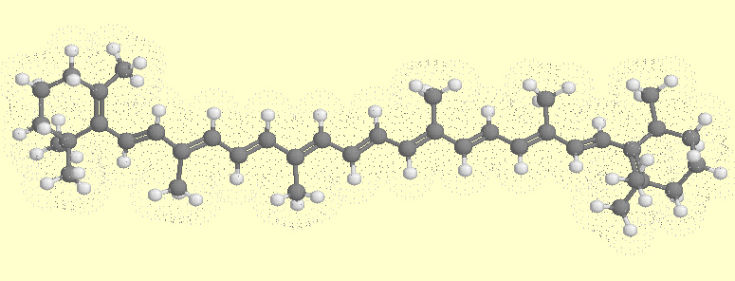
“Linear” Pigments: The Carotenoids

