Slide 1
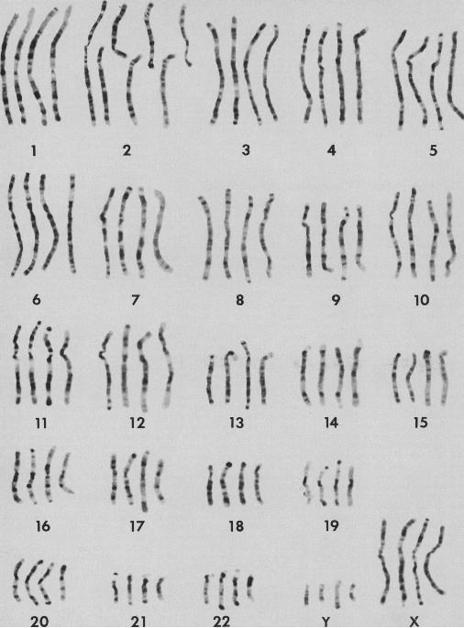
Genes, Chromosomes and Genomes
APh/BE161: Physical Biology of the Cell
Winter 2009
“Lecture 6”
Rob Phillips

Slide 2
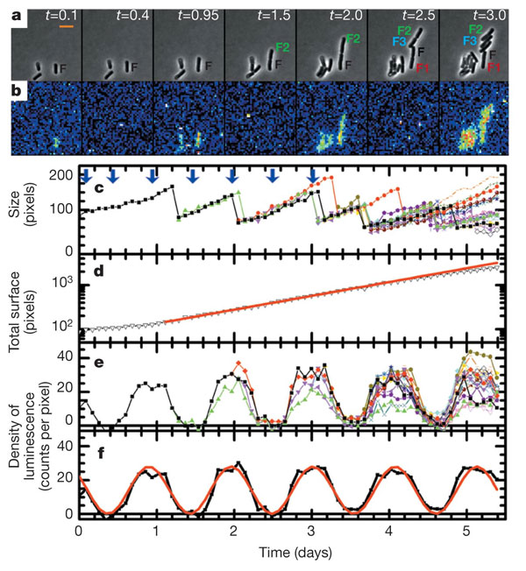
Gene Expression in Cyanobacteria
(Mihalcescu, Hsing, Leibler, Nature 2004)
a, Snapshots of phase-contrast image showing cell F and its progeny and b, related bioluminescence image at different times t (given in days, a 24 h period of time) from the beginning of the measurement. Pixels in the bioluminescence images were binned 3 times 3 (pseudo-colour, where red is high signal intensity and blue is low signal intensity). Scale bar, 5 microm. c, The size of the cell F and all its progeny as a function of time measured from the phase-contrast images (non-binned pixels). The arrows point to the time where the snapshots in (a) and (b) were taken. d, The total number of pixels occupied by F and its all progeny versus time (black line) plotted in a logarithmic scale. The red line is the corresponding exponential growth fit: total size (t) = initial size times 2t/tau with tau = 23.04 plusminus 0.17 h. e, Density of bioluminescence for the same cell and all its progeny versus time. f, The average density of bioluminescence versus time (black line) and its fit (red line) with: left fenced(t)right fence = B + A cos(2pit/T0 + phi0). The resulting period is T0 = 25.4 plusminus 0.12 h, the initial phase phi0 = 52 plusminus 2.8°, the amplitude A = 12.9 plusminus 0.3 counts per pixel and the offset B = 14.8 plusminus 0.3 counts per pixel.

Slide 3
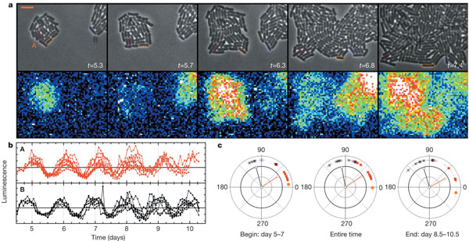
Gene Expression in Cyanobacteria
(Mihalcescu, Hsing, Leibler, Nature 2004)
a, Upper part shows the phase-contrast snapshots of colonies A and B; lower part shows the related bioluminescence images. Scale bar, 5 microm. b, Normalized density of bioluminescence of individual cyanobacterial cells. Each colour corresponds to the progeny from one of the initial cells: red line, colony A; black line, colony B. c, Phase of individual oscillators as a function of their original colony and their evolution in time: red square, colony A; asterisk, colony B. An example of the exact location for three of the cells tracked and their phase evolution is shown, marked by the corresponding coloured lines: magenta, orange and purple. The change of the phase in time was quantified by a fit over a different period of time: the first 2 days (days 5–7), the entire time (days 5–10.5) and the last 2 days of the measurement (days 8.5–10.5). The fit function is left fenced(t)right fence = B + A cos(2pit/T0 + phi), with T0 = 24.78 h. The line segments in each graph, with corresponding colours, represent the resulting vector Pres = sumPi, where Pi is the unit vector whose orientation is the measured angle of the same colony cell i.

Slide 4
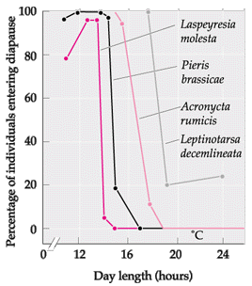
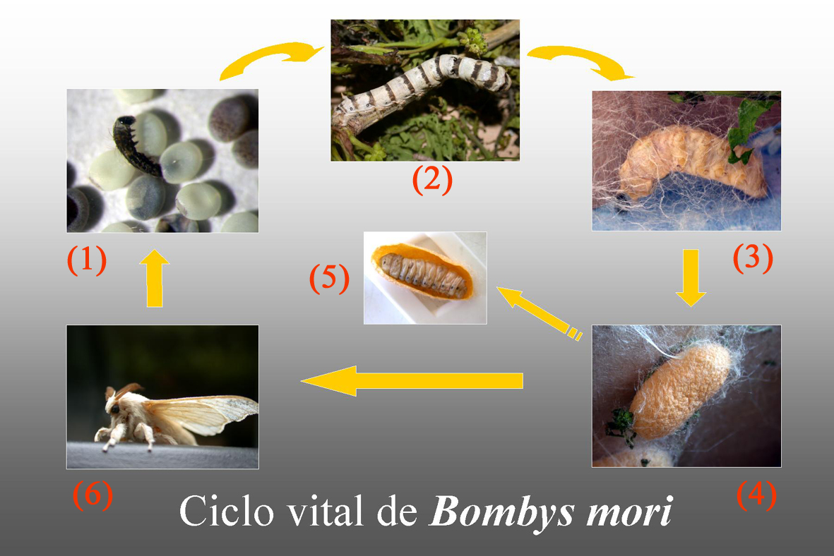
Diapause in Insects
Bombyx mori – diapause as early embryo
Claim: even the protein by itself goes through two-week time evolution.
(From Gilbert, Developmental Biology)
http://centros.edu.aytolacoruna.es/iesadormideras/actividades/Paginamicroscopio/Bombyx%20_mori.html
Figure 1 The photoperiodic response of long-day insects which are induced to enter diapause when the daylight hours falls below a certain level. The four species shown here, Laspeyresia molesta, Pieris brassicae, Acronycta rumicis, and Leptinotarsa decemlineata each leaves diapause when daylight is 14–17 hours. (After Danilevskii 1965).

Slide 5
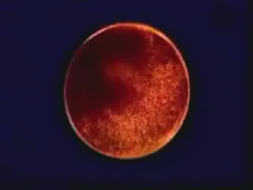
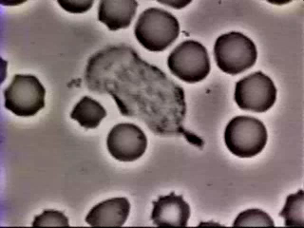
Cells Decide: What to Become, Where to Go
Embryonic Development
Immune Response
(Berman et al.)
Two very distinct examples of cellular decision making.
Case study #1: differentiation of cells during development. Starting from an egg, one cell becomes many different types.
Case study #2: decision of where to go. There are other decisions that represent the rapid response of cells.

Slide 6
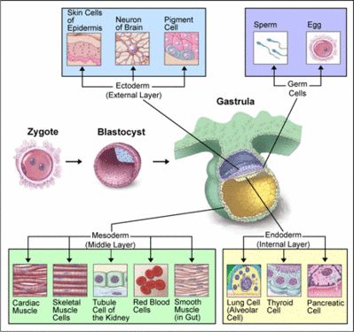
Your Cellular Diversity: A Rogue’s Gallery
As seen in the movie of the embryo, in multicellular organisms during development cells ``decide’’ to become different types.
Diversity of cell types is enormous. You have over 200 cell types in your body.
(Berman et al.)
http://content.answers.com/main/content/wp/en/thumb/9/94/400px-Cell_differentiation.gif
Big picture questions to ponder: how do cells decide, how are decisions implemented, how decisive? The answer came from an unexpected quarter: watching how cells decide what to eat.

Slide 7
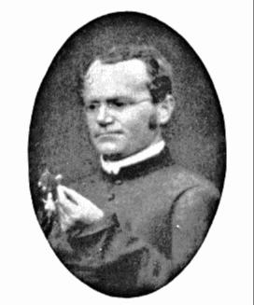
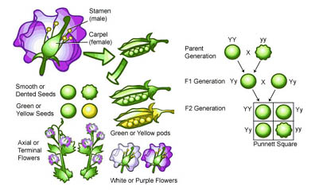
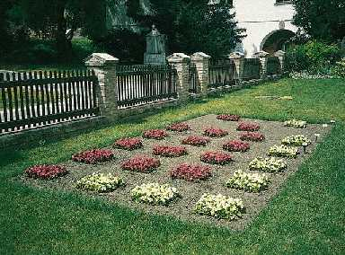
Genes and Decisions: The Long Road from Mendel to Monod
Breeding experiments led Mendel to the abstract idea of genes as the unit of inheritance.
Mendel examined the propagation of seven characters. He measured frequencies.
At that point, no linkage to the physical idea of a chromosome.
What is a gene? We now know that it is a particular part of a DNA molecule.
(Berman et al.)

Slide 8
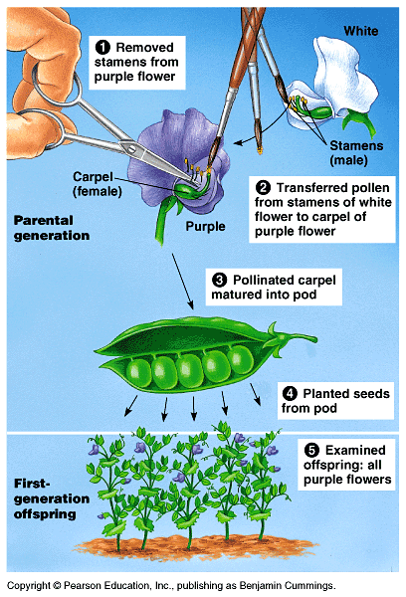
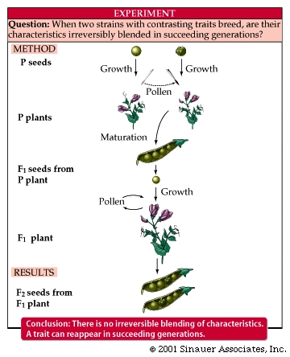
Genes and Decisions: The Long Road from Mendel to Monod
The numbers: Seed shape: 5474 vs 1850
Seed color: 6022 vs 2001

Slide 9
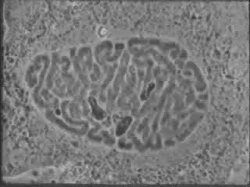
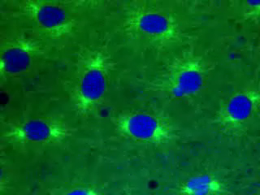
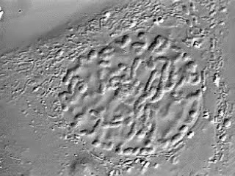
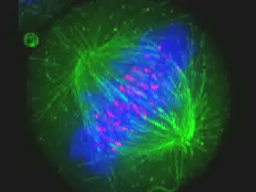
Genes and Physical Objects? A Parallel Thread
Studying the structure of cells led to a recognition that during cell division, there was systematic segregation of certain parts of the cell.

Slide 10
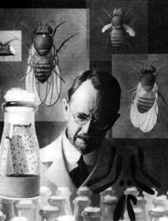
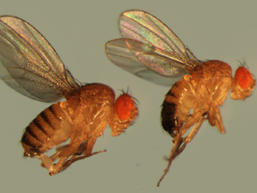
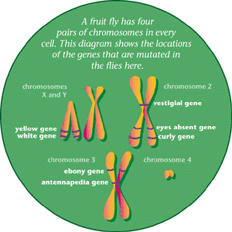
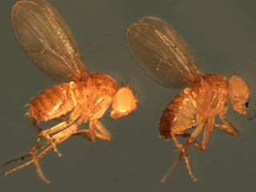
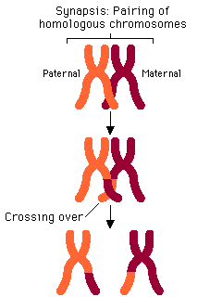
Red and White: Flies Eyes and the Nature of the Gene
Thomas Hunt Morgan and his gene hunters used flies as the basis for the attribution of physical significance to genes as parts of chromosomes.
(Berman et al.)
``The insight that unified these three fields- heredity, evolution, and development- and set biology on the course
toward its current success came only at the beginning of the twentieth century. It derived from the discovery that
the gene, localized to specific positions on the chromosome, was at once the unit of Mendelian heredity, the
driving force for Darwinian evolution, and the control switch for development.’’ -Eric Kandel

Slide 11
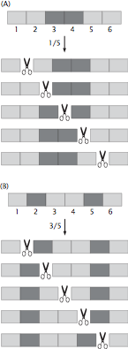

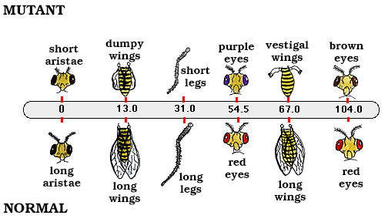
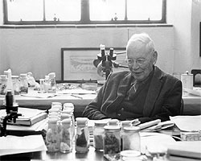
An Unusual Ruler Led to the First Genetic Map
(Berman et al.)
"I suddenly realized that the variations in the strength of linkage already attributed
by Morgan to difference in the spatial separation of the gene offered the possibility
of determining sequence in the linear dimensions of a chromosome. I went home and
spent most of the night (to the neglect of my undergraduate homework) in producing
the first chromosome map. . . .” Another unexpected ruler - statistics of inheritance.
``They [the results] form a new argument in favour of the chromosome view of inheritance,
since they strongly indicate that the factors investigated are arranged in a linear series, at least
mathematically.” - Alfred Sturtevant

Slide 12
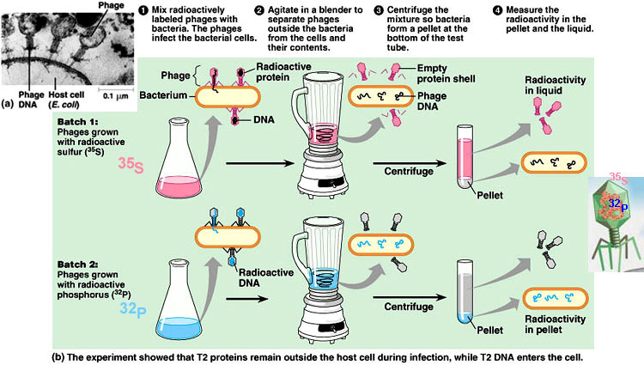
The Hershey-Chase Experiment and the Mechanism of Phage Genome Delivery
One of the great experiments in molecular biology (demonstrating DNA is the genetic material) also revealed intriguing features of the phage life cycle.
Led to speculations about ``syringe’’ mechanism of genome delivery.
Notes:
Here the goal is to show the data of Bustamante and to argue that this data presents key challenge for construction of a mechanical model.

Slide 13
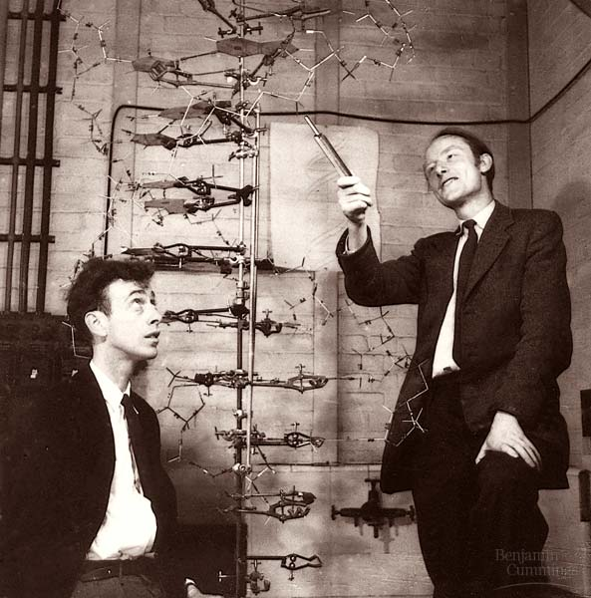
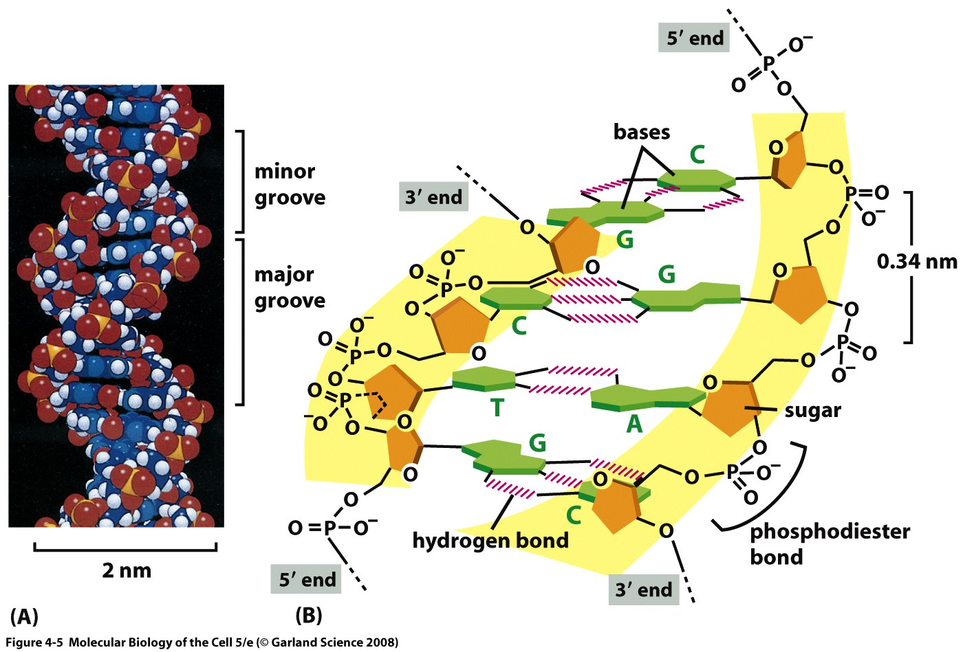
The Structure of DNA
A combination of data (x-ray data from Rosalind Franklin and Maurice Wilkins and Chargaff’s rules) led Watson and Crick to assert a model for DNA.
Notes:
Here the goal is to show the data of Bustamante and to argue that this data presents key challenge for construction of a mechanical model.

Slide 14
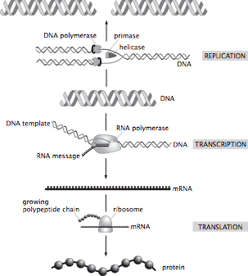
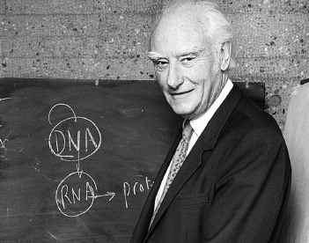
The Central Dogma of Molecular Biology: How Genes Lead to Proteins
Crick and others mused over the ``two great polymer languages’’.
Central dogma explains the chain of events relating them.
The ribosome is the universal translating machine that speaks both languages.
We have seen what genes are and how they serve as the informational memory of organisms. But we have NOT said how they are controlled.
(Berman et al.)
Now we have the background to tackle the question we started with: how do cells make decisions?

Slide 15
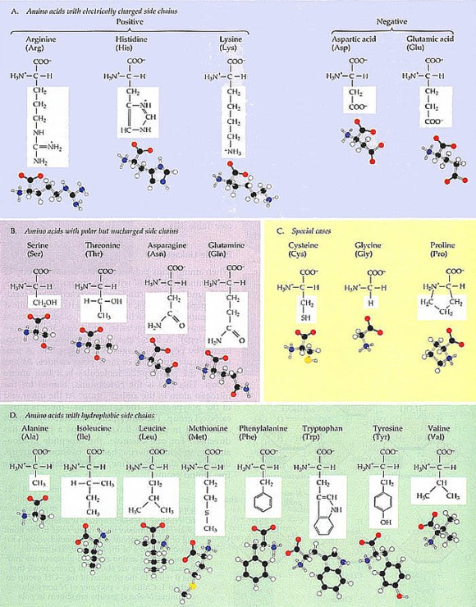
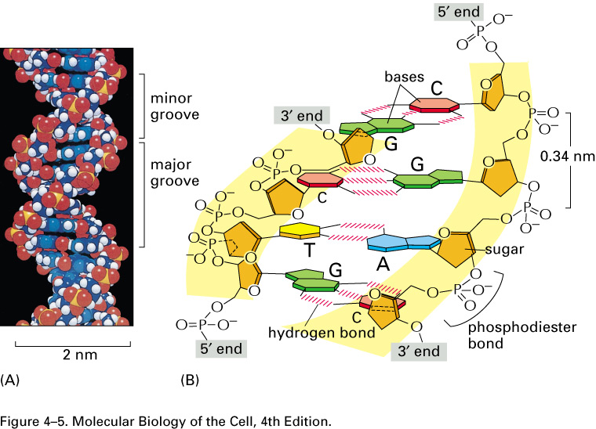
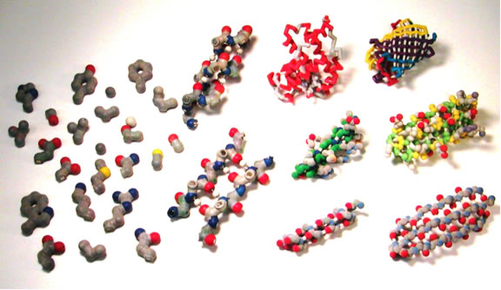
How Are Genes Related to What an Organism Is Like?
(Berman et al.)
How are the DNA and protein alphabets related?
The sequence of A, T, G, C in the DNA is turned into a sequence of 20 amino acids strung together to make a protein.

Slide 16
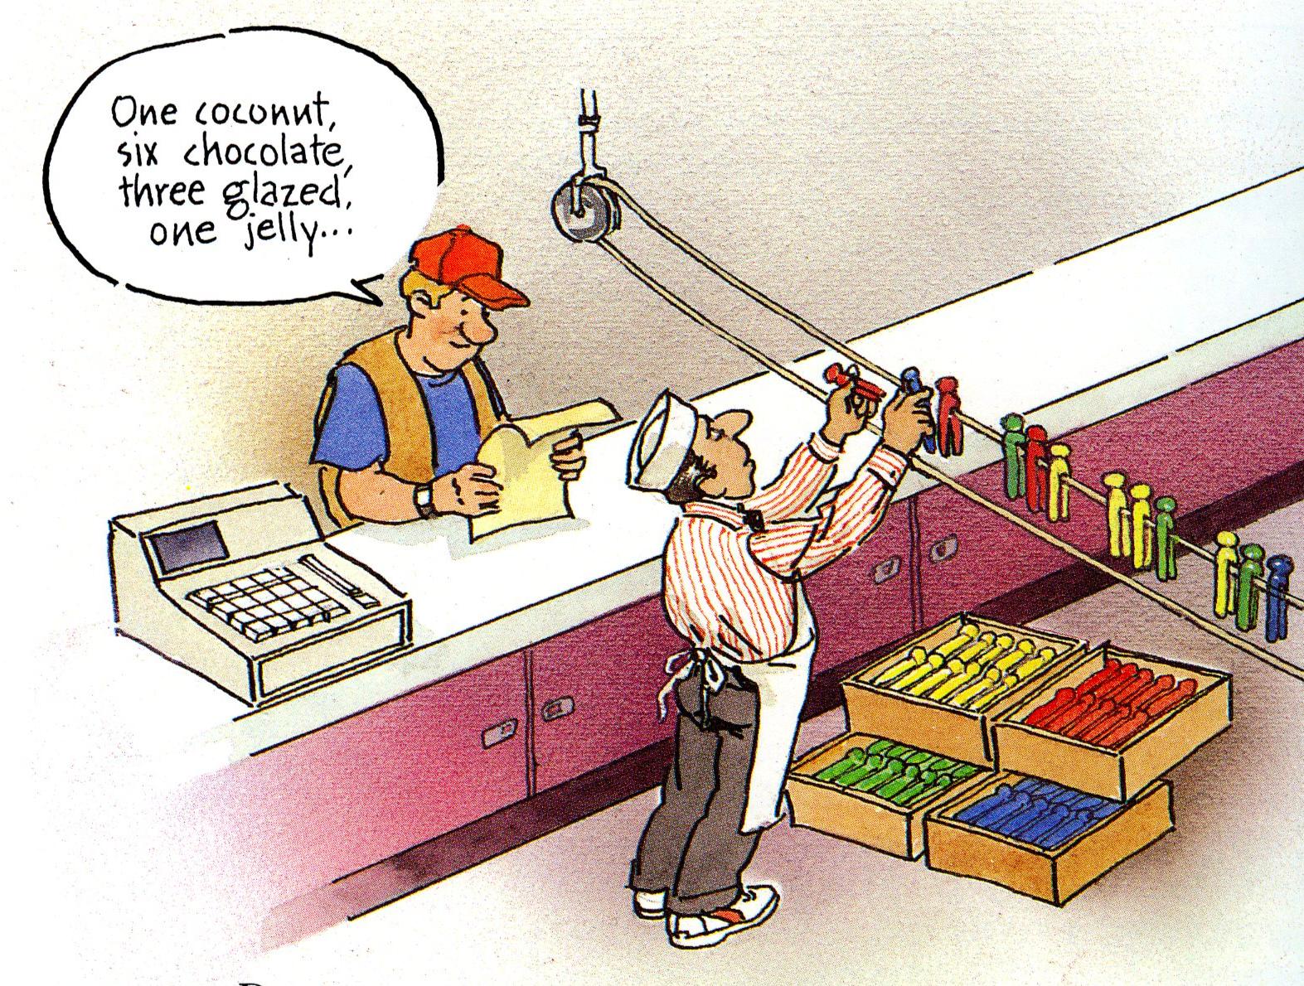
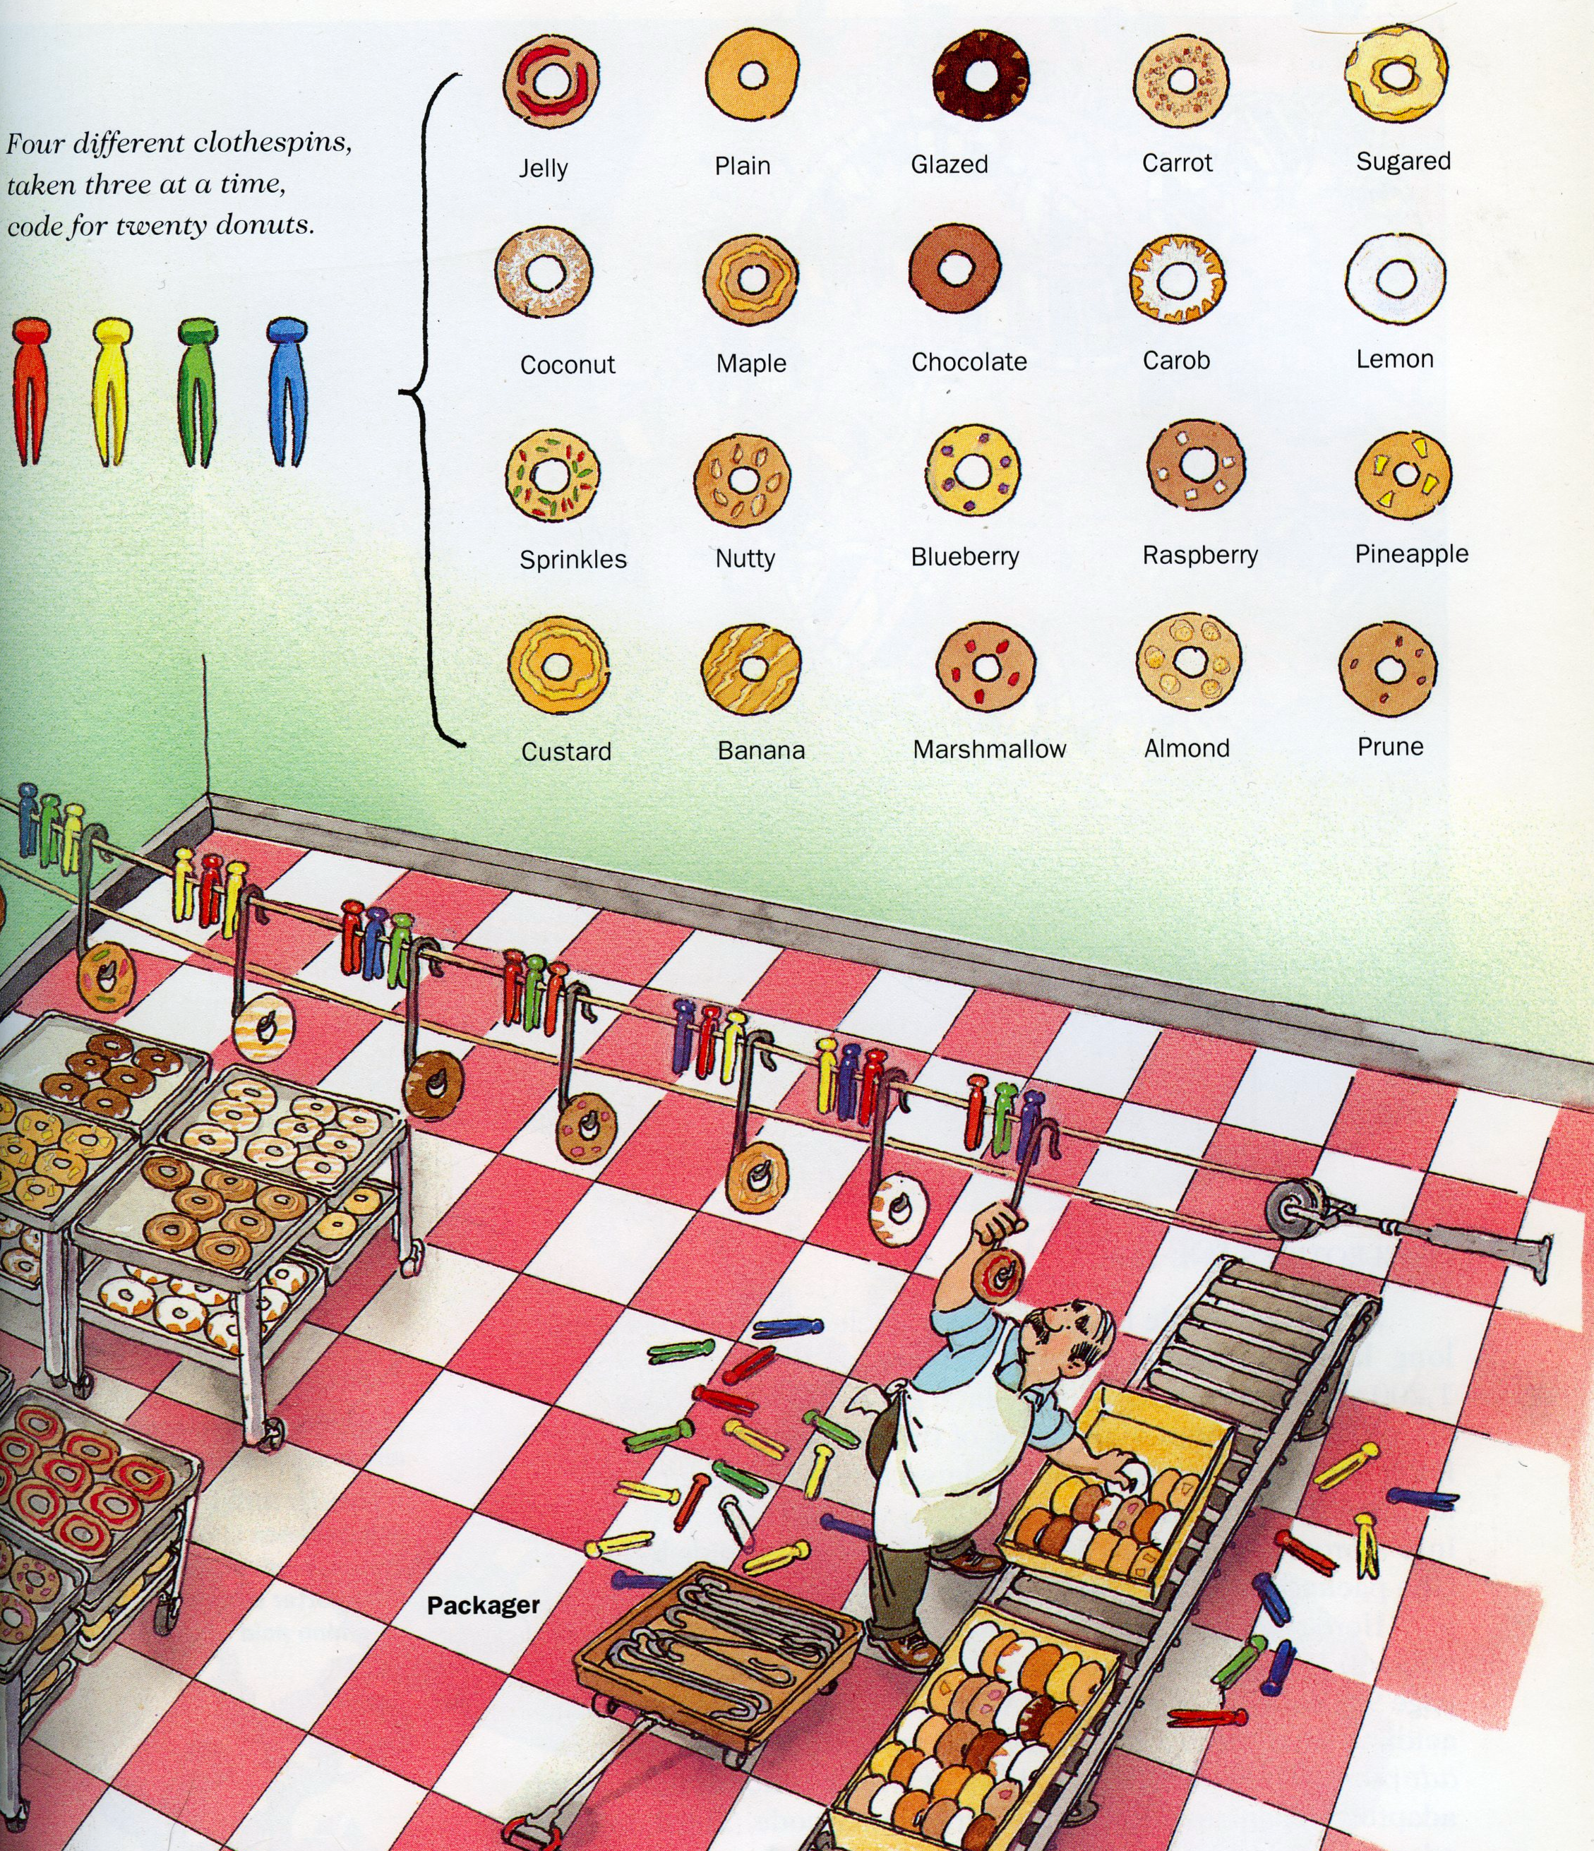
The Central Dogma of Molecular Biology: How Genes Lead to Proteins
(Berman et al.)
How are the DNA and protein alphabets related?
Exquisite molecular machines carry out the processes illustrated by this analogy from a donut shop.

Slide 17
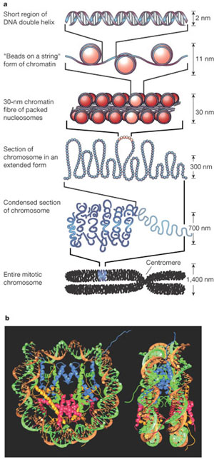
Genes and DNA: What Have We Learned?
(Yunis and Prakash, Science, 1982)
(Berman et al.)
The gene is no longer an abstraction - it is a particular sequence on a molecule called DNA. Amazing!

Slide 18
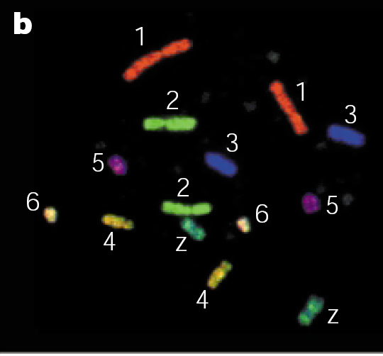
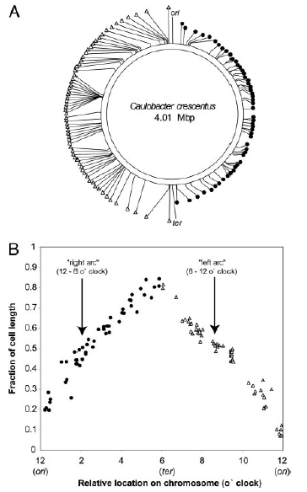
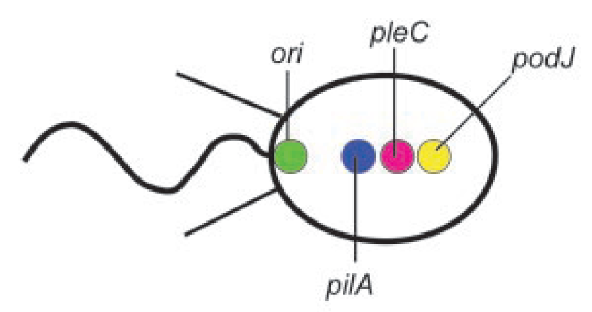
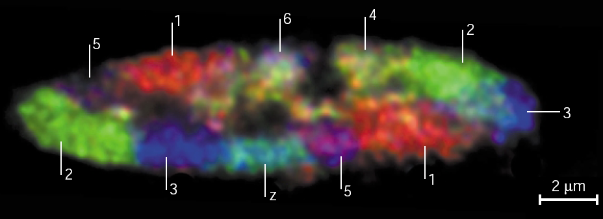
Chromosome Geography: Genomic vs. physical position
Cremer and Cremer
Lucy Shapiro

Slide 19
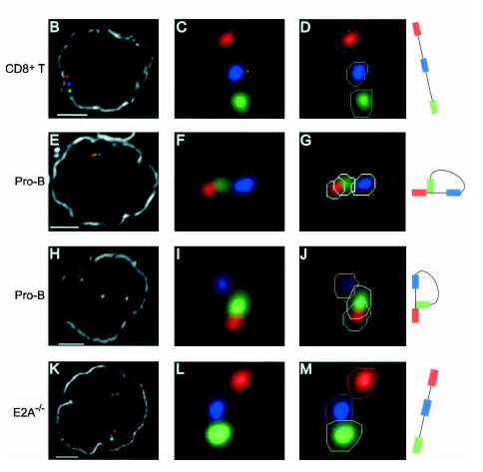
The Immune System
Kees Murre, UCSD

Slide 20
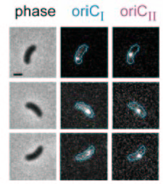
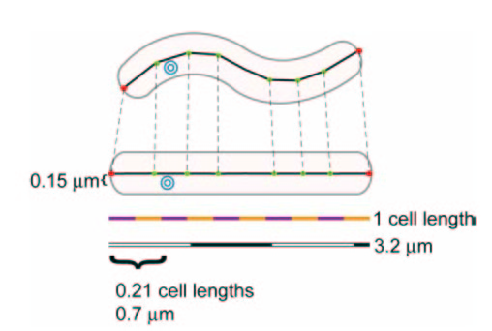
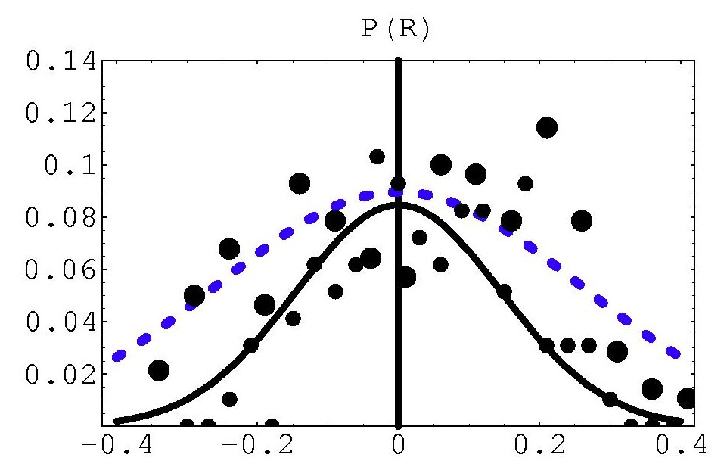
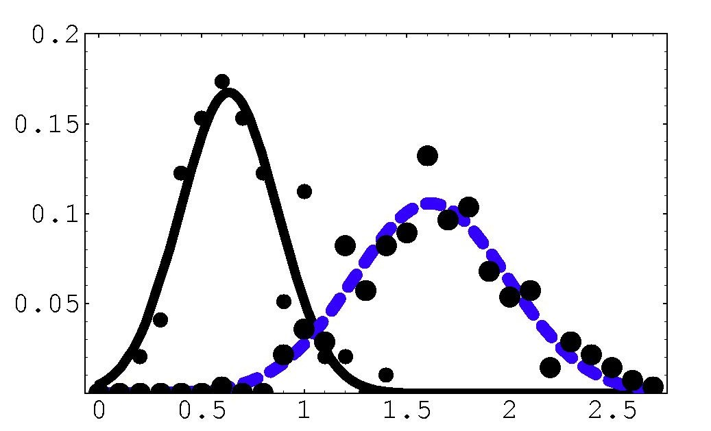
Chromosome Geography in Vibrio
y
x
oriCI
oriCII
Probability
Probability
x
(Theriot et al.)
Replication origins are confined!
y

Slide 21
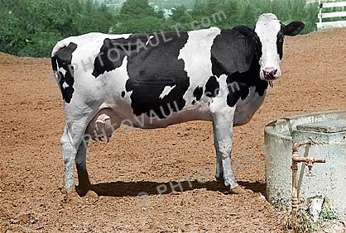
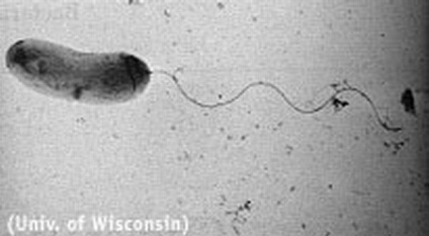
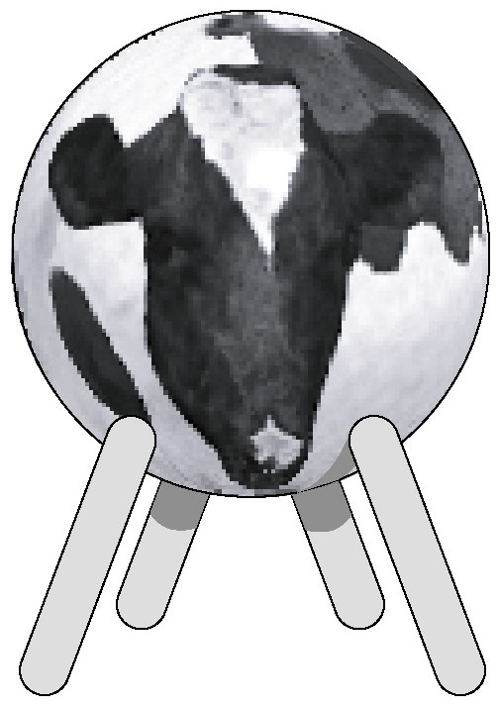

The cylindrical bacterium

