Slide 1
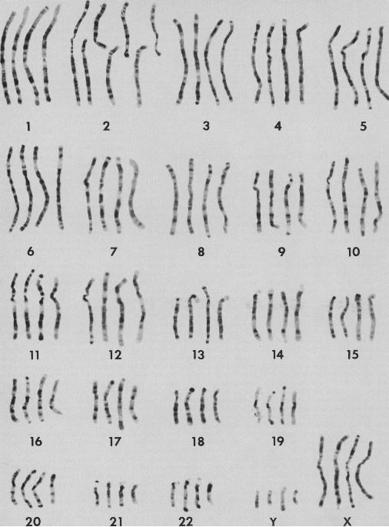
Genes, Chromosomes and Genomes
APh/BE161: Physical Biology of the Cell
Winter 2009
“Lecture 6”
Rob Phillips

Slide 2
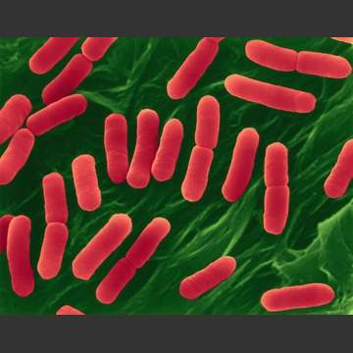
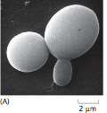
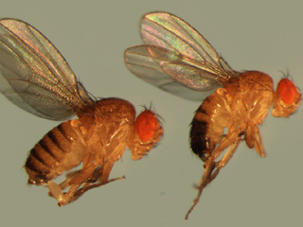
How Cells Decide as Seen Through Three Hall of Fame ``Model’’ Organisms
E. coli
yeast
(Berman et al.)
Fruit fly
Various organisms are accorded hall of fame status as ``model’’ organisms either because they are specialists at some particular process of interest or they are experimentally convenient (grow fast, easily accessible).
Each of these organisms offers something extremely important on the question of how cells decide.

Slide 3
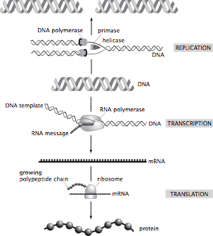
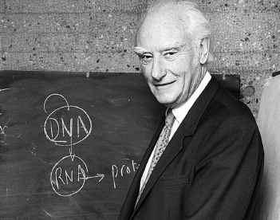
The Central Dogma of Molecular Biology: How Genes Lead to Proteins
Crick and others mused over the ``two great polymer languages’’.
Central dogma explains the chain of events relating them.
The ribosome is the universal translating machine that speaks both languages.
We have seen what genes are and how they serve as the informational memory of organisms. But we have NOT said how they are controlled.
(Berman et al.)
Now we have the background to tackle the question we started with: how do cells make decisions?

Slide 4
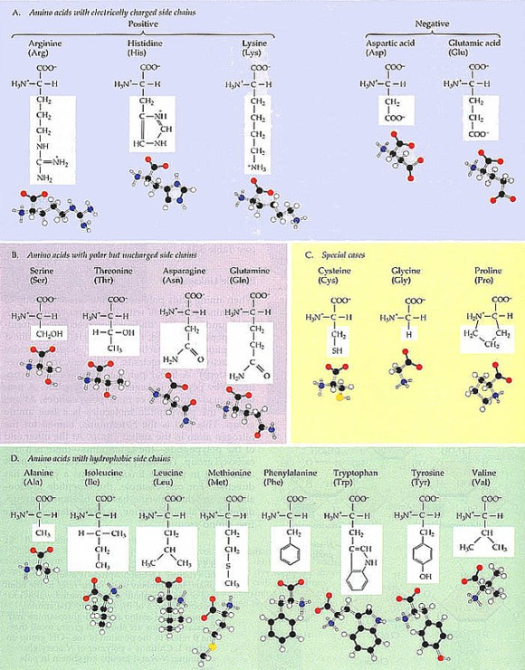
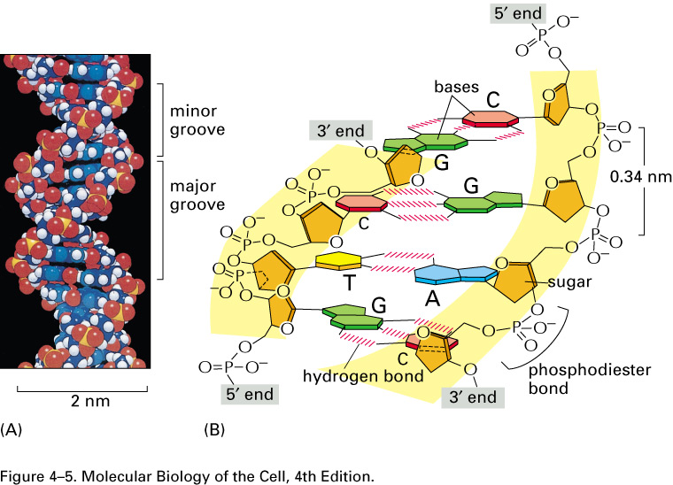
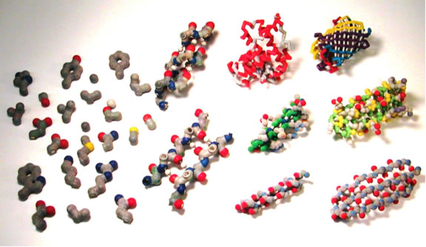
How Are Genes Related to What an Organism Is Like?
(Berman et al.)
How are the DNA and protein alphabets related?
The sequence of A, T, G, C in the DNA is turned into a sequence of 20 amino acids strung together to make a protein.

Slide 5
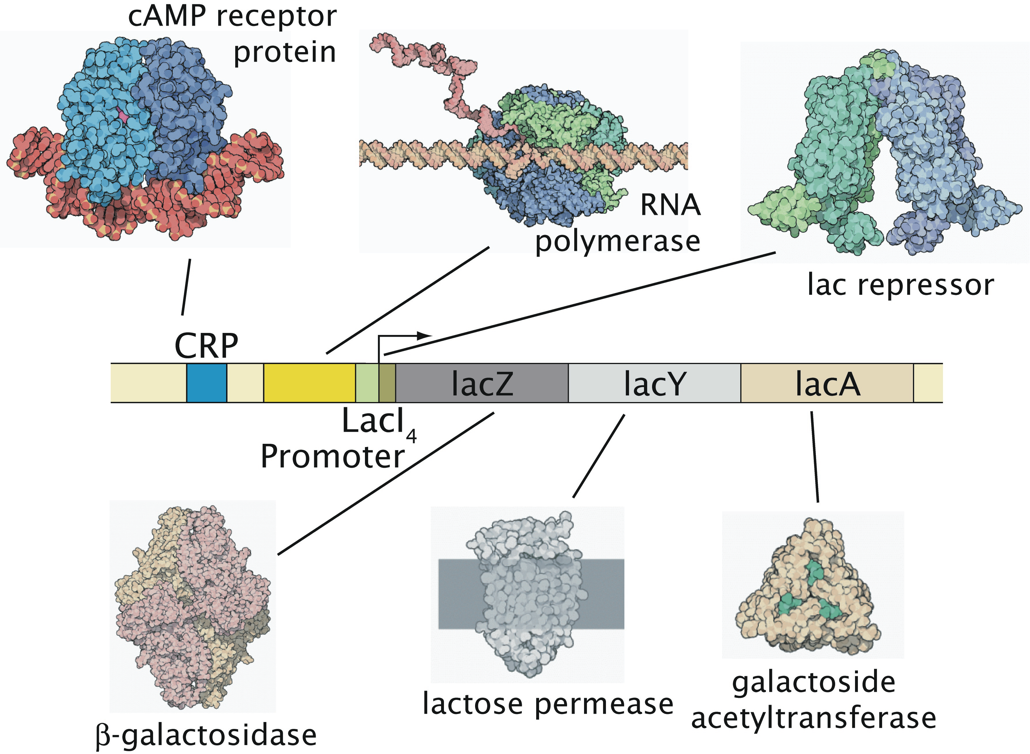
The Big Message
The Puzzle: All the cells in a given organism (almost) carry the same
genetic information. And yet, depending upon where they are within
the organism, they turn out quite differently.
This lecture: how we found out, some beautiful examples, where we stand now.
The Insight: The genome (i.e. genetic material) is under exquisite
control. Genes are turned on and off in response to environmental cues.

Slide 6
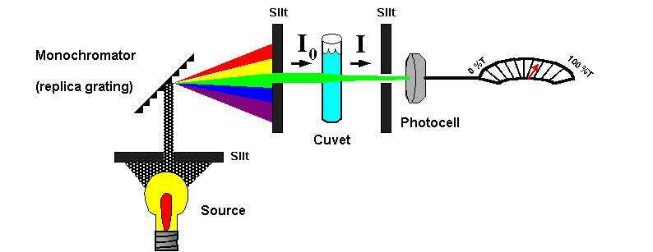
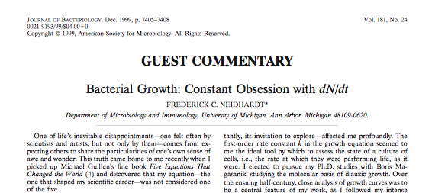
Measuring the Diet of a Bacterium
Growth curves have served a central role in dissecting the physiology of cells of all types.
In particular, we know much about how cells decide based upon watching them grow and seeing what they like to eat.

Slide 7
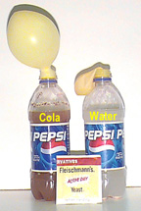
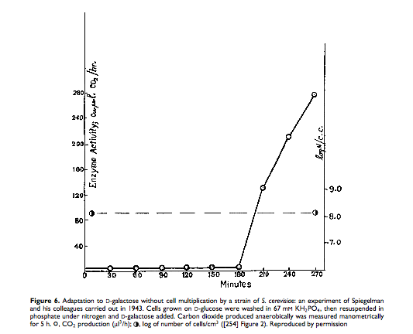
Deciding What to Eat: Giant Discoveries Often Arise From Seemingly Arcane Topics
Fascinating twist of history of science: human curiosity leads to investigation of seemingly arcane topics (spectral lines of atoms, specific heats of solids, peculiarities in the orbits of Uranus or Mercury, etc.) from which emerge hugely important insights.
An example: nutrition of single cells like yeast and bacteria.
Yeast cells express preferences about which sugar to use.
Interestingly, the proteins used to digest the less preferable sugars are only synthesized when those sugars are present and the more preferable sugars are absent.
(Berman et al.)
(Spiegelman et al., PNAS, 1944)
Notes:
Anﾊintriguing aspect of multicellular organisms is the fact that there are a wide variety of different cell types, this despite the fact that each and every cell carries the same genetic information.ﾊ ﾊOne of the key mechanisms giving rise to distinct cellular identities is particular ``decisions'' that are made about which genes to express at different times and places in an organism's history.ﾊ Interestingly, decision making is not restricted to multicellular organisms, nor even to eukaryotic cells.ﾊ Indeed, the modern theory of gene regulation was born out of efforts to understand how bacterial cells decide which sugars to utilize at any given time.ﾊ In this talk, I will describe the ways in which statistical mechanics can be used to examine the regulatory processes that take place in the lives of cells.ﾊ These simple models result in surprising predictions and I will also describe our experimental efforts to probe this rich behavior both in test tubes and in living cells.ﾊ

Slide 8
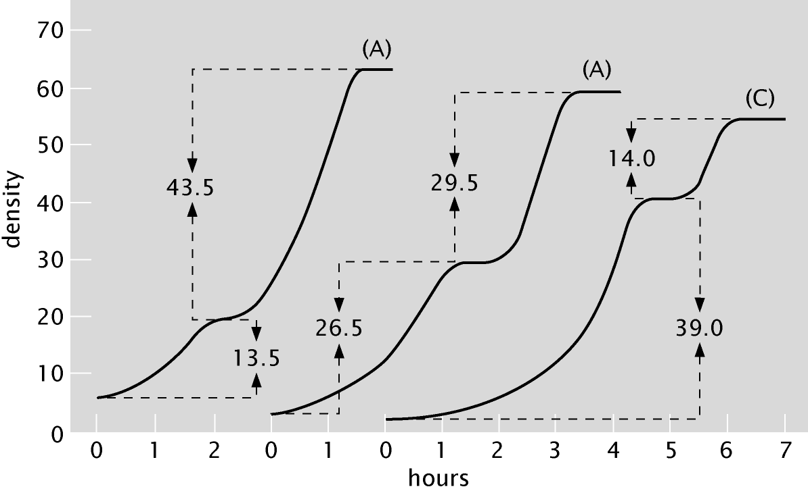
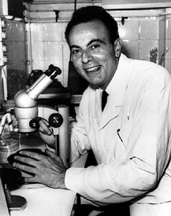
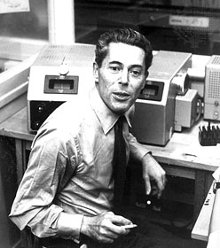
The Development of the Operon Concept: What Cells Eat and When They Die
Studies of the cultures of bacterial cells sufficed to lead Jacob and Monod to formulate the operon concept - the revolutionary view that there are certain genes whose mission is to control other genes.
This superseded the dictum of Beadle and Tatum which was ``one gene, one enzyme’’.
The Mendelian revolution taken to the next stage.
(Berman et al.)
(J. Monod)
Bacterial growth curves
Notes:
Anﾊintriguing aspect of multicellular organisms is the fact that there are a wide variety of different cell types, this despite the fact that each and every cell carries the same genetic information.ﾊ ﾊOne of the key mechanisms giving rise to distinct cellular identities is particular ``decisions'' that are made about which genes to express at different times and places in an organism's history.ﾊ Interestingly, decision making is not restricted to multicellular organisms, nor even to eukaryotic cells.ﾊ Indeed, the modern theory of gene regulation was born out of efforts to understand how bacterial cells decide which sugars to utilize at any given time.ﾊ In this talk, I will describe the ways in which statistical mechanics can be used to examine the regulatory processes that take place in the lives of cells.ﾊ These simple models result in surprising predictions and I will also describe our experimental efforts to probe this rich behavior both in test tubes and in living cells.ﾊ

Slide 9
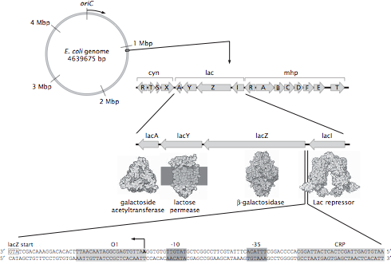
Not All DNA Codes for Proteins
The E. coli genome is a circle with roughly 4.7 million base pairs.
How many genes? An estimate.
The genes related to sugar usage have been one of the most important stories in the history of modern biology and biochemistry (and take us right back to the great debate on vitalism played out with Pasteur in the 1800s).
“Promoter” region on DNA is subject to intervention by various molecular bouncers that govern the gene.
(Berman et al.)
The regulatory landscape

Slide 10
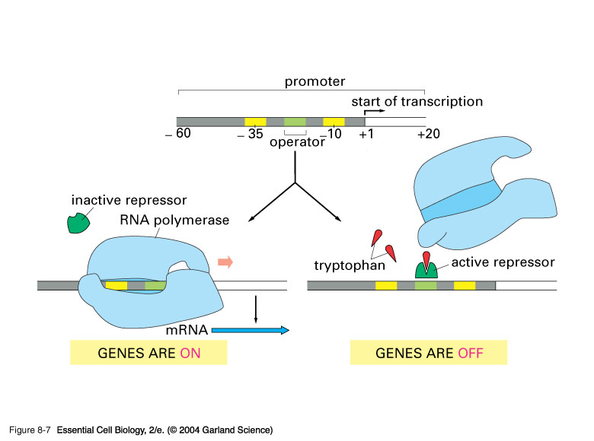
Repressors: The Cartoon
Repressor molecules inhibit action of RNA polymerase.
Repressors can be under the control of other molecules (i.e. inducers) that dictate when repressor is bound and not.
Notes:
Repressor – simple minded picture is that the repressor molecule blocks the promoter. We are not interested in the fine point of whether or not this is REALLY the structural picture.

Slide 11
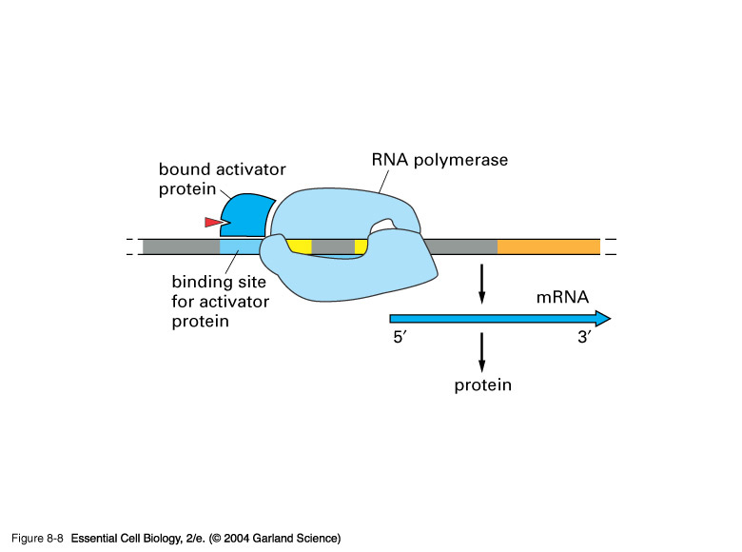
Activators: The Cartoon
Activator molecules enhance the action of RNA polymerase.
Activators can be under the control of other molecules (i.e. inducers) that dictate when activator is bound and not.
Activators “RECRUIT” the polymerase.
Adhesive interaction between RNAP
and activator

Slide 12
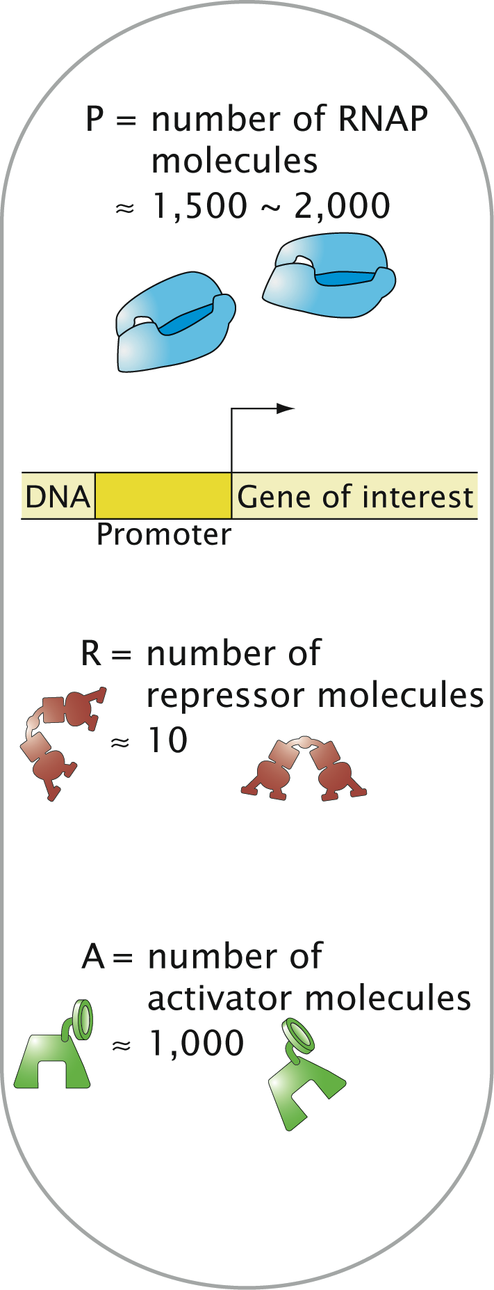
The Single Molecule Census
(Beautiful work of David Goodsell)

Slide 13
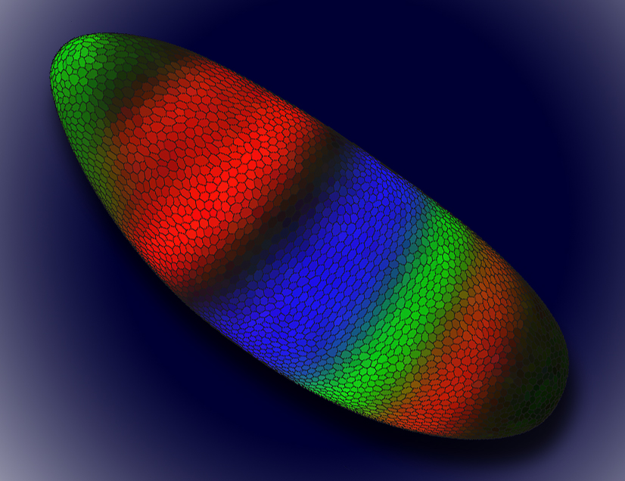
Ways to Measure Gene Expression
Basic point: looking for “reporters” of the level of expression of gene of interest.
Can ask the system to report on the level of gene expression at various steps in the processes linking DNA to active protein.
Promoter occupancy, level of mRNA, level of active protein.
http://www.lbl.gov/Science-Articles/Archive/sabl/2008/Feb/genome-mystery.html
This image shows a Drosophila embryo colored to show the expression patterns of early gene regulators. Each color represents the level of expression of one of three gene regulators, Knirps (green), Kruppel (blue), and Giant (red). Color intensity reflects a higher level of expression. The darker areas of the embryo are cells where none of these gene regulators are expressed, and the yellowish areas indicate that both Knirps and Giant are being expressed.

Slide 14
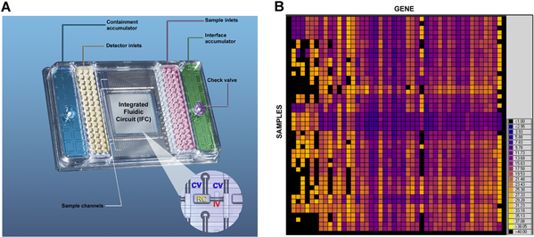
Count the Messenger RNA Molecules

Slide 15
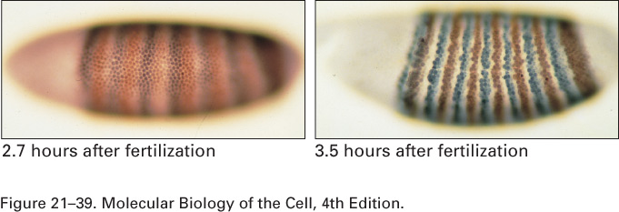
Enzymatic Assay or In-Situ Hybridization
Enzymatic assays – promoter leads to the production of a protein that then does some enzymatic action on the substrate which yields a product that can be visualized.
In-situ hybridization – described the other day – probe is complementary to the RNA of interest and is labelled for detection.

Slide 16
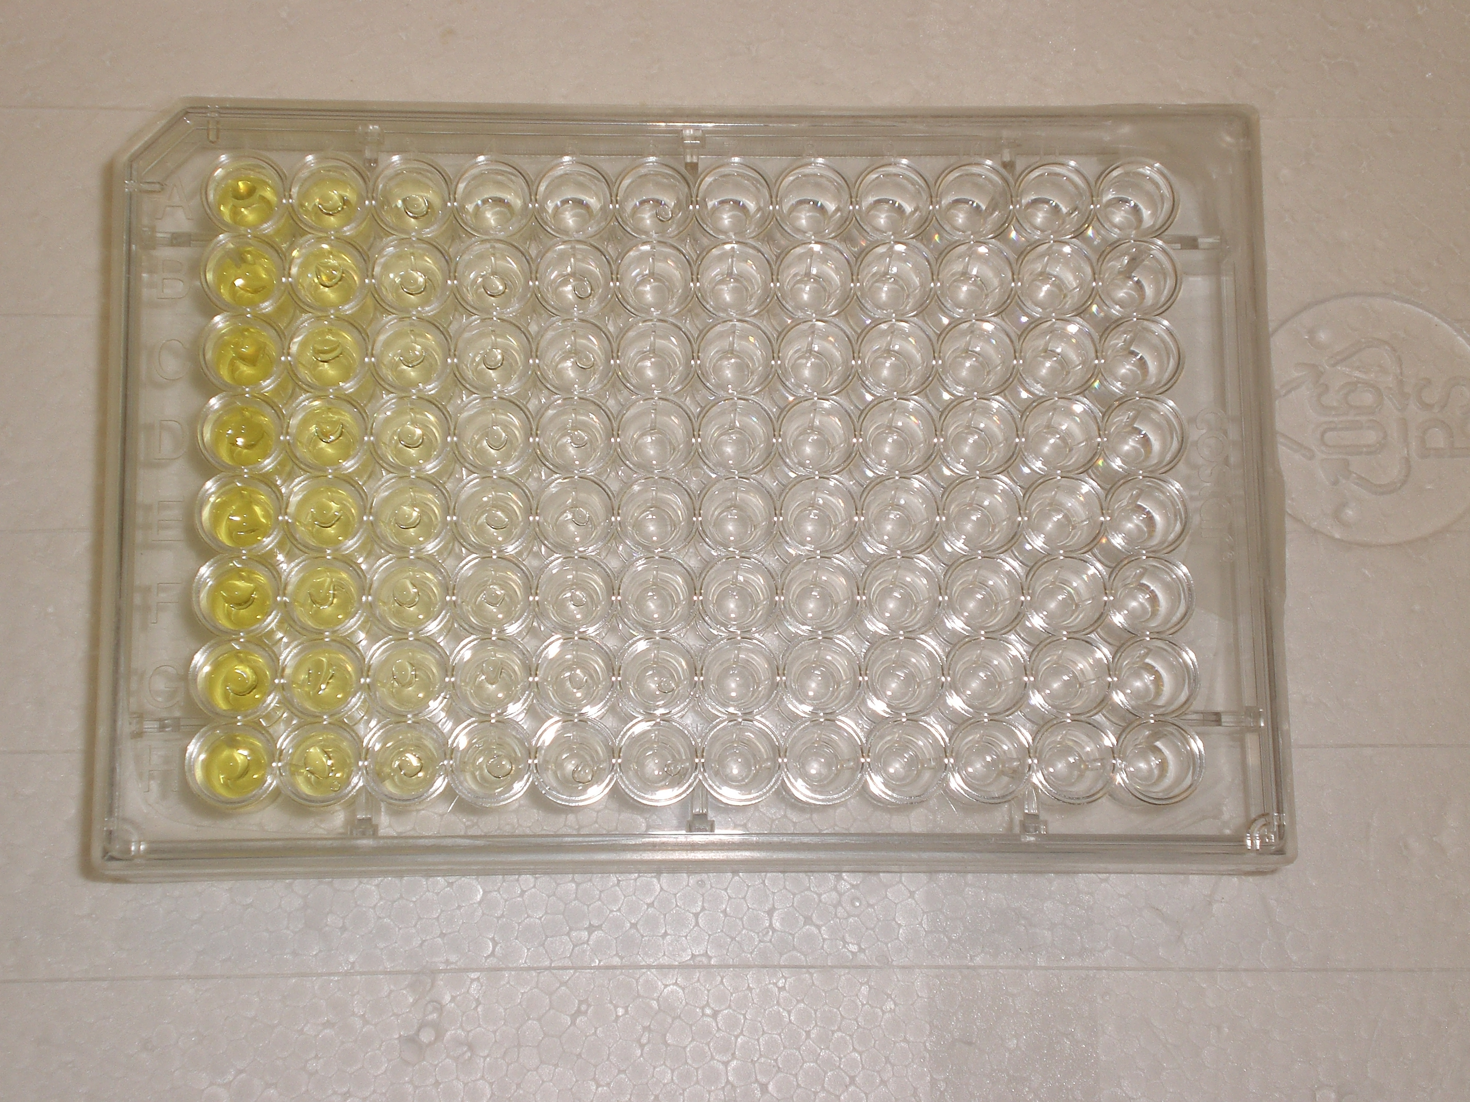
Enzymatic Assay or In-Situ Hybridization
Enzymatic assays – promoter leads to the production of a protein that then does some enzymatic action on the substrate which yields a product that can be visualized.
In-situ hybridization -

Slide 17
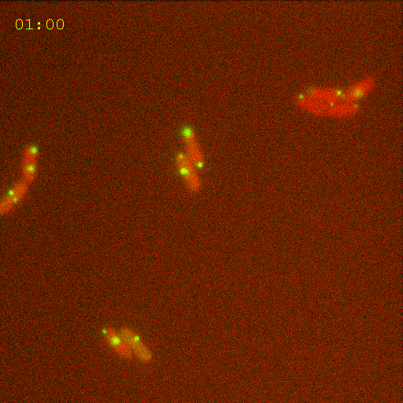
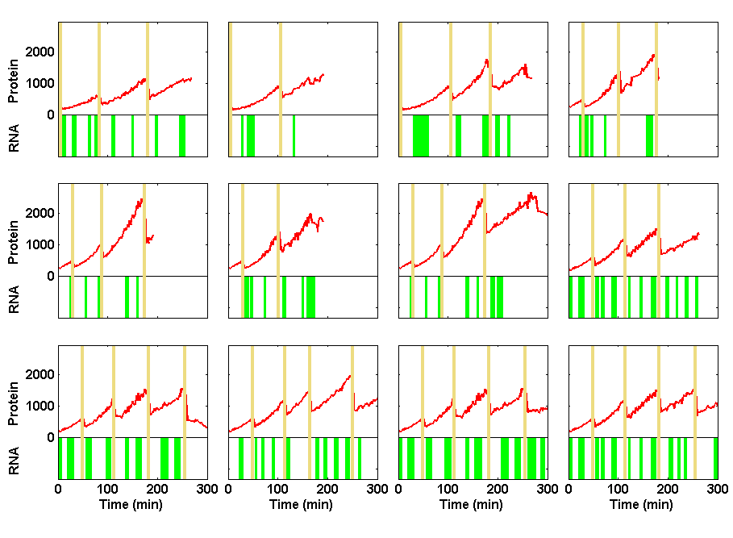
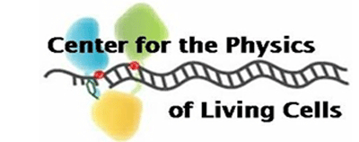

Information Processing in Living Cells:
Beyond First Approximations
Ido Golding
Department of Physics
Caltech 11/2008
Notes:
Movie: Zoom052004_031a
Figure: levels1 made by talk_plot_levels1 at singer/results

Slide 18
Simple Case of Turning a Gene “On”
s(t)
Stimulus (sugar)
t
r(t)
Response (RNA production)
t
Approximations used to describe the process…

Slide 19
Engineering bacteria to report on gene activity
(RNA-tagging protein;
in excess in the cell)
MS2-GFP
Gene of interest:
binding
P_{lac/ara}
RFP
96x MS2-bs
IPTG, arabinose
transcription
RNA target
translation
RFP protein
Golding et al., Cell (2005)

Slide 20
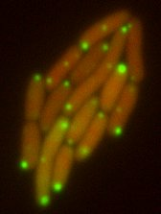
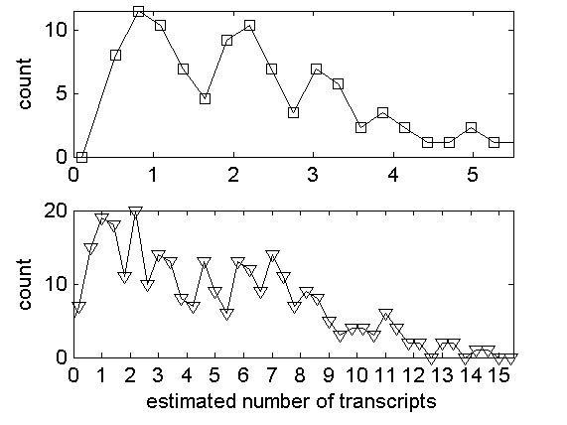
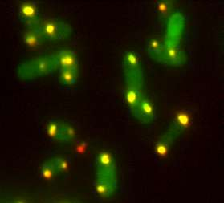
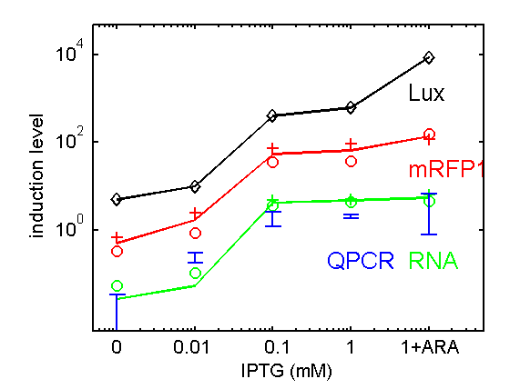
Measuring mRNA & protein numbers
mRNA ∝ number of bound MS2-GFPs
∝ photon flux from localized green fluorescence
Protein ∝ number of RFPs
∝ photon flux from whole-cell red fluorescence
Histogram of
RNA copy number:
1st peak =
inter-peak interval ≈
50-100 X GFP =
1 transcript
Controls:
FISH
Controls:
QPCR
Protein levels
Lux: Lutz & Bujard 1997
(Thanks to: A. Raj, A. van Oudenaarden)

Slide 21
RNA kinetics in individual cells
Distribution of on & off times
# mRNA vs time
Distribution of burst size

Slide 22
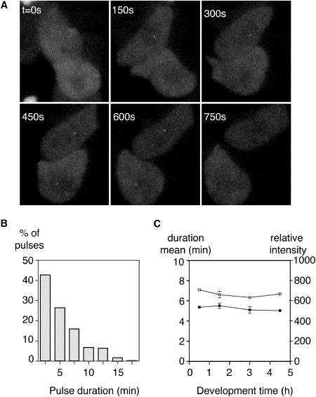
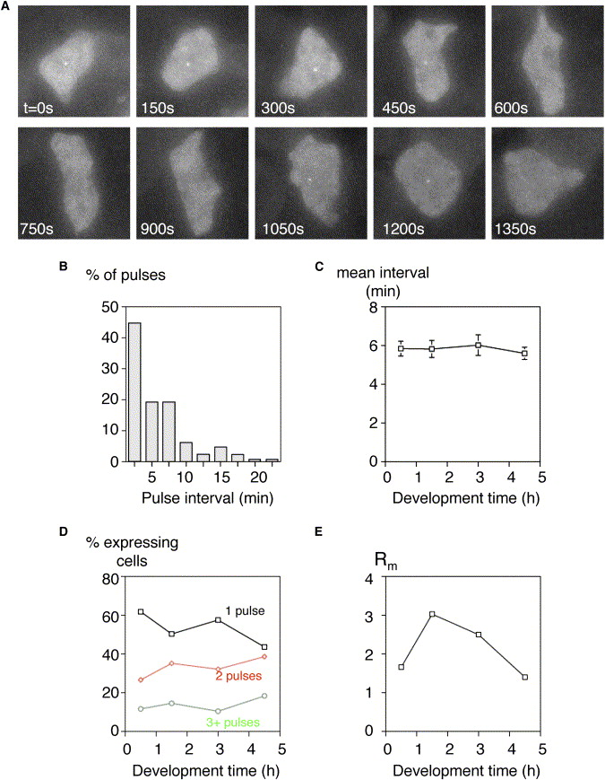
Transcriptional bursting in eukaryotes
Chubb JR, Trcek T, Shenoy SM, Singer RH. Curr. Biol. (2006)
See also: Golding & Cox, Curr. Biol. (2006)
Raj A, Peskin CS, Tranchina D, Vargas DY, Tyagi S, PLoS Biol. (2006)
“Stochastic mRNA Synthesis in Mammalian Cells”.

Slide 23
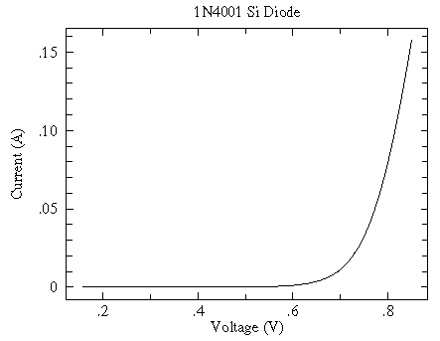
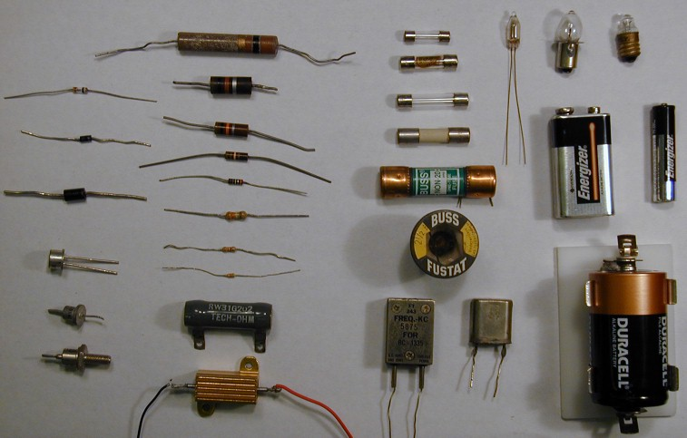
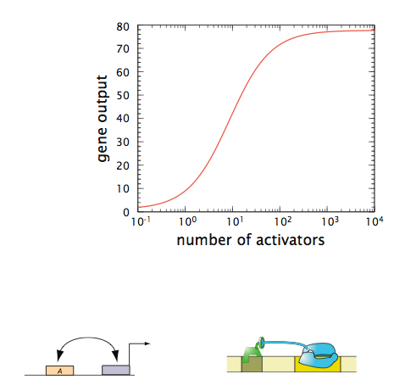
Input-Output Curves: An Analogy
Electronic Devices
http://www.physics.csbsju.edu/trace/CC.html
Regulatory Devices
How do we know the number of molecules controlling the decision?

Slide 24
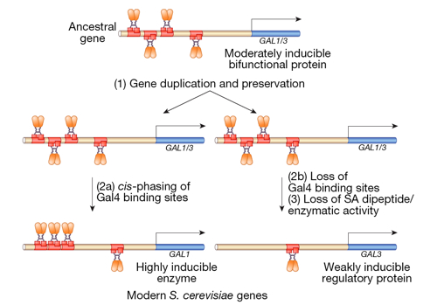
Yeast Care What They Eat Too - Galactose vs Glucose
Studies of the cultures of bacterial cells sufficed to lead Jacob and Monod to formulate the operon concept - the revolutionary view that there are certain genes whose mission is to control other genes.
Amusing aside: both of the examples from Jacob and Monod involve DNA looping, a form of biochemistry on a leash.
(Berman et al.)
Notes:
Anﾊintriguing aspect of multicellular organisms is the fact that there are a wide variety of different cell types, this despite the fact that each and every cell carries the same genetic information.ﾊ ﾊOne of the key mechanisms giving rise to distinct cellular identities is particular ``decisions'' that are made about which genes to express at different times and places in an organism's history.ﾊ Interestingly, decision making is not restricted to multicellular organisms, nor even to eukaryotic cells.ﾊ Indeed, the modern theory of gene regulation was born out of efforts to understand how bacterial cells decide which sugars to utilize at any given time.ﾊ In this talk, I will describe the ways in which statistical mechanics can be used to examine the regulatory processes that take place in the lives of cells.ﾊ These simple models result in surprising predictions and I will also describe our experimental efforts to probe this rich behavior both in test tubes and in living cells.ﾊ

Slide 25
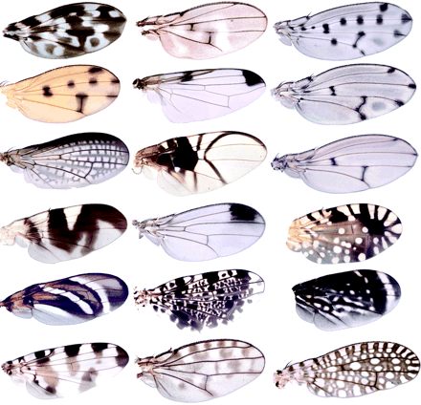
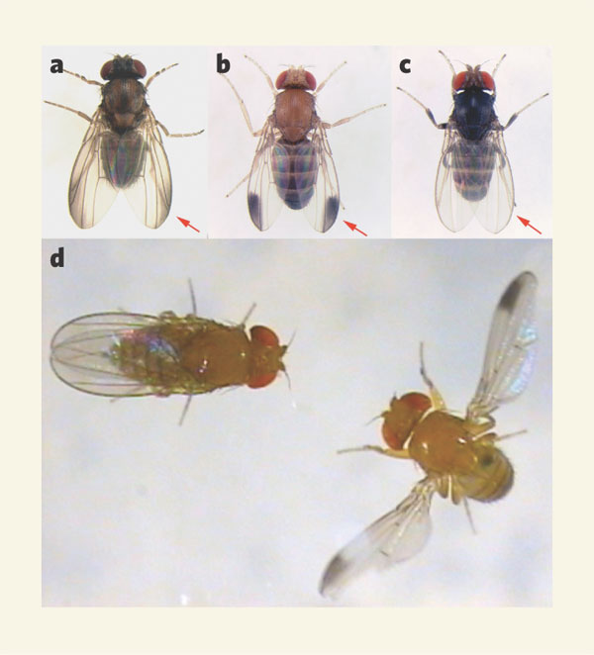
Chance Caught on a Wing: Decision Making and Evolution
Concept: study of wing patterns of gene expression a model system for probing how genes are deployed in space and time and, more importantly, a particular evolutionary mechanism.
The concept: compare different species of fly that have different patterns on their wings.
The conclusion: Not changes in the proteins themselves, just changes in the decision about which genes are turned on or off.
(Berman et al.)
(Prud’homme, Gompel and Carroll, PNAS, 2007)
(Wray, Nature, 2006)

Slide 26
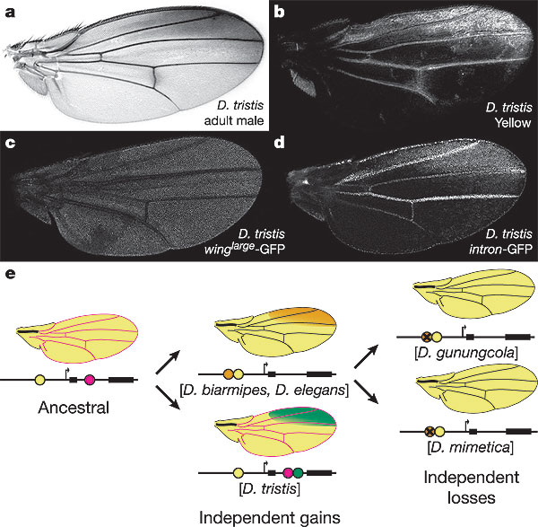
Chance Caught on a Wing: Decision Making and Evolution
This figure illustrates how the regulatory genome changes over evolutionary time.
Physical question that remains as fun challenge: what is the mechanism of action at a distance?
(Prud’homme, Gompel and Carroll, et al., Nature, 2006)
(Berman et al.)
DNA molecules as “documents of evolutionary history” - these sequences are a stopwatch!

Slide 27
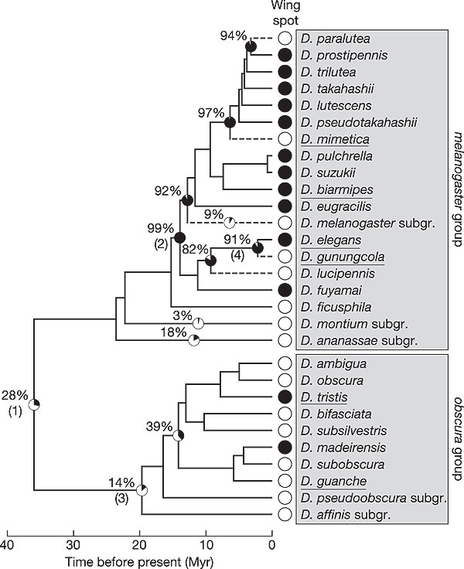
Chance Caught on a Wing: Decision Making and Evolution
Molecules as “documents of evolutionary history” can be used to examine relatedness of flies.
(Berman et al.)
(Prud’homme, Gompel and Carroll, et al., Nature, 2006)
Notes:
Carroll: 1) wings are a great MODEL for regulatory evolution since they can be studied in closely related species, 2) pigmentation results from the deposition of pigments after conversion of precursor metabolites into pigments locally by several enzymes.

Slide 28
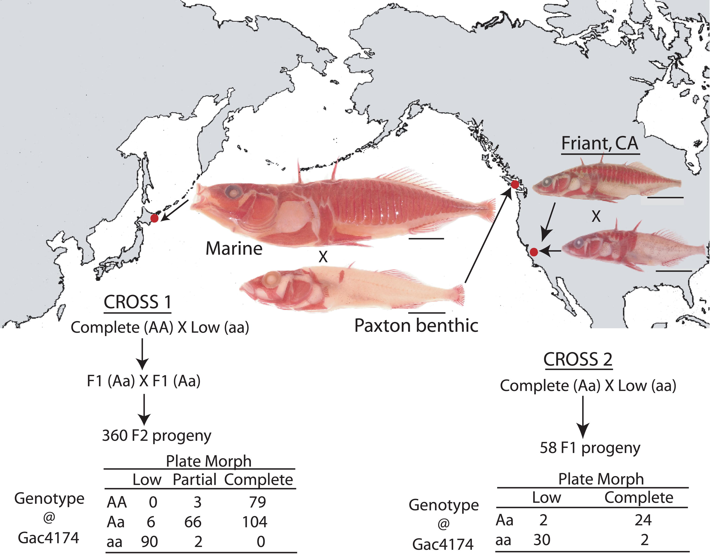
Fun Case Studies: Changes in Body Plan in Fish
Stickleback fish separated after last ice age more than 10,000 years ago.
Morphologically, fresh water and salt water versions all differ. Some of the interesting features include pelvic reduction and the nature of their armor.
Fantastic conclusion - changes not necessarily induced by changes in protein coding regions.
These studies merge genetics with molecular analysis and evolutionary biology. Stunning window onto how novelty is generated in body plans.
David Kingsley group, Stanford University

Slide 29
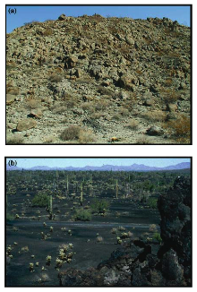
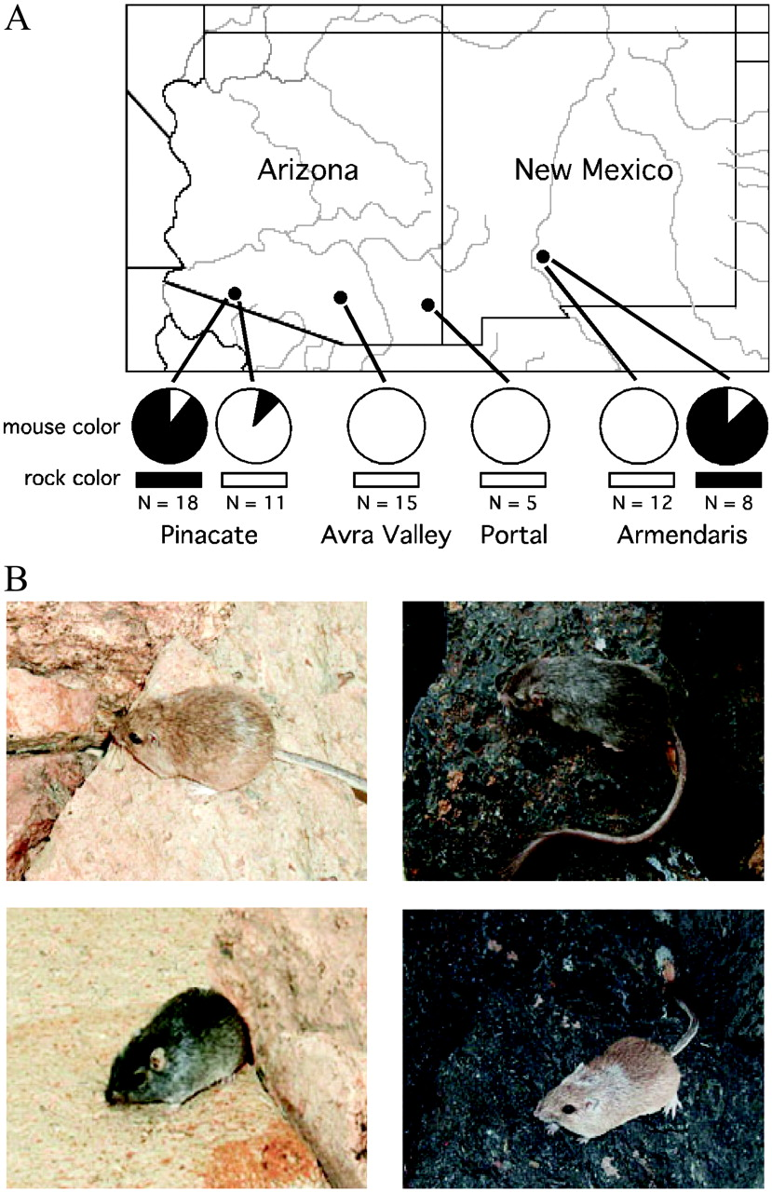
The Ingredients of Evolution: Natural Selection
If the offspring have different success (``fitness’’), they will yield more offspring and will drive the population in new directions.
An exciting and concrete case study is that of the rock pocket mouse, some of which live on lava rock and are most often dark colored.
Modest changes in a receptor protein suffice to change the color. Recurring theme!
PNAS | April 29, 2003 | vol. 100 | no. 9 | 5268-5273
Notes:
The claim made in the case of these mice is that there is a strong selective pressure resulting from predation. Mice with the “right” color have a better chance of not being eaten by predatory owls. The particular difference has to do with mutations in the melanocortin-1 receptor.

Slide 30
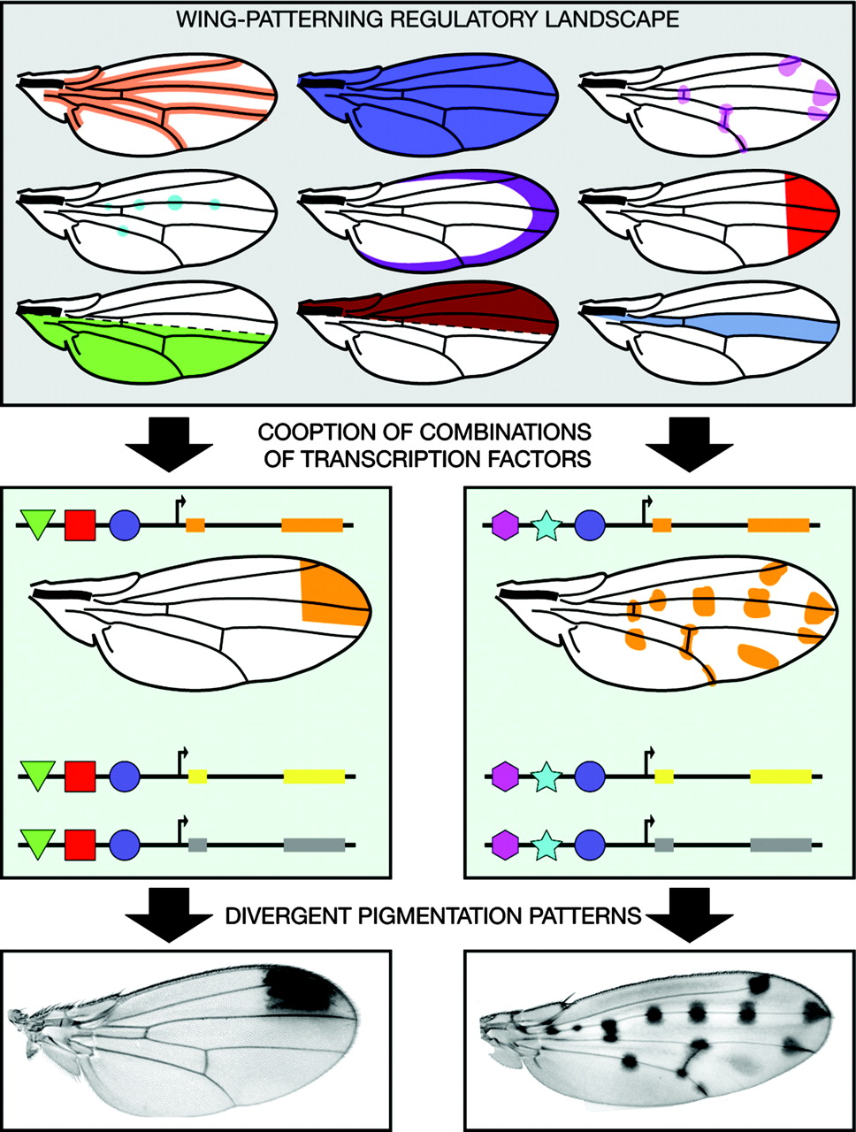
Chance Caught on a Wing: Decision Making and Evolution
(Prud’homme, Gompel and Carroll, et al., Nature, 2006)
(Prud’homme, Gompel and Carroll, PNAS, 2007)
(Berman et al.)
DNA molecules as “documents of evolutionary history” - these sequences are a stopwatch!

