Slide 1
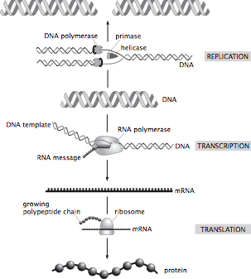
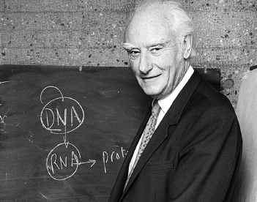
The Central Dogma of Molecular Biology: How Genes Lead to Proteins
Crick and others mused over the ``two great polymer languages’’.
Central dogma explains the chain of events relating them.
The ribosome is the universal translating machine that speaks both languages.
We have seen what genes are and how they serve as the informational memory of organisms. But we have NOT said how they are controlled.
(Berman et al.)
Now we have the background to tackle the question we started with: how do cells make decisions?

Slide 2
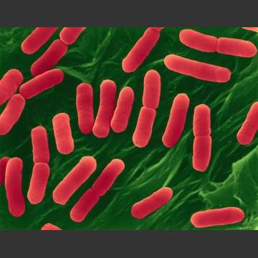
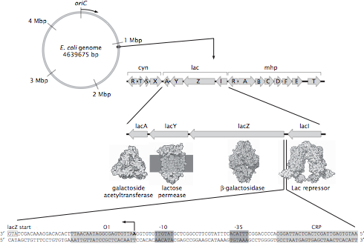
Not All DNA Codes for Proteins
The E. coli genome is a circle with roughly 4.7 million base pairs.
How many genes? An estimate.
The genes related to sugar usage have been one of the most important stories in the history of modern biology and biochemistry (and take us right back to the great debate on vitalism played out with Pasteur in the 1800s).
“Promoter” region on DNA is subject to intervention by various molecular bouncers that govern the gene.
(Berman et al.)
The regulatory landscape

Slide 3
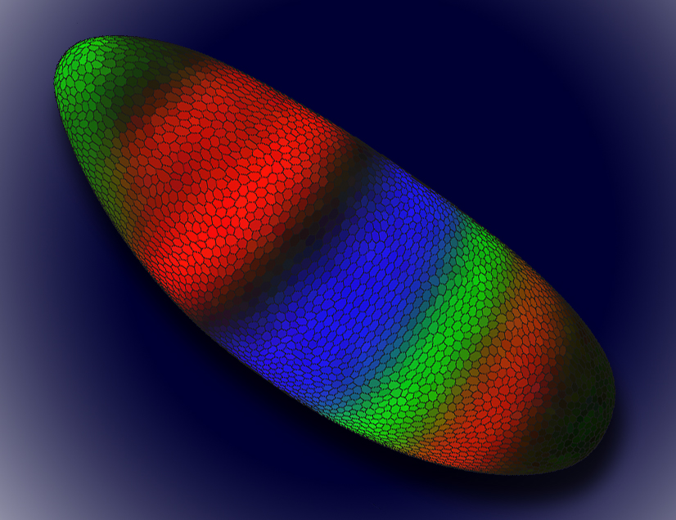
Ways to Measure Gene Expression
Basic point: looking for “reporters” of the level of expression of gene of interest.
Can ask the system to report on the level of gene expression at various steps in the processes linking DNA to active protein.
Promoter occupancy, level of mRNA, level of active protein.
http://www.lbl.gov/Science-Articles/Archive/sabl/2008/Feb/genome-mystery.html
This image shows a Drosophila embryo colored to show the expression patterns of early gene regulators. Each color represents the level of expression of one of three gene regulators, Knirps (green), Kruppel (blue), and Giant (red). Color intensity reflects a higher level of expression. The darker areas of the embryo are cells where none of these gene regulators are expressed, and the yellowish areas indicate that both Knirps and Giant are being expressed.

Slide 4
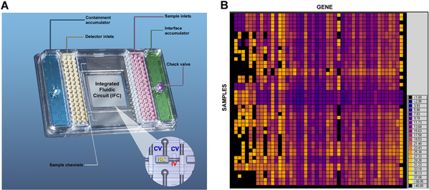
Count the Messenger RNA Molecules

Slide 5
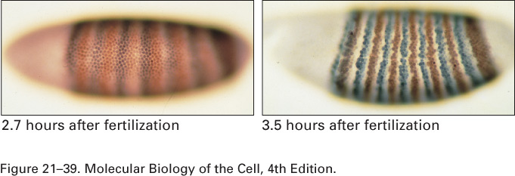
Enzymatic Assay or In-Situ Hybridization
Enzymatic assays – promoter leads to the production of a protein that then does some enzymatic action on the substrate which yields a product that can be visualized.
In-situ hybridization – described the other day – probe is complementary to the RNA of interest and is labelled for detection.

Slide 6
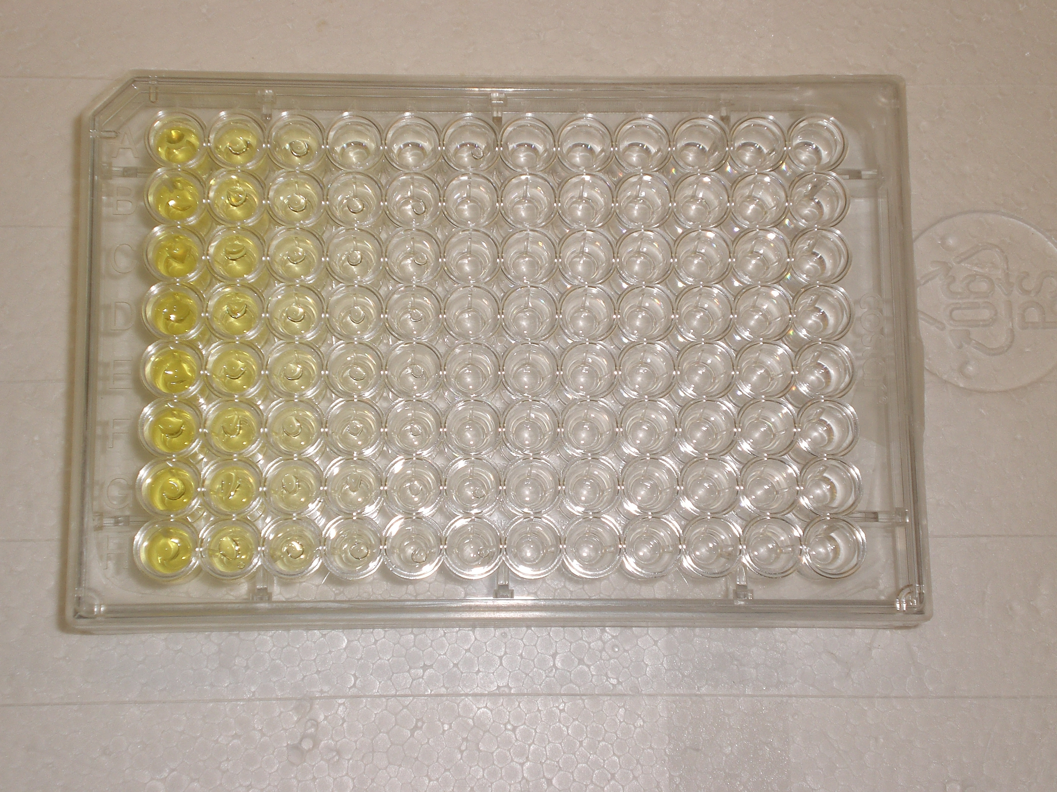
Enzymatic Assay or In-Situ Hybridization
Enzymatic assays – promoter leads to the production of a protein that then does some enzymatic action on the substrate which yields a product that can be visualized.
In-situ hybridization -

Slide 7
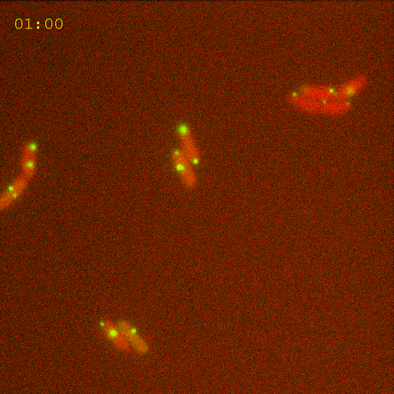
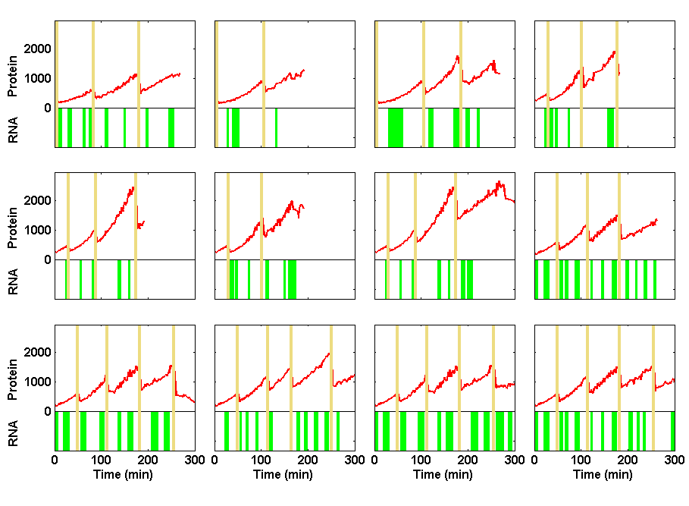


Information Processing in Living Cells:
Beyond First Approximations
Ido Golding
Department of Physics
Caltech 11/2008
Notes:
Movie: Zoom052004_031a
Figure: levels1 made by talk_plot_levels1 at singer/results

Slide 8
Simple Case of Turning a Gene “On”
s(t)
Stimulus (sugar)
t
r(t)
Response (RNA production)
t
Approximations used to describe the process…

Slide 9
Engineering bacteria to report on gene activity
(RNA-tagging protein;
in excess in the cell)
MS2-GFP
Gene of interest:
binding
P_{lac/ara}
RFP
96x MS2-bs
IPTG, arabinose
transcription
RNA target
translation
RFP protein
Golding et al., Cell (2005)

Slide 10
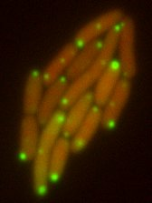
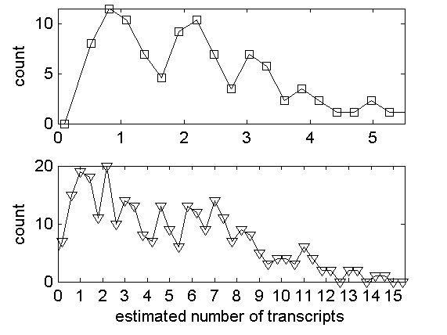
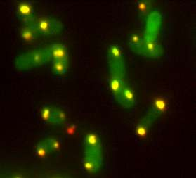
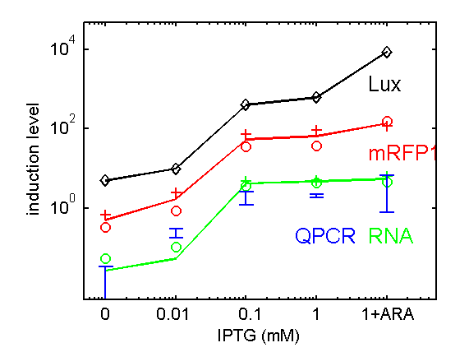
Measuring mRNA & protein numbers
mRNA ∝ number of bound MS2-GFPs
∝ photon flux from localized green fluorescence
Protein ∝ number of RFPs
∝ photon flux from whole-cell red fluorescence
Histogram of
RNA copy number:
1st peak =
inter-peak interval ≈
50-100 X GFP =
1 transcript
Controls:
FISH
Controls:
QPCR
Protein levels
Lux: Lutz & Bujard 1997
(Thanks to: A. Raj, A. van Oudenaarden)

Slide 11
RNA kinetics in individual cells
Distribution of on & off times
# mRNA vs time
Distribution of burst size

Slide 12
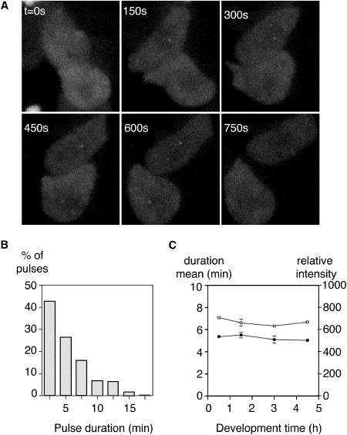
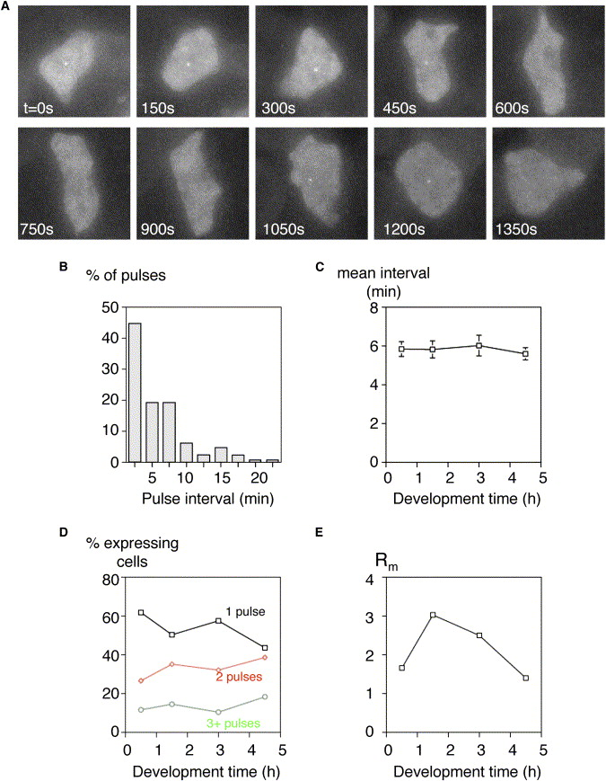
Transcriptional bursting in eukaryotes
Chubb JR, Trcek T, Shenoy SM, Singer RH. Curr. Biol. (2006)
See also: Golding & Cox, Curr. Biol. (2006)
Raj A, Peskin CS, Tranchina D, Vargas DY, Tyagi S, PLoS Biol. (2006)
“Stochastic mRNA Synthesis in Mammalian Cells”.

Slide 13
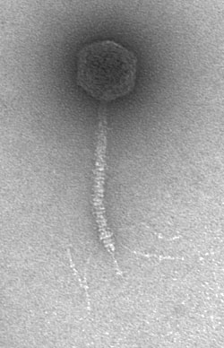
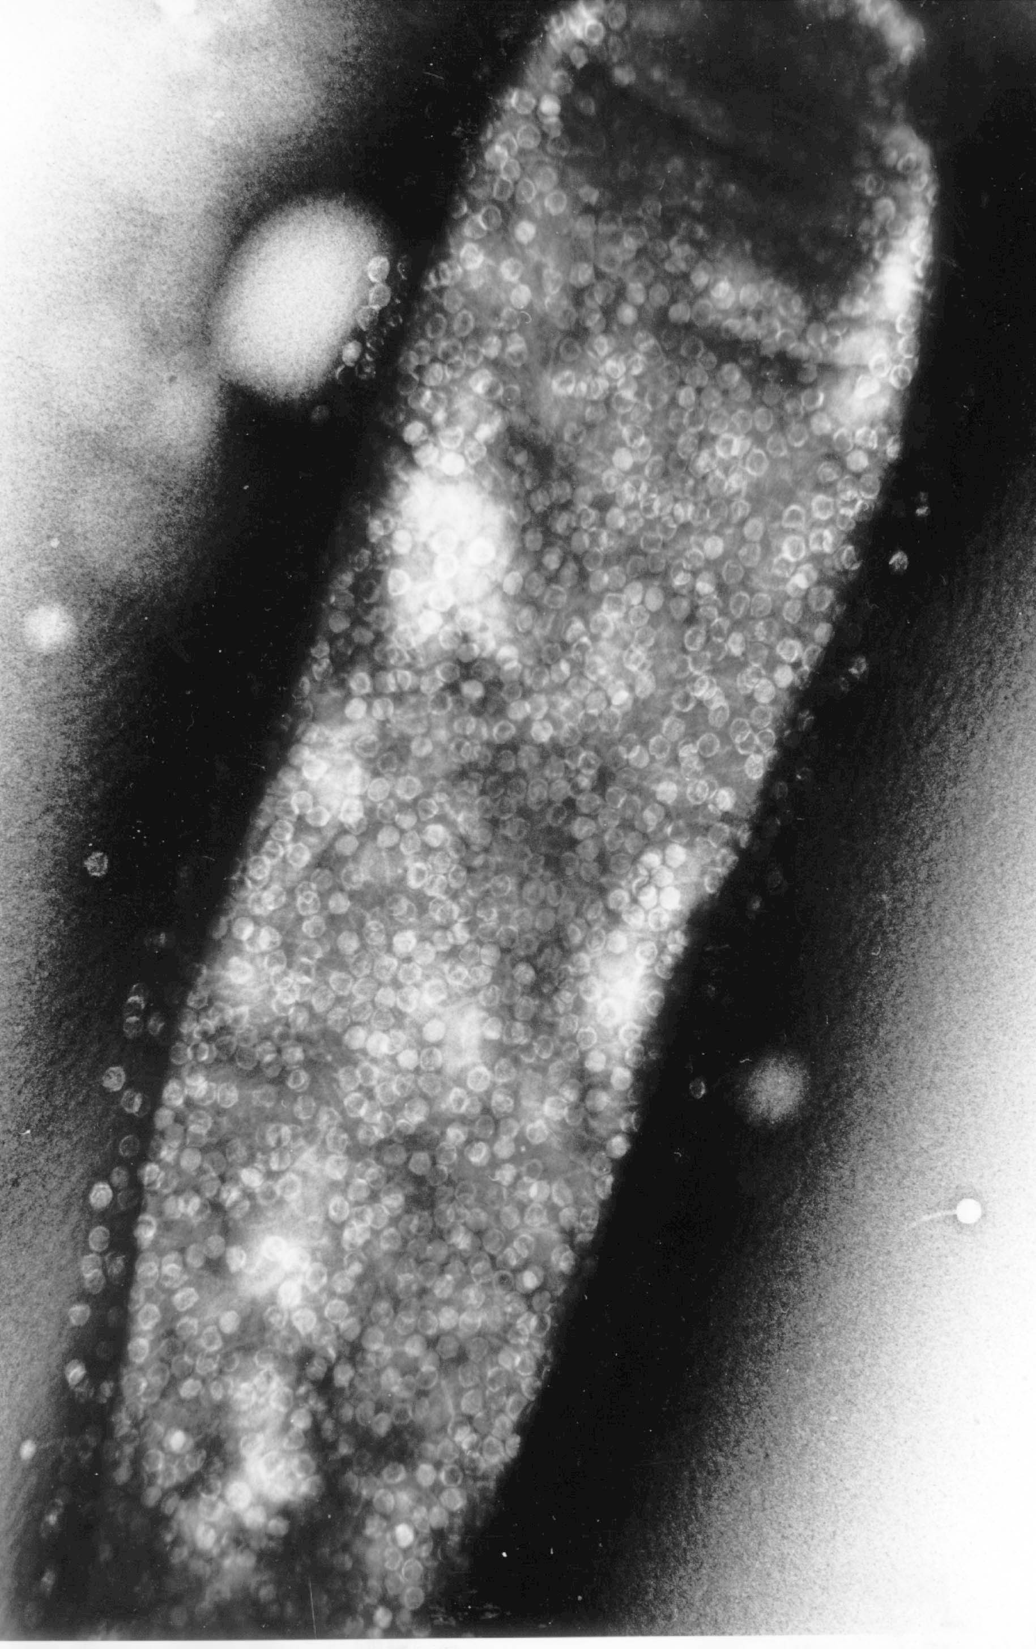
The Lambda Switch: The Other Hydrogen Atom of Gene Regulation
Roger Hendrix

Slide 14
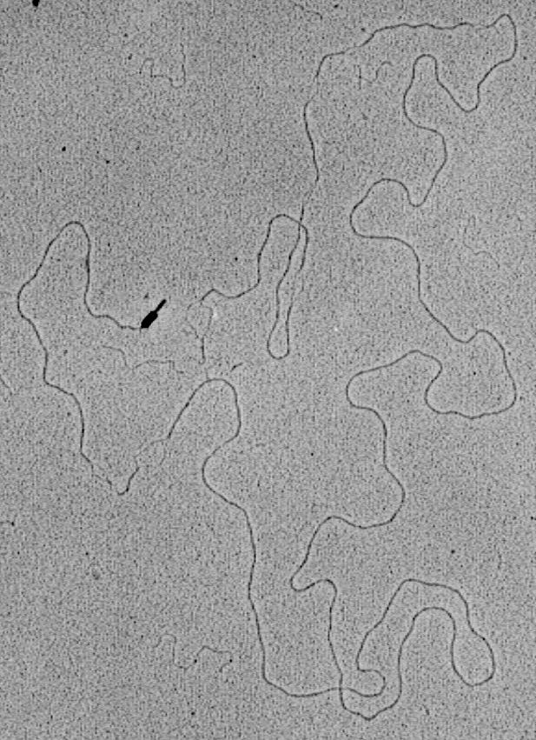
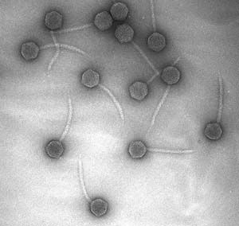
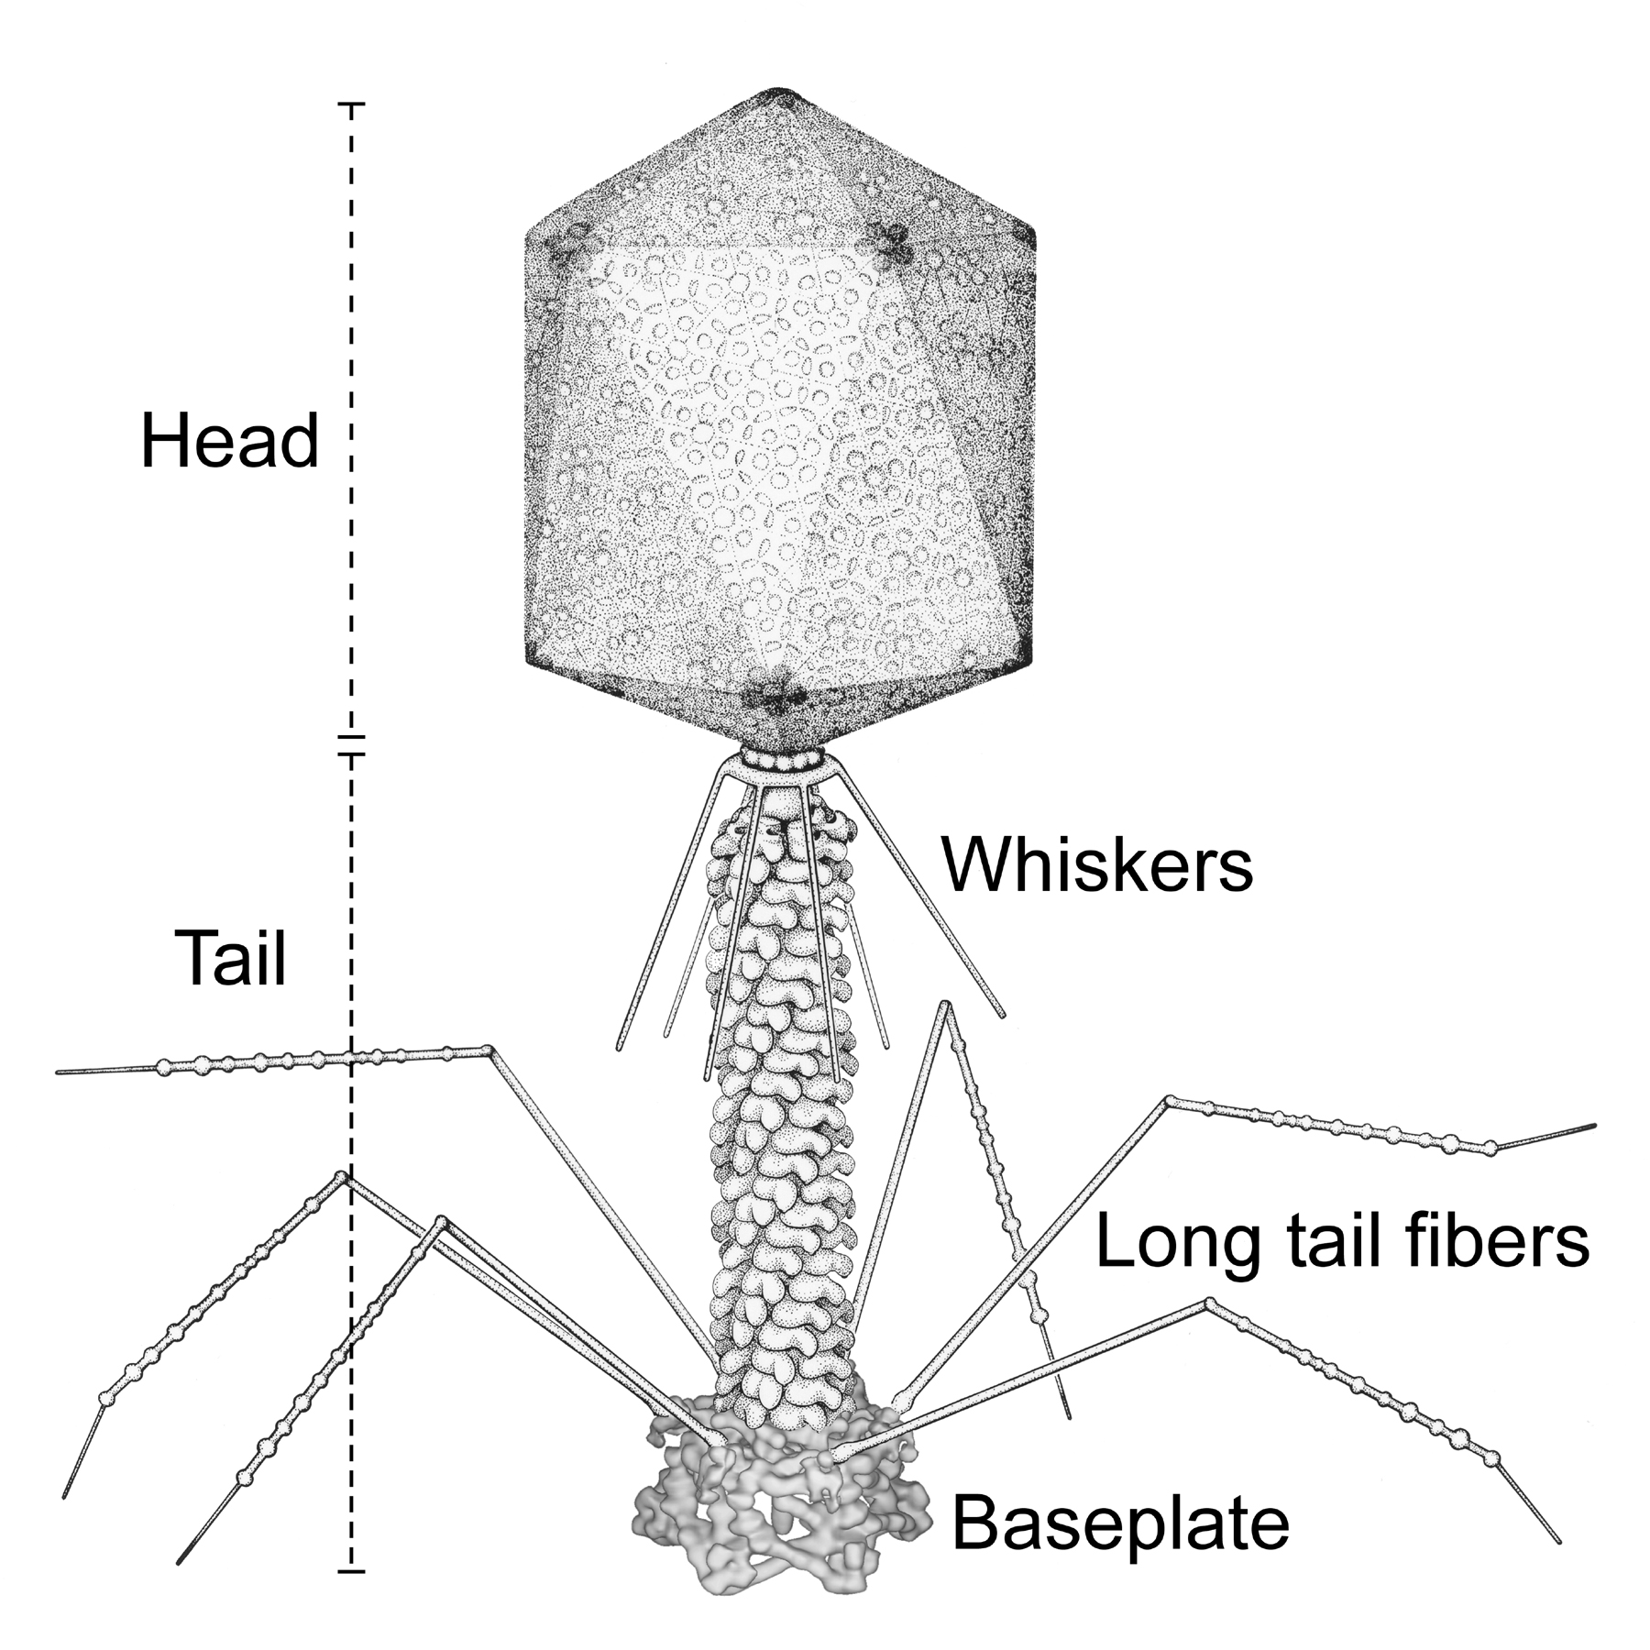
Bacteriophage and Their Genomes
http://www.biochem.wisc.edu/inman/empics/0020b.jpg

Slide 15
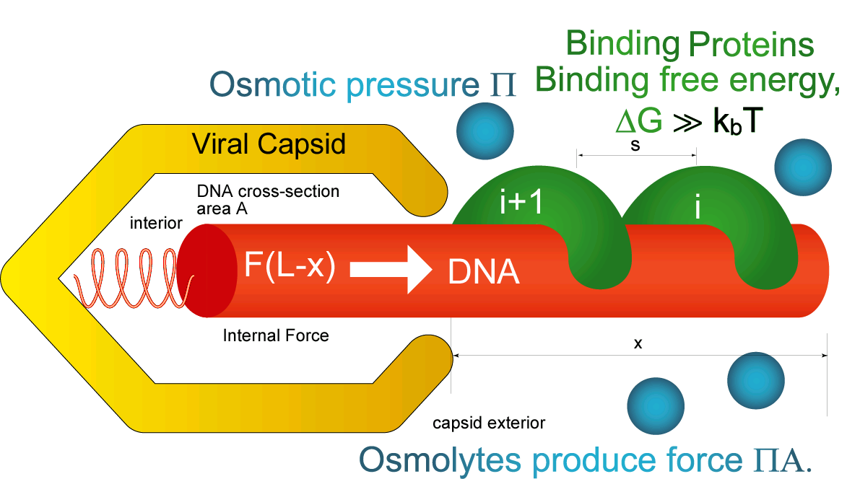
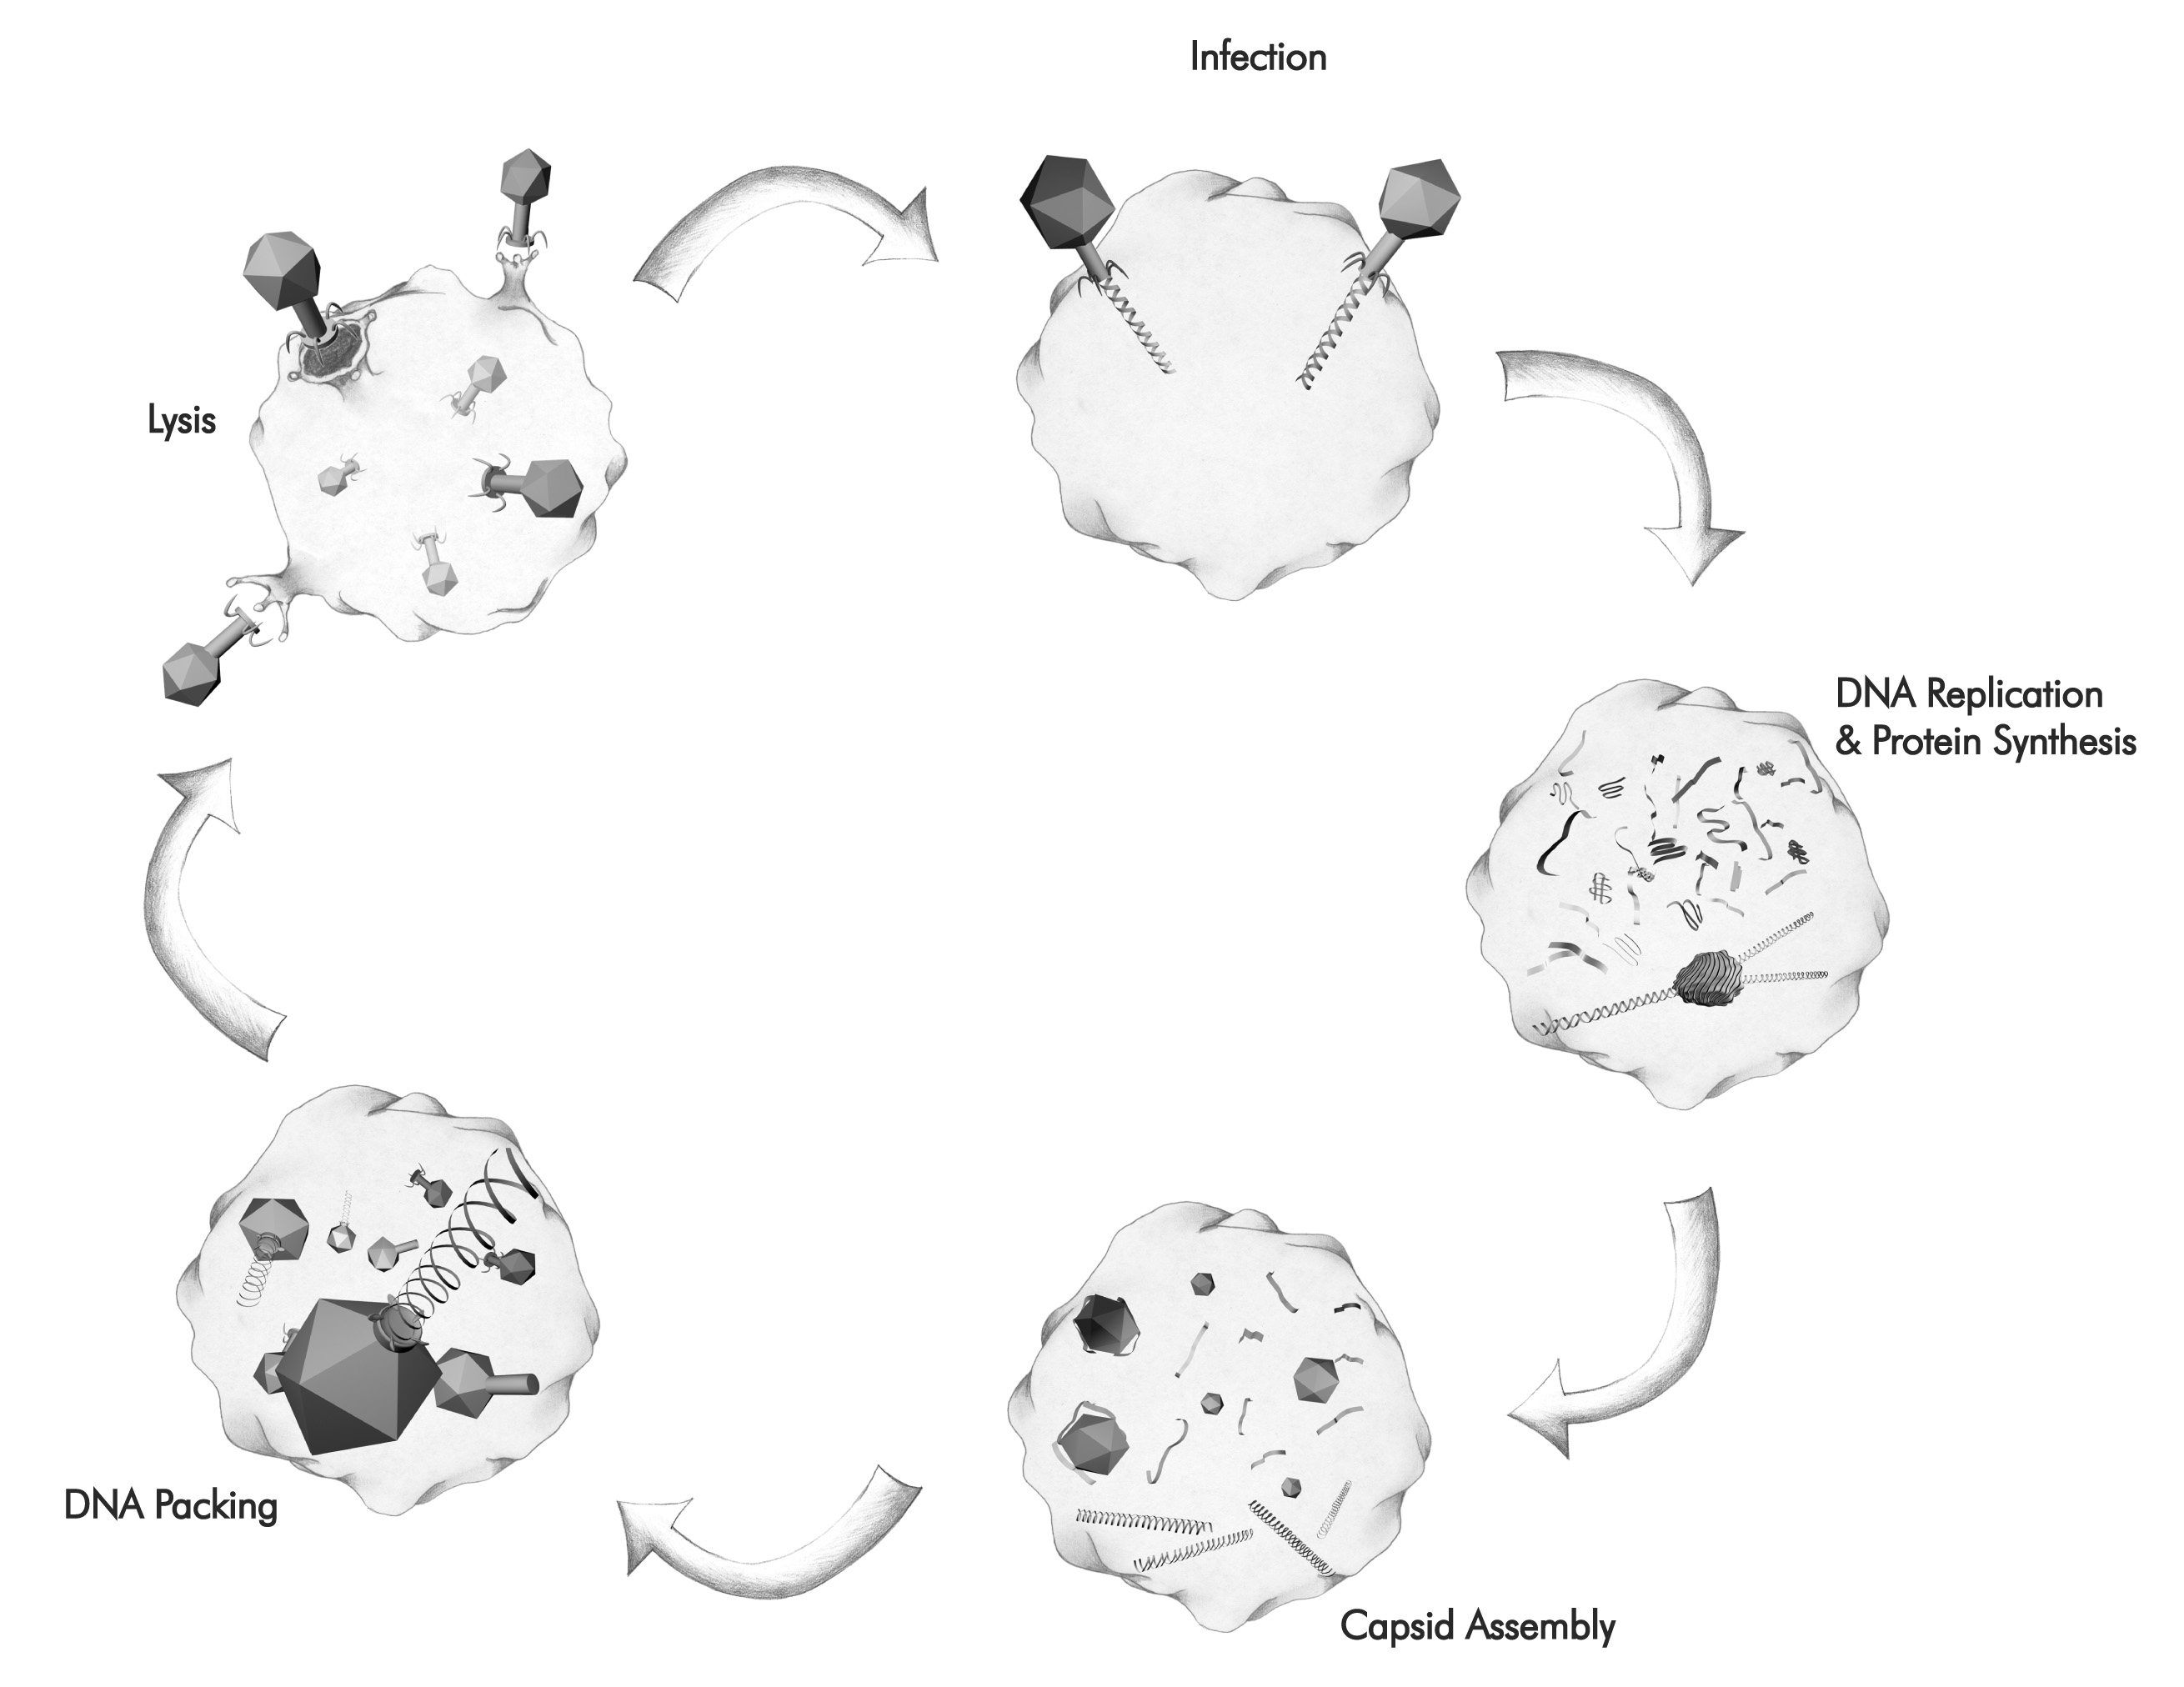
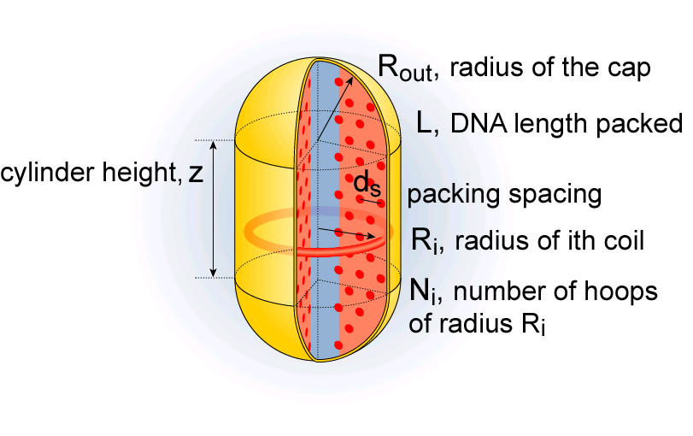
Physical Consequences of the Tight Squeeze in the Life Cycle of a Bacteriophage
Rate of ejection: ≈ 100 - 1000bp/sec
Forceful ejection
Construct a physical
model of these processes.
Rate of packing: 100bp/sec
“Some assembly required”
Self-assembly
Notes:
Case study # 1: life cycle of bacteriophage (and Herpes?) – my key point is that tightly packed DNA figures centrally in the life style of bacterial viruses.

Slide 16
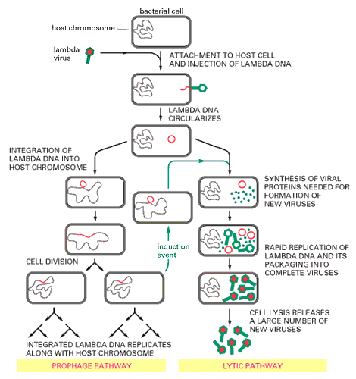
The Life Cycle of Bacteriophage Lambda

Slide 17
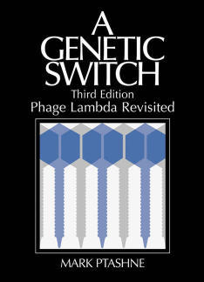
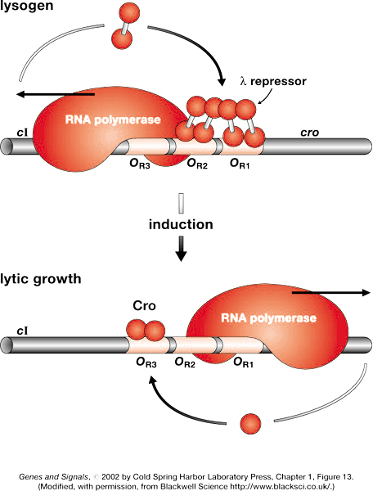
A Genetic Switch

Slide 18
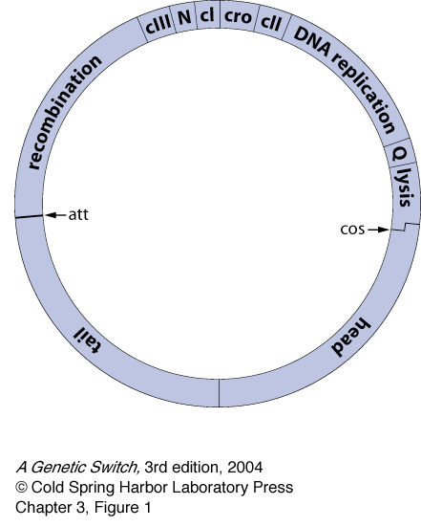
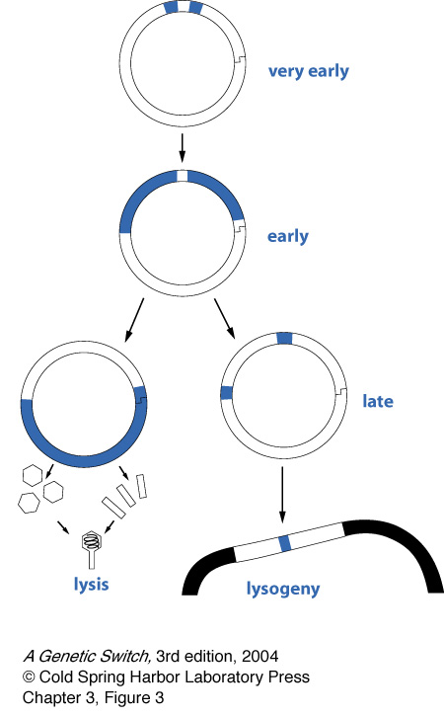
The Lambda Genome

Slide 19
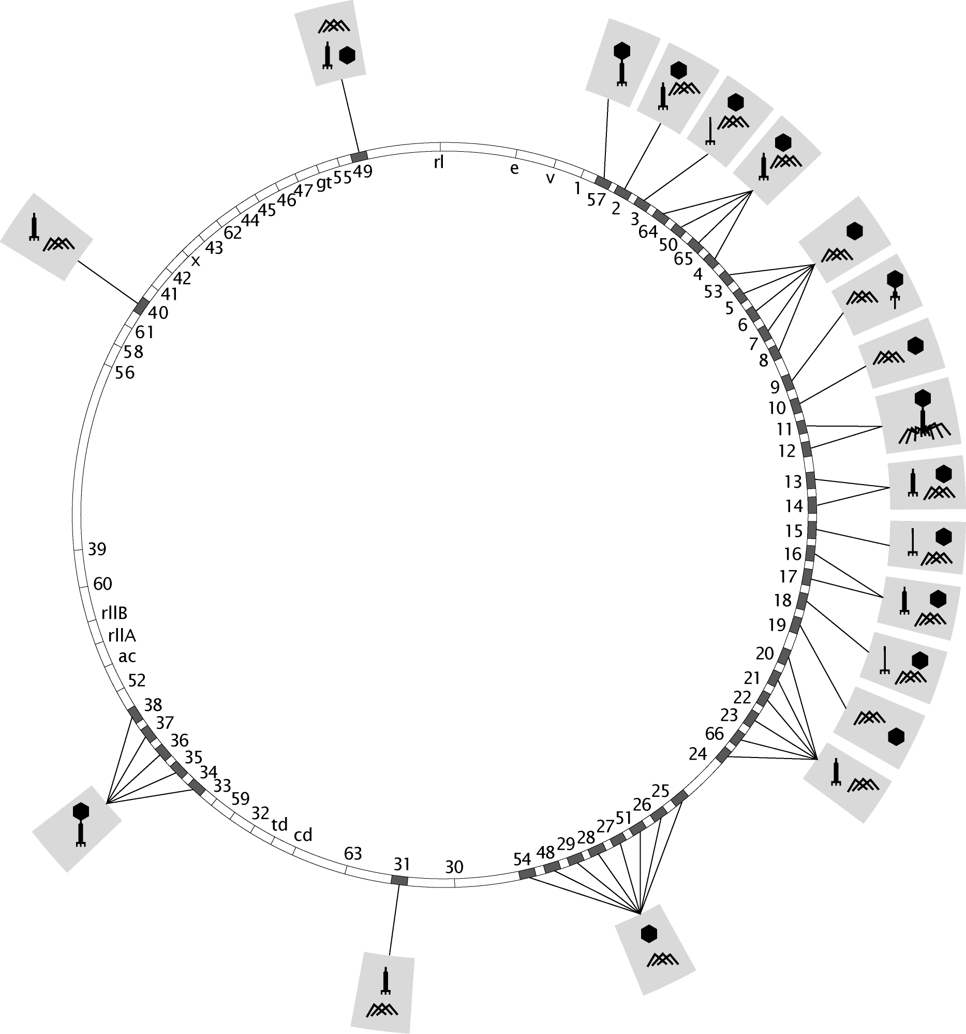
A More Detailed Example of the Parrts List

Slide 20
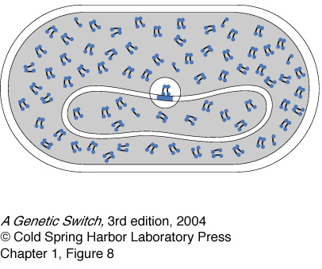
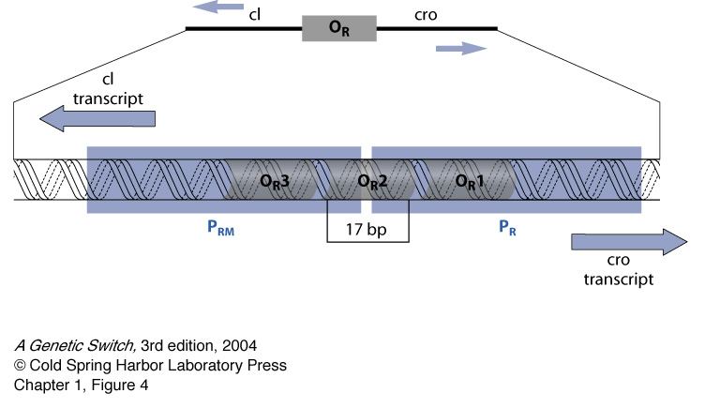
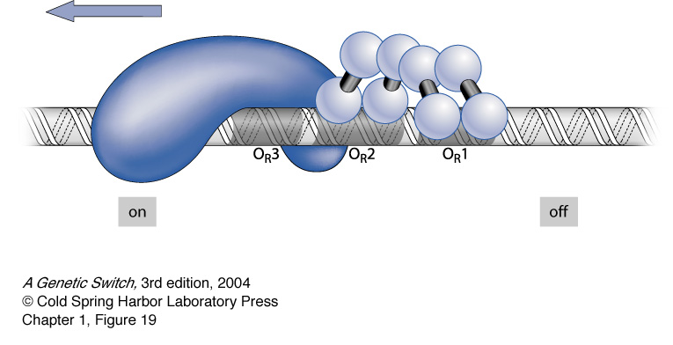
The Lambda Switch: Lysogenic State

Slide 21
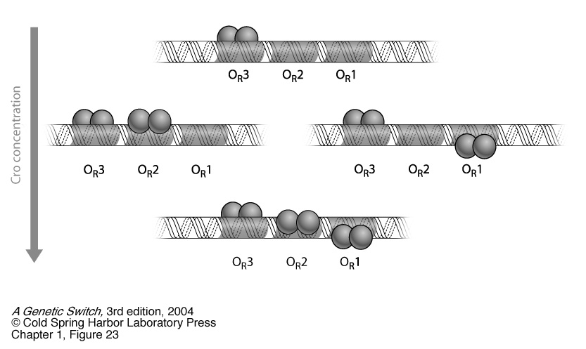
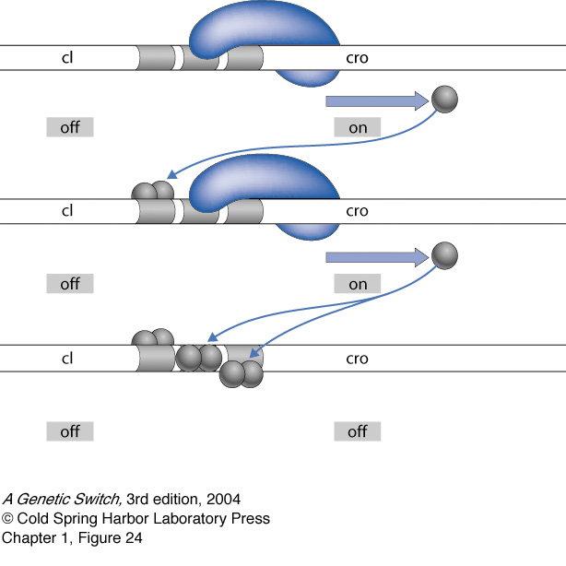
The Lambda Switch: Lytic State

Slide 22
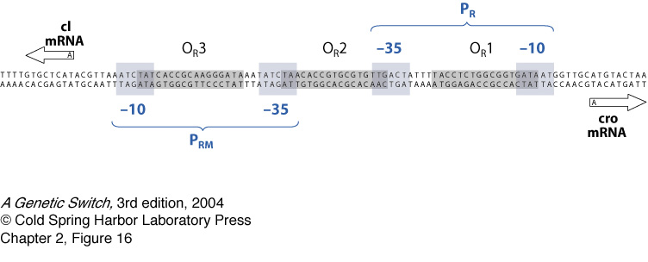
DNA Geography of the Switch

Slide 23
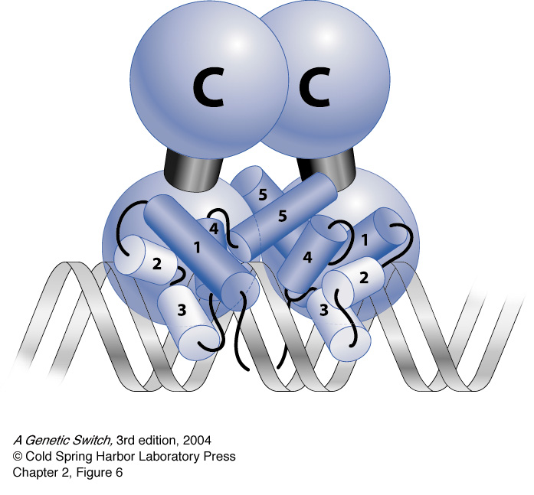
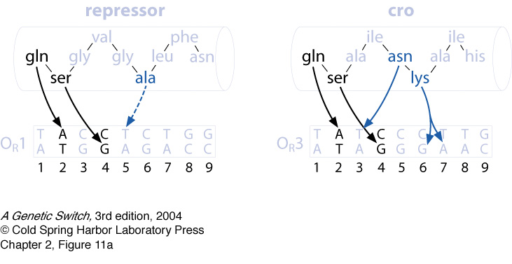
Binding of Transcription Factors

Slide 24
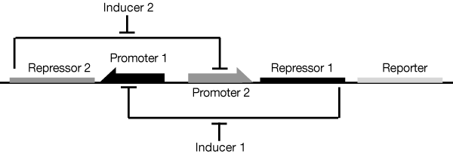
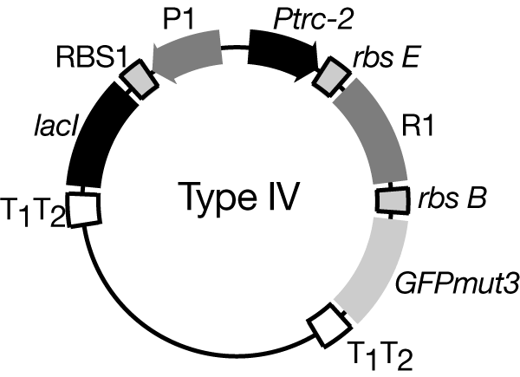
Synthetic Genetic Switch
Collins et al. - see course website

Slide 25
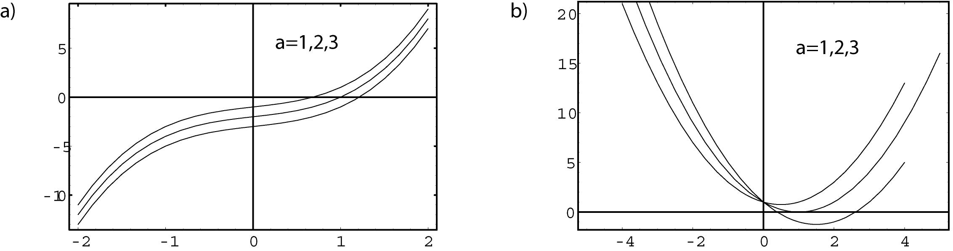
Stable Solutions

Slide 26
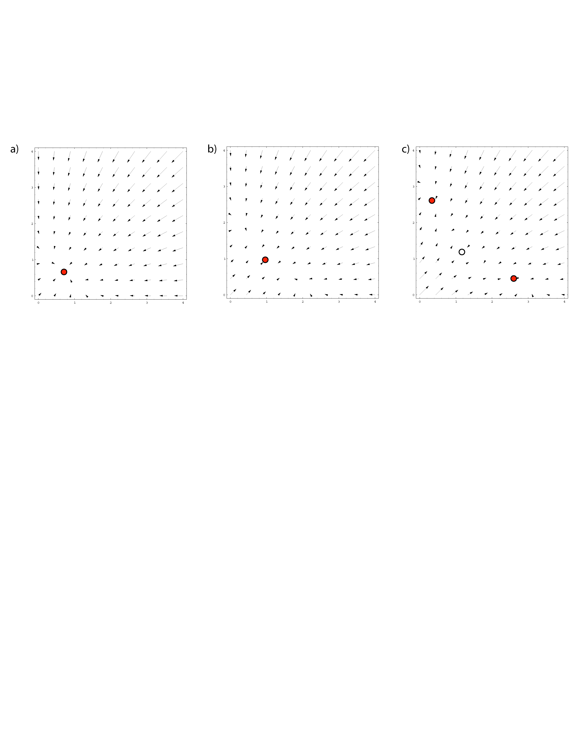
Phase Portrait for the Switch

Slide 27
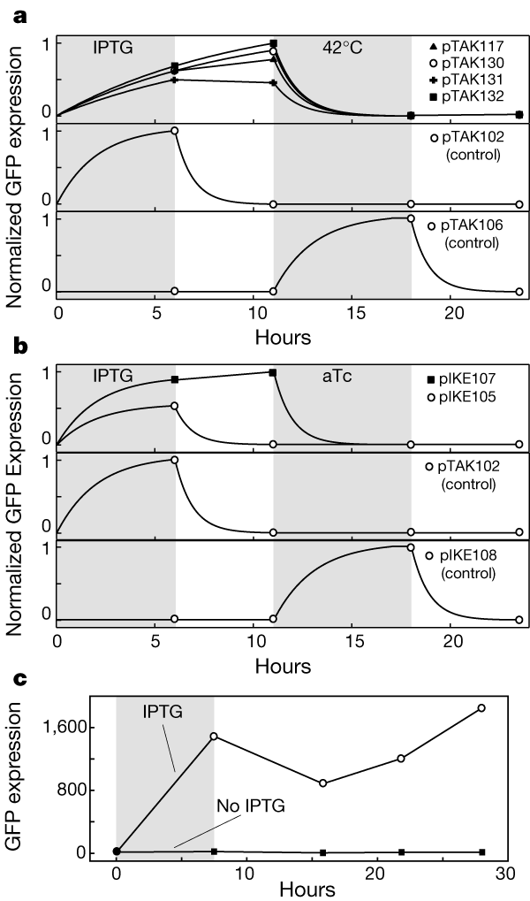
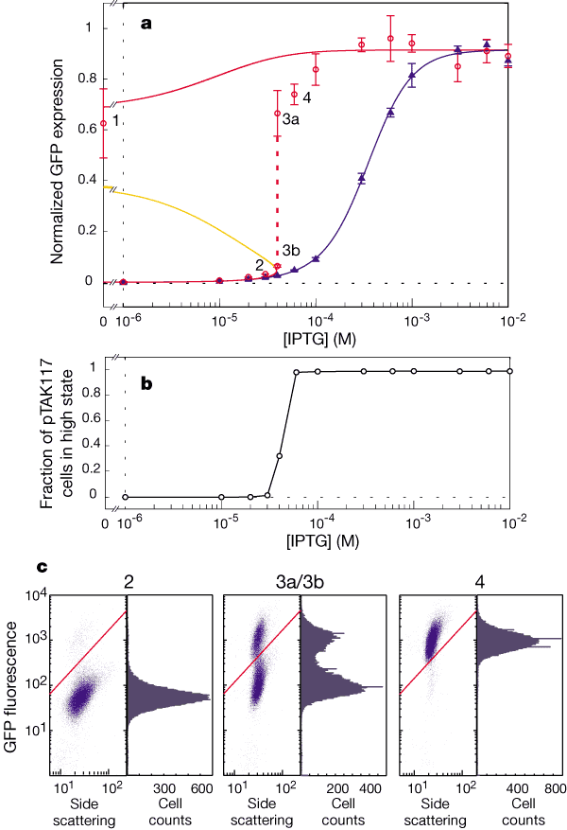
Synthetic Genetic Switch
Collins et al. - see course website

Slide 28
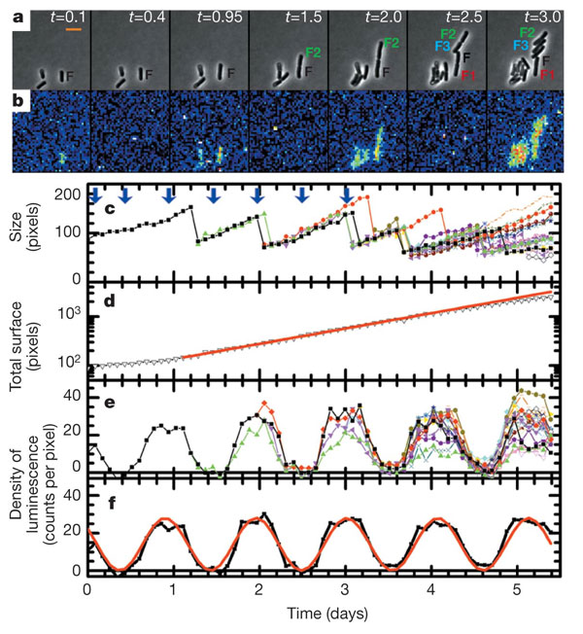
Gene Expression in Cyanobacteria
(Mihalcescu, Hsing, Leibler, Nature 2004)
a, Snapshots of phase-contrast image showing cell F and its progeny and b, related bioluminescence image at different times t (given in days, a 24 h period of time) from the beginning of the measurement. Pixels in the bioluminescence images were binned 3 times 3 (pseudo-colour, where red is high signal intensity and blue is low signal intensity). Scale bar, 5 microm. c, The size of the cell F and all its progeny as a function of time measured from the phase-contrast images (non-binned pixels). The arrows point to the time where the snapshots in (a) and (b) were taken. d, The total number of pixels occupied by F and its all progeny versus time (black line) plotted in a logarithmic scale. The red line is the corresponding exponential growth fit: total size (t) = initial size times 2t/tau with tau = 23.04 plusminus 0.17 h. e, Density of bioluminescence for the same cell and all its progeny versus time. f, The average density of bioluminescence versus time (black line) and its fit (red line) with: left fenced(t)right fence = B + A cos(2pit/T0 + phi0). The resulting period is T0 = 25.4 plusminus 0.12 h, the initial phase phi0 = 52 plusminus 2.8°, the amplitude A = 12.9 plusminus 0.3 counts per pixel and the offset B = 14.8 plusminus 0.3 counts per pixel.

Slide 29
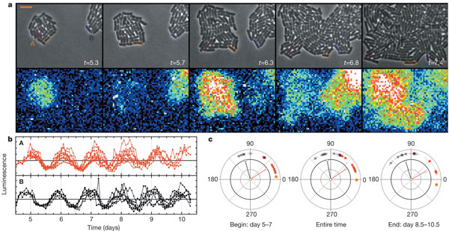
Gene Expression in Cyanobacteria
(Mihalcescu, Hsing, Leibler, Nature 2004)
a, Upper part shows the phase-contrast snapshots of colonies A and B; lower part shows the related bioluminescence images. Scale bar, 5 microm. b, Normalized density of bioluminescence of individual cyanobacterial cells. Each colour corresponds to the progeny from one of the initial cells: red line, colony A; black line, colony B. c, Phase of individual oscillators as a function of their original colony and their evolution in time: red square, colony A; asterisk, colony B. An example of the exact location for three of the cells tracked and their phase evolution is shown, marked by the corresponding coloured lines: magenta, orange and purple. The change of the phase in time was quantified by a fit over a different period of time: the first 2 days (days 5–7), the entire time (days 5–10.5) and the last 2 days of the measurement (days 8.5–10.5). The fit function is left fenced(t)right fence = B + A cos(2pit/T0 + phi), with T0 = 24.78 h. The line segments in each graph, with corresponding colours, represent the resulting vector Pres = sumPi, where Pi is the unit vector whose orientation is the measured angle of the same colony cell i.

Slide 30
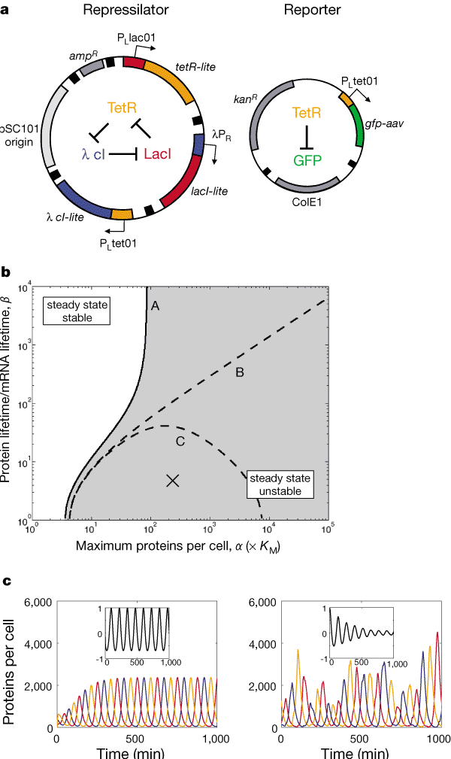
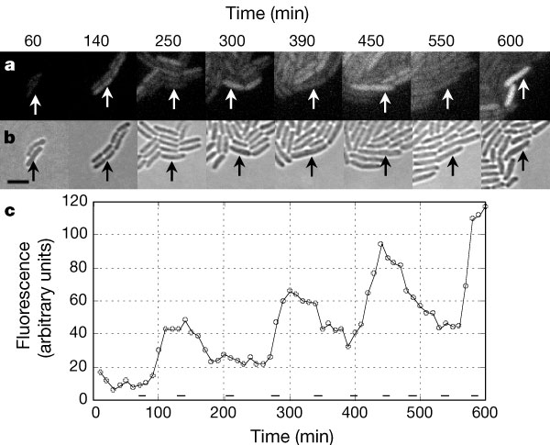
Synthetic Transcriptional Oscillator
(Elowitz, Leibler, Nature 2002)

Slide 31
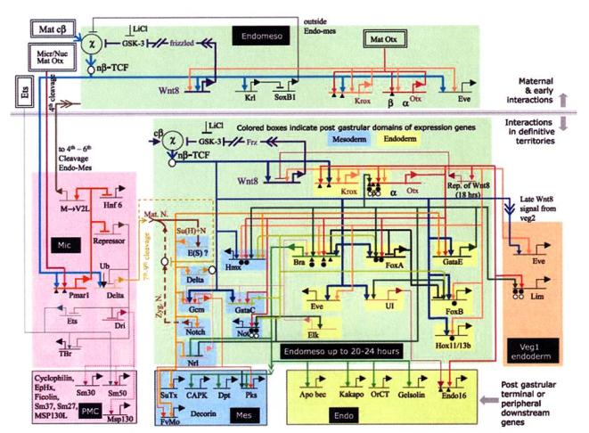
Coupling of Genes in Networks

