Slide 1
BE/APh161 – Physical Biology of the Cell
Rob Phillips
Applied Physics and Bioengineering
California Institute of Technology

Slide 2
Cells Decide: Where to Go
The Hunters of the Immune Response
(David Rogers)
(Berman et al.)
There is another kind of rapid response to environmental cues that is much faster than gene regulation.
The “decision” about where to go next is highly regulated and results in the synthesis of new cytoskeletal filaments at the leading edge of the cell.
Once again, there is an interesting random walk story behind the scenes.

Slide 3
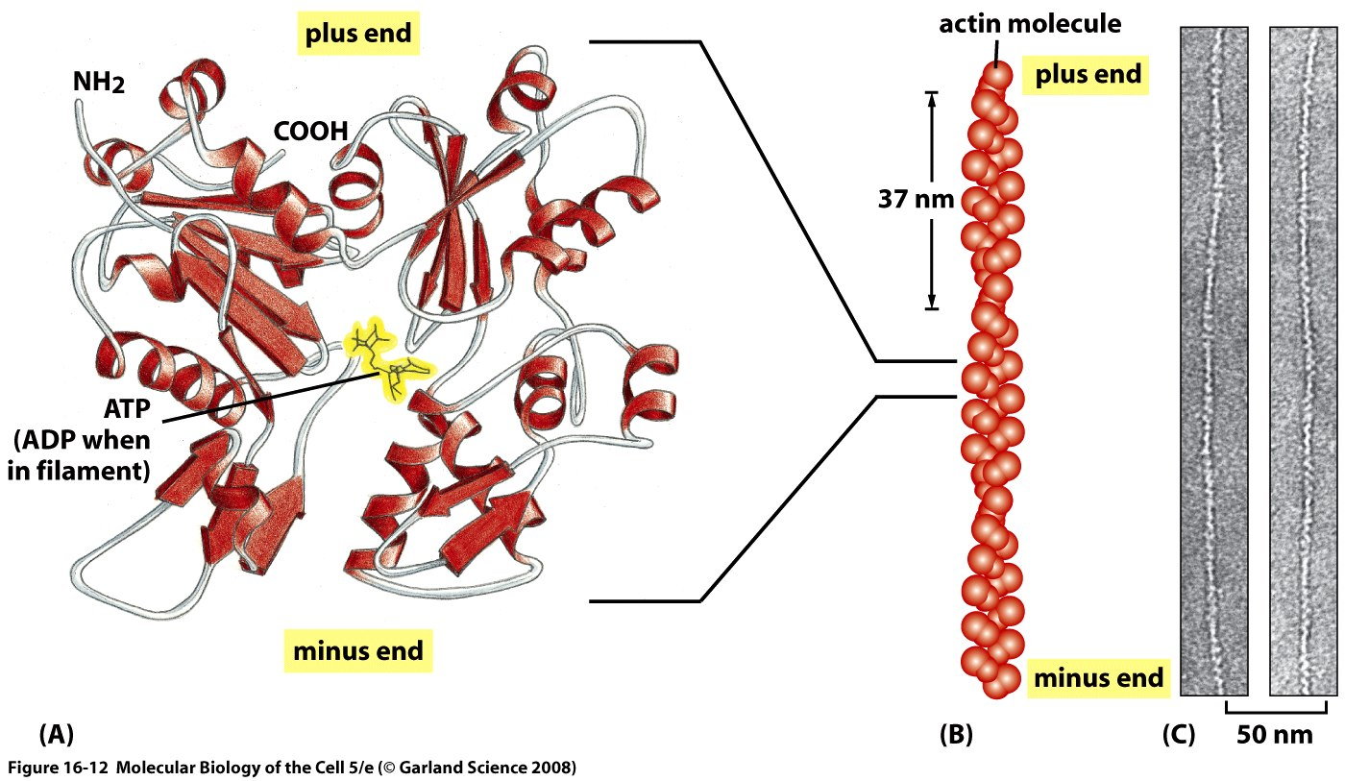
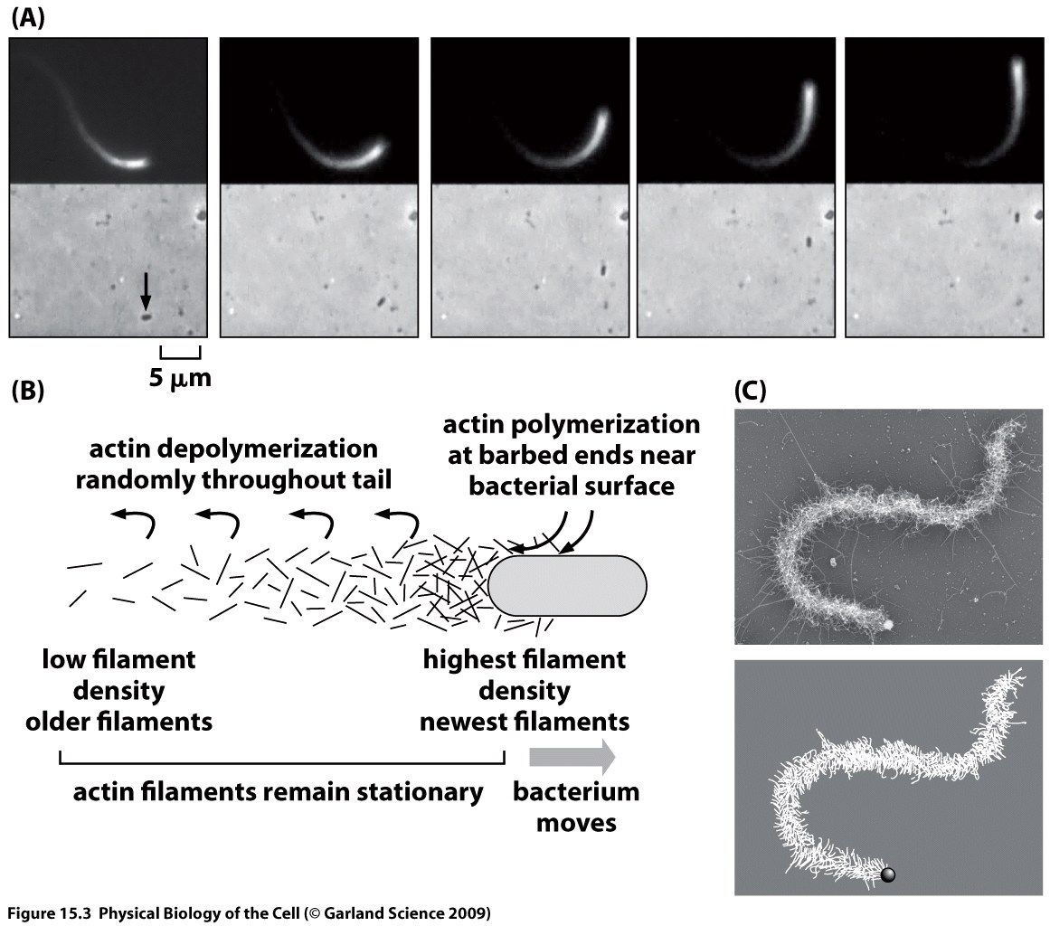
Cell Motility and Actin Polymerization
Motility is driven by the protein actin. Actin assembles into long filaments.
Through hydrolysis of ATP, these filaments can actually do work as a result of this polymerization process by pushing on membranes, for example.
(Theriot et al.)
Notes:
JT

Slide 4
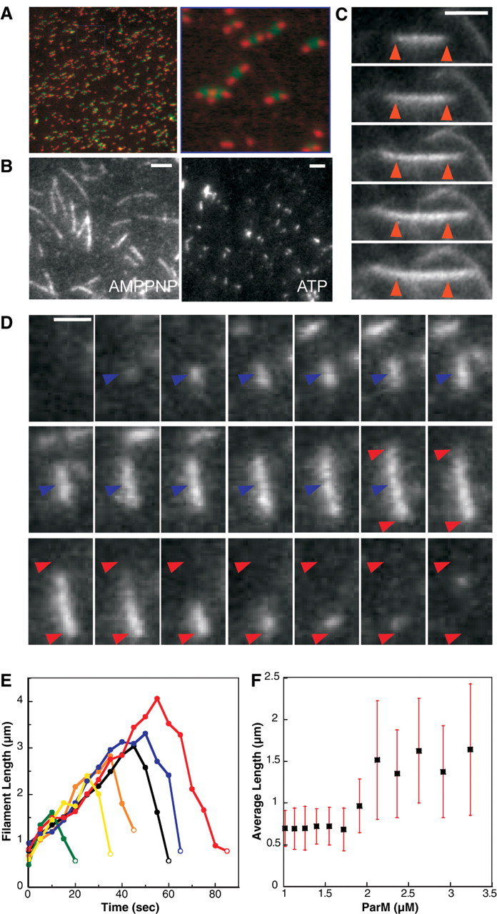
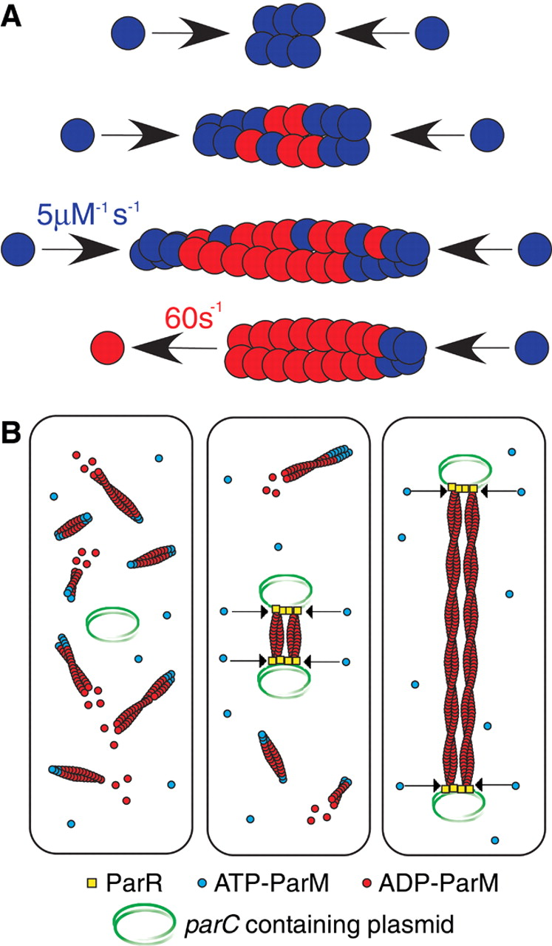
The Story of ParM
The story of Par-m
One of the most interesting stories for me is that of plasmid segregation in bacteria.
This process is mediated by the bacterial cytoskeleton protein ParM.
(Dyche Mullins et al.)

Slide 5
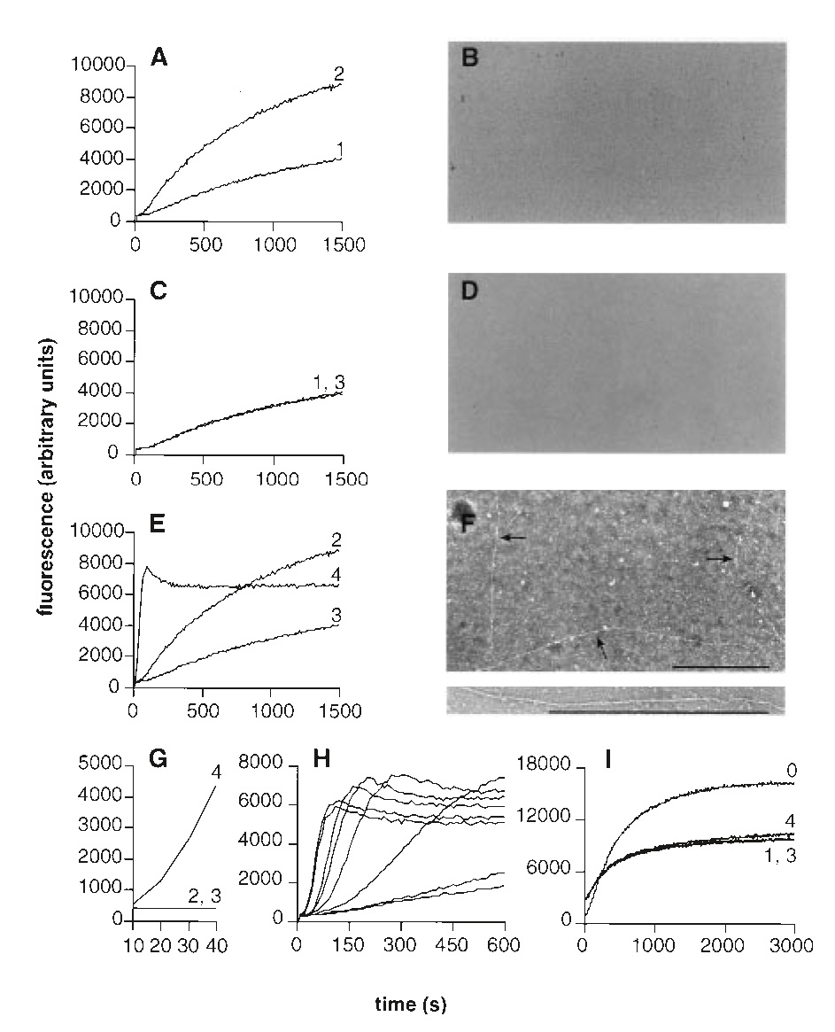
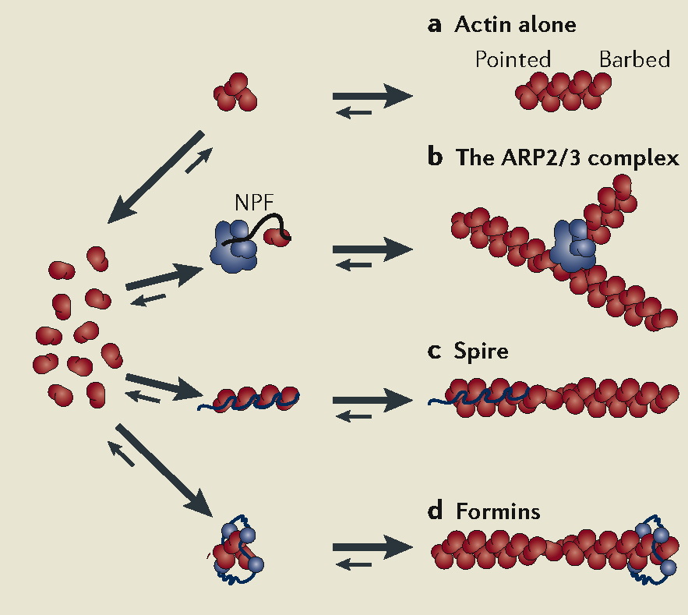
How Is Polymerization Controlled in Space and Time?
Just as with the measurement of cell growth described earlier, bulk growth assays using light absorption (or fluorescence) as a readout have spoken volumes on mechanism.
One of the outcomes of such experiments is the discovery of molecules that nucleate polymerization of new filaments (or branches off of existing filaments).
Using these experiments, they proved the existence of protein nucleating factors.
(Welch et al.)
30 s into expt.
Notes:
JT

Slide 6
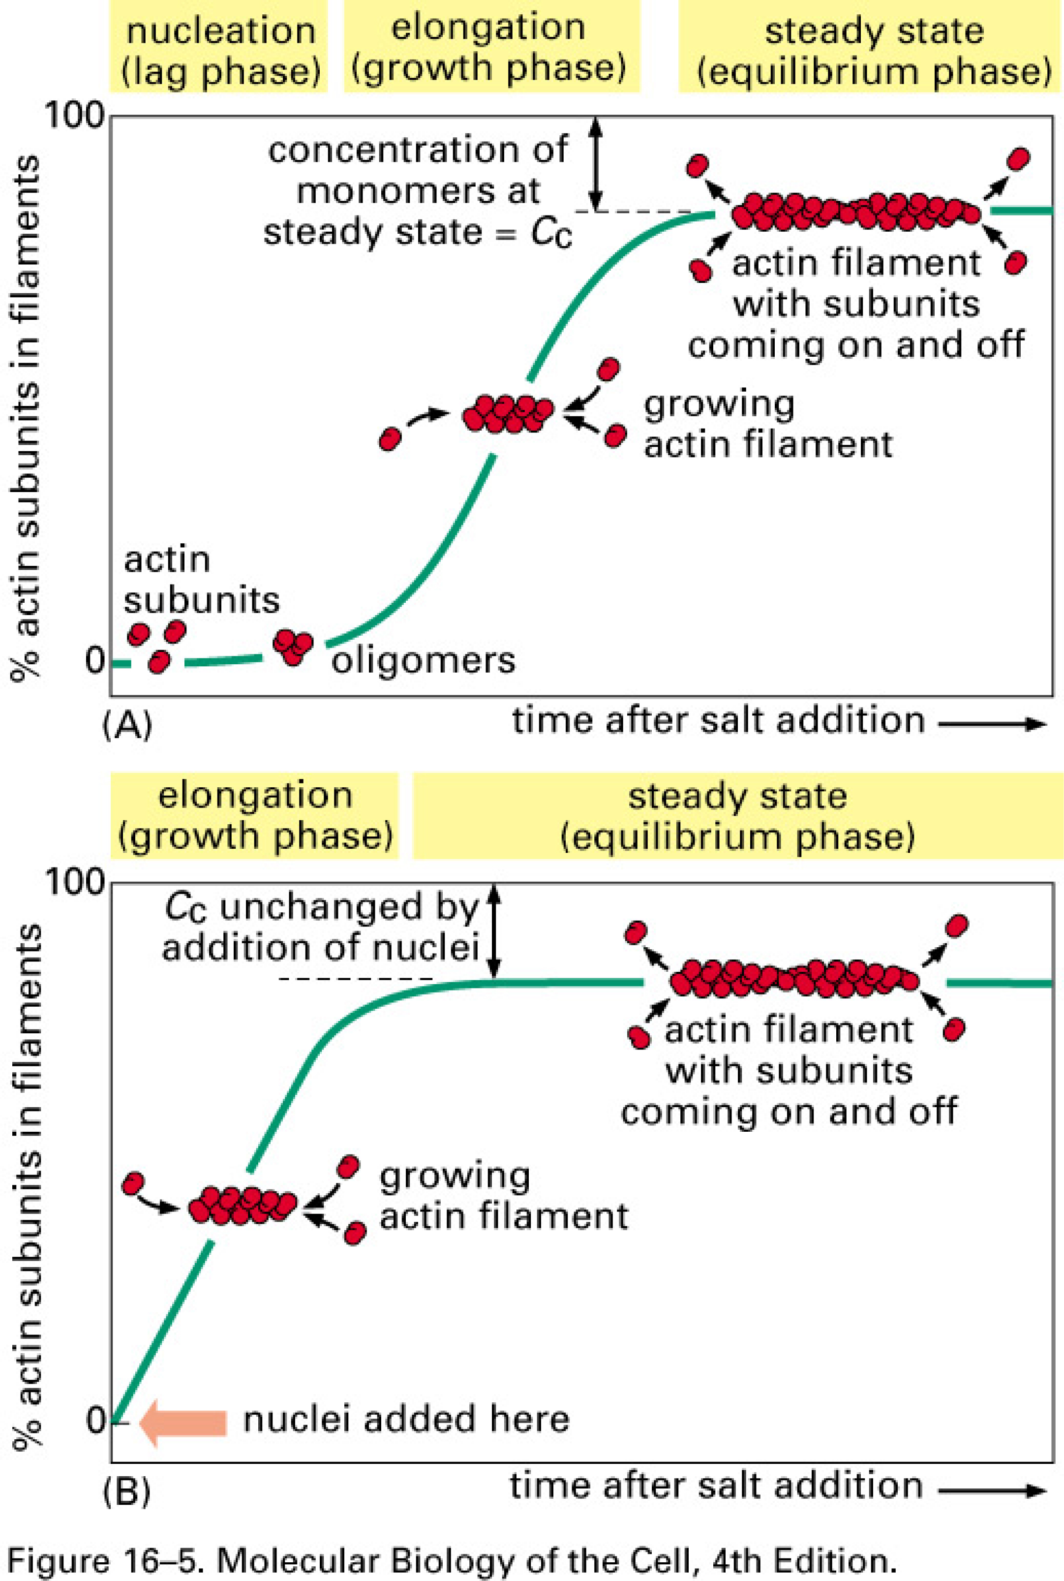
Actin Polymerization Rate in vitro
Actin polymerization dynamics
In vitro assay for measuring the amount of actin filaments as a function of time.
The nucleation process leads to a lag phase.

Slide 7
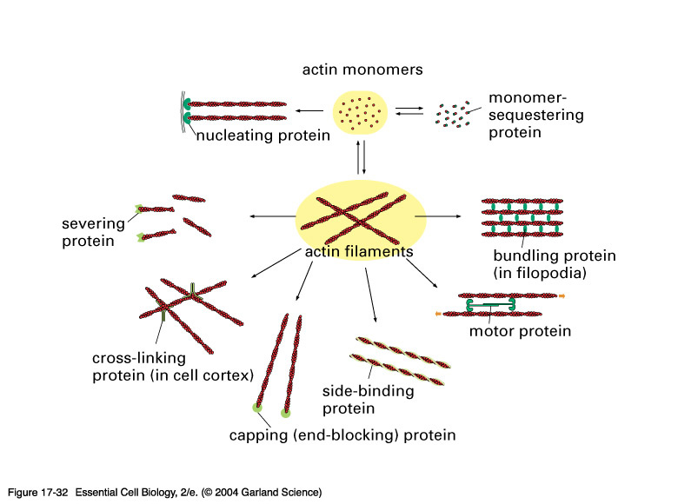
Actin and its Partners
How Is Polymerization Controlled in Space and Time?
There are a host of “accessory” proteins that participate in the REGULATION of the actin polymerization process.

Slide 8
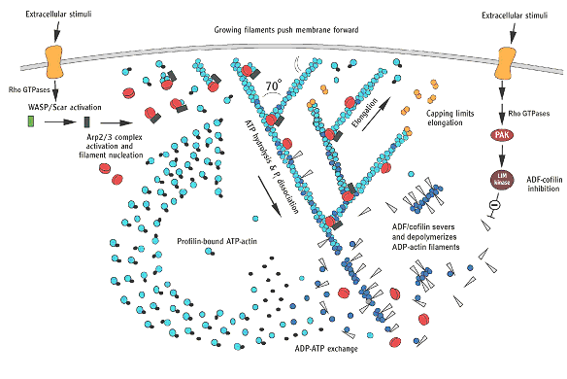
The Control of Actin Polymerization at the Leading Edge
Spacetime control of polymerization is mediated by a host of different proteins that do stuff such as: cap, nucleate, branch, sequester, etc. the actin itself.
Our story will focus on one little piece of this complex system, namely, the way in which Arp2/3 leads to the synthesis of new filaments.
Key point: signal integration – how do cells know when and where to put in new actin filaments?
Pollard & Borisy
Notes:
JT

Slide 9
Arp2/3 and actin nucleation
Arp2/3 needs to be activated itself as a result of signal integration.
Once activated Arp2/3 promotes actin filament nucleation and growth.
. (B) A model for actin filament nucleation by the ARP complex. In the absence of an activating factor, Arp2 and Arp3 are held by their accessory proteins in an orientation that prevents them from nucleating a new actin filament. When an activating factor indicated by the blue triangle binds the complex, Arp2 and Arp3 are brought together into a new configuration that resembles the plus end of an actin filament. Actin subunits can then assemble onto this structure, bypassing the rate-limiting step of filament nucleation (see Figure 16-10). (C) The ARP complex nucleates filaments most efficiently when it is bound to the side of a preexisting actin filament. The result is a filament branch that grows at a 70o angle relative to the original filament. Repeated rounds of branching nucleation result in a treelike web of actin filaments. (D) Top, electron micrographs of branched actin filaments formed by mixing purified actin subunits with purified ARP complexes. Bottom, reconstructed image of a branch where the crystal structures of actin and the ARP complex have been fitted to the electron density. The mother filament runs from top to bottom, and the daughter filament branches off to the right where the ARP complex binds to three actin subunits in the mother filament (D, from R.D. Mullins et al., Proc. Natl Acad. Sci. U.S.A. 95:6181-6186, 1998. With permission from National Academy of Sciences, and from N. Volkmann et al., Science 293:2456-2459, 2001. With permission from Macmillan Publishers Ltd.)
Author: Bruce Alberts, Alexander Johnson, Julian Lewis, Martin Raff, Keith Roberts, Peter Walter
Notes:
RP

Slide 10
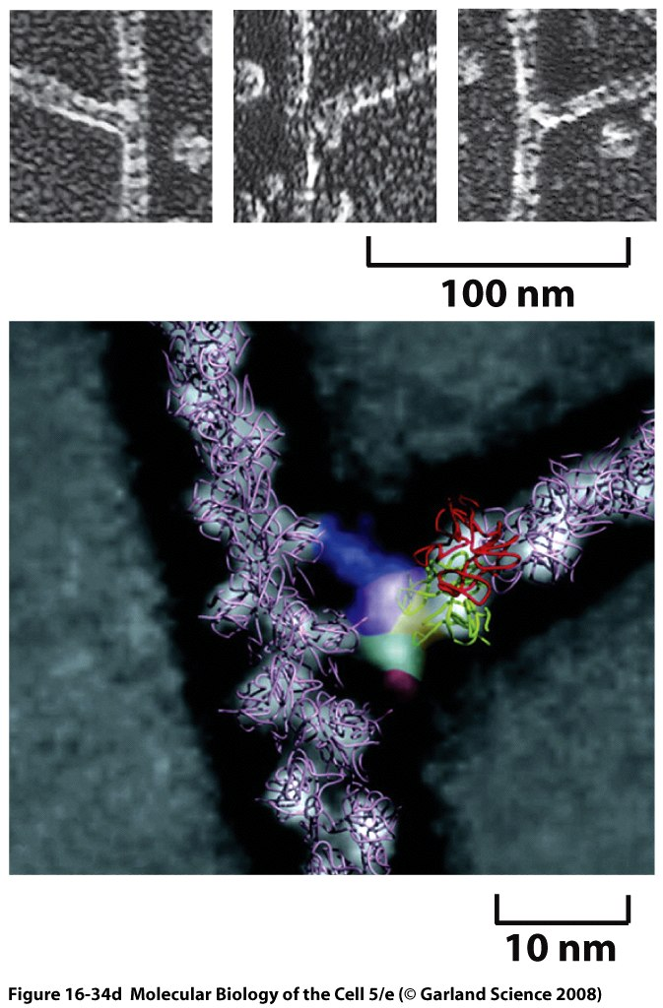
Structural studies of Arp2/3
Electron microscopy images reveal the nature of Arp2/3 action on actin filaments.
(D) Top, electron micrographs of branched actin filaments formed by mixing purified actin subunits with purified ARP complexes. Bottom, reconstructed image of a branch where the crystal structures of actin and the ARP complex have been fitted to the electron density. The mother filament runs from top to bottom, and the daughter filament branches off to the right where the ARP complex binds to three actin subunits in the mother filament (D, from R.D. Mullins et al., Proc. Natl Acad. Sci. U.S.A. 95:6181-6186, 1998. With permission from National Academy of Sciences, and from N. Volkmann et al., Science 293:2456-2459, 2001. With permission from Macmillan Publishers Ltd.)
Author: Bruce Alberts, Alexander Johnson, Julian Lewis, Martin Raff, Keith Roberts, Peter Walter
Notes:
RP

Slide 11
Signaling and Polymerization
External signals activate Arp2/3 which in turn nucleates actin polymerization.
Group of Wendell Lim has used a Lego approach to mix and match components so that signals normally reserved for other circuits can induce polymerization.
Do we really “understand” how these molecules work? Let theory and predictions be the judge of that!
(Lim et al., Science)
Notes:
RP

Slide 12
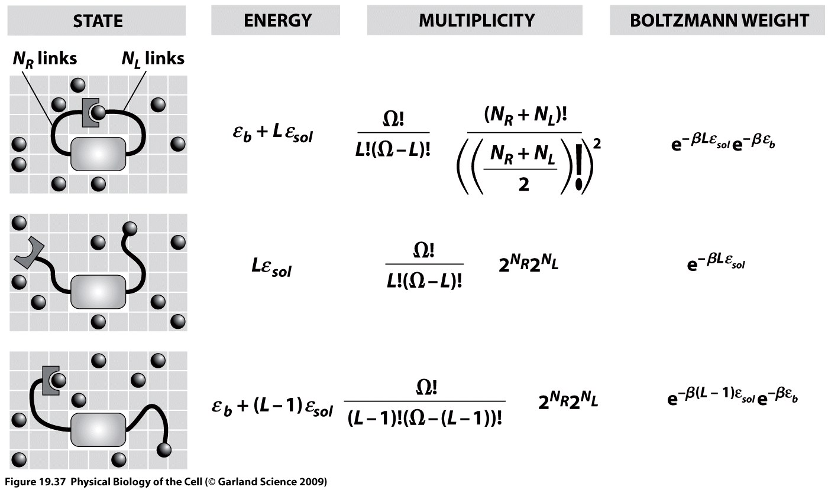
Computing the Activity of the Switch
Competition between tethered ligand and free ligands.
Use simple ideas from statistical mechanics to reckon the free energy of the various contributions.
Notes:
RP

Slide 13
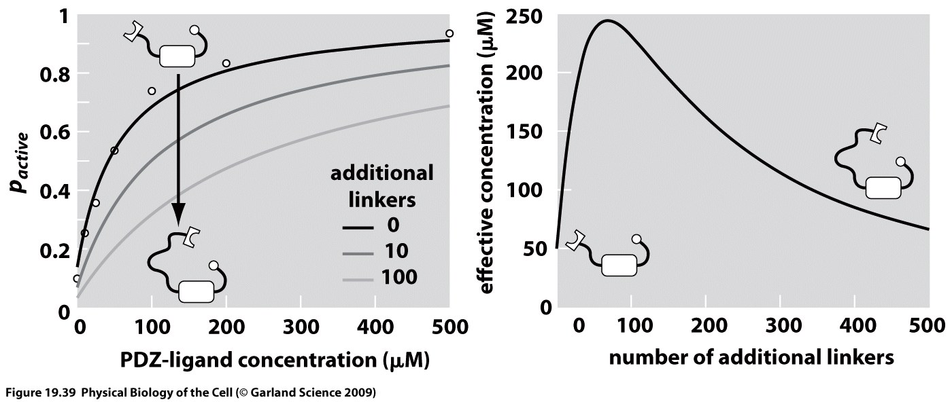
Tuning Tethers to Alter Signaling
We view the tether length as a dial that can be tuned in order to vary the probability that N-Wasp will activate Arp2/3.
As with many free energy stories, the point here is a competition between the free and tethered ligands and their entropies (especially).
Notes:
RP

