Slide 1
BE/APh161 – Physical Biology of the Cell
Rob Phillips
Applied Physics and Bioengineering
California Institute of Technology

Slide 2
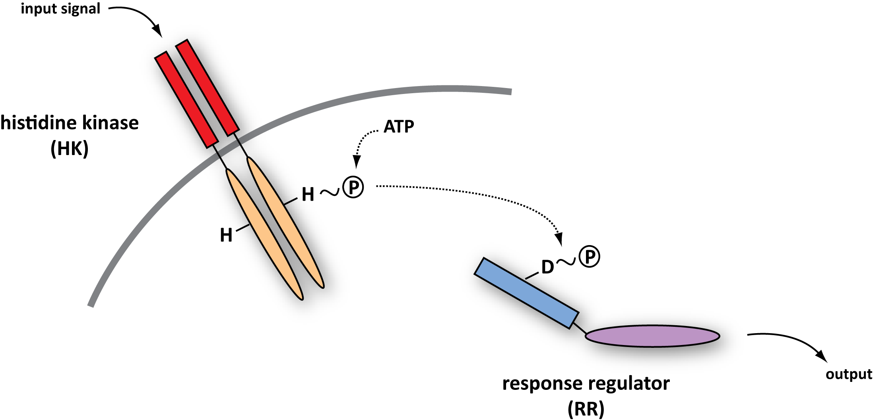
Two-Component Signal Transduction
Next few slides are courtesy of Michael Laub (MIT) and Mark Goulian (Upenn) – experts in the quantitative dissection of signaling networks.
This figure shows the generic features of the two-component signal transduction systems.
Notes:
2
2

Slide 3
Coordinating multiple signaling systems in a single cell
PhoR
EnvZ
CpxA
PhoQ
CusS
BasS
DcuS
TorS
NarX
PhoB
OmpR
CpxR
PhoP
UhpB
CusR
BasR
NarQ
DcuR
TorR
RstB
NarL
UhpC
KdpD
NarP
RstA
ArcB
KdpE
FimZ
OmpR
CheB
NtrC
NtrB
RcsB
RcsD
CheA
CheY
SprE
RcsC
AtoC
CreB
DpiB
YpdB
AtoS
EvgA
YehT
CreC
UvrY
YfJR
DpiA
HydD
BaeR
YedW
YpdA
EvgS
QseC
YehU
BarA
YfhK
HydG
BaeS
YedV
QseB
animation by Mark Gouilan
Notes:
3

Slide 4
Phosphotransfer profiling
HK + ATP* → HK~P* + ADP
(use complete set of purified RRs)
-
RR1
RR2
RR3
.........
RR44
incubate,
separate by
SDS-PAGE
HK~P* + RR → HK + RR~P*
HK~P
RR~P
Notes:
4

Slide 5
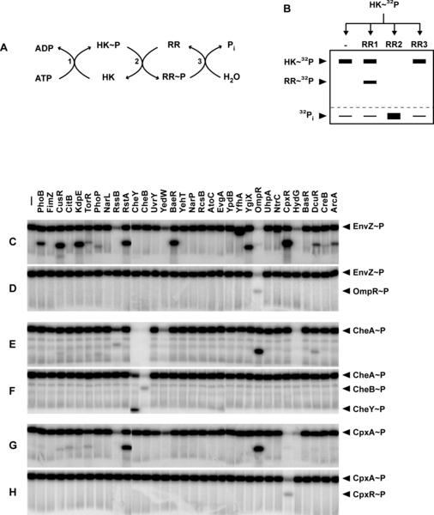
Phosphotransfer profiling
(see Skerker, Laub et al..)
Notes:
5

Slide 6
Assessing Specificity: Phosphotransfer Profiling
C. crescentus PhoR profile – 60 min phosphotransfer reactions
+PhoB
C. crescentus PhoR profile – 5 min phosphotransfer reactions
+PhoB
➔ histidine kinases exhibit a strong kinetic preference in vitro
for their in vivo cognate substrate
➔ specificity based on molecular recognition
Notes:
6
6
6

Slide 7
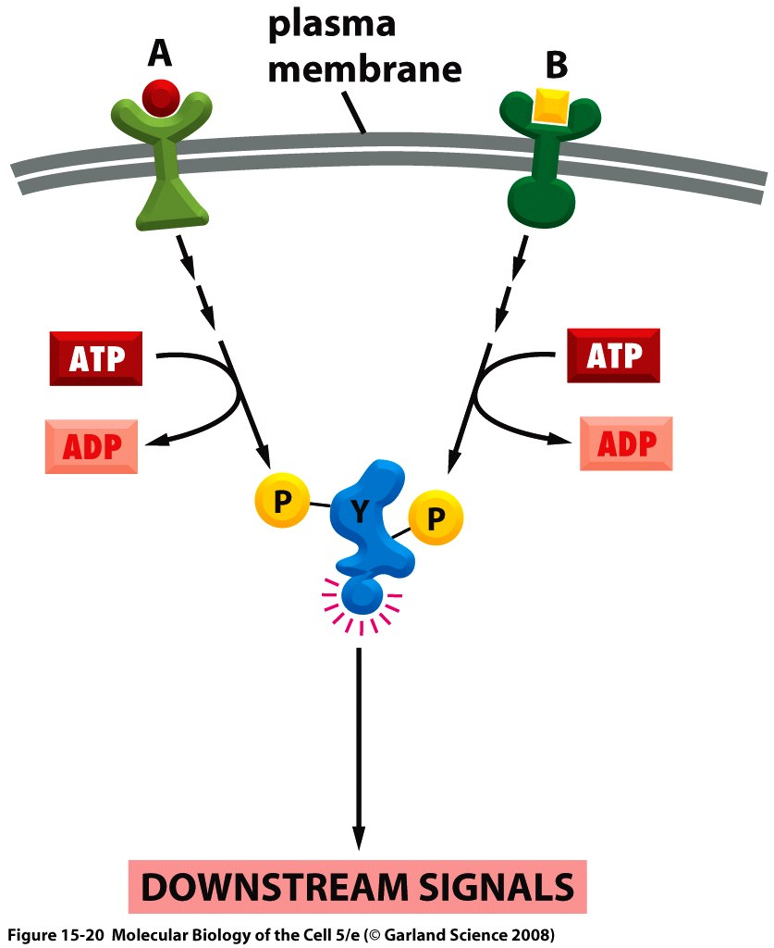
Signal integration
Once we finish with our concrete example of chemotaxis, we will turn to the way in which cells decide where to put new actin filament and that will make us face this question of signal integration.
Cell as a computer: not just amplification, but also logical operations such as AND, OR, etc.

Slide 8
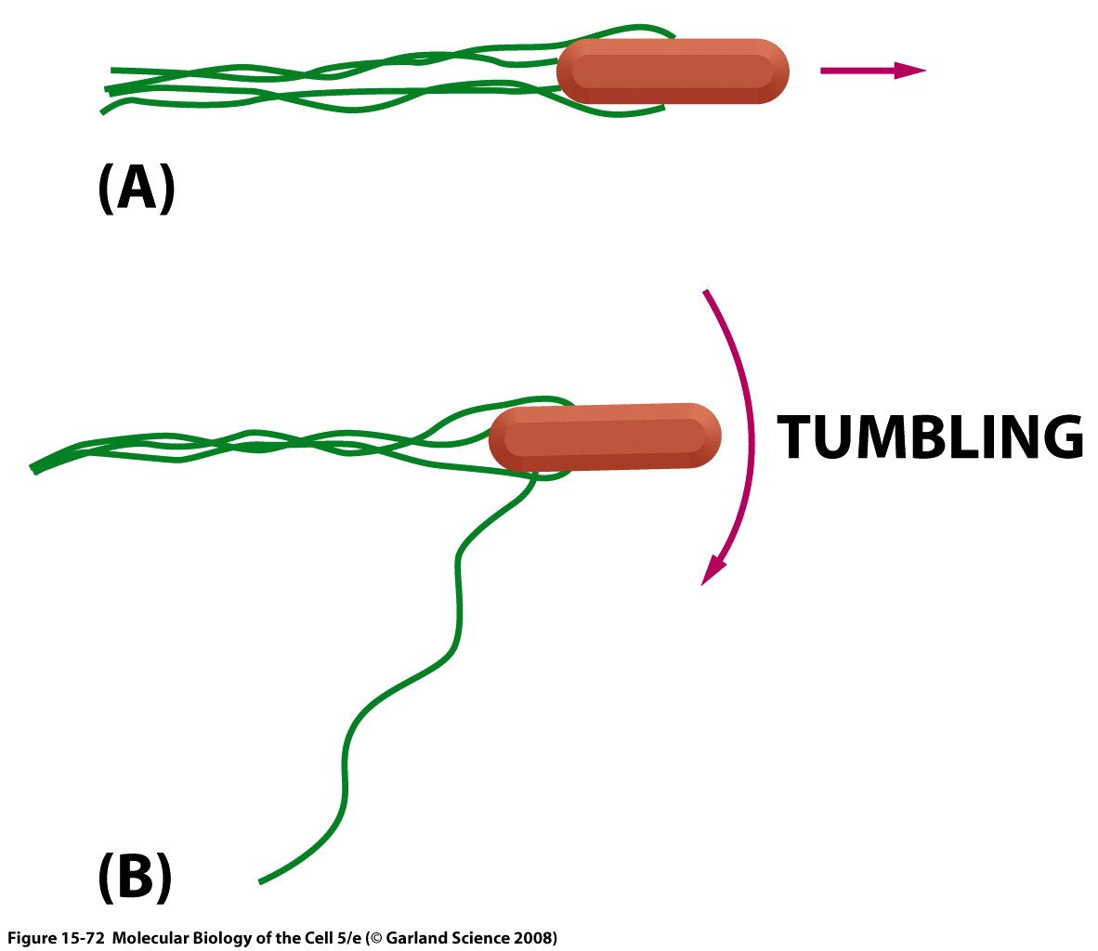
Cellular decisions and swimming
We have already seen the strategy of neutrophils for chasing down cellular offenders.
Bacteria also exhibit motile strategies based upon environmental cues.

Slide 9
Cellular decisions and swimming
We have already seen the strategy of neutrophils for chasing down cellular offenders.
Bacteria also exhibit motile strategies based upon environmental cues.

Slide 10
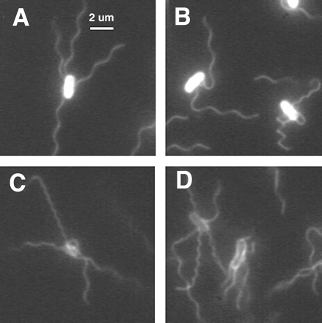
Cellular decisions and swimming
See the movies from Howard Berg website.
(see Turner, Ryu, Berg – J. Bacteriol. 2000 .)

Slide 11
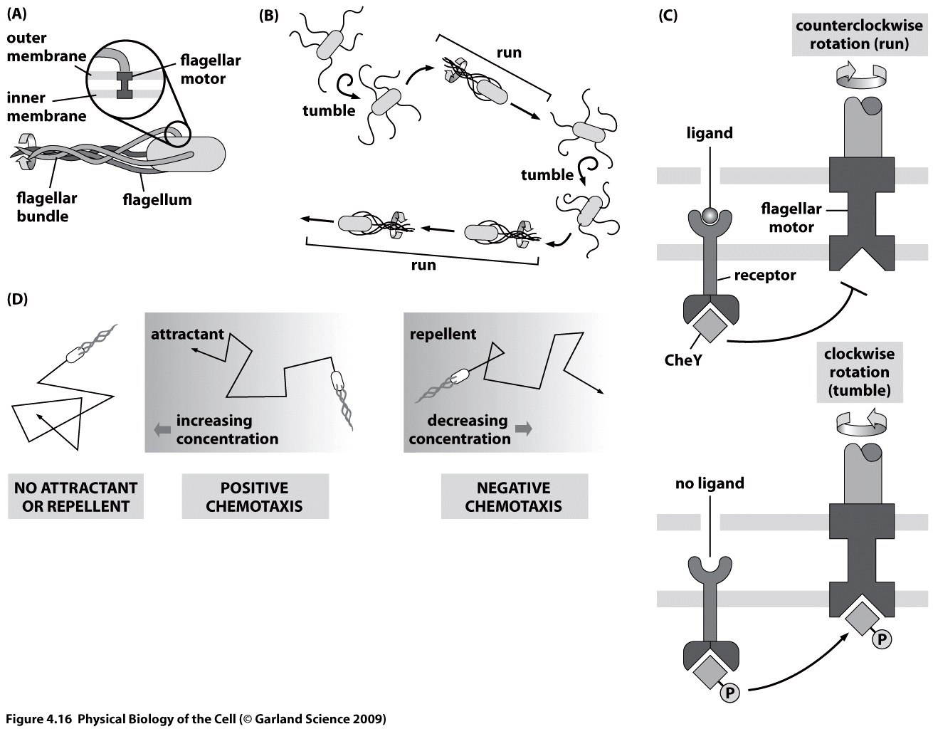
A general view of bacterial chemotaxis
We will return to this figure several times in order to clarify various aspects of the bacterial chemotactic response.

Slide 12
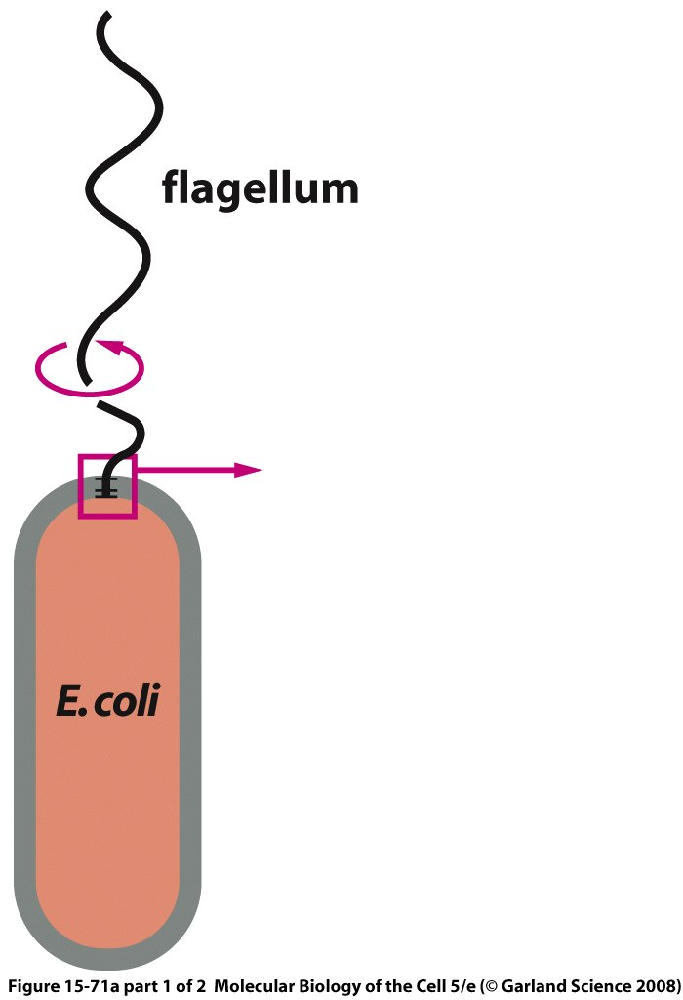
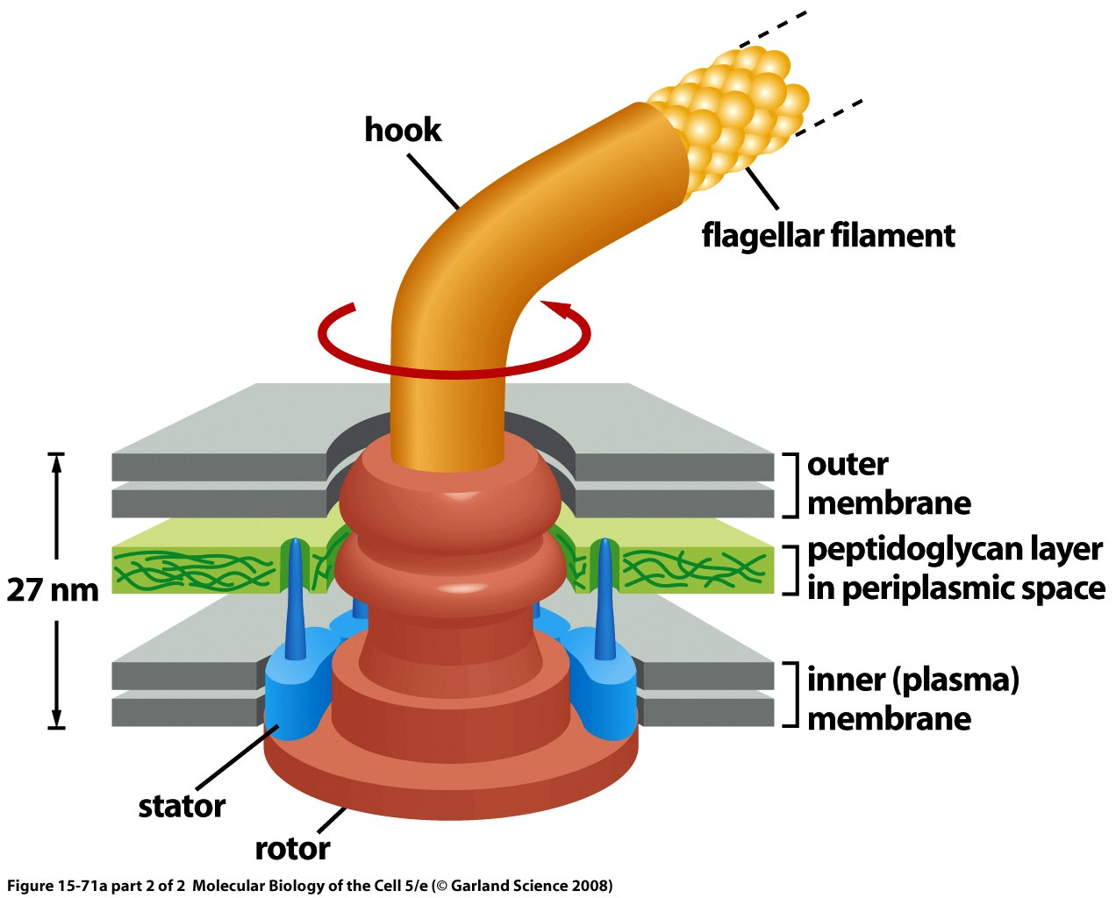
An amazing molecular machine
The flagellar motor uses a proton gradient to rotate at roughly the angular speed of a jet engine.
This motor is a darling of the creationists as an example of something that “couldn’t have evolved” because of its supposed “irreducible complexity”.

Slide 13
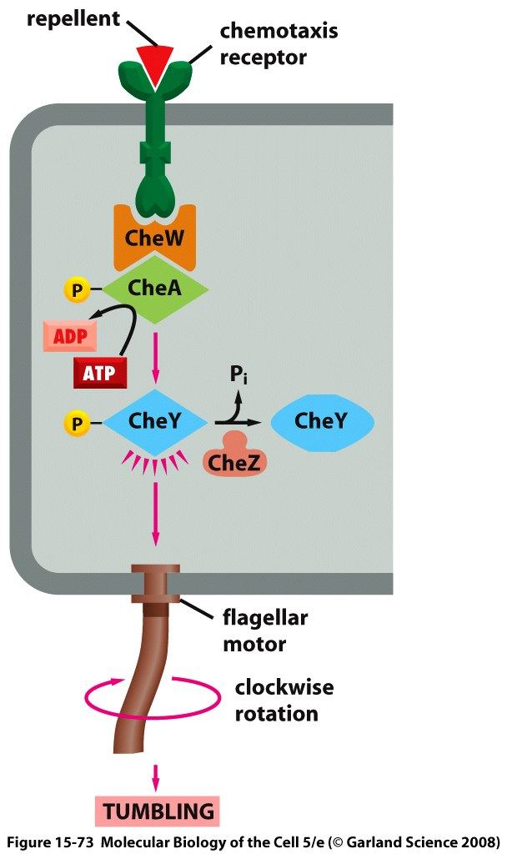
Bacterial chemotaxis circuit
The circuit for bacterial chemotaxis involves precisely the kind of two-component signal transduction system that we discussed earlier.

Slide 14
Cellular decisions and swimming
Concept of experiment: tether cell to surface and watch the rotation of the motor. They use a second color to watch the CheY-P in the cell. The result is a plot that shows the frequency of motor tumble rate as a function of CheY-P.
(see Cluzel, Surrette and Leibler, Science.)

Slide 15
Cellular decisions and swimming
Measure the response of the motor as a function of the concentration of CheY-P.
Clockwise bias (CW) is obtained by taking fraction of time spent in clockwise state divided by the total time.
(see Cluzel, Surrette and Leibler, Science.)

Slide 16
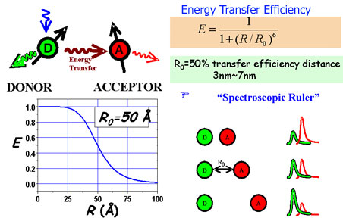
The fret technique
Fluorescence resonance energy transfer is an amazing molecular ruler.
Proximity of acceptor and donor is readout by the efficiency of the transfer.
https://netfiles.uiuc.edu/tjha/www/images/FRET_concept.jpg

Slide 17
Fret and chemotaxis
FRET between CheY-P and CheZ.
This is from the paper of Sourjik and Berg, PNAS, 2002. They have two papers in PNAS that year, this is the first one.

Slide 18
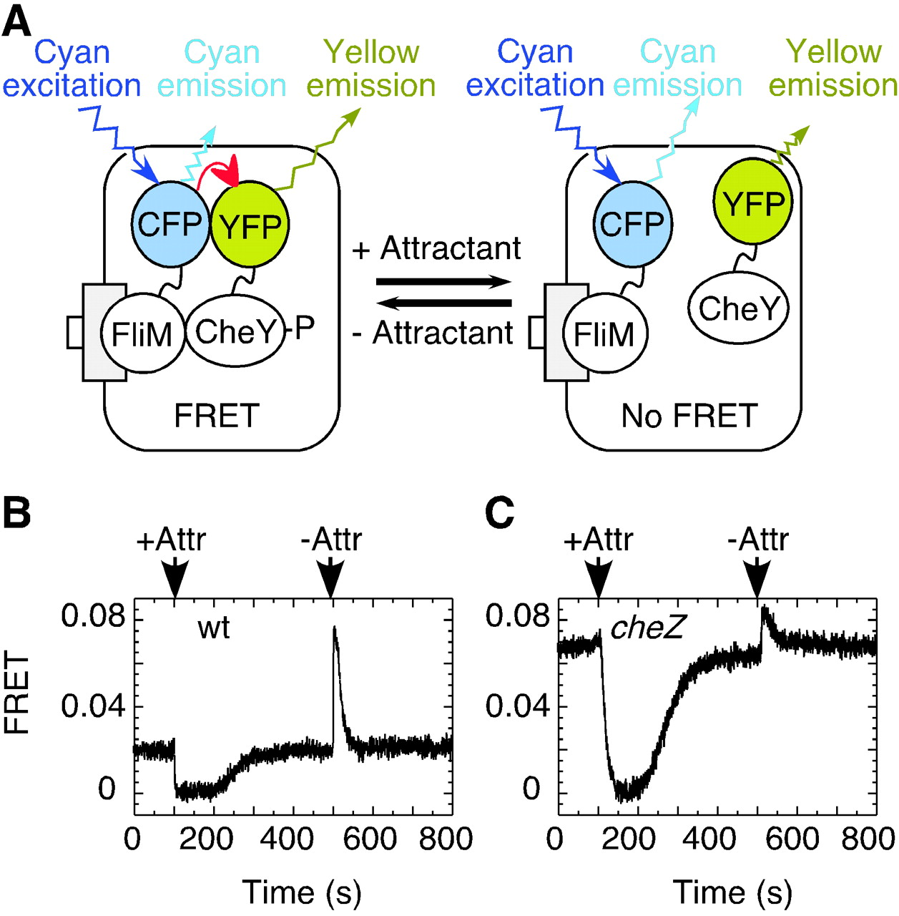
Changes in interactions between labeled proteins observed by FRET on chemotactic stimulation of E. coli cells
The circuit for bacterial chemotaxis involves precisely the kind of two-component signal transduction system that we discussed earlier.
Sourjik V, Berg H C PNAS 2002;99:12669-12674
©2002 by The National Academy of Sciences
Notes:
Changes in interactions between labeled proteins observed by FRET on chemotactic stimulation of E. coli cells. (A) Addition or removal of attractant changes the level of CheY phosphorylation, and thus the interaction between CheY and FliM. As a result, there is a change in energy transfer from CFP-FliM (donor) to CheY-YFP (acceptor), and a corresponding change in cyan and yellow emission levels. (B and C) Stepwise addition and subsequent removal of attractant to the cells attached to a coverslip resulted in changes of energy transfer, expressed here as the fractional decrement in CFP fluorescence (FRET), in (B) wild-type (wt) and (C) cheZ cells. Arrows indicate the time of addition (+Attr) or removal (-Attr) of attractant [30 μM α-methylaspartate (MeAsp)].

Slide 19
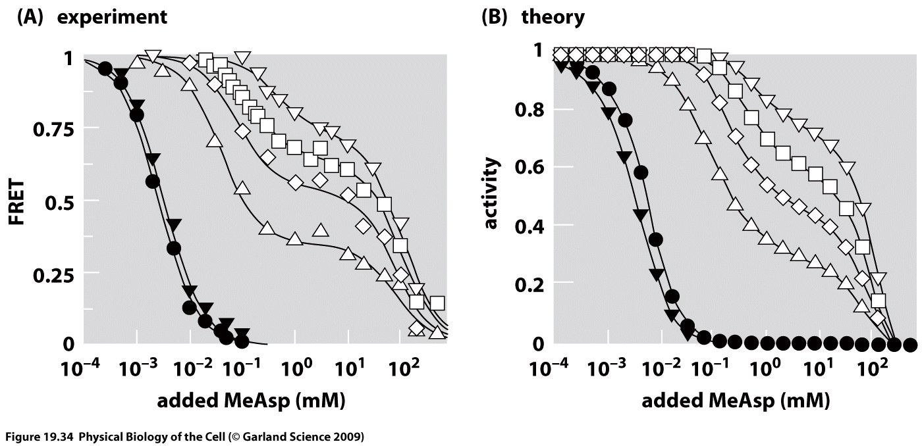
Receptor activity and chemoattractant concentration
Measure the FRET activity for different chemoattractant concentrations.
Different mutants have different adaptive responses.

Slide 20
Motor Binding and Bias

Slide 21
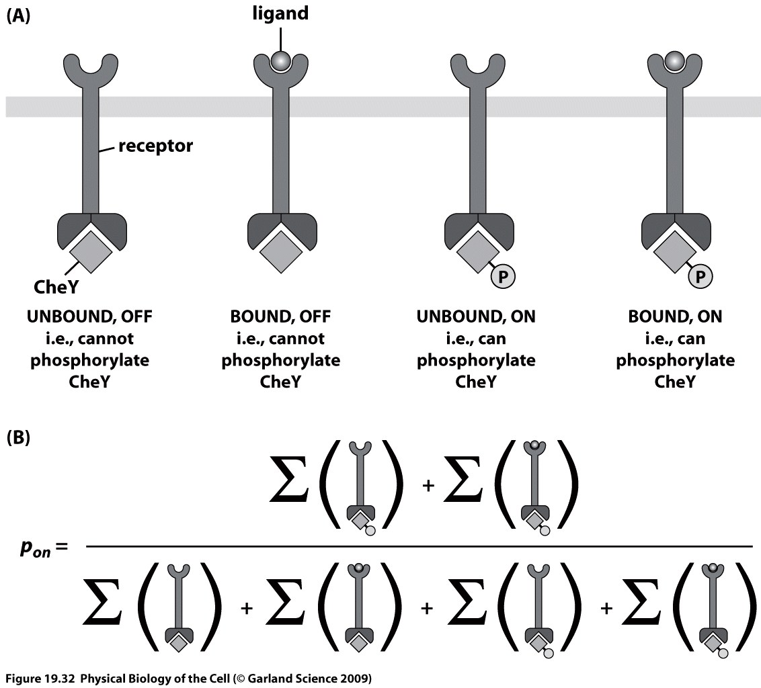
Building a statistical mechanics model
Our goal is to find the probability that the receptor will be in the on state as a function of the chemoattractant concentration.

Slide 22
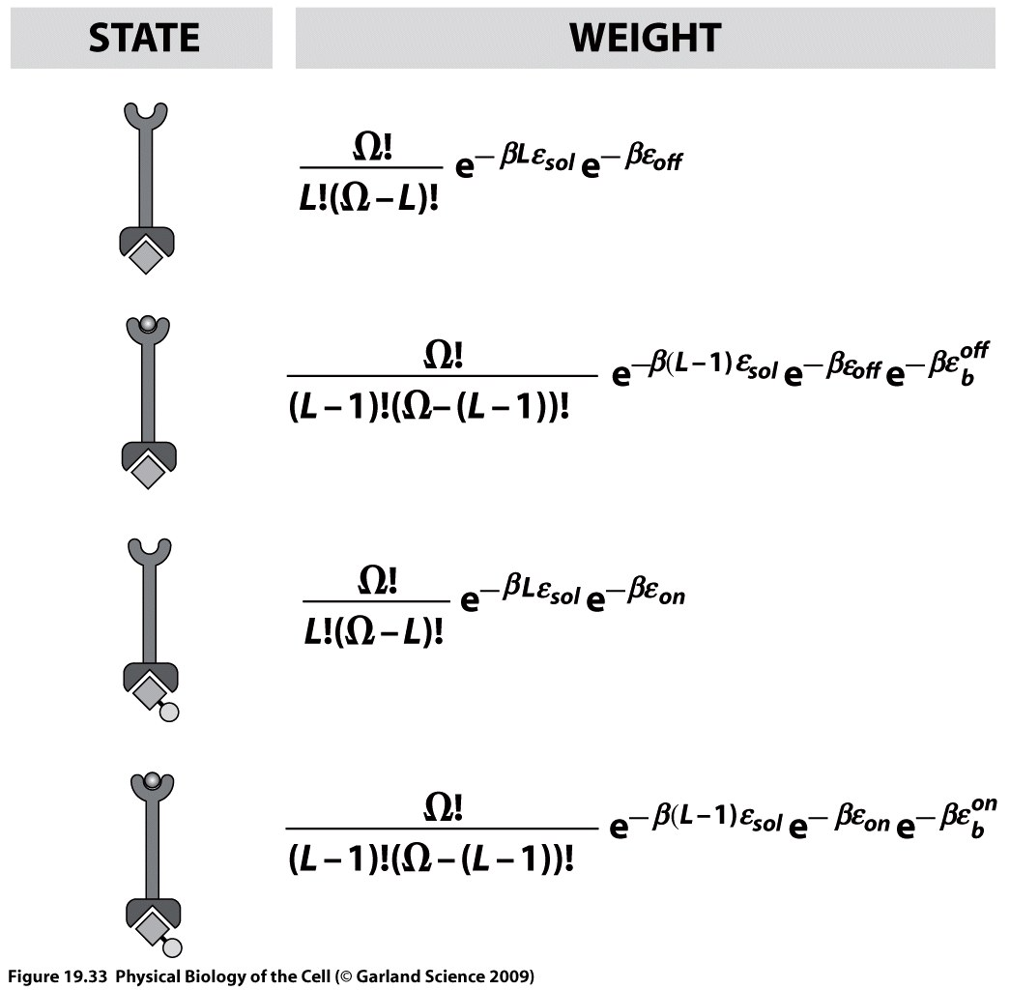
States and weights
Each of the states has a corresponding statistical weight.

Slide 23
Changes in FliM occupancy after flash-release of caged chemoeffectors
After addition of a chemoattractant, the FRET measurements permit direct determination of the kinetics of the process.
Sourjik V, Berg H C PNAS 2002;99:12669-12674
©2002 by The National Academy of Sciences
Notes:
Changes in FliM occupancy after flash-release of caged chemoeffectors. Attractant was released by UV flash at the times indicated by the arrows and thin vertical dashed lines. The smooth curves are exponential fits to the data; see Materials and Methods. FliM occupancy was calculated from the FRET signals as in Fig. 2B. (A) Response of wild-type cells to release of 10 μM caged l-aspartate. The horizontal solid line indicates the average prestimulus FliM occupancy. The data points just before and after the flash are shown with greater time resolution in the Inset. (B) Response of cheZ cells to release of 10 μM caged l-aspartate. (C) Changes in FliM occupancy after flash release of caged proton, resulting in a pH decrement of about 0.45.

Slide 24
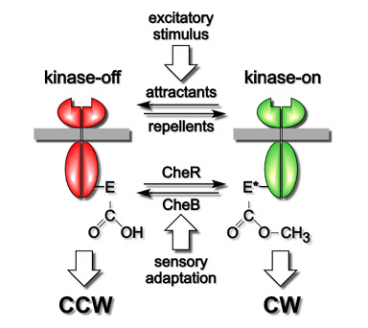
Adaptation of the circuit
Methylation provides a scheme for tuning the energy difference between the on and off states of the receptor complex.
Quantitative measurements leave us with many interesting questions: mutants and their responses, sharpness of response, adaptation, motor binding vs switching, etc…
Parkinson lab - Utah

Slide 25
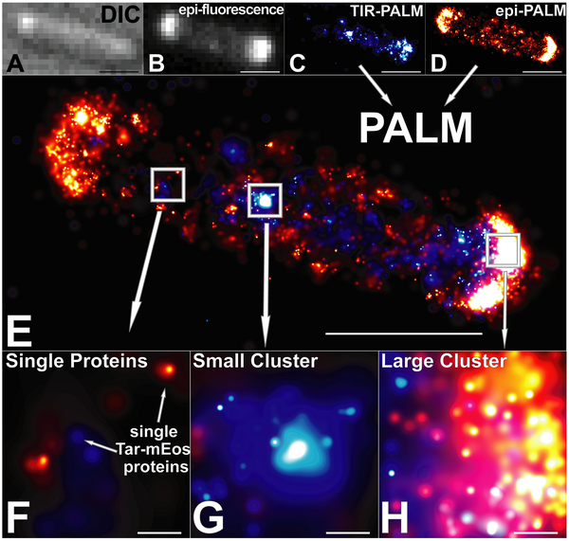
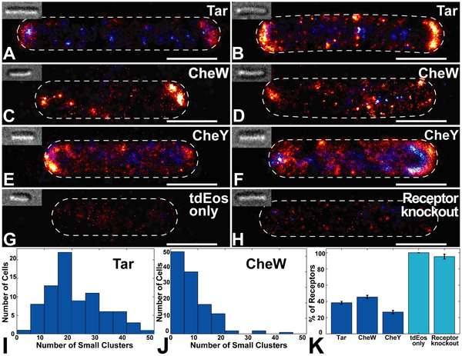
High resolution imaging of chemotaxis proteins
PALM is a high-resolution technique that permits beating the diffraction limit.
In this case, they are looking at chemotaxis proteins in E. coli.
(Greenfield, Liphardt et al, PLoS Biology, 2009.)

Slide 26
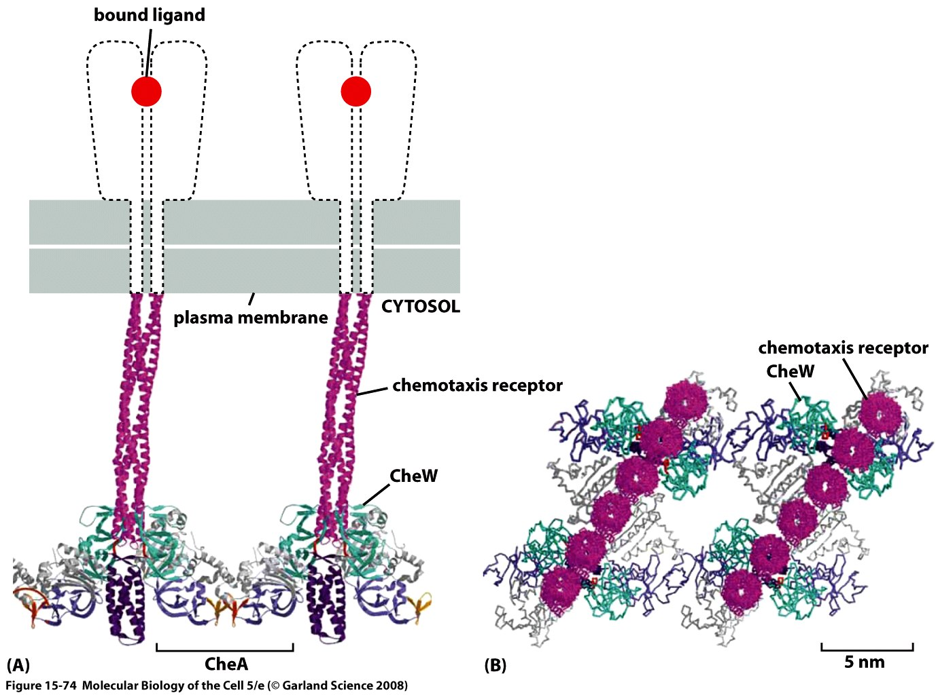
Nature of the receptors
Receptors assemble into trimers of dimers.
Receptor clustering is part of the overall story.

Slide 27
Cells Decide: Where to Go
The Hunters of the Immune Response
(David Rogers)
(Berman et al.)
There is another kind of rapid response to environmental cues that is much faster than gene regulation.
The “decision” about where to go next is highly regulated and results in the synthesis of new cytoskeletal filaments at the leading edge of the cell.
Once again, there is an interesting random walk story behind the scenes.

Slide 28
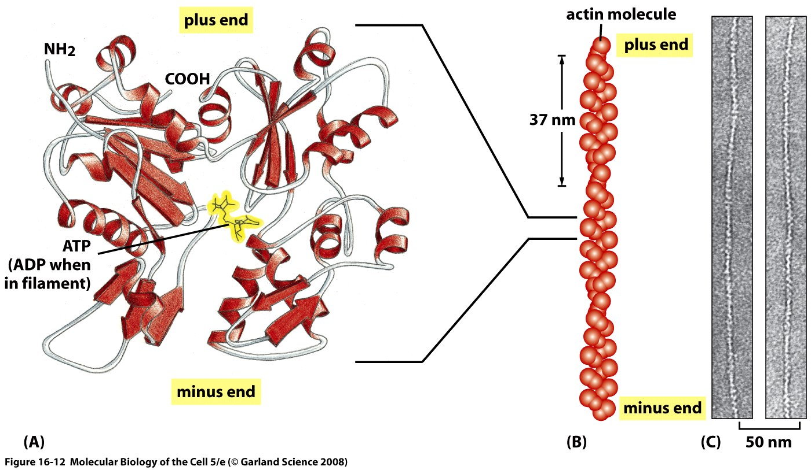
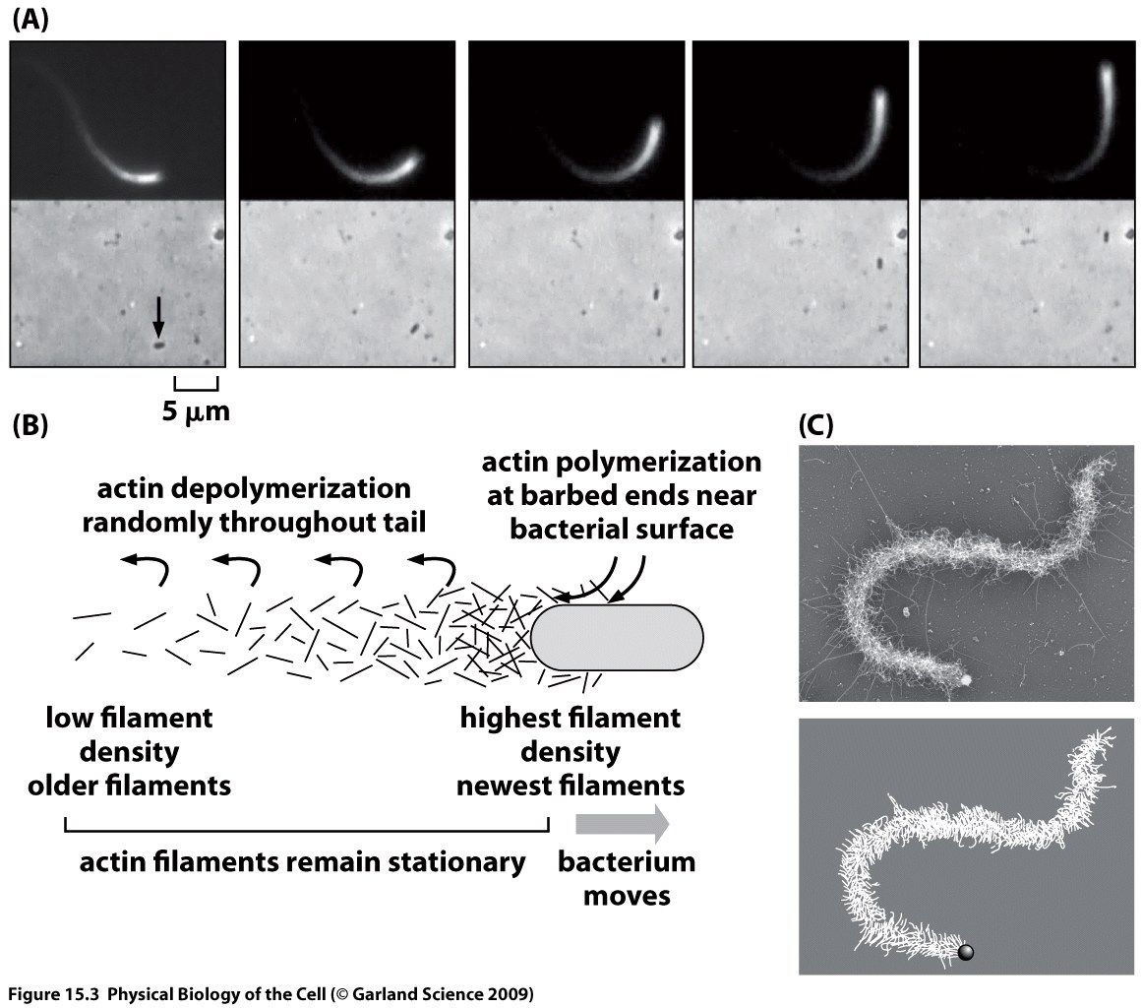
Cell Motility and Actin Polymerization
Motility is driven by the protein actin. Actin assembles into long filaments.
Through hydrolysis of ATP, these filaments can actually do work as a result of this polymerization process by pushing on membranes, for example.
(Theriot et al.)
Notes:
JT

Slide 29
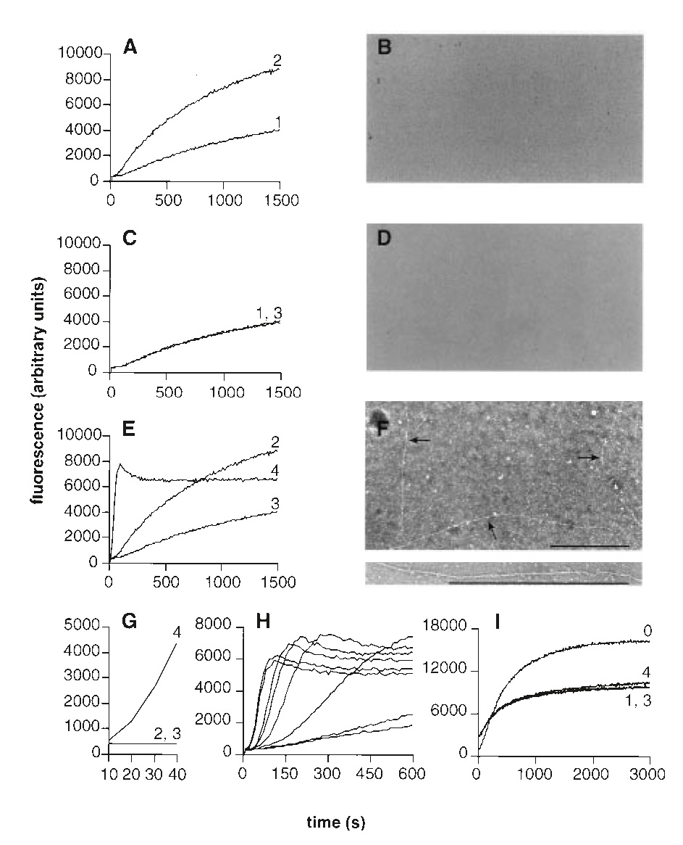
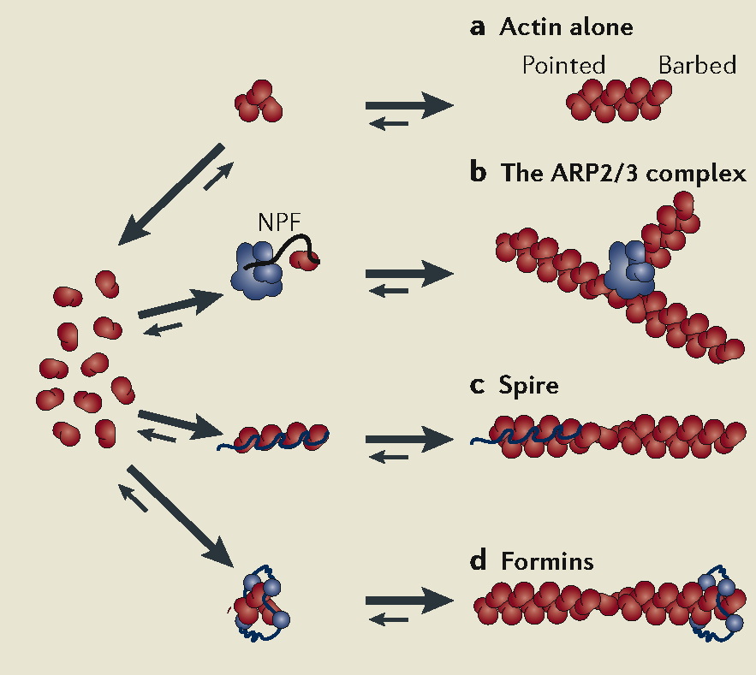
How Is Polymerization Controlled in Space and Time?
Just as with the measurement of cell growth described earlier, bulk growth assays using light absorption (or fluorescence) as a readout have spoken volumes on mechanism.
One of the outcomes of such experiments is the discovery of molecules that nucleate polymerization of new filaments (or branches off of existing filaments).
Using these experiments, they proved the existence of protein nucleating factors.
(Welch et al.)
30 s into expt.
Notes:
JT

Slide 30
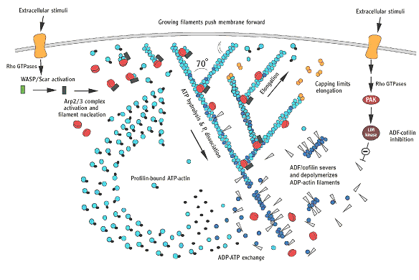
The Control of Actin Polymerization at the Leading Edge
Spacetime control of polymerization is mediated by a host of different proteins that do stuff such as: cap, nucleate, branch, sequester, etc. the actin itself.
Our story will focus on one little piece of this complex system, namely, the way in which Arp2/3 leads to the synthesis of new filaments.
Key point: signal integration – how do cells know when and where to put in new actin filaments?
Pollard & Borisy
Notes:
JT

Slide 31
Signaling and Polymerization
External signals activate Arp2/3 which in turn nucleates actin polymerization.
Group of Wendell Lim has used a Lego approach to mix and match components so that signals normally reserved for other circuits can induce polymerization.
Do we really “understand” how these molecules work? Let theory and predictions be the judge of that!
(Lim et al., Science)
Notes:
RP

Slide 32
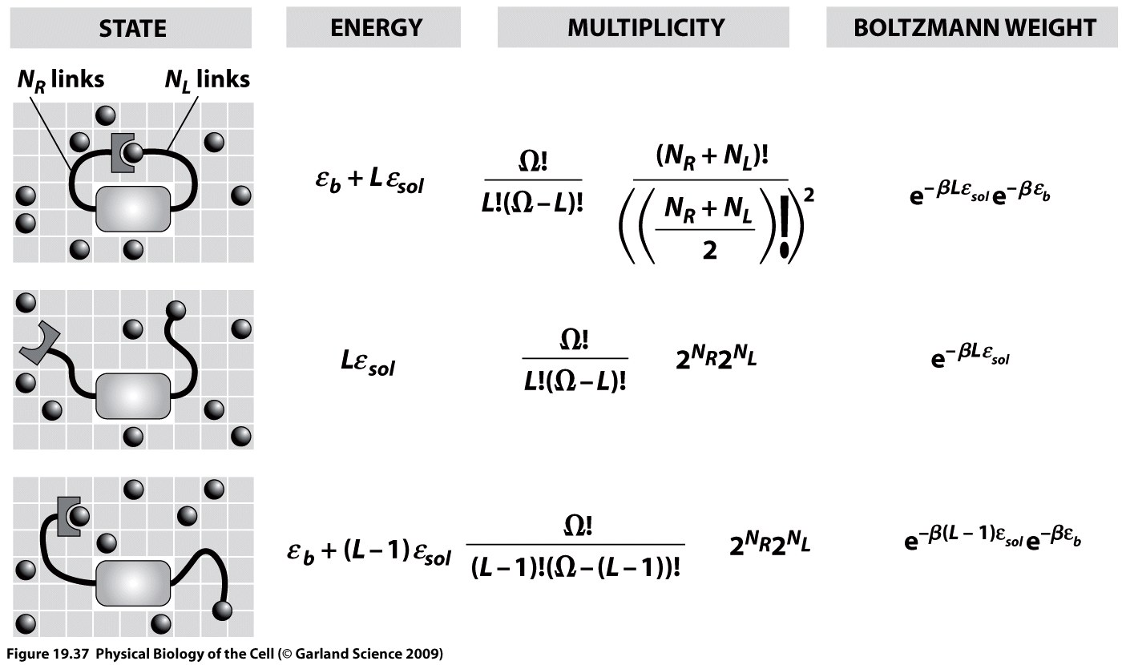
Computing the Activity of the Switch
Competition between tethered ligand and free ligands.
Use simple ideas from statistical mechanics to reckon the free energy of the various contributions.
Notes:
RP

Slide 33
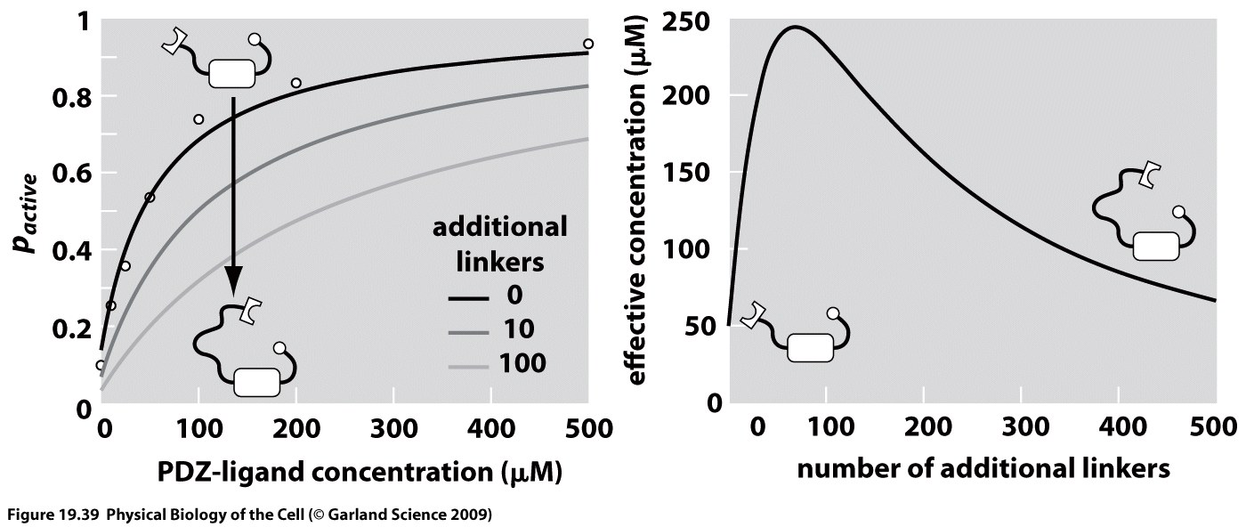
Tuning Tethers to Alter Signaling
We view the tether length as a dial that can be tuned in order to vary the probability that N-Wasp will activate Arp2/3.
As with many free energy stories, the point here is a competition between the free and tethered ligands and their entropies (especially).
Notes:
RP

