Slide 1
BE/APh161 – Physical Biology of the Cell
Rob Phillips
Applied Physics and Bioengineering
California Institute of Technology

Slide 2
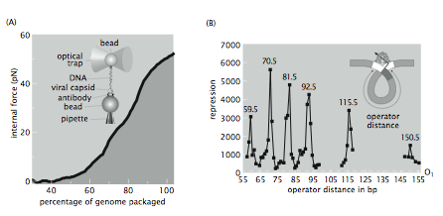
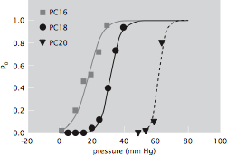
A Call to Arms: The Biological Frontiers of Physics
Often, biological data reports on functional relationships like those that are the lifeblood of physics.
Data of this variety imposes much stricter demands on biological theory. No amount of words or cartoons suffice to describe such data.
Genome Management
Gene regulation
Mechanosensors
(Smith et al.)
(Müller-Hill et al.)
(Perozo et al.)
Notes:
JT
Facet 1 of vision: the advent of quantitative data in biology REQUIRES a different way of doing business. In particular, such data demands associated quantitative models.

Slide 3
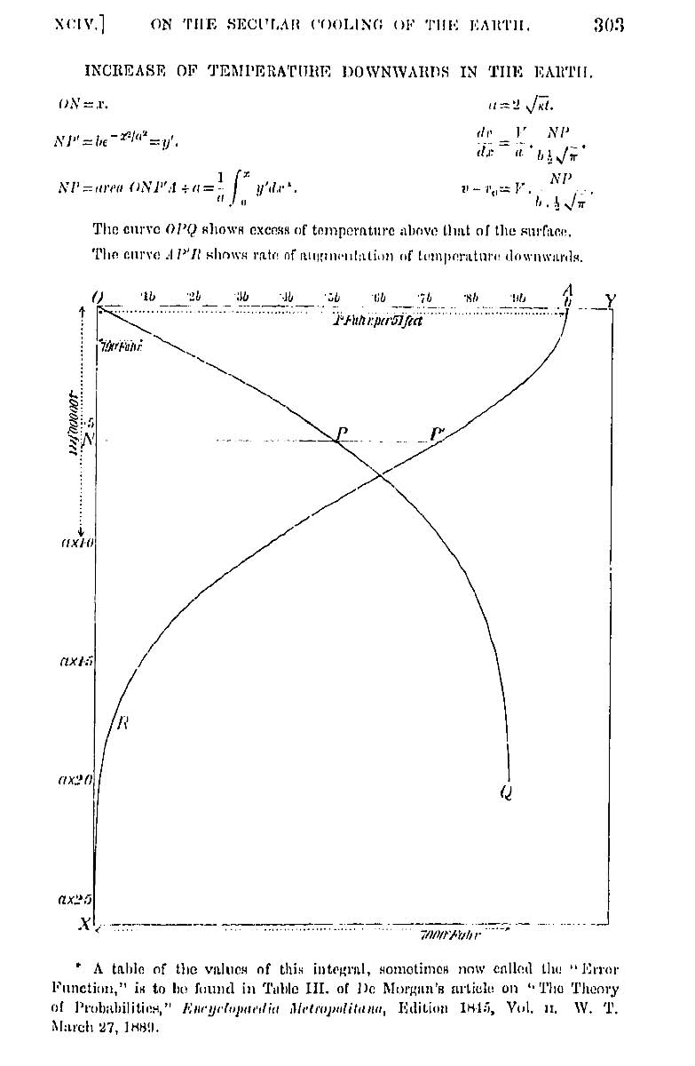
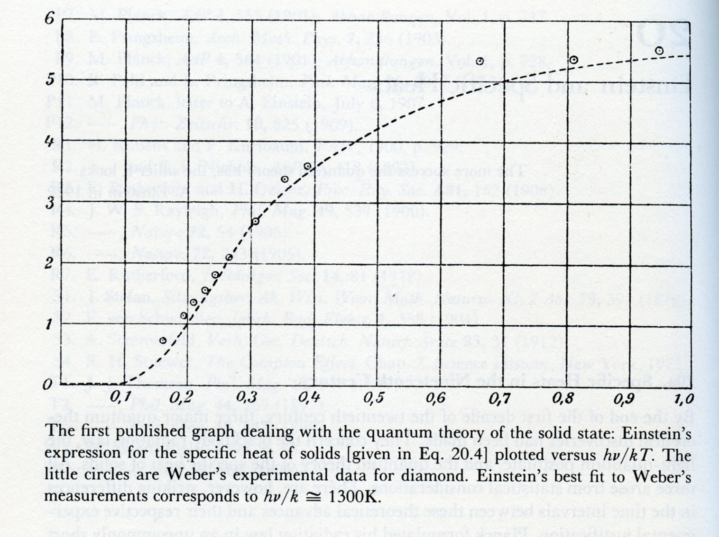
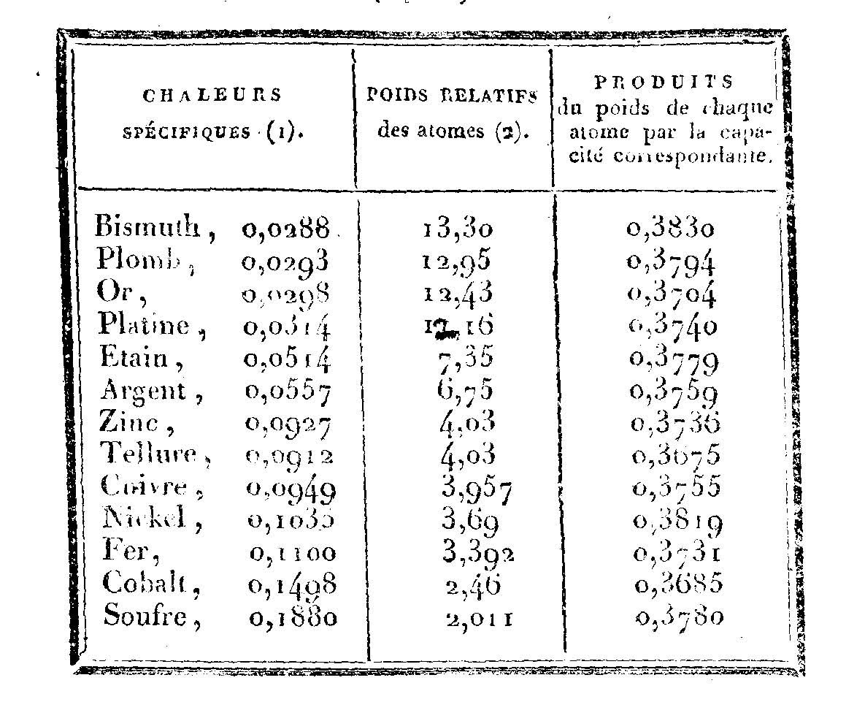
“The Job of Theorists in Biology Is to Be Wrong” – Analogies That Might Make the Point
Data of Dulong and Petit
Data of Weber
(Berman et al.)
“In order to recognize an anomaly, one needs a theory or a rule or at least a prejudice.” – Pais on Einstein’s work on specific heats.
Lord Rayleigh: “What would appear to be wanted is some escape from the destructive simplicity of the general conclusion [derived from equipartition].” – quoted in Pais, “Subtle is the Lord”
On the Secular Cooling of the Earth
By Lord Kelvin (William Thomson)
Excerpt. Transactions of the Royal Society of Edinburgh, Vol. XXIII, pp. 167-169, 1864.
Notes:
Anﾊintriguing aspect of multicellular organisms is the fact that there are a wide variety of different cell types, this despite the fact that each and every cell carries the same genetic information.ﾊ ﾊOne of the key mechanisms giving rise to distinct cellular identities is particular ``decisions'' that are made about which genes to express at different times and places in an organism's history.ﾊ Interestingly, decision making is not restricted to multicellular organisms, nor even to eukaryotic cells.ﾊ Indeed, the modern theory of gene regulation was born out of efforts to understand how bacterial cells decide which sugars to utilize at any given time.ﾊ In this talk, I will describe the ways in which statistical mechanics can be used to examine the regulatory processes that take place in the lives of cells.ﾊ These simple models result in surprising predictions and I will also describe our experimental efforts to probe this rich behavior both in test tubes and in living cells.ﾊ

Slide 4
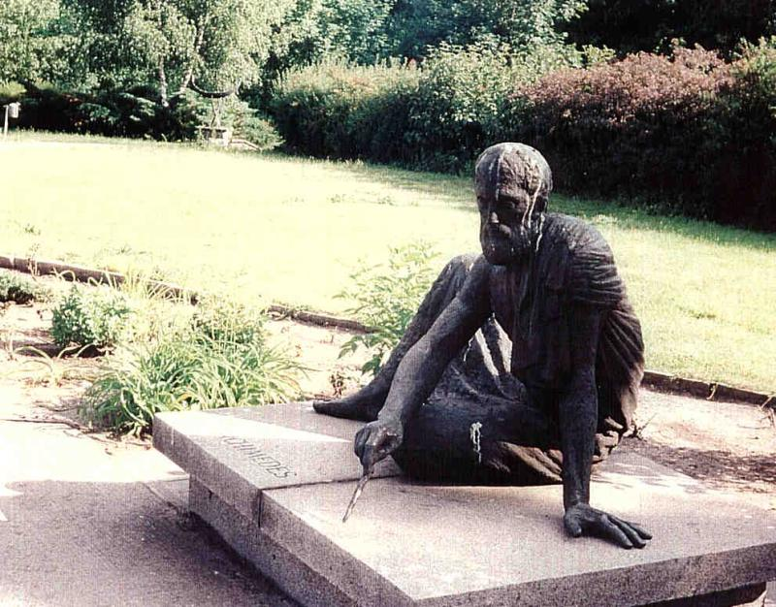
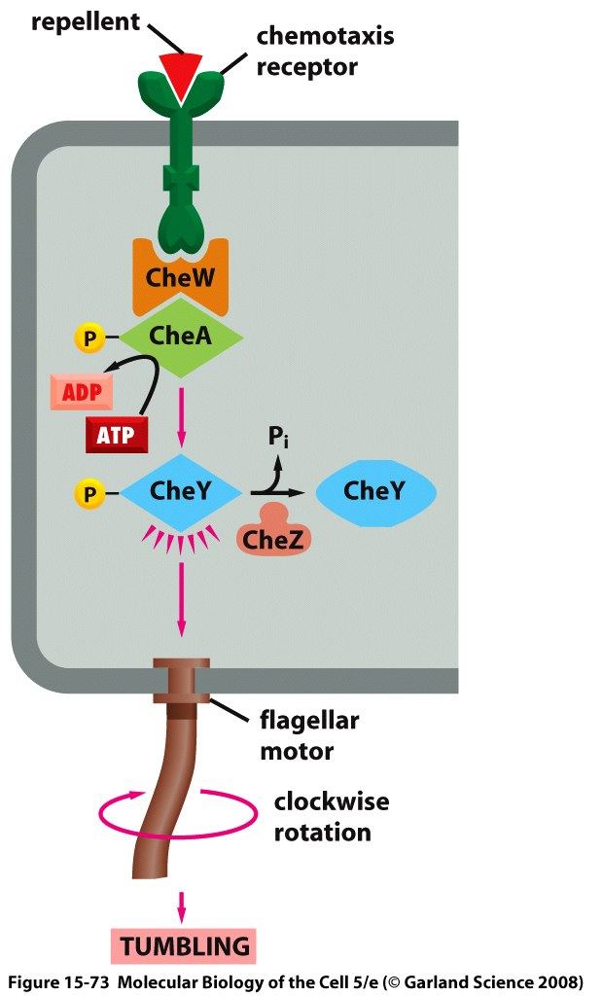
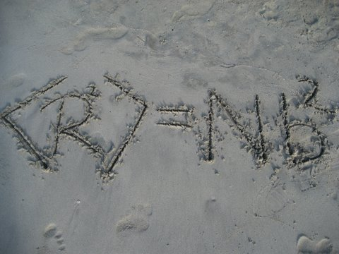
Our Starting Point: Stick in the Sand Estimates
Inspiring tradition from Archimedes to Newton to Fermi to Weisskopf to our own Caltech Physics Department (i.e my talk title is not an accident!
Concept: mathematicize the cartoons – that is, take the mechanisms suggested by biological cartoons seriously and see if they lead us to paradoxes when recast as precise mathematical arguments.
Notes:
JT

Slide 5
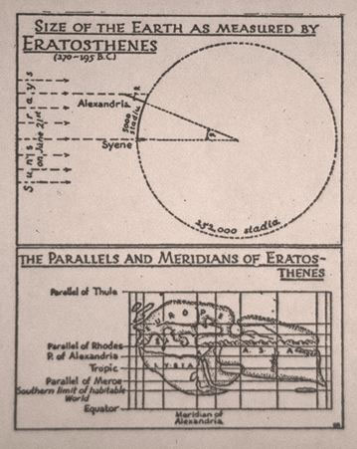
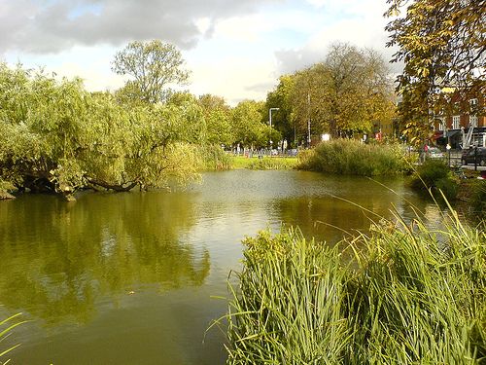
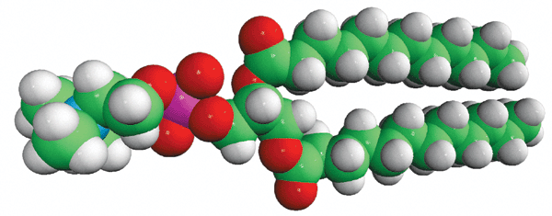
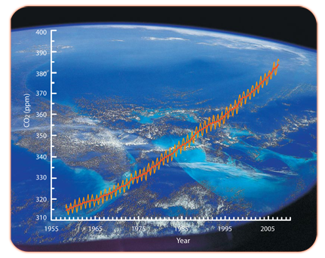
The Order of Magnitude Tradition: A List of Favorites
In high school, I found science uninspiring. On a Saturday night, at a friend’s house, I learned of Eratosthenes estimate of the radius of the Earth and was hooked just like that. One Saturday night devoted to a simple estimate beat 3 years of school.
(Berman et al.)
Newton worked out the number of “Paris feet” that the moon falls in one minute and also noted that “a body in our regions” (i.e. on the surface of the Earth) will “describe 60 x 60 x 15 ½ Paris feet” thus satisfying himself of the inverse square law.
From Franklin to Rayleigh and the size of a lipid molecule. Rayleigh’s oil estimate results in lipid size of 1.67 nm!
Keeling’s first great discovery can be used to estimate how many gigatons of carbon are fixed every year.
http://www.phys-astro.sonoma.edu/observatory/eratosthenes/
Estimates as a call to arms, as a producer of conundrums and surprises, as a tool to bring astronomically large numbers down to Earth and as a sanity check on purported mechanisms.
Notes:
Anﾊintriguing aspect of multicellular organisms is the fact that there are a wide variety of different cell types, this despite the fact that each and every cell carries the same genetic information.ﾊ ﾊOne of the key mechanisms giving rise to distinct cellular identities is particular ``decisions'' that are made about which genes to express at different times and places in an organism's history.ﾊ Interestingly, decision making is not restricted to multicellular organisms, nor even to eukaryotic cells.ﾊ Indeed, the modern theory of gene regulation was born out of efforts to understand how bacterial cells decide which sugars to utilize at any given time.ﾊ In this talk, I will describe the ways in which statistical mechanics can be used to examine the regulatory processes that take place in the lives of cells.ﾊ These simple models result in surprising predictions and I will also describe our experimental efforts to probe this rich behavior both in test tubes and in living cells.ﾊ

Slide 6
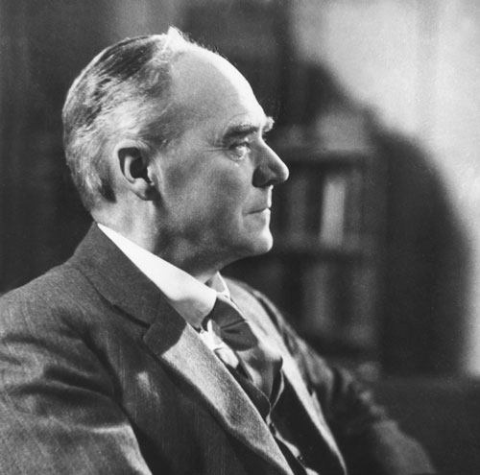
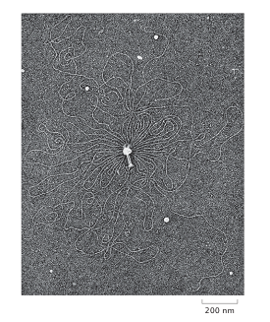
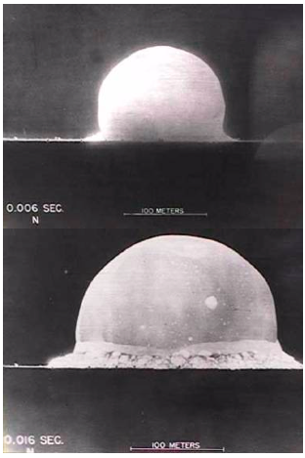
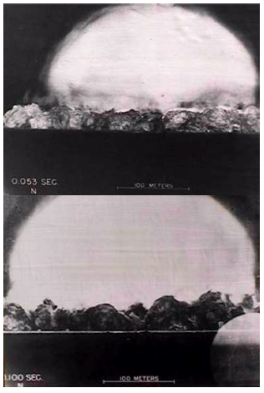
Bombs and Exploding Genomes: An analogy
Politicians and generals can make some information “classified” and it can be circumvented by cleverness.
This is a segue into our main topic: genomes and their use. Estimates on genome management.
Same idea could be used to estimate genome length by examining exploding genomes.
The concept: figure out the length of the genome using a single picture and pure thought!
(G. Stent)
Notes:
RP

Slide 7
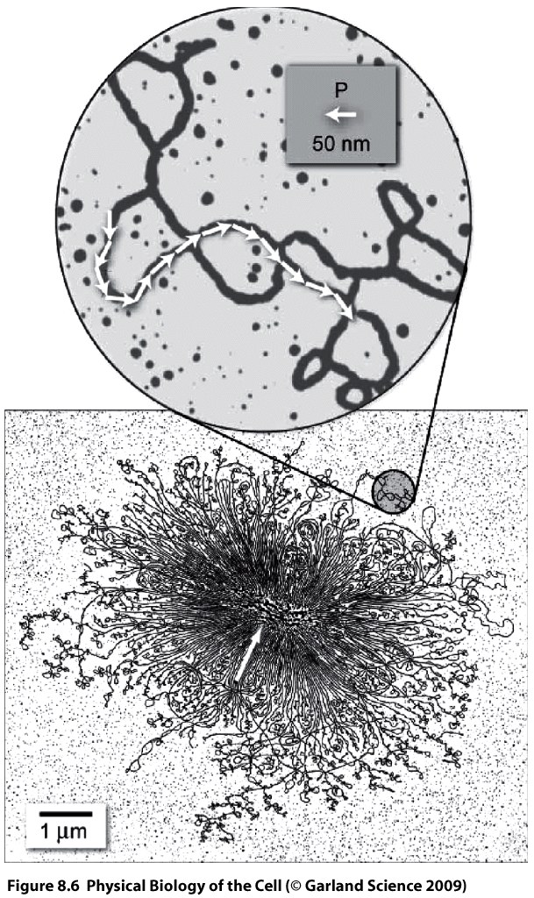
Estimations on Genome Management: How Big Are Genomes?
(G. Stent)
Use the simplest nunchuk physics of random walks to estimate the genome size (i.e. size in terms of number of base pairs).
What makes DNA different from some other polymer? The persistence length!
The radius of gyration scales as N^{1/2}, which allows us to estimate the number of such Kuhn segments and hence back out the genome length.
Note: This also tells us that work needs to be done to squish genomes into their hosts.
(R. Kavenoff)
Notes:
RP

Slide 8
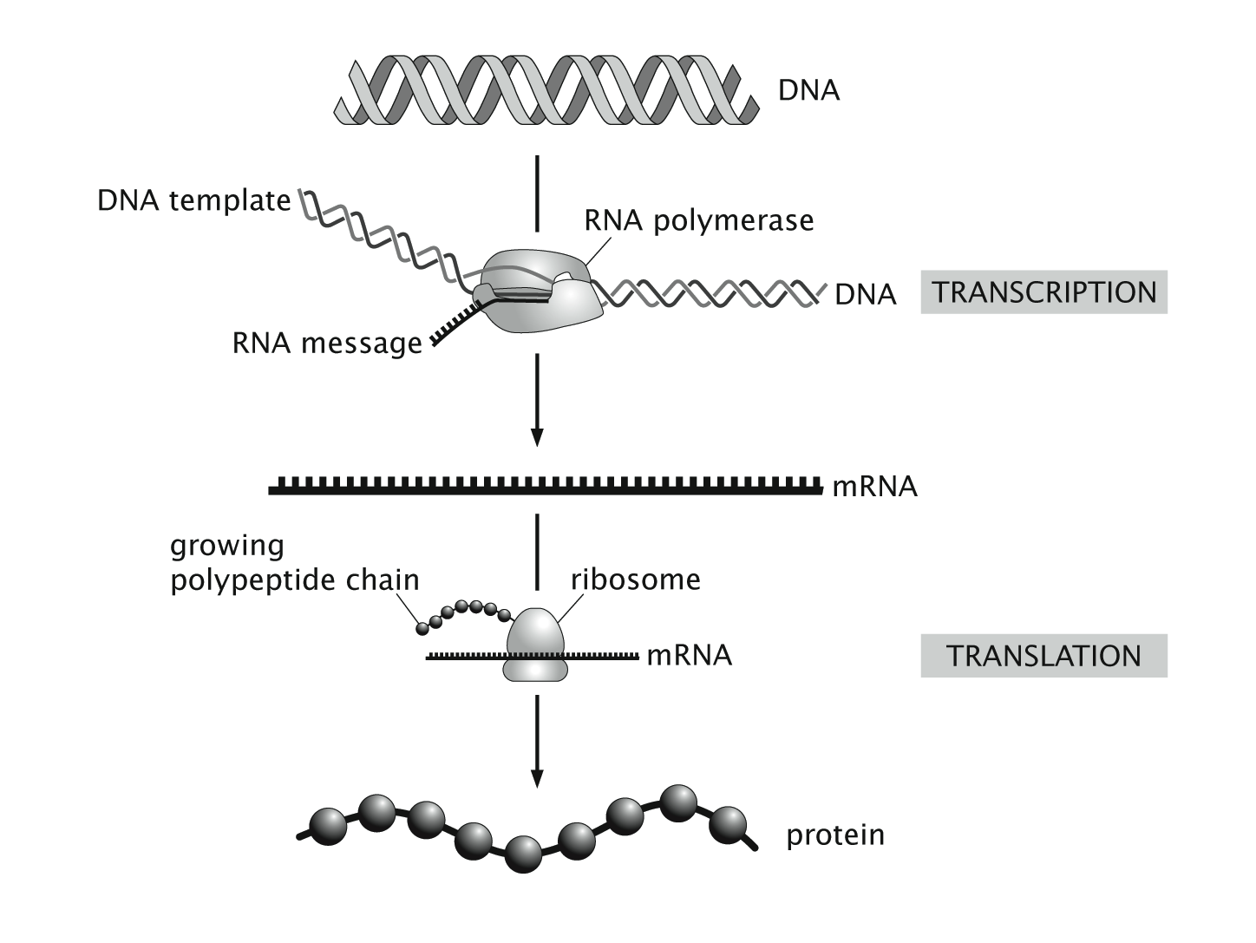
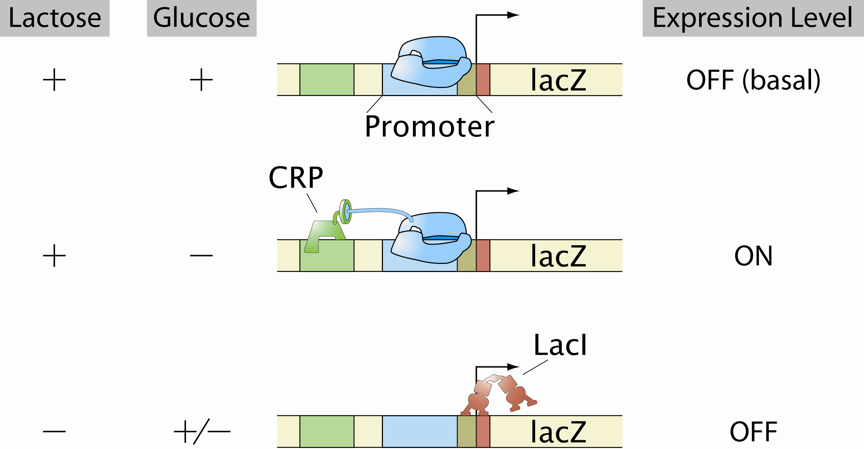
How Genes Are Controlled: The Journey From DNA to Active Proteins
As noted above, Francis Crick referred to nucleic acids and proteins as “the two great polymer languages”. The insight of Jacob and Monod was that there are genes that control other genes, permitting the flow of information from DNA to proteins only when certain conditions are met.
Metabolic genes for lactose usage in E. coli - the hydrogen atom of gene regulation.

Slide 9
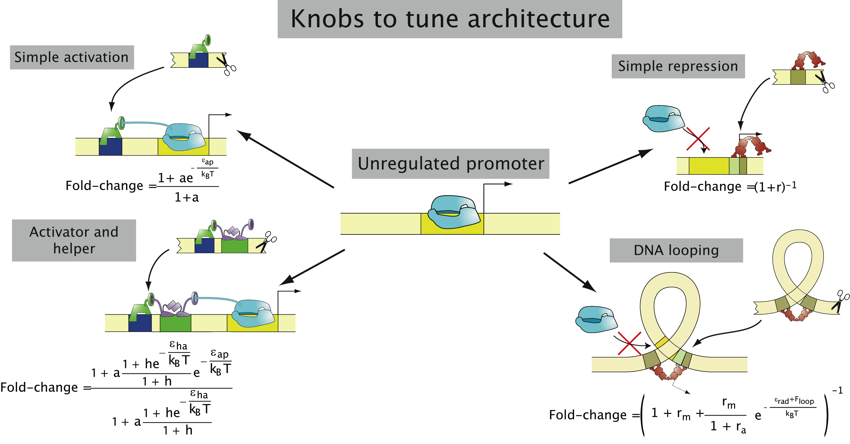
Can We Compute How Cells Decide?
The level of gene expression is described by a function that depends upon parameters such as the number of repressors and activators.
Key point: Systematic variation of parameters and examine the biological outcome. We are interested in the “fold-change” when parameters are tuned.
The equations are falsifiable predictions for a wide variety of regulatory architectures.
Notes:
9
Just show the variety of constructs

Slide 10
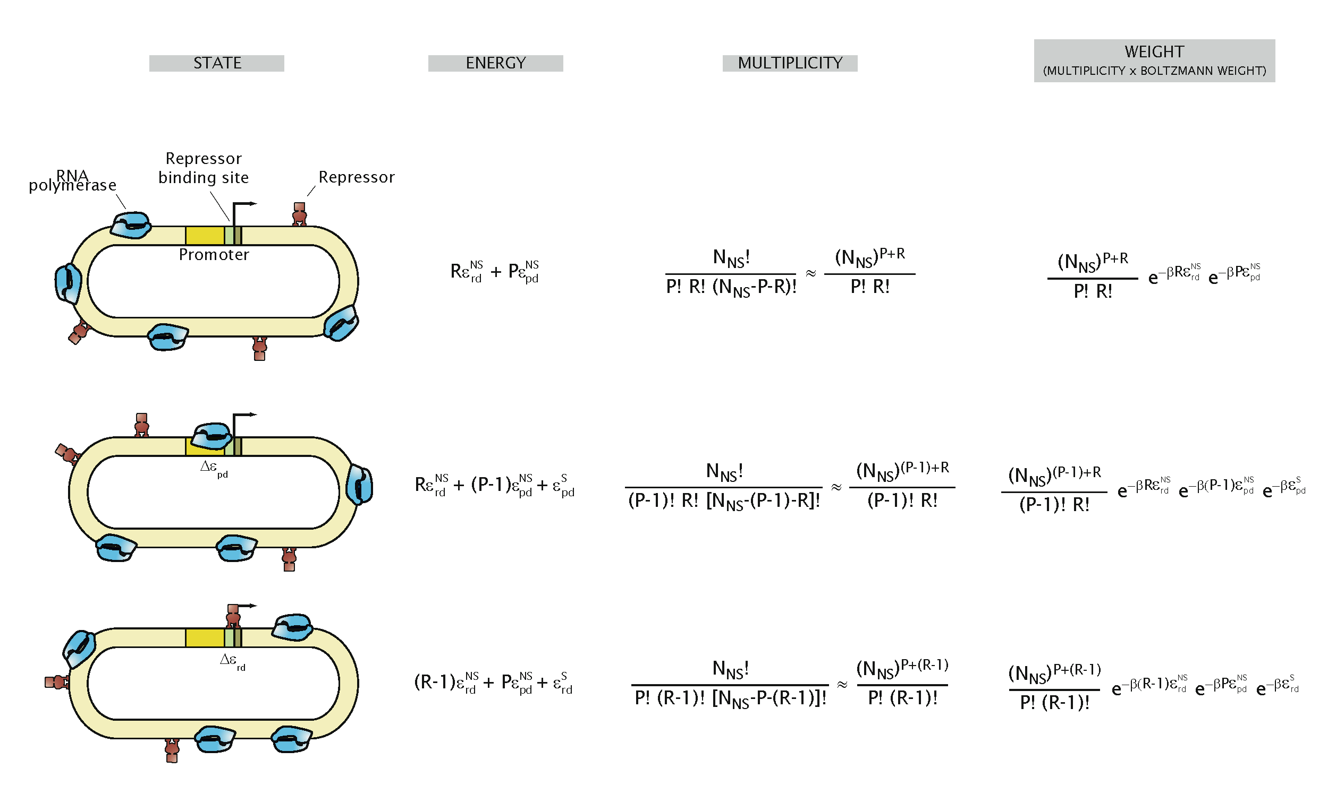
Statistical Mechanics to Estimate the Level of Gene Expression
The real estate in the vicinity of the promoter is under the control of molecular bouncers: activators and repressors.
``Thermodynamic models’’ (Ackers & Shea, Buchler, Gerland & Hwa, Vilar & Leibler, etc.) permit us to compute the probability of promoter occupancy as a function of the many parameters that can be controlled quantitatively. Do such models make sense?
Notes:
IDEA: Describe pbound. The two assumptions are hard to test in vivo, but they seem to make sense in vitro.
Supplementary:
Check out Novick and Sadler as well.
Have Smolke’s data for a justification.
Emphasize the assumption of pbound vs. gene expression!

Slide 11
Cells Decide: Where to Go
The Hunters of the Immune Response
(David Rogers)
(Berman et al.)
There is another kind of rapid response to environmental cues that is much faster than gene regulation.
The “decision” about where to go next is highly regulated and results in the synthesis of new cytoskeletal filaments at the leading edge of the cell.
Once again, there is an interesting random walk story behind the scenes.

Slide 12
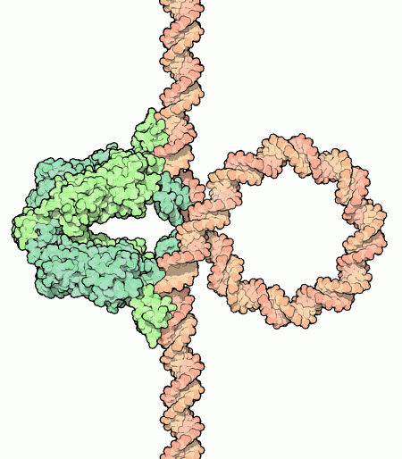
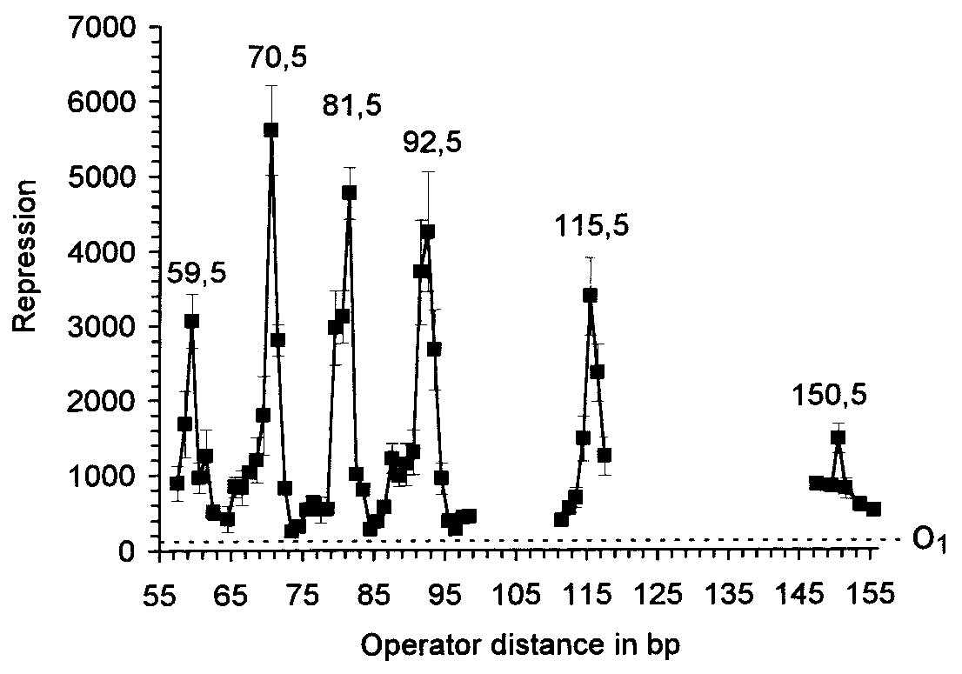
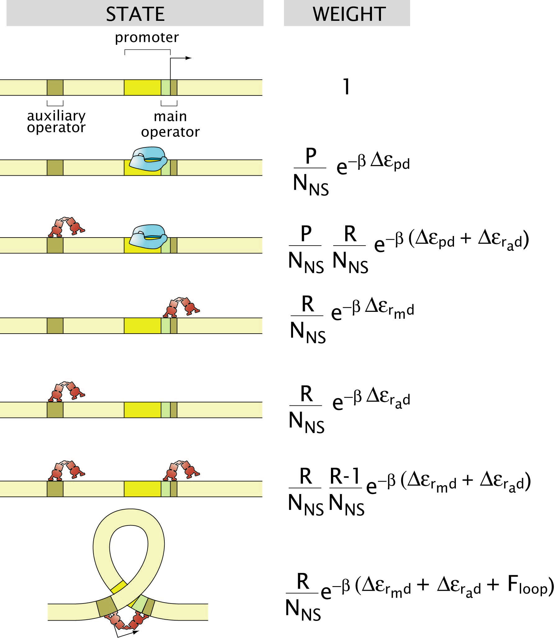
Conclusions
Strongly held opinion: quantitative data demands quantitative models. The traditional verbal and cartoon approach is incommensurate with the data.
We are in the stage when often stick in the sand estimates or simple back of the envelope calculations suffice to provide the kinds of polarizing predictions referred to in the quote from Rayleigh.
A Caltech qualifier story: “If you don’t know what to ask them, ask them about diffusion (i.e. random walks).” – John Hopfield – Random walks have great biological reach. This talk: use of random walks in thinking about cellular decision making.
Einstein on his ETH experience: “The most fascinating subject at the time that I was a student was Maxwell’s theory”, “we waited in vain for a presentation of Maxwell’s theory”.
The study of living matter is one of most fascinating subjects of the day (don’t care if it is called biology or physics or bioengineering or tomato soup).
?
Notes:
RP

Slide 13
Warning: Criticisms of the Approach
What is a biophysicist? Scott Fraser had an answer for me. “You can’t be interdisciplinary without the disciplines”.
Many of the most important recent discoveries in biology such as the role of small RNAs have not required any physical input.
Biologists want “new biology” and physicists want “new physics”. For now, perhaps both groups view “physical biology” as dotting “i”s and crossing “t”s. The only way I know how to progress is by making thorough attack on specific, detailed case studies and seeing if the approach pays off.
(Berman et al.)
Notes:
Anﾊintriguing aspect of multicellular organisms is the fact that there are a wide variety of different cell types, this despite the fact that each and every cell carries the same genetic information.ﾊ ﾊOne of the key mechanisms giving rise to distinct cellular identities is particular ``decisions'' that are made about which genes to express at different times and places in an organism's history.ﾊ Interestingly, decision making is not restricted to multicellular organisms, nor even to eukaryotic cells.ﾊ Indeed, the modern theory of gene regulation was born out of efforts to understand how bacterial cells decide which sugars to utilize at any given time.ﾊ In this talk, I will describe the ways in which statistical mechanics can be used to examine the regulatory processes that take place in the lives of cells.ﾊ These simple models result in surprising predictions and I will also describe our experimental efforts to probe this rich behavior both in test tubes and in living cells.ﾊ

Slide 14
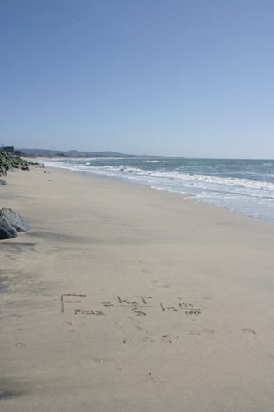
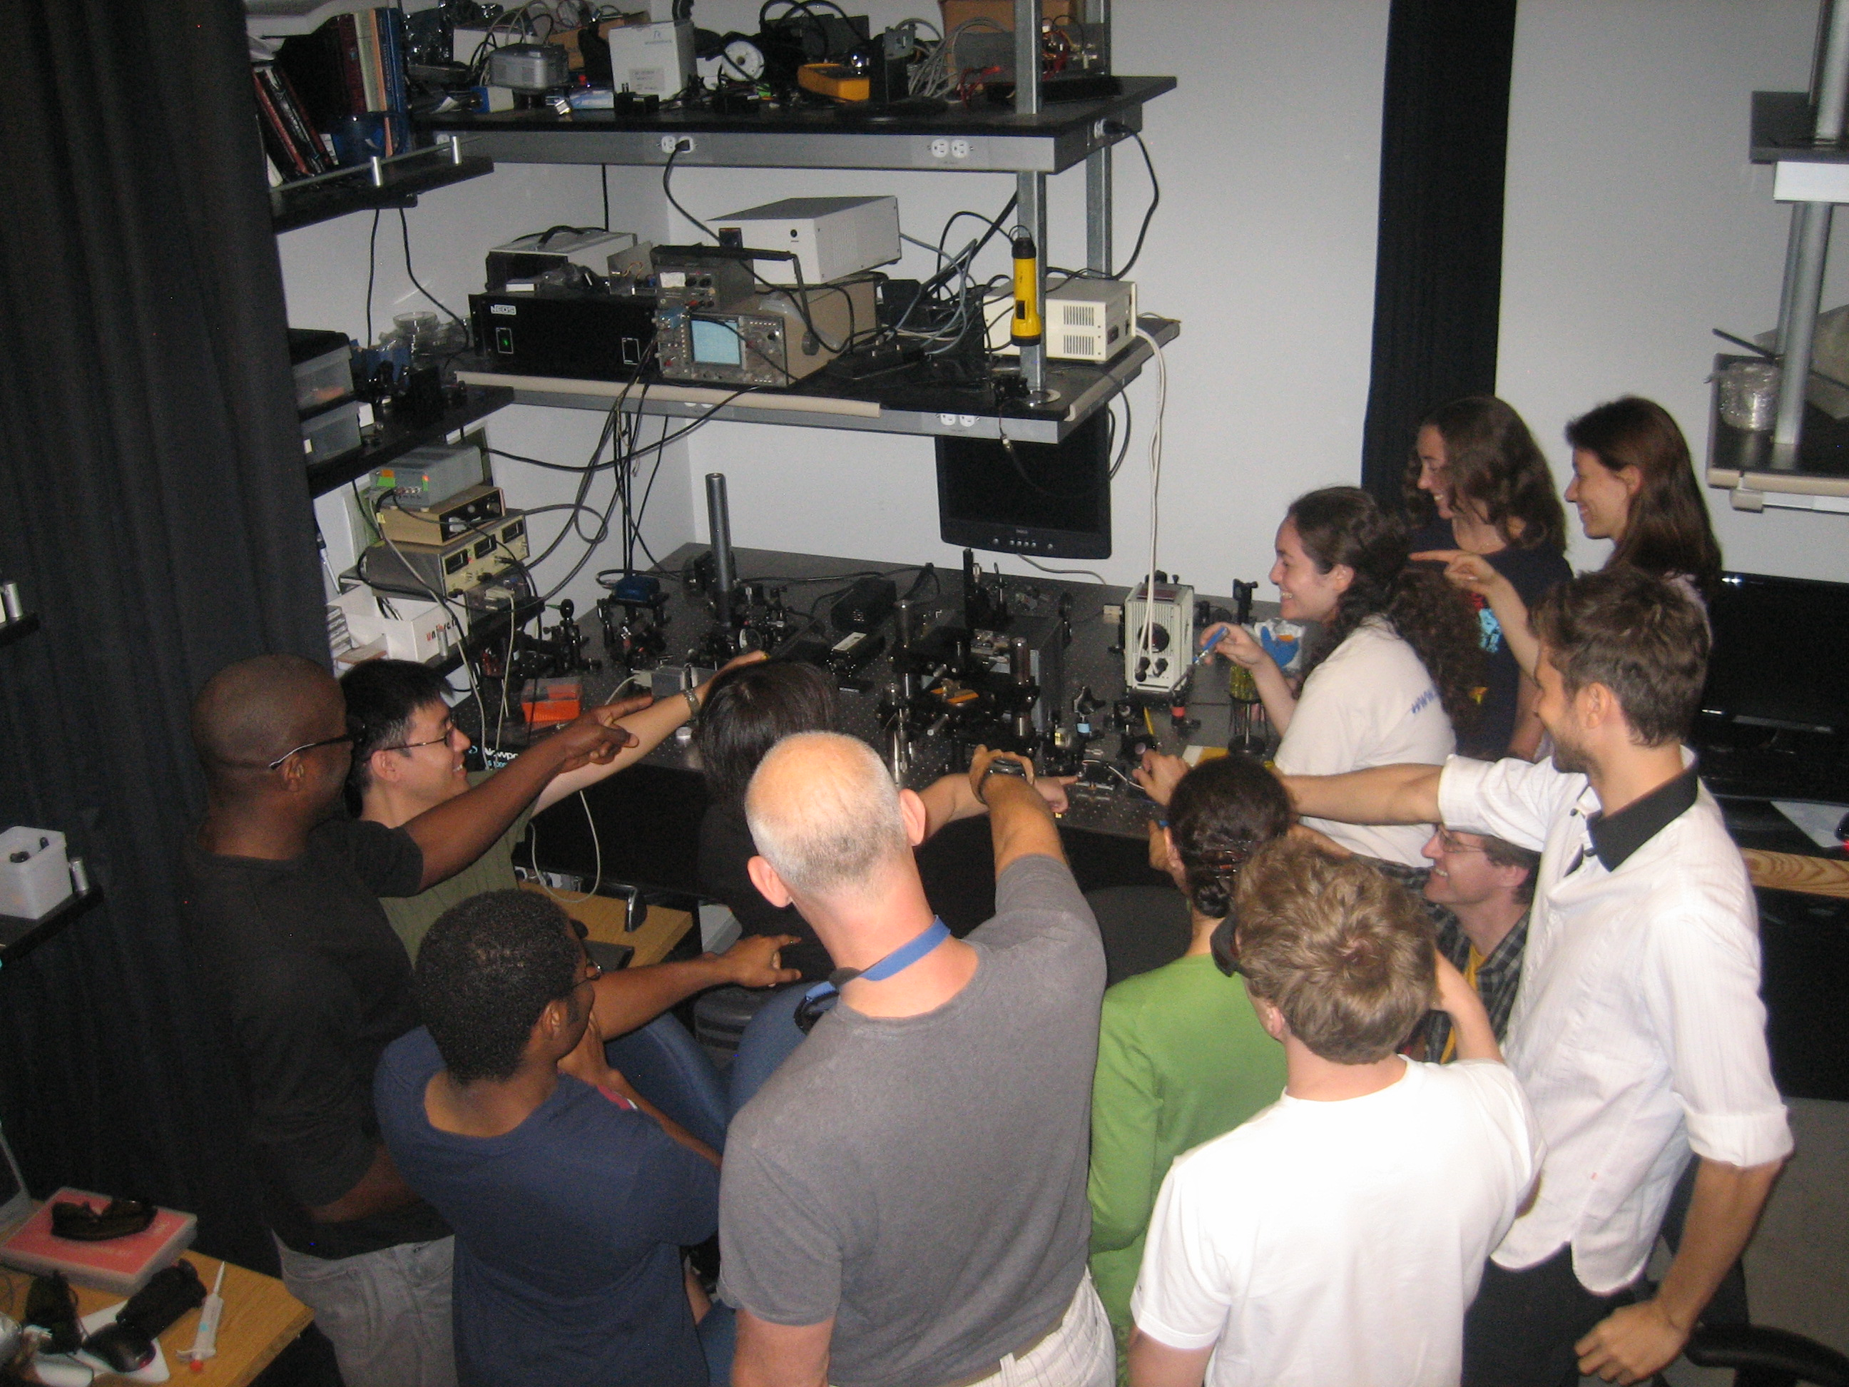
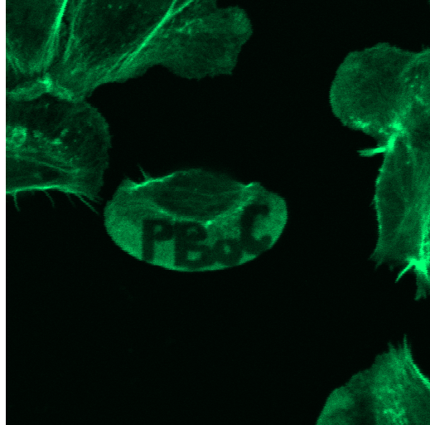
Acknowledgements
Julie Theriot
Jane Kondev
Nigel Orme
Lin Han, Hernan Garcia, Stephanie Johnson
Ron Milo
David Van Valen and Mikko Haatja
RP group – thanks for the fun and education!

Slide 15
Extra Slides for Questions
This slide left blank intentionally

Slide 16
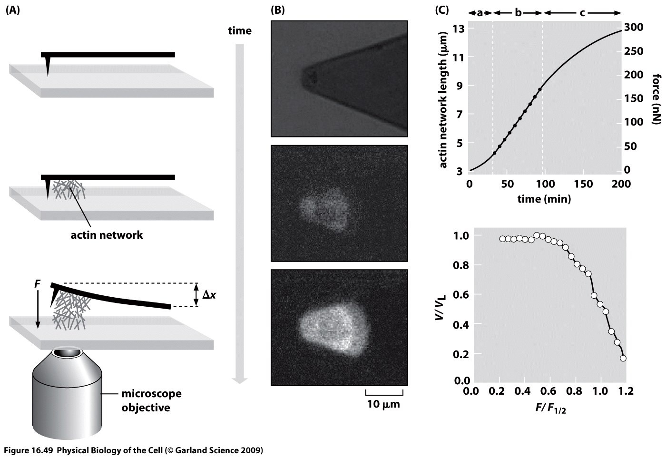
Application of force by polymerizing actin filaments
In this beautiful experiment, the force applied by cytoskeletal filaments is measured using an AFM.
Our focus here though is on the decision making aspects rather than the force generation characteristics.

Slide 17
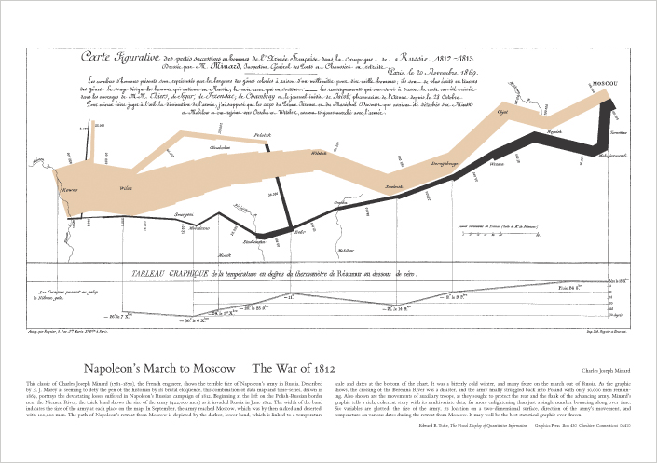
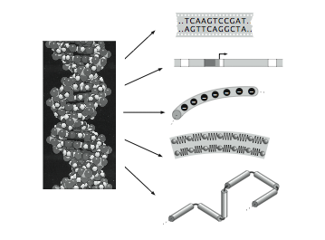
Beautiful Evidence, Envisioning Information
I just finished Tufte’s most recent, excellent book where he includes his biting assessment of “the cognitive style of powerpoint” so I am feeling guilty and self-conscious and tried to do a better job of constructing my presentation so you can better assess my message and the evidence supporting it.
Tufte on “Envisioning Information” brings us to our topic: DNA as information and how is that related to the fact that DNA is a real world molecule (not just a set of letters)?

