Slide 1
BE/APh161 – Physical Biology of the Cell
Rob Phillips
Applied Physics and Bioengineering
California Institute of Technology

Slide 2
Patterning During Development: Spacetime gene expression

Slide 3
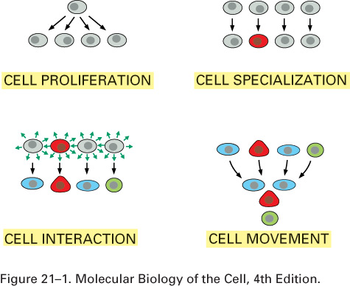
Building a multicellular organism

Slide 4
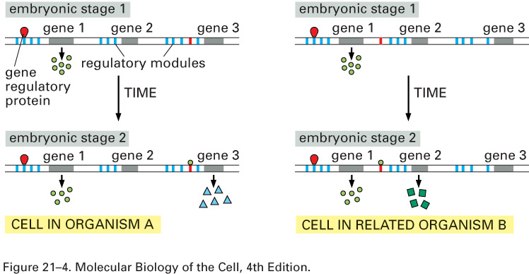
Changes in the regulatory landscape: An Evolutionary View
Figure 21–4 How regulatory DNA defines the succession of gene expression patterns in development.
The genomes of organisms A and B code for the same set of proteins but have different regulatory DNA. The two cells in the cartoon start in the same state, expressing the same proteins at stage 1, but step to quite different states at stage 2 because of their different arrangements of regulatory modules.

Slide 5
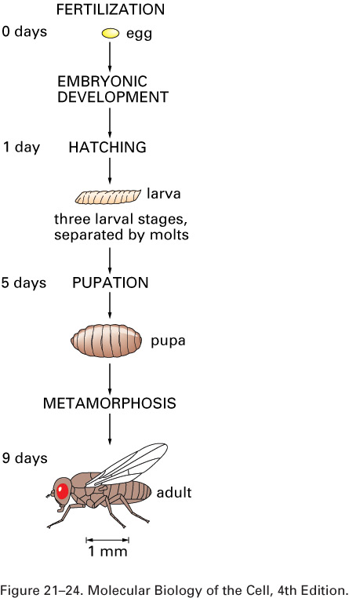
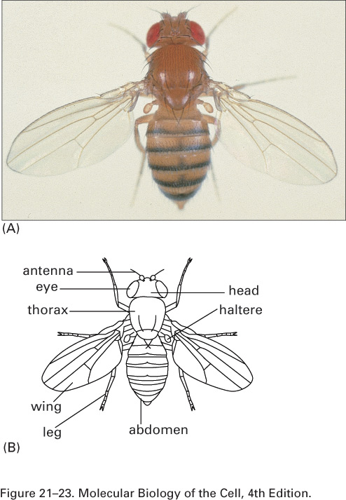
Flies and their development

Slide 6
Fly development

Slide 7
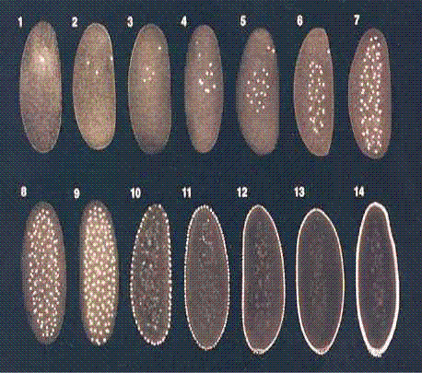
Fly early embryo
Development in a box!
Doubling time = 8min

Slide 8
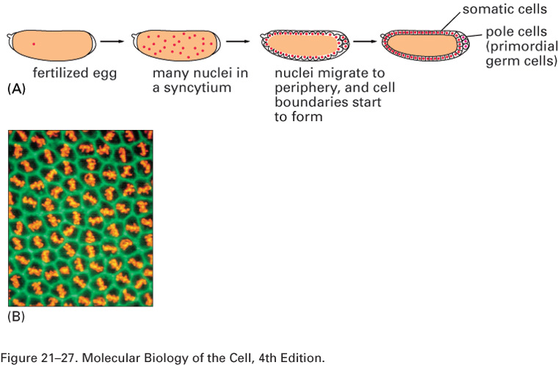
Fly early embryo
Figure 21–27 Development of the Drosophila egg from fertilization to the cellular blastoderm stage.
(A) Schematic drawings. (B) Surface view—an optical-section photograph of blastoderm nuclei undergoing mitosis at the transition from the syncytial to the cellular blastoderm stage. Actin is stained green, chromosomes orange. (A, after H.A. Schneiderman, in Insect Development [P.A. Lawrence, ed.], pp. 3–34. Oxford, UK: Blackwell, 1976; B, courtesy of William Sullivan.)

Slide 9
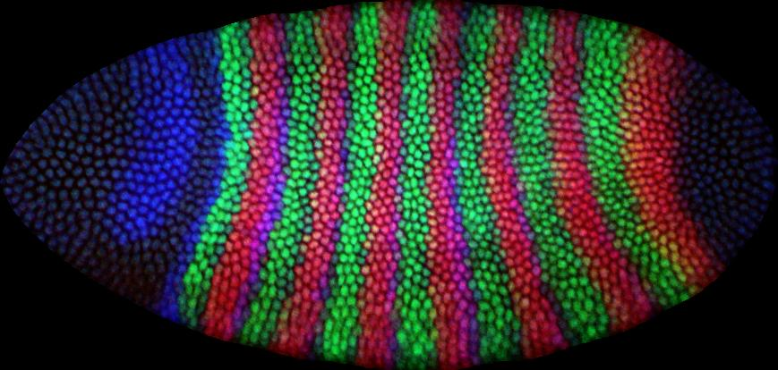
Fly early embryo
Development in a box!
Doubling time = 8min
How are these spatial patterns of gene expression established?

Slide 10
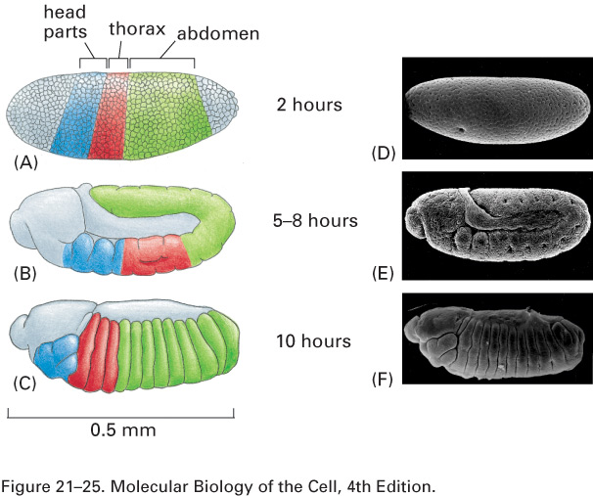
Fly early embryo
Figure 21–25 The origins of the Drosophila body segments during embryonic development.
The embryos are seen in side view in drawings (A–C) and corresponding scanning electron micrographs (D–F). (A and D) At 2 hours the embryo is at the syncytial blastoderm stage (see Figure 21–51) and no segmentation is visible, although a fate map can be drawn showing the future segmented regions (color in A). (B and E) At 5–8 hours the embryo is at the extended germ band stage: gastrulation has occurred, segmentation has begun to be visible, and the segmented axis of the body has lengthened, curving back on itself at the tail end so as to fit into the egg shell. (C and F) At 10 hours the body axis has contracted and become straight again, and all the segments are clearly defined. The head structures, visible externally at this stage, will subsequently become tucked into the interior of the larva, to emerge again only when the larva goes through pupation to become an adult. (D and E, courtesy of F.R. Turner and A.P. Mahowald, Dev. Biol. 50:95–108, 1976. © Academic Press; F, from J.P. Petschek, N. Perrimon, and A.P. Mahowald, Dev. Biol. 119:175–189, 1987. © Academic Press.)

Slide 11
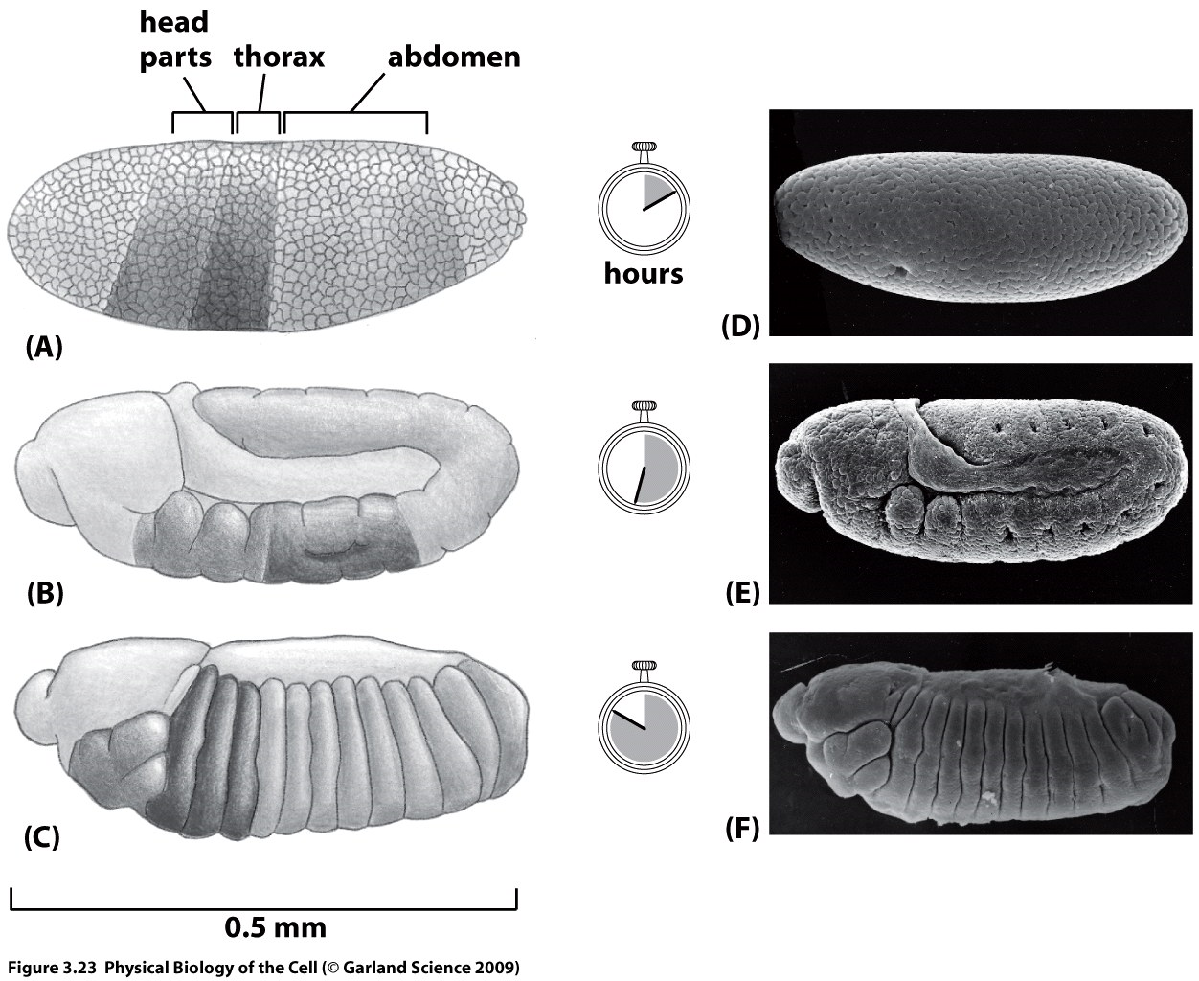
Fly embryo by the numbers

Slide 12
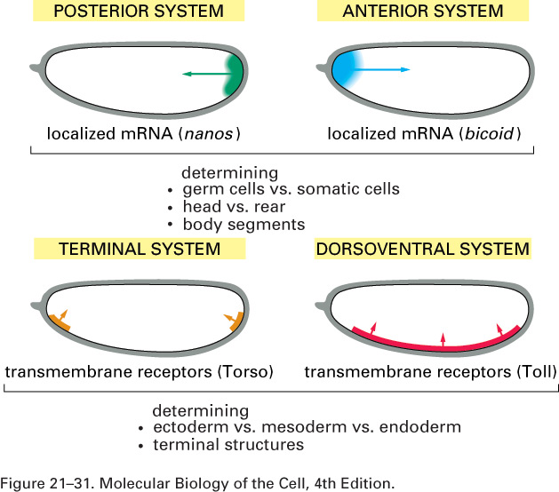
Setting up positional information

Slide 13
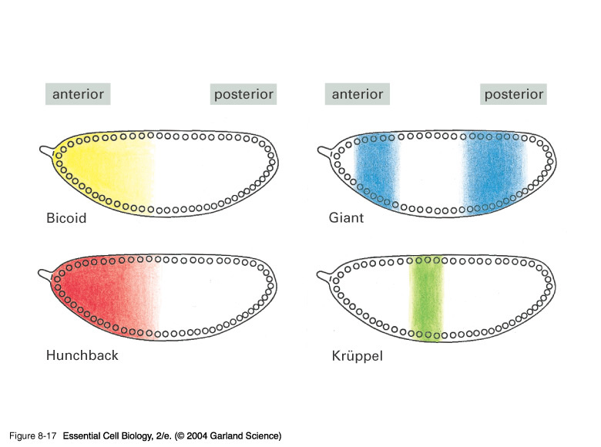
08_017.jpg
Key regulatory proteins and their gradients

Slide 14
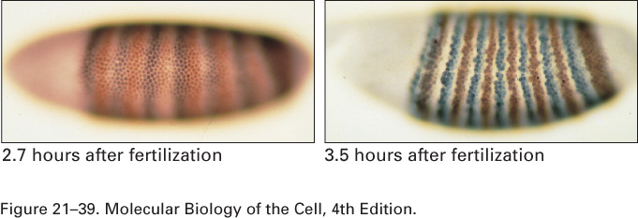
Patterns of gene expression on the anterior-posterior axis
Figure 21–39 The formation of ftz and eve stripes in the Drosophila blastoderm.
ftz and eve are both pair-rule genes. Their expression patterns (shown in brown for ftz and in gray for eve) are at first blurred but rapidly resolve into sharply defined stripes. (From P.A. Lawrence, The Making of a Fly. Oxford, UK: Blackwell, 1992.)

Slide 15
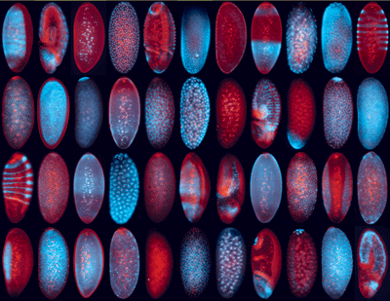
Measuring patterns of gene expression during fly development
http://fly-fish.ccbr.utoronto.ca/

Slide 16
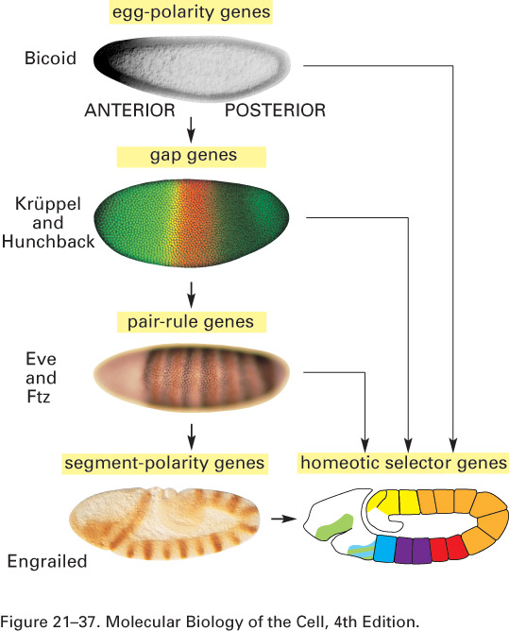
Setting up positional information: anterior-posterior axis
Figure 21–37 The regulatory hierarchy of egg- polarity, gap, segmentation, and homeotic selector genes.
The photographs show expression patterns of representative examples of genes in each category, revealed by staining with antibodies against the protein products. The homeotic selector genes, discussed below, define the lasting differences between one segment and the next. (Photographs (i) from W. Driever and C. Nüsslein-Volhard, Cell 54:83–104, 1988. © Elsevier; (ii) courtesy of Jim Langeland, Steve Paddock, Sean Carroll, and the Howard Hughes Medical Institute; (iii) from P.A. Lawrence, The Making of a Fly. Oxford, UK: Blackwell, 1992; (iv) from C. Hama, Z. Ali, and T.B. Kornberg, Genes Dev. 4:1079–1093, 1990. © Cold Spring Harbor Press.)

Slide 17
Turing model two cell model

Slide 18
Turing waves

