Slide 1
BE/APh161 – Physical Biology of the Cell
Rob Phillips
Applied Physics and Bioengineering
California Institute of Technology

Slide 2
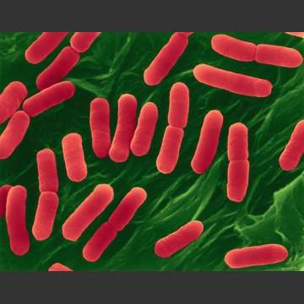
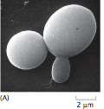
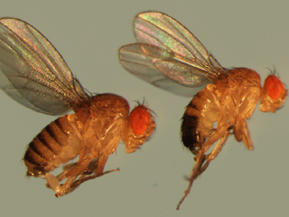
How Cells Decide as Seen Through Three Hall of Fame ``Model’’ Organisms
E. coli
yeast
(Berman et al.)
Fruit fly
Various organisms are accorded hall of fame status as ``model’’ organisms either because they are specialists at some particular process of interest or they are experimentally convenient (grow fast, easily accessible).
Each of these organisms offers something extremely important on the question of how cells decide.

Slide 3
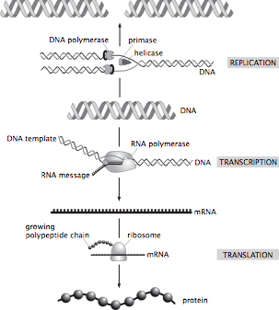
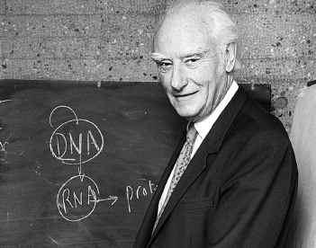
The Central Dogma of Molecular Biology: How Genes Lead to Proteins
Crick and others mused over the ``two great polymer languages’’.
Central dogma explains the chain of events relating them.
The ribosome is the universal translating machine that speaks both languages.
We have seen what genes are and how they serve as the informational memory of organisms. But we have NOT said how they are controlled.
(Berman et al.)
Now we have the background to tackle the question we started with: how do cells make decisions?

Slide 4
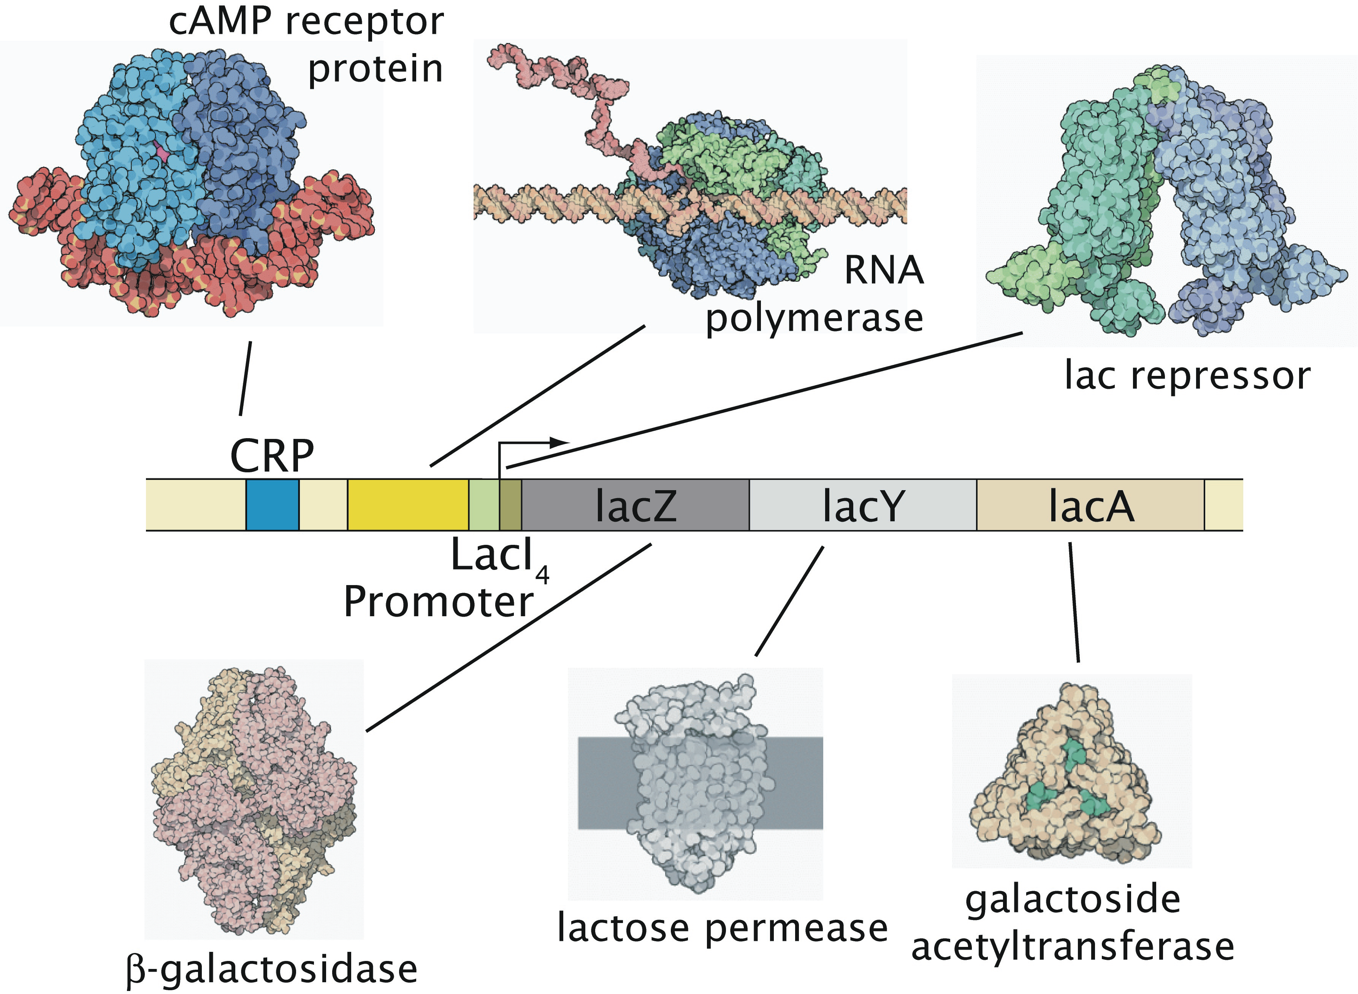
The Big Message
The Puzzle: All the cells in a given organism (almost) carry the same
genetic information. And yet, depending upon where they are within
the organism, they turn out quite differently.
This lecture: how we found out, some beautiful examples, where we stand now.
The Insight: The genome (i.e. genetic material) is under exquisite
control. Genes are turned on and off in response to environmental cues.

Slide 5
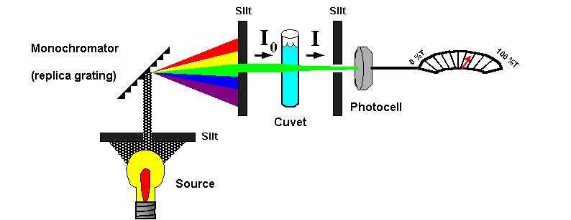
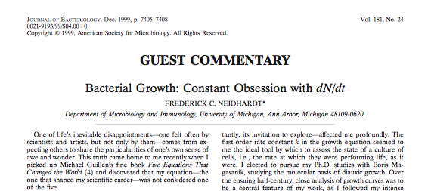
Measuring the Diet of a Bacterium
Growth curves have served a central role in dissecting the physiology of cells of all types.
In particular, we know much about how cells decide based upon watching them grow and seeing what they like to eat.

Slide 6
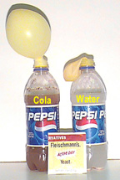
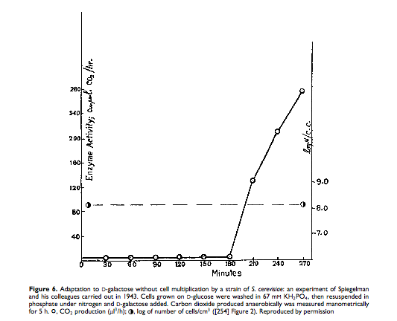
Deciding What to Eat: Giant Discoveries Often Arise From Seemingly Arcane Topics
Fascinating twist of history of science: human curiosity leads to investigation of seemingly arcane topics (spectral lines of atoms, specific heats of solids, peculiarities in the orbits of Uranus or Mercury, etc.) from which emerge hugely important insights.
An example: nutrition of single cells like yeast and bacteria.
Yeast cells express preferences about which sugar to use.
Interestingly, the proteins used to digest the less preferable sugars are only synthesized when those sugars are present and the more preferable sugars are absent.
(Berman et al.)
(Spiegelman et al., PNAS, 1944)
Notes:
Anﾊintriguing aspect of multicellular organisms is the fact that there are a wide variety of different cell types, this despite the fact that each and every cell carries the same genetic information.ﾊ ﾊOne of the key mechanisms giving rise to distinct cellular identities is particular ``decisions'' that are made about which genes to express at different times and places in an organism's history.ﾊ Interestingly, decision making is not restricted to multicellular organisms, nor even to eukaryotic cells.ﾊ Indeed, the modern theory of gene regulation was born out of efforts to understand how bacterial cells decide which sugars to utilize at any given time.ﾊ In this talk, I will describe the ways in which statistical mechanics can be used to examine the regulatory processes that take place in the lives of cells.ﾊ These simple models result in surprising predictions and I will also describe our experimental efforts to probe this rich behavior both in test tubes and in living cells.ﾊ

Slide 7
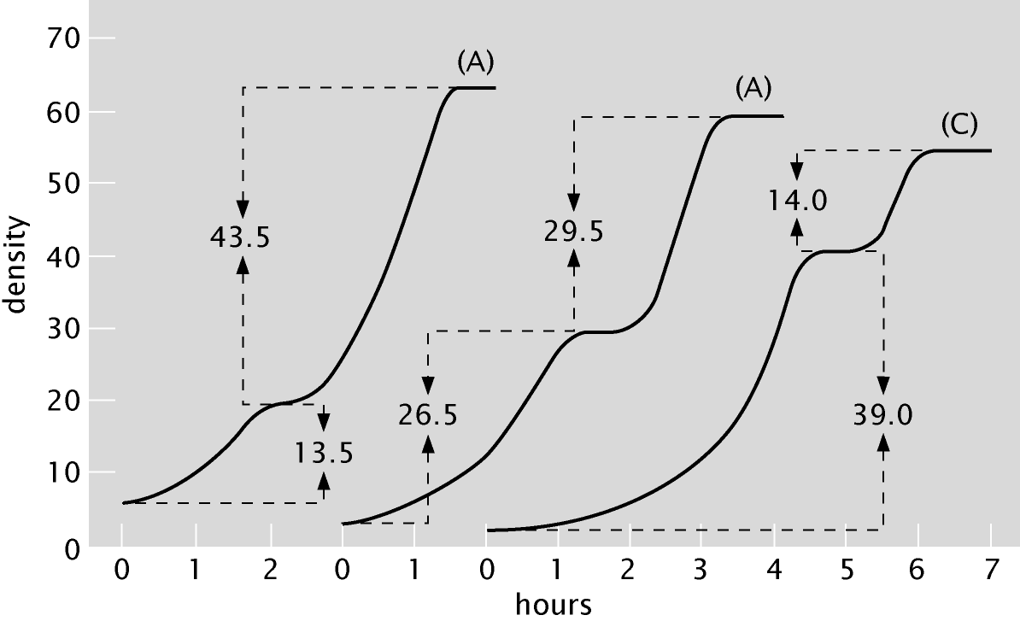
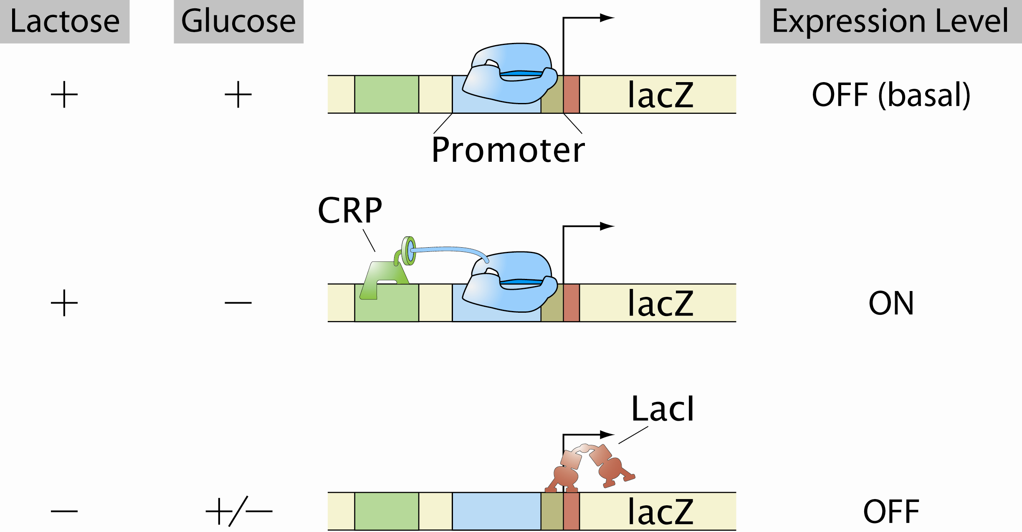
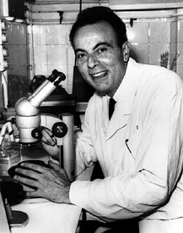
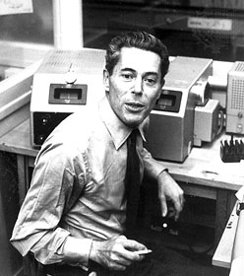
A Model System for Mathematically Dialing in Transcription
The way all of this works was first figured out in the context of a very specific question in bacteria. How do cells implement the decision that they prefer some sugar sources (i.e. glucose) over others (i.e. lactose)?
What emerged was a picture in which genomic DNA is controlled by an army of molecular bouncers (transcription factors) that activate or repress expression of their genes of interest.
(Berman et al.)
Bacterial growth curves
Notes:
Anﾊintriguing aspect of multicellular organisms is the fact that there are a wide variety of different cell types, this despite the fact that each and every cell carries the same genetic information.ﾊ ﾊOne of the key mechanisms giving rise to distinct cellular identities is particular ``decisions'' that are made about which genes to express at different times and places in an organism's history.ﾊ Interestingly, decision making is not restricted to multicellular organisms, nor even to eukaryotic cells.ﾊ Indeed, the modern theory of gene regulation was born out of efforts to understand how bacterial cells decide which sugars to utilize at any given time.ﾊ In this talk, I will describe the ways in which statistical mechanics can be used to examine the regulatory processes that take place in the lives of cells.ﾊ These simple models result in surprising predictions and I will also describe our experimental efforts to probe this rich behavior both in test tubes and in living cells.ﾊ

Slide 8
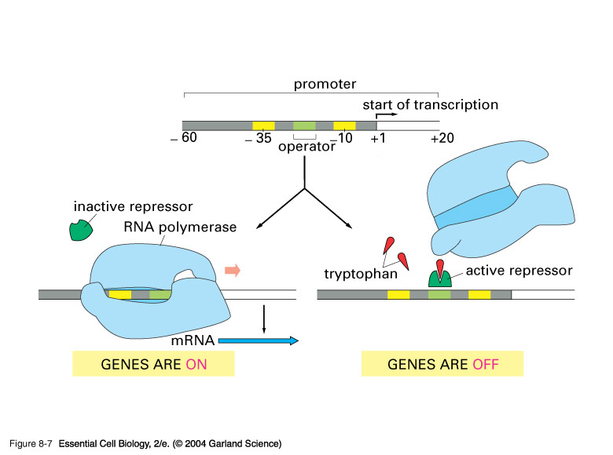
Repressors: The Cartoon
Repressor molecules inhibit action of RNA polymerase.
Repressors can be under the control of other molecules (i.e. inducers) that dictate when repressor is bound and not.
Notes:
Repressor – simple minded picture is that the repressor molecule blocks the promoter. We are not interested in the fine point of whether or not this is REALLY the structural picture.

Slide 9
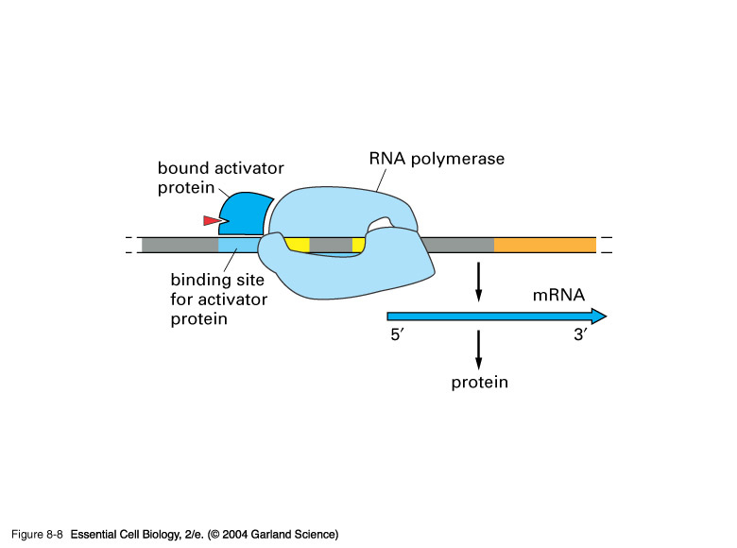
Activators: The Cartoon
Activator molecules enhance the action of RNA polymerase.
Activators can be under the control of other molecules (i.e. inducers) that dictate when activator is bound and not.
Activators “RECRUIT” the polymerase.
Adhesive interaction between RNAP
and activator

Slide 10
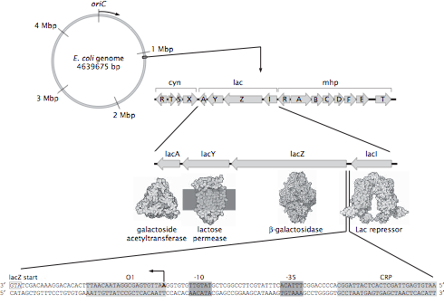
Not All DNA Codes for Proteins
The E. coli genome is a circle with roughly 4.7 million base pairs.
How many genes? An estimate.
The genes related to sugar usage have been one of the most important stories in the history of modern biology and biochemistry (and take us right back to the great debate on vitalism played out with Pasteur in the 1800s).
“Promoter” region on DNA is subject to intervention by various molecular bouncers that govern the gene.
(Berman et al.)
The regulatory landscape

Slide 11
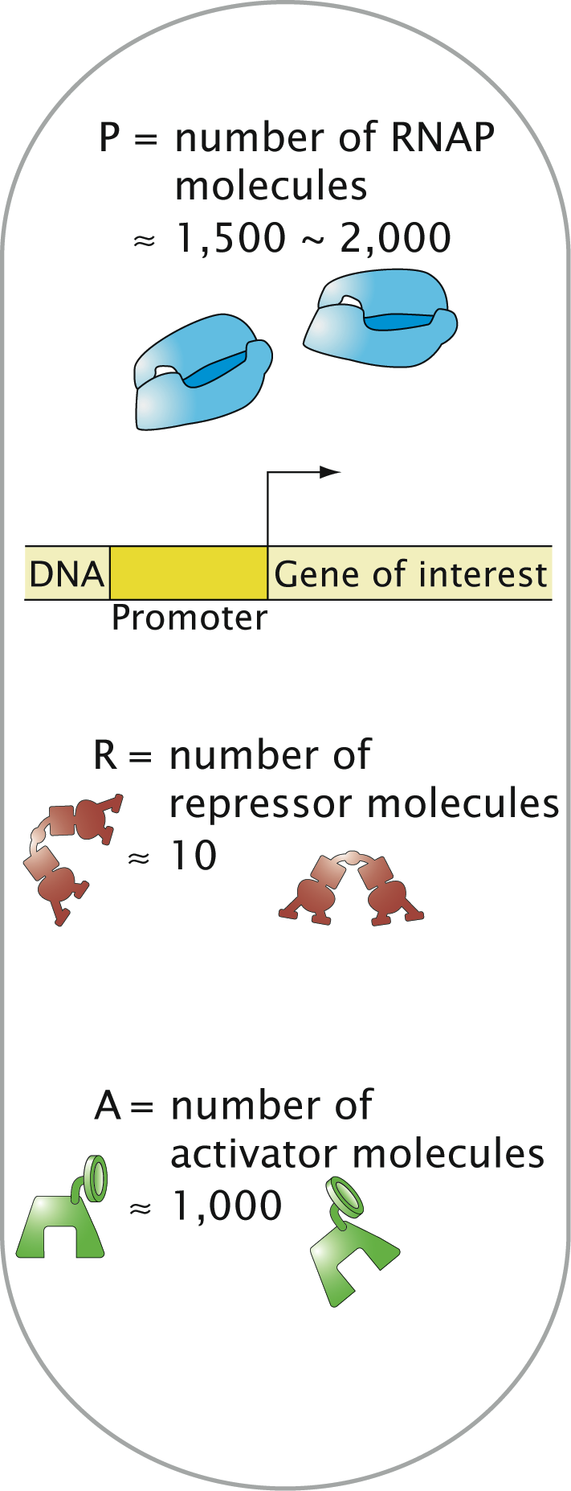
Lac Operon: The Single Molecule Census
(Beautiful work of David Goodsell)

Slide 12
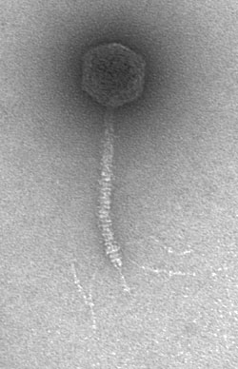
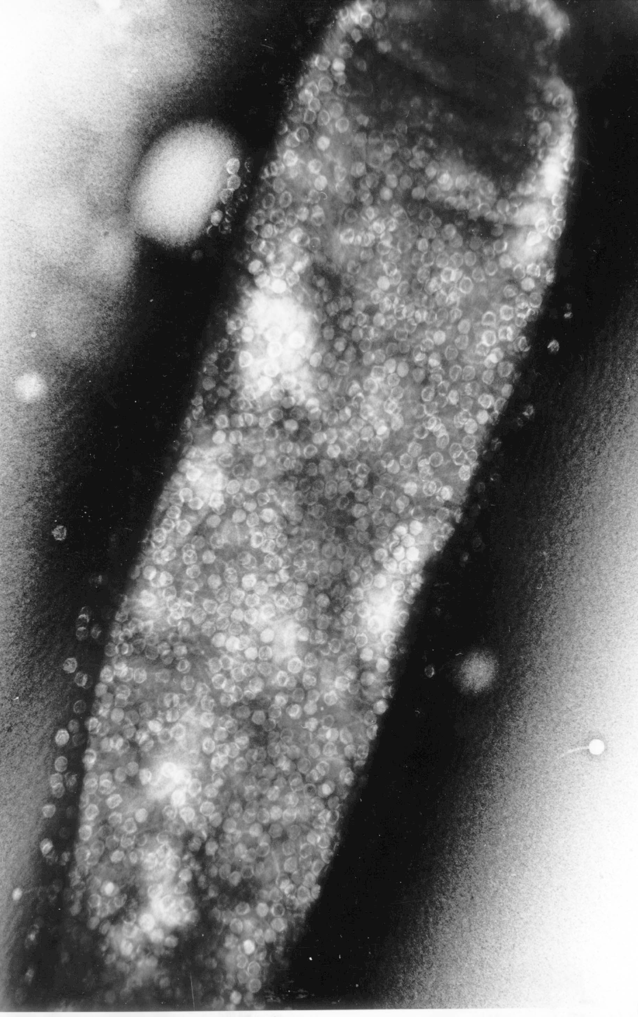
The Lambda Switch: The Other Hydrogen Atom of Gene Regulation
Roger Hendrix

Slide 13
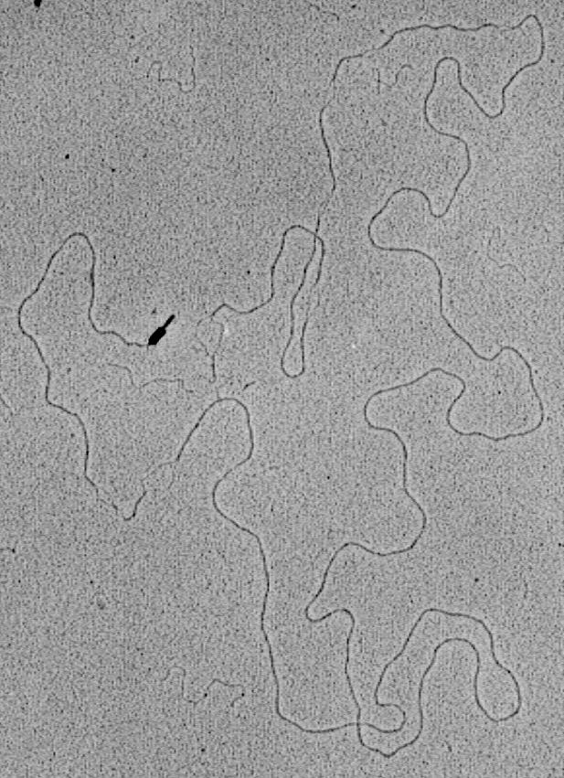
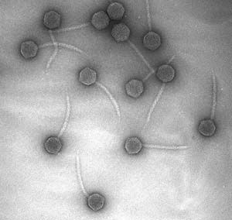
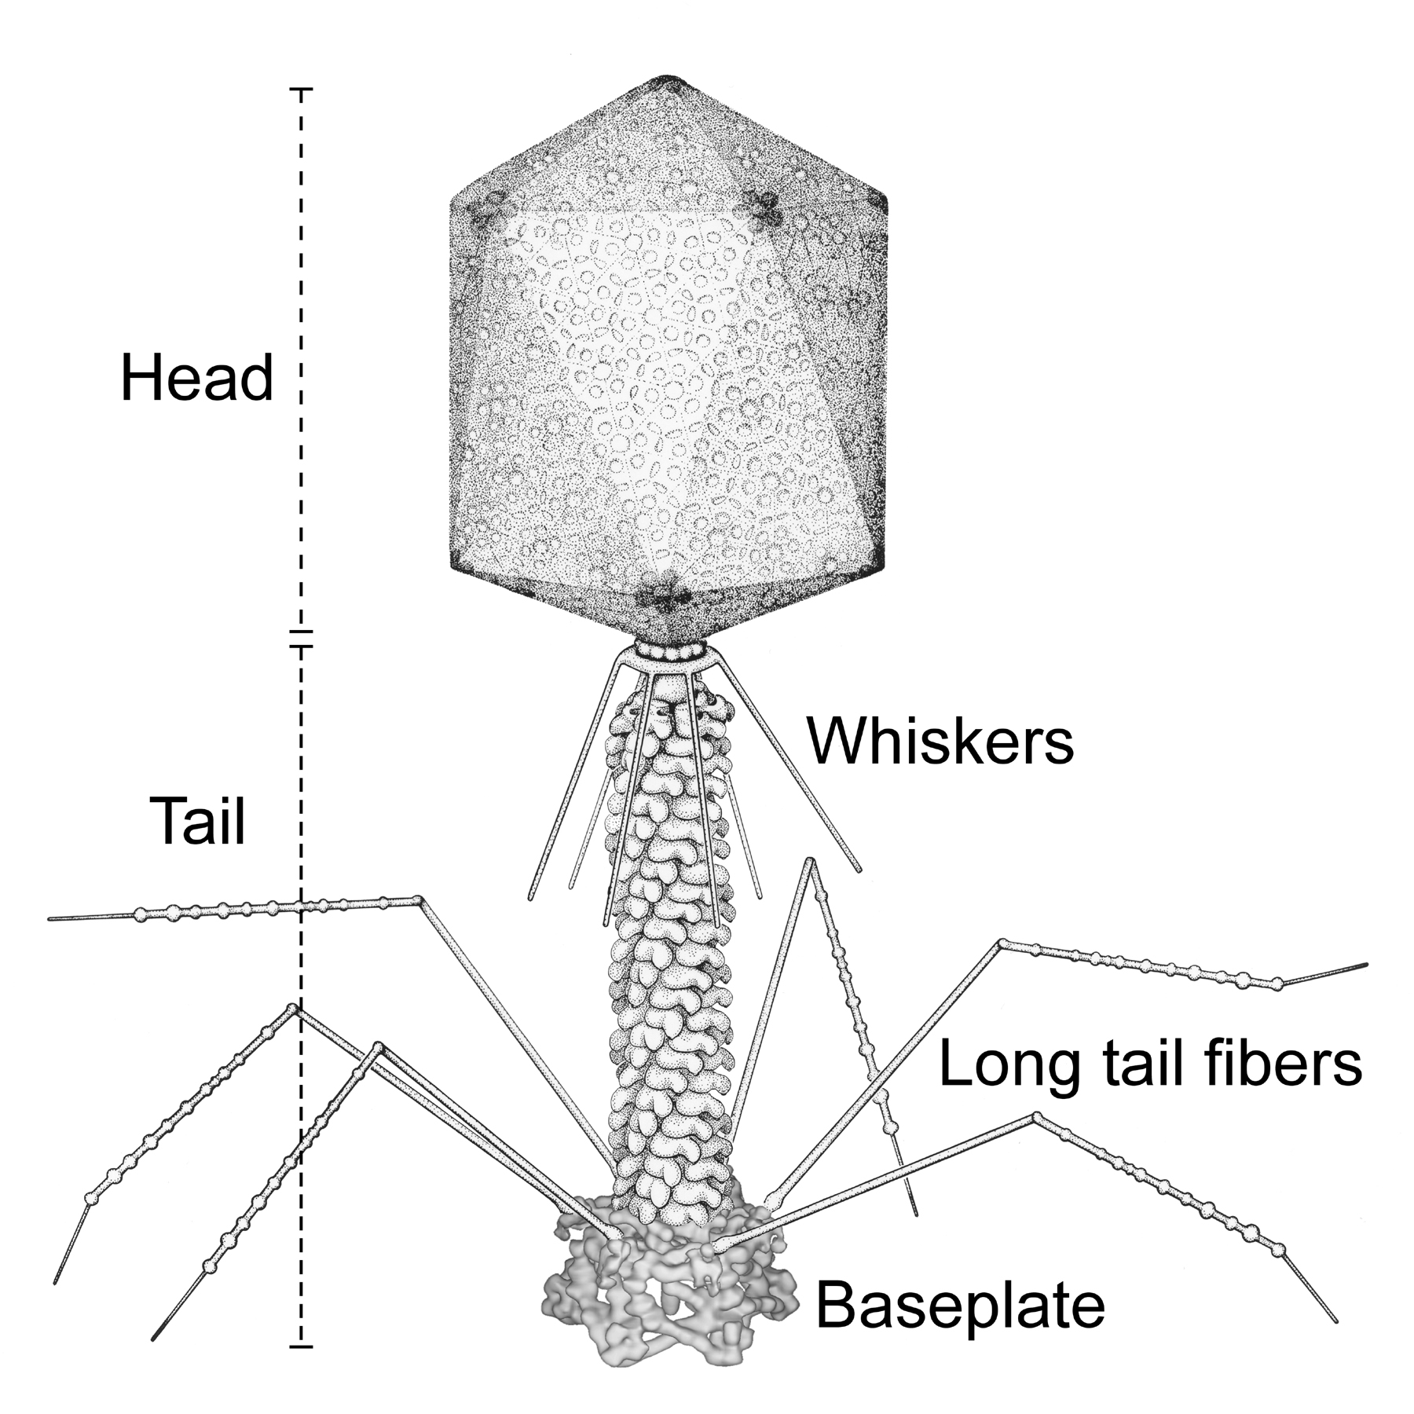
Bacteriophage and Their Genomes
http://www.biochem.wisc.edu/inman/empics/0020b.jpg

Slide 14
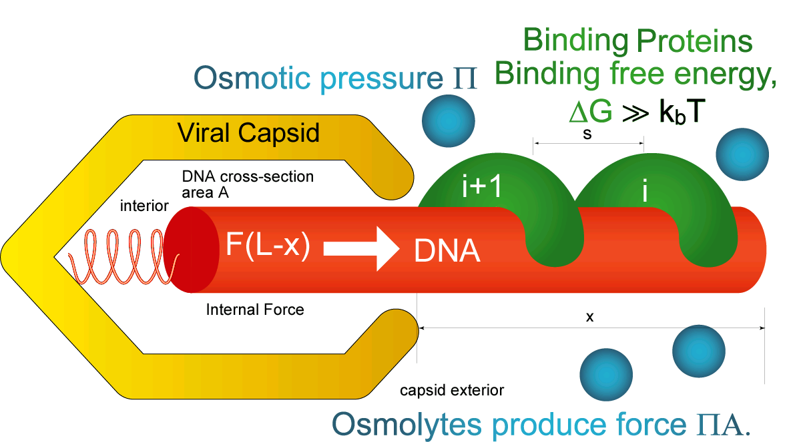
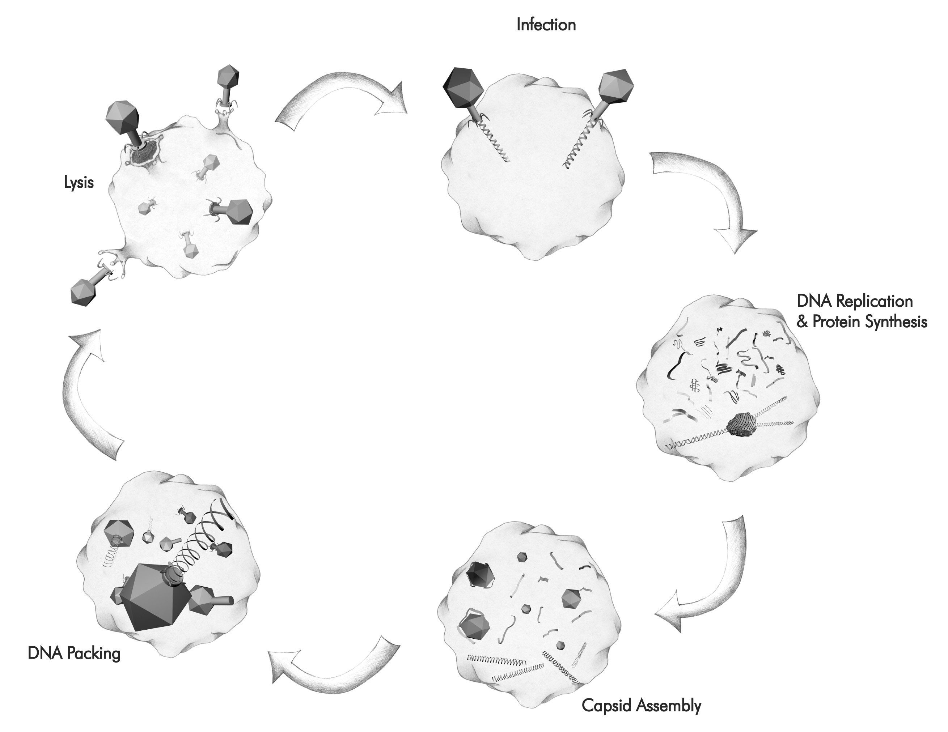
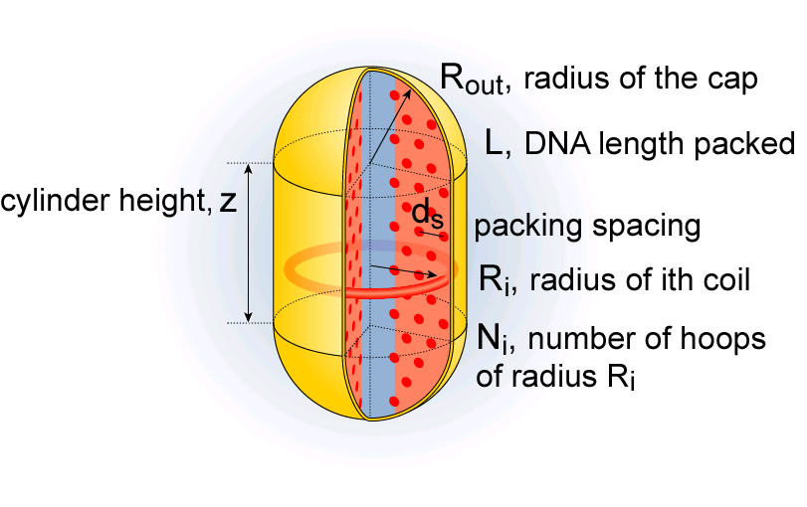
Bacteriophage Life cycle 1
Rate of ejection: ≈ 100 - 1000bp/sec
Forceful ejection
Rate of packing: 100bp/sec
“Some assembly required”
Self-assembly
Notes:
Case study # 1: life cycle of bacteriophage (and Herpes?) – my key point is that tightly packed DNA figures centrally in the life style of bacterial viruses.

Slide 15
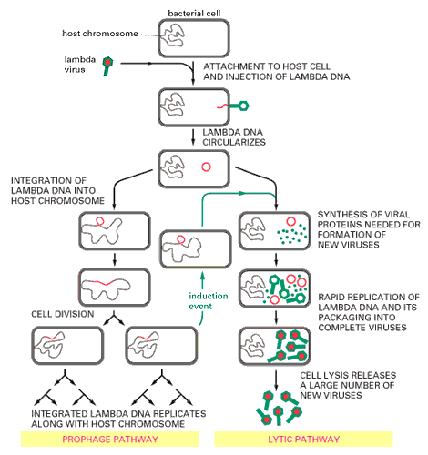
The Life Cycle of Bacteriophage Lambda

Slide 16
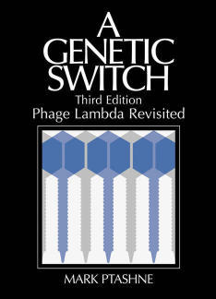
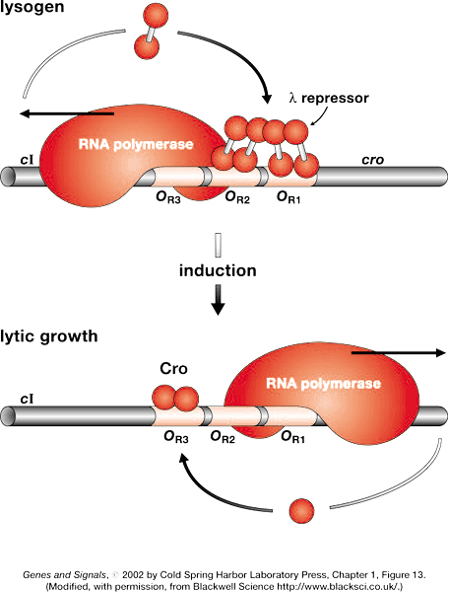
A Genetic Switch

Slide 17
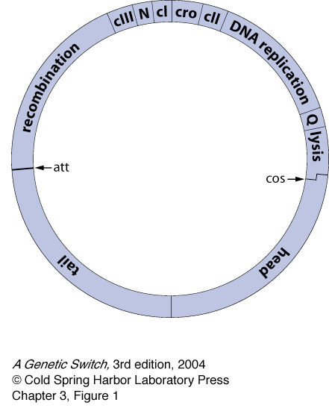
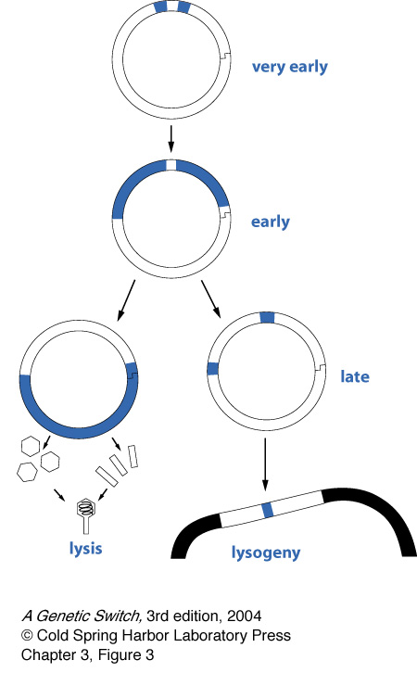
The Lambda Genome

Slide 18
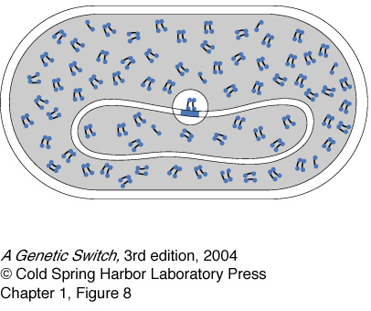
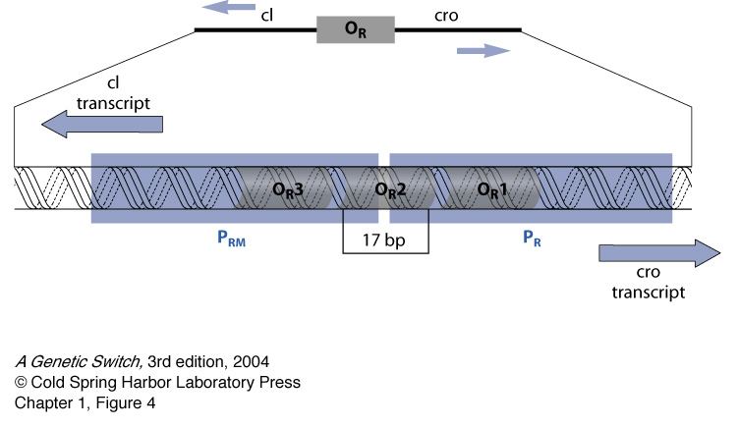
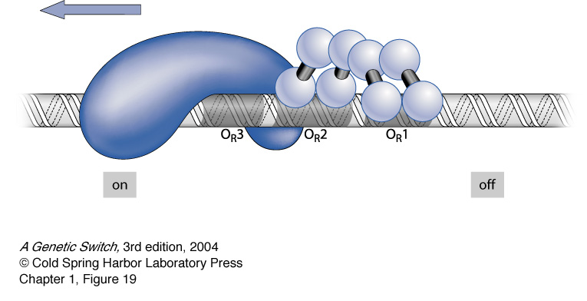
The Lambda Switch: Lysogenic State

Slide 19
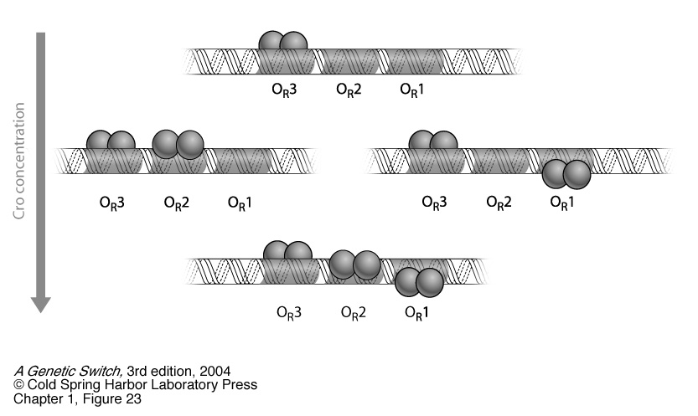
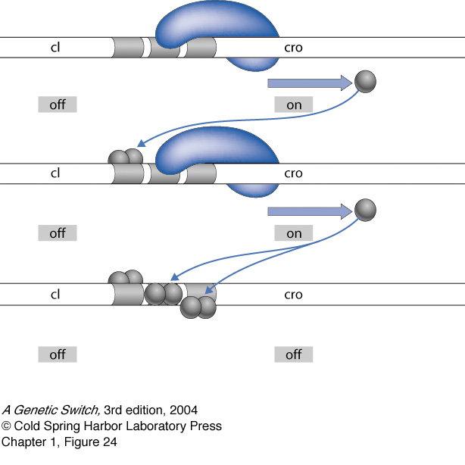
The Lambda Switch: Lytic State

Slide 20
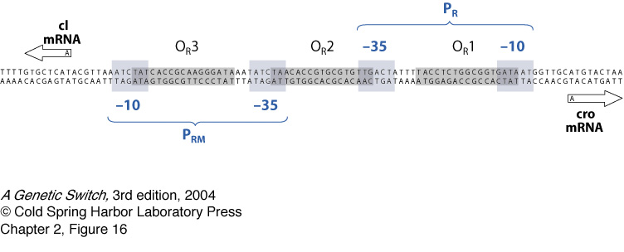
DNA Geography of the Switch

Slide 21
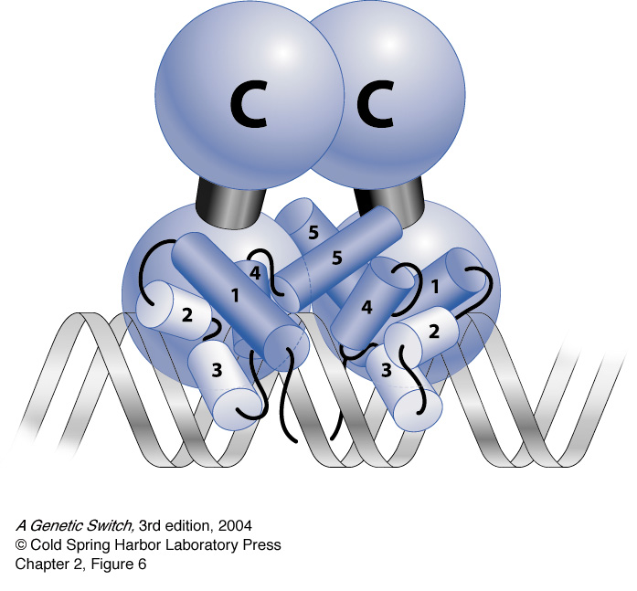
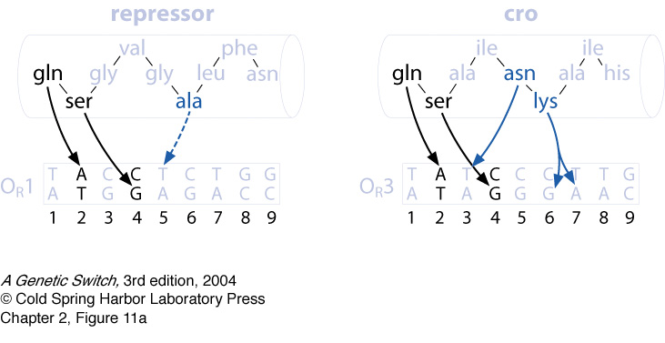
Binding of Transcription Factors

Slide 22
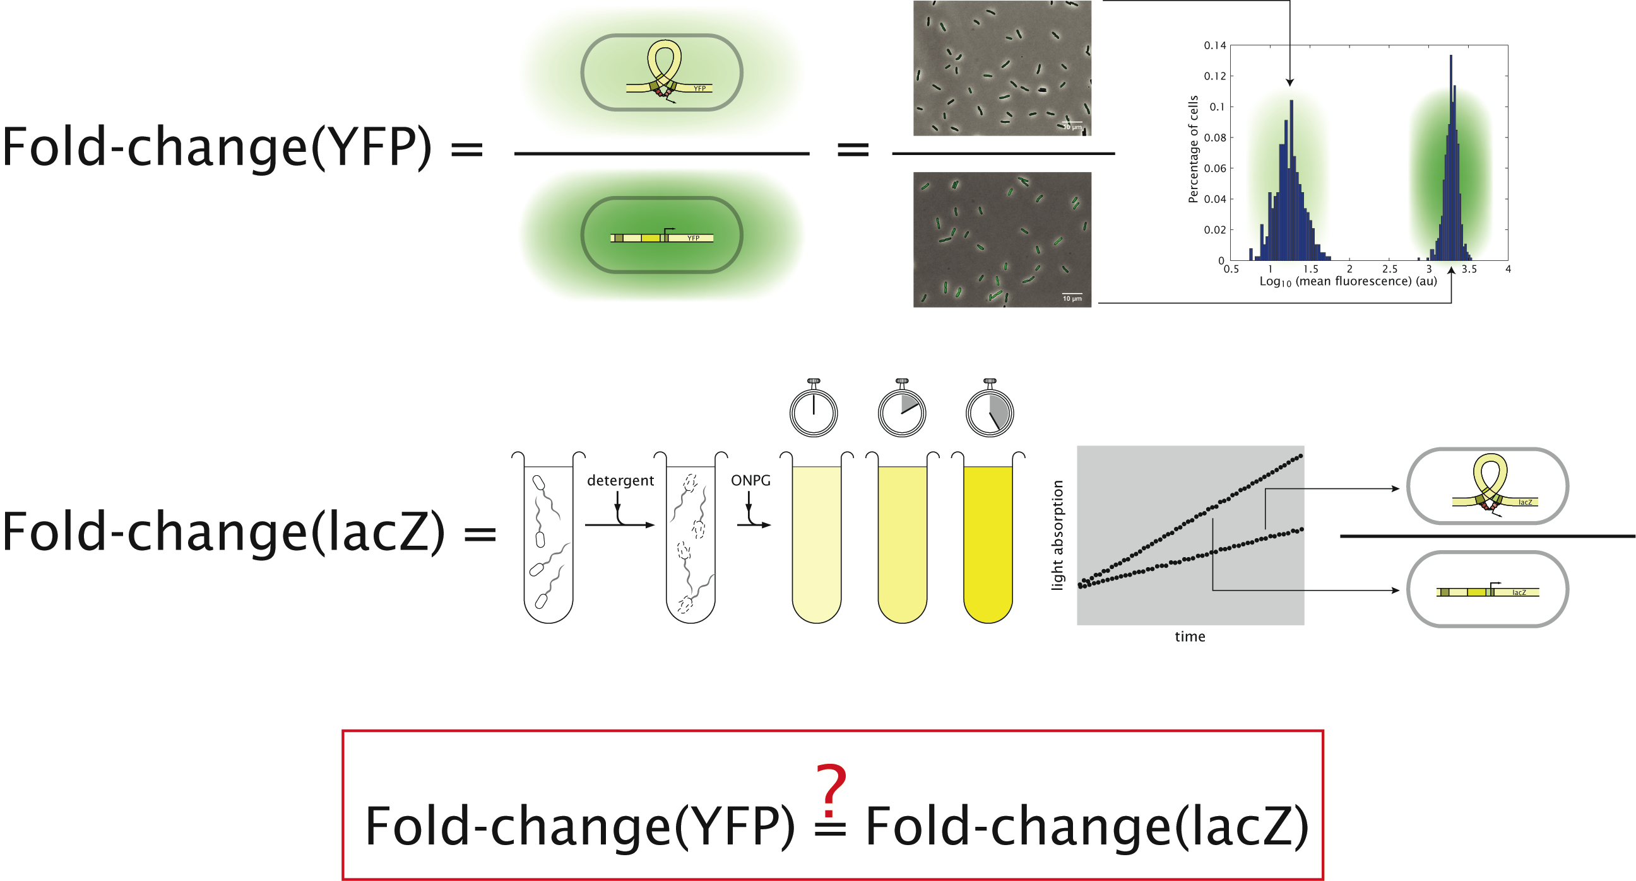
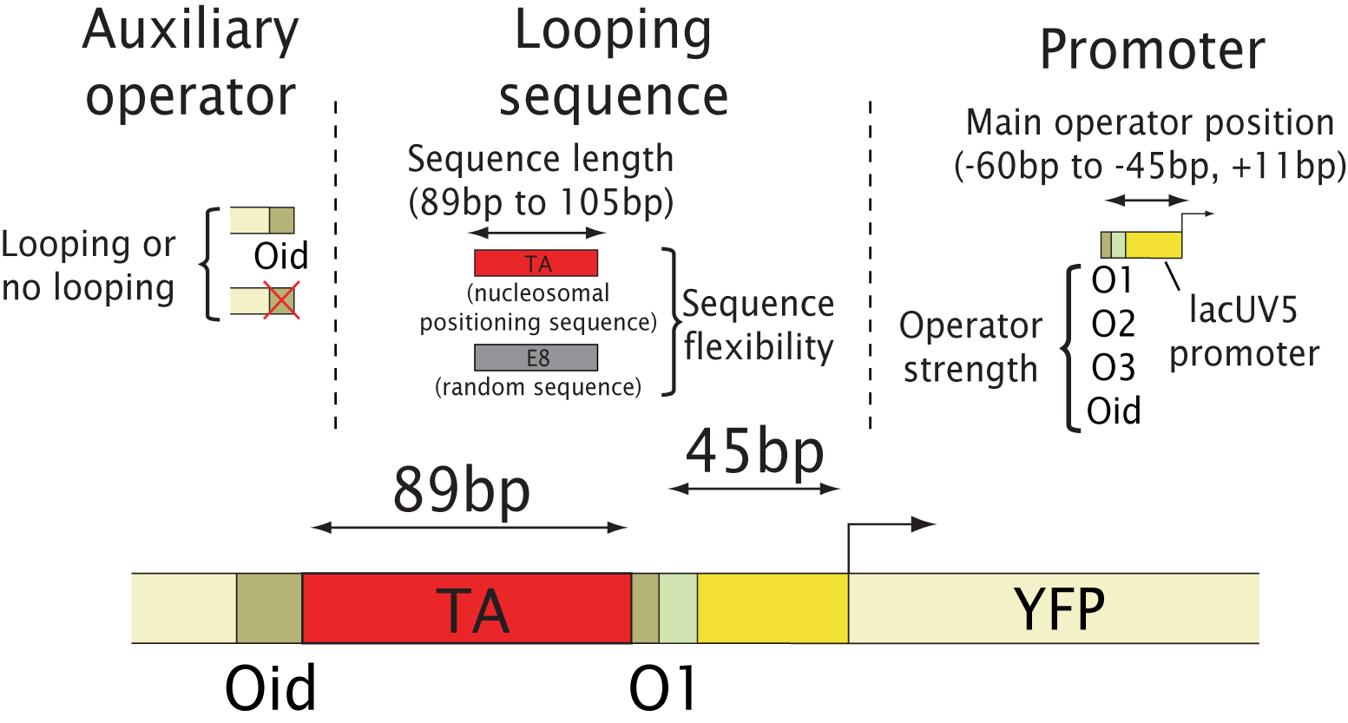
Measuring fold change: The Cell as a test tube
Install the architecture of interest in the cell and then “read out” the state of the DNA and its battery of attendant proteins using gene expression.

Slide 23
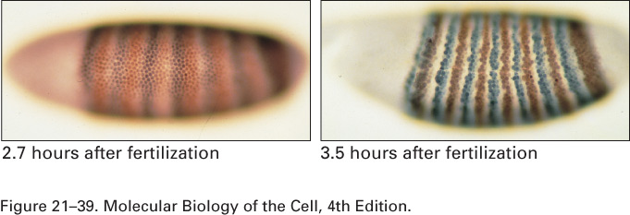
Enzymatic Assay or In-Situ Hybridization
Enzymatic assays – promoter leads to the production of a protein that then does some enzymatic action on the substrate which yields a product that can be visualized.
In-situ hybridization – described the other day – probe is complementary to the RNA of interest and is labelled for detection.

Slide 24
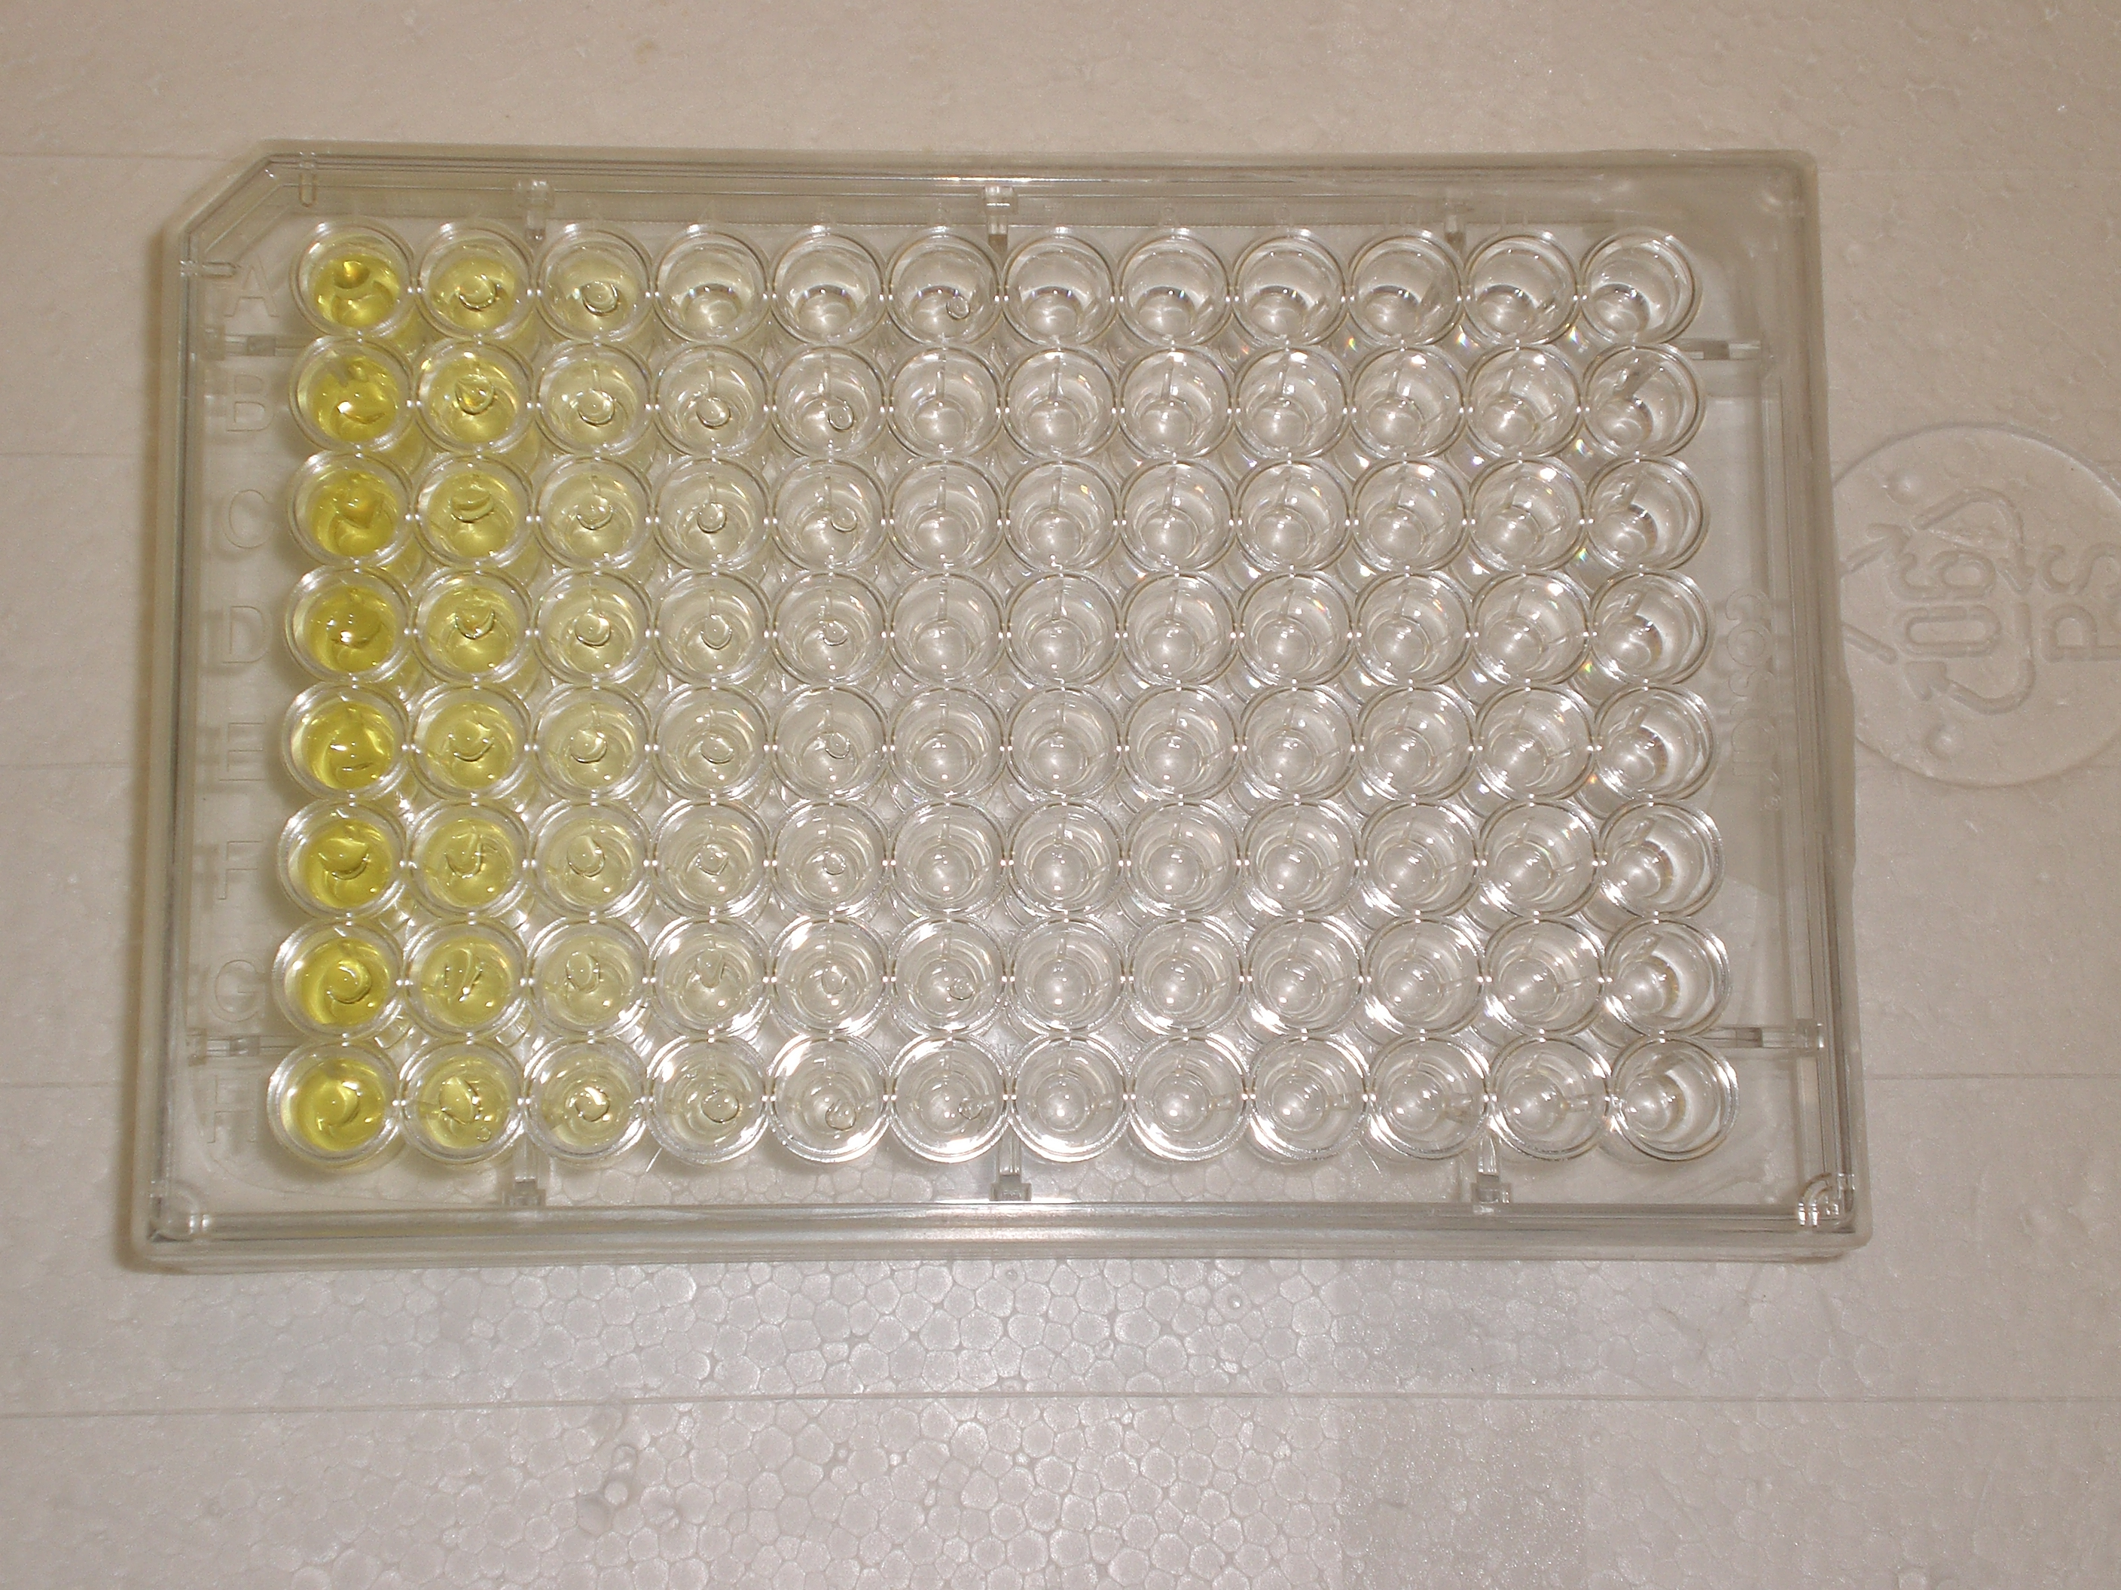
Enzymatic Assay or In-Situ Hybridization
Enzymatic assays – promoter leads to the production of a protein that then does some enzymatic action on the substrate which yields a product that can be visualized.
In-situ hybridization -

Slide 25
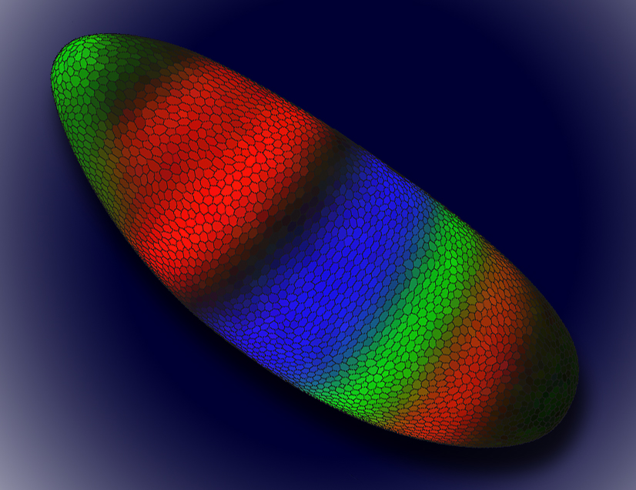
Ways to Measure Gene Expression
Basic point: looking for “reporters” of the level of expression of gene of interest.
Can ask the system to report on the level of gene expression at various steps in the processes linking DNA to active protein.
Promoter occupancy, level of mRNA, level of active protein.
http://www.lbl.gov/Science-Articles/Archive/sabl/2008/Feb/genome-mystery.html
This image shows a Drosophila embryo colored to show the expression patterns of early gene regulators. Each color represents the level of expression of one of three gene regulators, Knirps (green), Kruppel (blue), and Giant (red). Color intensity reflects a higher level of expression. The darker areas of the embryo are cells where none of these gene regulators are expressed, and the yellowish areas indicate that both Knirps and Giant are being expressed.

Slide 26
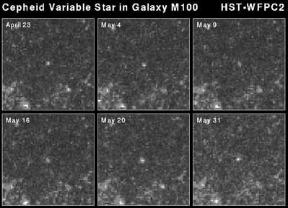
A Standard Candle for Gene Expression
Cepheids variables
Hubble Space Telescope
A prerequisite for doing the theory-experiment comparison in the way advocated here is that one has to really know the meaning of the readout of the expression level.
In particular, is the response linear and do different measurement techniques tell the same story?
Notes:
RP: Show the jelly fish
Modern biology is full of fluorescent images. How do we go form a qualitative interpretation of these images to a quantitative measurement? What we choose as a messenger might be affecting the measurement. We need to be careful not to be affecting the cells with our reporter!
Absolute measurements, molecular census, are not extremely common in biology. We lack standard candles such as the Cepheid variables in astronomy. We sometimes normalize by one gene, but how do we know that gene is a good standard (this is Quake’s point).

Slide 27
Tuning the Regulatory Apparatus and Comparing the Reporters
Explore wide range of different regulatory responses (i.e. expression levels) by controlling parameters such as the gene dosage and the number of repressors.
Note: The census is not so easy.
Notes:
HG: Make more steps in the animation. Start from no repressor without showing the E. coli cell.

Slide 28
Does the Measurement Depend Upon the Technique Used?
One of our concerns in adopting the quantitative mindset was to see to what extent all measurements on these systems are in agreement.
But, there are many different readouts of gene expression.
With this result in hand, we turn to exploring how the expression changes in a case where we tune various parameters for the single-site repression architecture.
Useful to attempt to make an absolute count of molecules.
Notes:
RP: Make a separate graph with the literature promoters. Measured values of expression in real world promoters vary over 5-6 orders of magnitude. Conductivity 31 orders of magnitude! This should be before talking about the different levels (Comparing the Reporters)
Title something like: It’s not enough to count, we need dynamic range!
Our ability of capturing these values with these two methods. Maybe have a bar graph for the literature promoters since this is only measured with lacZ.
Make the point about counting again.
Use words “counting”, “census”. Connect back to the precision theme.
What we choose as a messenger might be affecting the measurement. We need to be careful not to be affecting the cells with our reporter!
HG: Link to the histograms of fluorescence and to the growth rates.

Slide 29
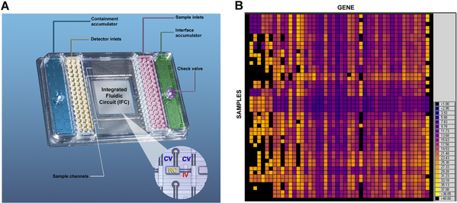
Count the Messenger RNA Molecules

Slide 30
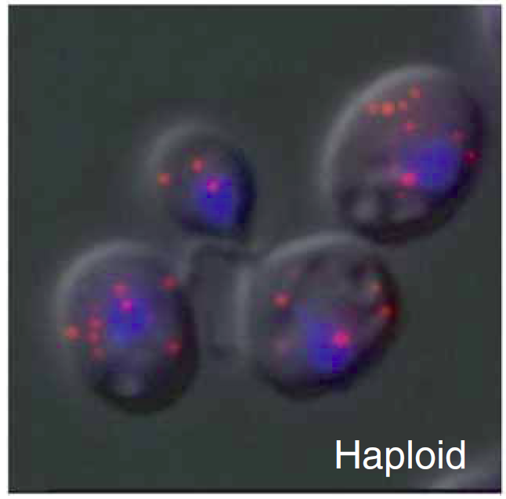
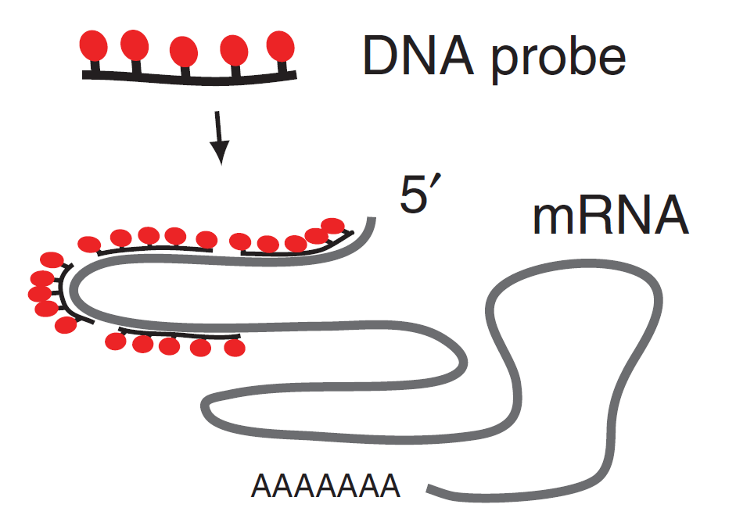
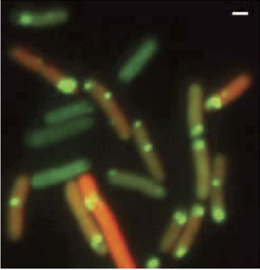
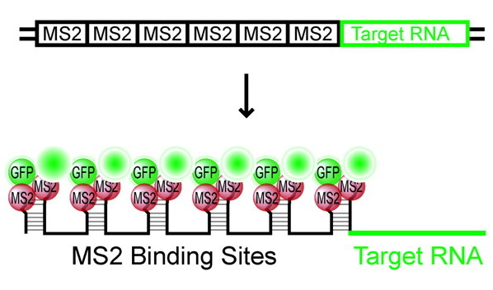
Counting messenger RNAs in cells
Fixed cells
Zenklusen et al. ‘08
Live cells
Golding et al. ‘05

Slide 31



Input-Output Curves: An Analogy
Electronic Devices
http://www.physics.csbsju.edu/trace/CC.html
Regulatory Devices
How do we know the number of molecules controlling the decision?

Slide 32
Dialing in Different Responses in Simple Repression
As a starting point for our in vivo story, we begin with the “simpler” case of simple repression.
The idea is to tune the same parameters that we can control in the theoretical analysis in our experiments.

Slide 33

Confronting theory and experiment: a simple case
Oehler et al. (1994)
Becker et al. (2005)
Vilar and Leibler (2003)
Bintu et al. (2005)
Notes:
Remember to mention Maher!

Slide 34




Using Drunks to Count Proteins and Measure Expression
Find new ways to count, new watches, new rulers. Perrin gave us more than 10 ways to measure Avogadro’s number, many involve fluctuations.
Key point: in order to use the statistical mechanical theory, we must know the number of transcription factors. This suggested a cool new way to count and to measure the whole fold-change function.
(Berman et al.)
(Rosenfeld, Young, Alon, Swain, Elowitz, Science, 2005)
Notes:
18 minutes between frames in the movie

Slide 35


A Mathematical Description: The Statistics of Dilution
One video of dividing cells can be used to perform multiple measurements on the gene regulation function.
(Rosenfeld, Young, Alon, Swain, Elowitz, Science, 2005)
Notes:
18 minutes between frames in the movie

Slide 36
Thermodynamic models of gene regulation
This table shows the outcome of performing exactly the same kind of calculations we have just done for simple repression, but for other classes of regulatory architecture.

Slide 37




Information Processing in Living Cells:
Beyond First Approximations
Ido Golding
Department of Physics
Caltech 11/2008
Notes:
Movie: Zoom052004_031a
Figure: levels1 made by talk_plot_levels1 at singer/results

Slide 38
Simple Case of Turning a Gene “On”
s(t)
Stimulus (sugar)
t
r(t)
Response (RNA production)
t
Approximations used to describe the process…

Slide 39
Engineering bacteria to report on gene activity
(RNA-tagging protein;
in excess in the cell)
MS2-GFP
Gene of interest:
binding
P_{lac/ara}
RFP
96x MS2-bs
IPTG, arabinose
transcription
RNA target
translation
RFP protein
Golding et al., Cell (2005)

Slide 40




Measuring mRNA & protein numbers
mRNA ∝ number of bound MS2-GFPs
∝ photon flux from localized green fluorescence
Protein ∝ number of RFPs
∝ photon flux from whole-cell red fluorescence
Histogram of
RNA copy number:
1st peak =
inter-peak interval ≈
50-100 X GFP =
1 transcript
Controls:
FISH
Controls:
QPCR
Protein levels
Lux: Lutz & Bujard 1997
(Thanks to: A. Raj, A. van Oudenaarden)

Slide 41
RNA kinetics in individual cells
Distribution of on & off times
# mRNA vs time
Distribution of burst size

Slide 42

mRNA production in E. coli
Golding et al. ‘05

