Slide 1
BE/APh161 – Physical Biology of the Cell
Rob Phillips
Applied Physics and Bioengineering
California Institute of Technology

Slide 2
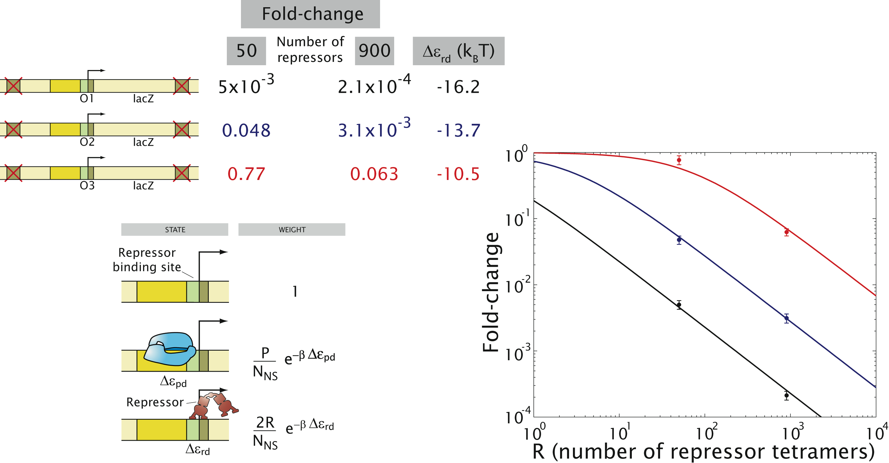
Confronting theory and experiment: a simple case
Oehler et al. (1994)
Becker et al. (2005)
Vilar and Leibler (2003)
Bintu et al. (2005)
Notes:
Remember to mention Maher!

Slide 3
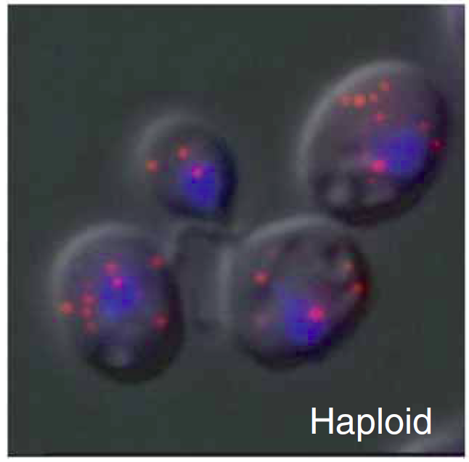
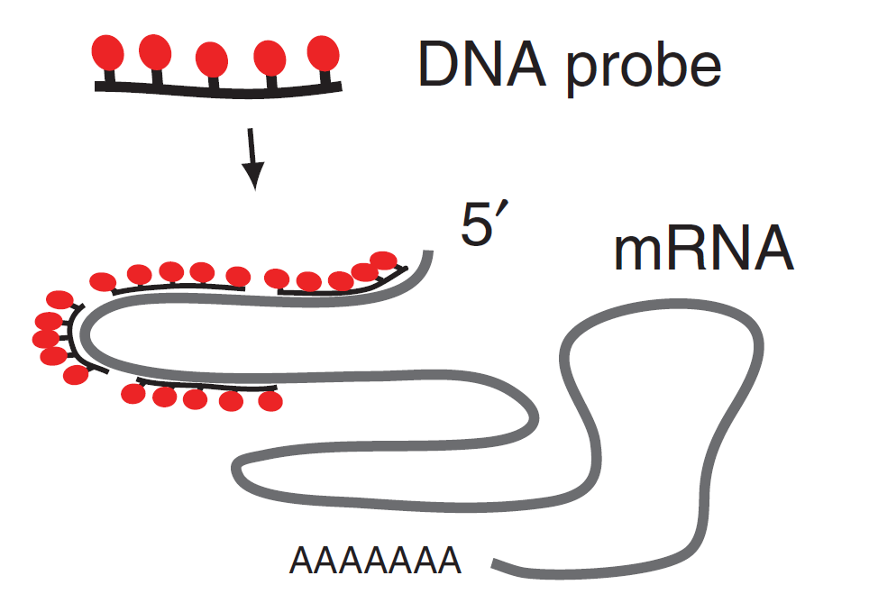
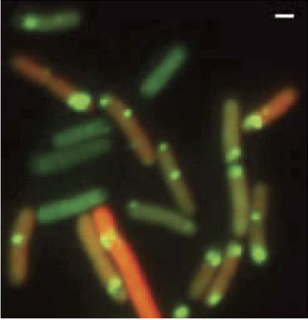
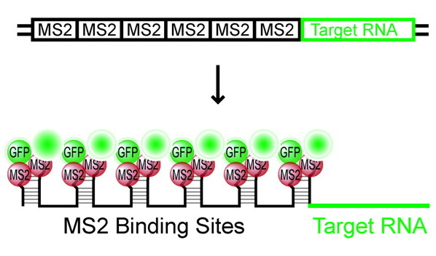
Counting messenger RNAs in cells
Fixed cells
Zenklusen et al. ‘08
Live cells
Golding et al. ‘05

Slide 4
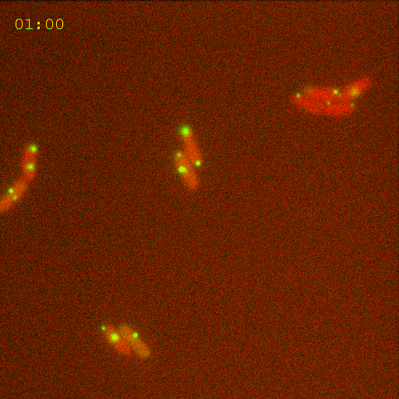
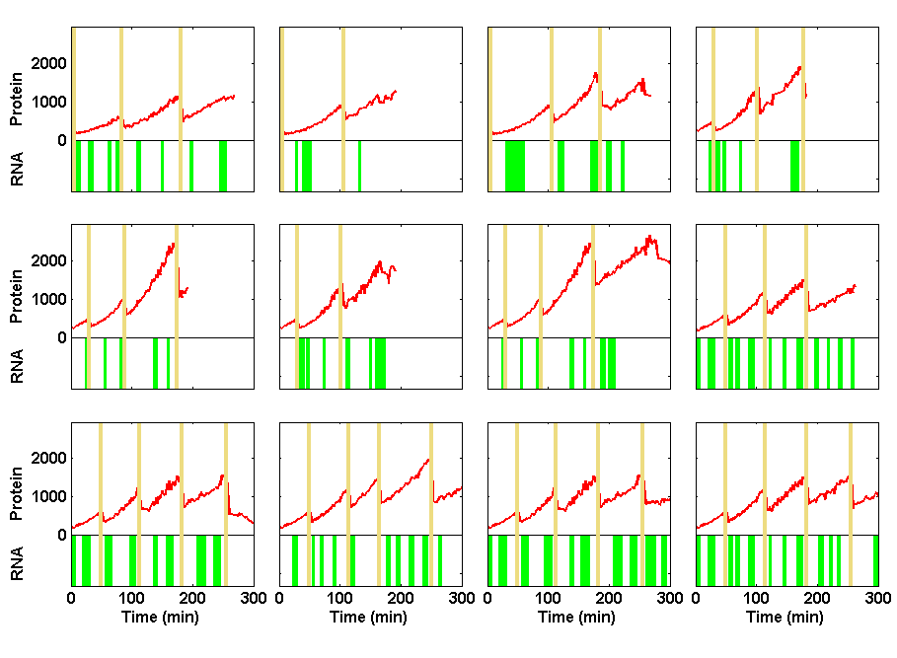


Information Processing in Living Cells:
Beyond First Approximations
Ido Golding
Department of Physics
Caltech 11/2008
Notes:
Movie: Zoom052004_031a
Figure: levels1 made by talk_plot_levels1 at singer/results

Slide 5
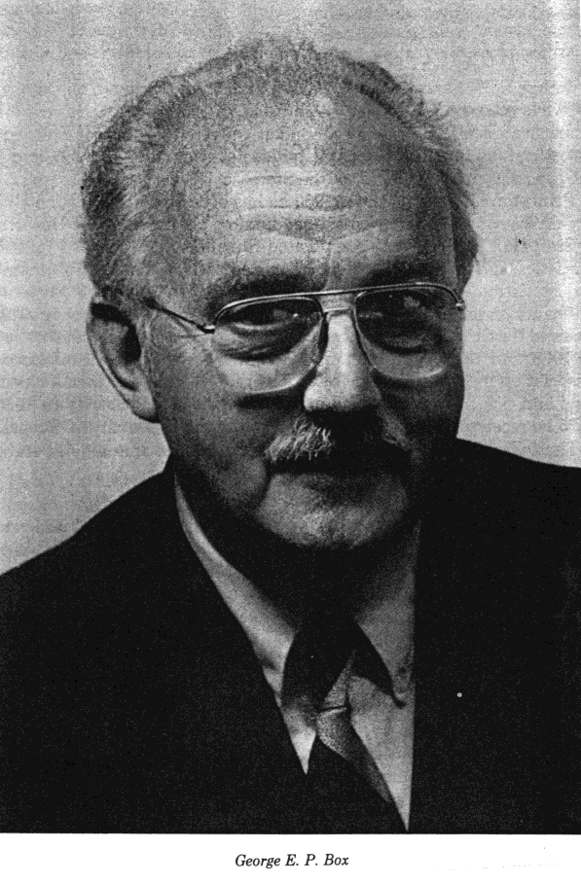
On the usefulness of models
"It should be remembered that just as the Declaration of Independence promises the pursuit of happiness rather than happiness itself, so the iterative scientific model building process offers only the pursuit of the perfect model. For even when we feel we have carried the model building process to a conclusion, some new initiative may make further improvement possible. Fortunately to be useful a model does not have to be perfect." George Box

Slide 6
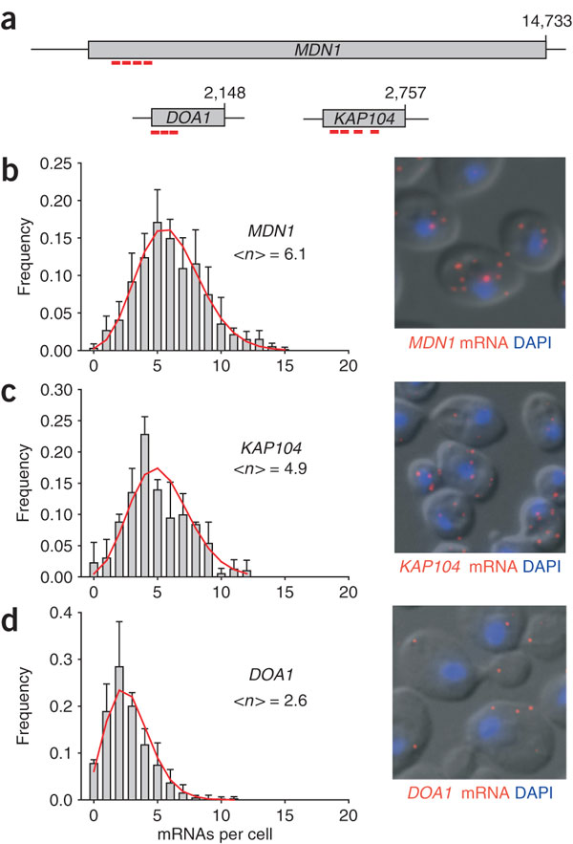
Rna distribution in yeast
Zenklusen et al. ‘08

Slide 7
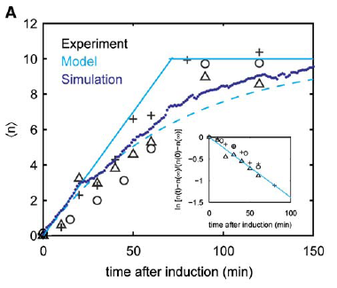
mRNA production in E.coli
Golding et al. ‘05

Slide 8
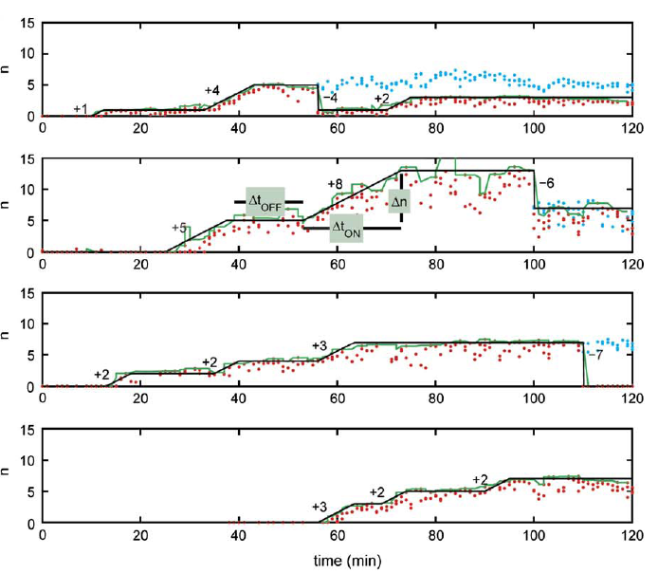
mRNA production happens in bursts

Slide 9
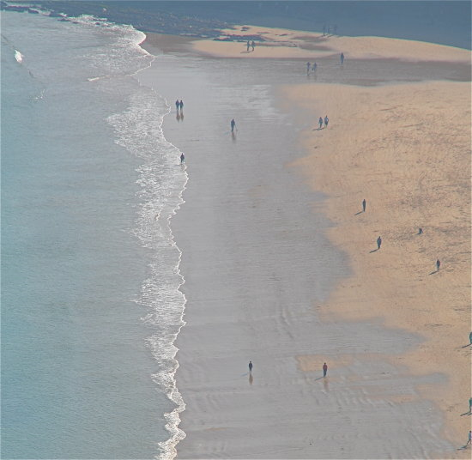


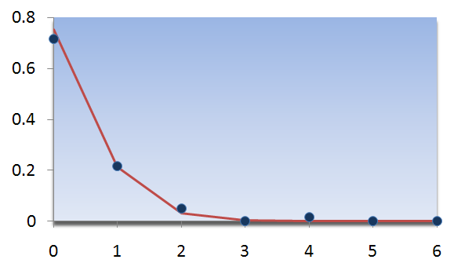
The Poisson distribution
What is the distribution
of people per square?
Probability
Histogram
Poisson
people/unit area
(thanks to Al Sanchez and Jane Kondev)

Slide 10
Interactions can change the distribution
Independent singles: Poisson distribution of people
Valentine's Day: Poisson distribution of couples

Slide 11
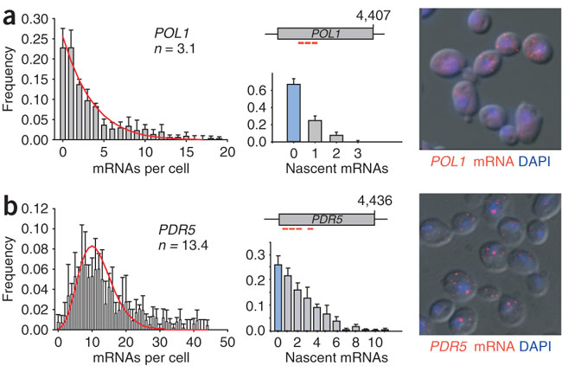
Not poisson
Zenklusen et al. ‘08

Slide 12
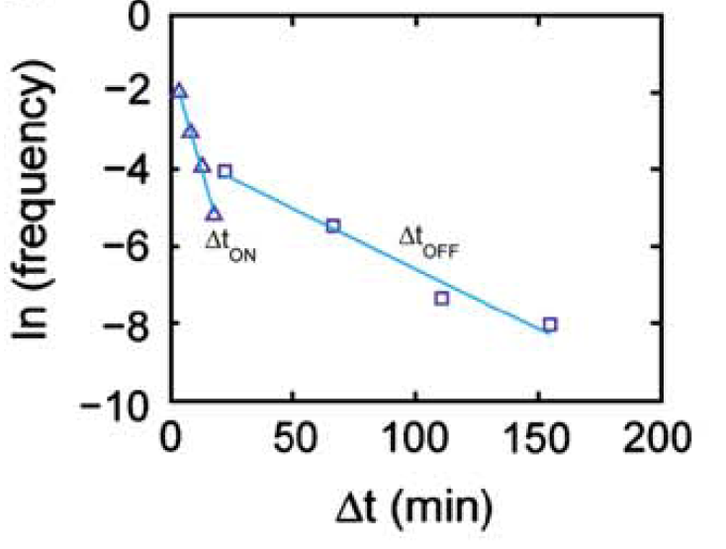
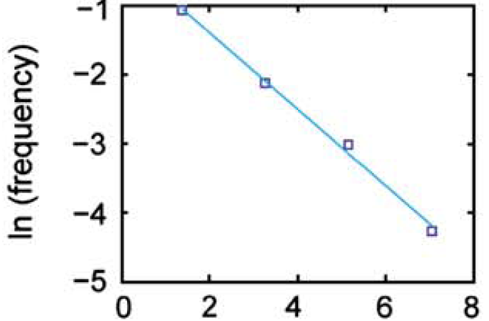
mRNA production occurs in bursts
What is the origin of transcriptional bursts?

Slide 13
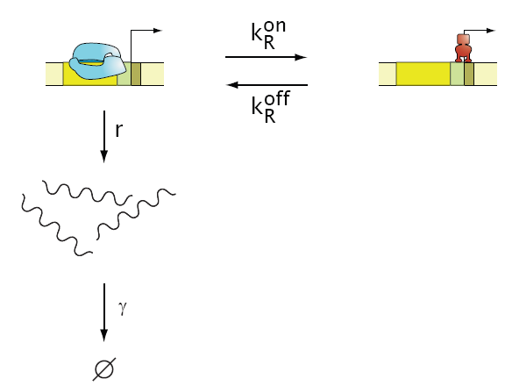
Two-state promoter
Master equation for a two state promoter

Slide 14
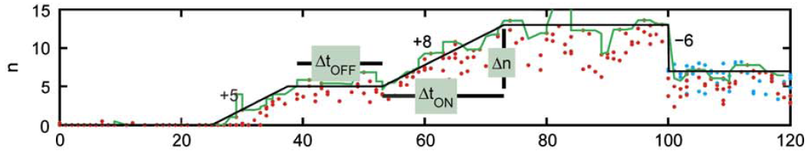
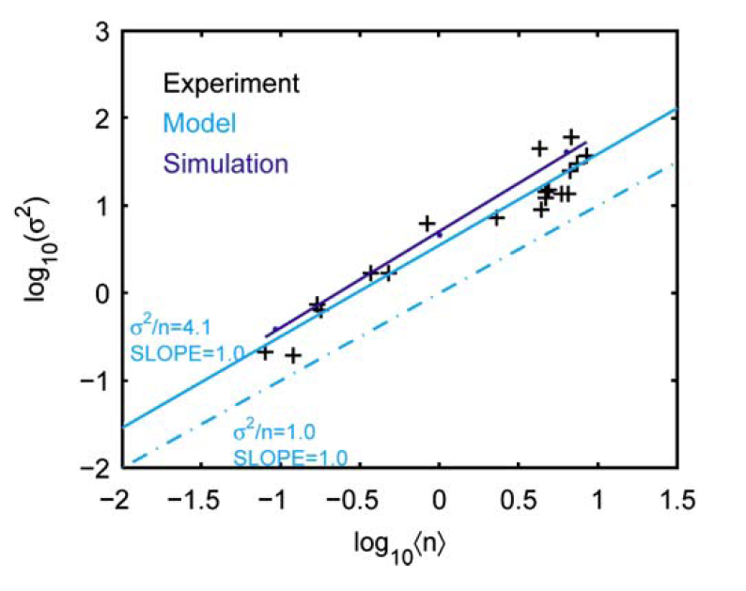
Two-state promoter
At full induction
k_{on} = 1/(6min)
k_{off} = 1/(36 min)
r = 1/(2.5 min}
° = 1/(72 min)
Prediction: For the scaling to hold, k_{off}, not k_{on}, must be the rate that changes with induction .

Slide 15
Stochastic model of transcription
Kepler and Elston ‘02
Generalize to arbitrary number of promoter states with different transcription rates.

Slide 16
Phenotypic consequences of noise
Maamar, Raj, and Dubnau ‘07
Amount of noise in expression of a single gene determines the number of competent cells in a population.
High noise
Low noise
Mettetal and van Oudernaaden ‘07
Notes:
How is noise controlled? What is the effect of promoter complexity?

Slide 17
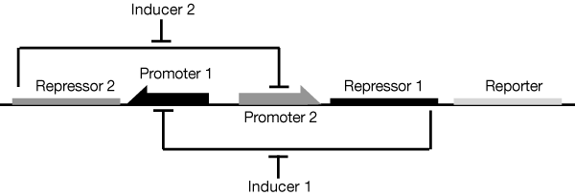
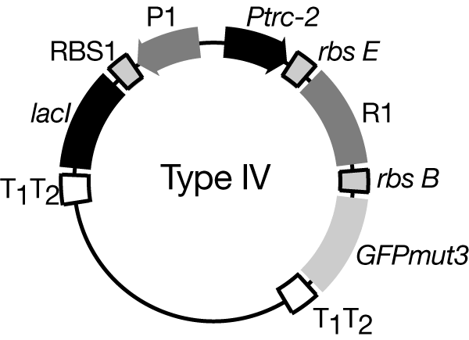
Synthetic Genetic Switch
Collins et al. - see course website

Slide 18
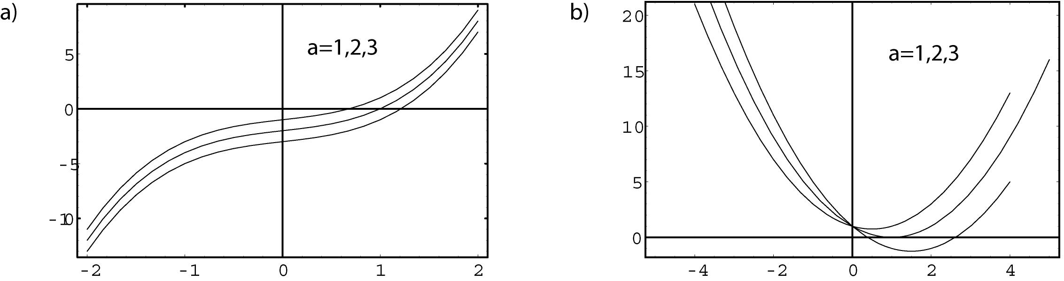
Stable Solutions

Slide 19
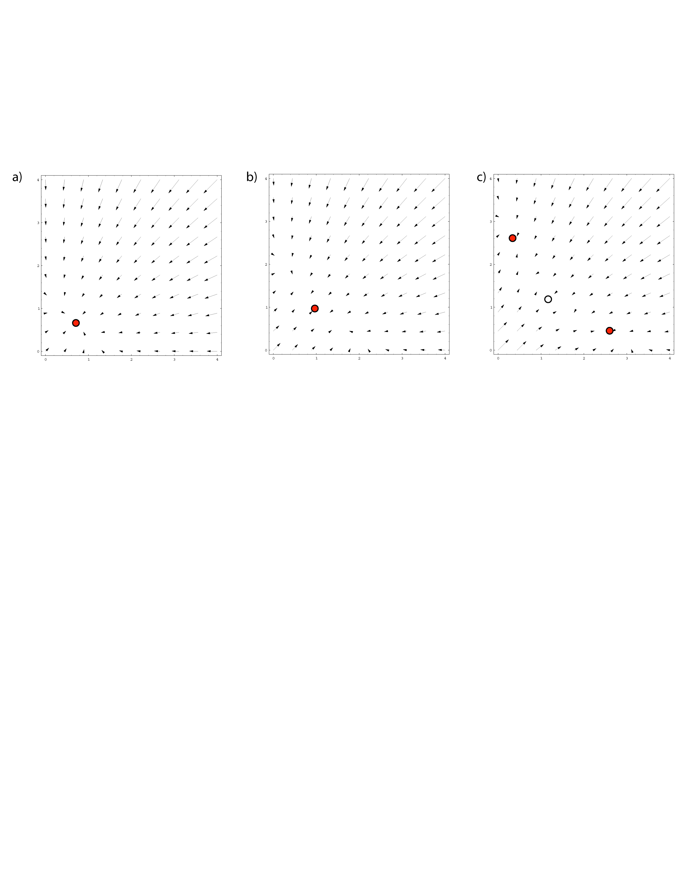
Phase Portrait for the Switch

Slide 20
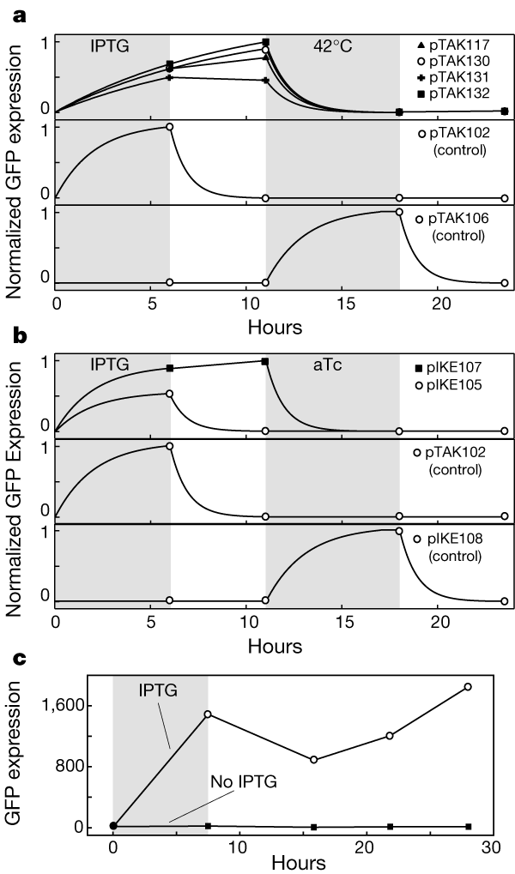
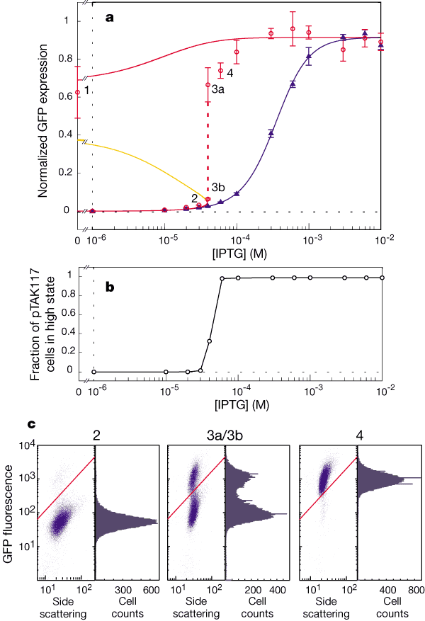
Synthetic Genetic Switch
Collins et al. - see course website

Slide 21
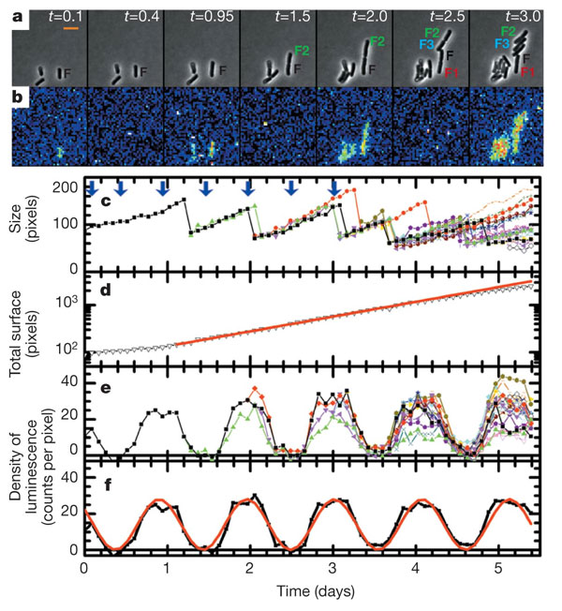
Gene Expression in Cyanobacteria
(Mihalcescu, Hsing, Leibler, Nature 2004)
a, Snapshots of phase-contrast image showing cell F and its progeny and b, related bioluminescence image at different times t (given in days, a 24 h period of time) from the beginning of the measurement. Pixels in the bioluminescence images were binned 3 times 3 (pseudo-colour, where red is high signal intensity and blue is low signal intensity). Scale bar, 5 microm. c, The size of the cell F and all its progeny as a function of time measured from the phase-contrast images (non-binned pixels). The arrows point to the time where the snapshots in (a) and (b) were taken. d, The total number of pixels occupied by F and its all progeny versus time (black line) plotted in a logarithmic scale. The red line is the corresponding exponential growth fit: total size (t) = initial size times 2t/tau with tau = 23.04 plusminus 0.17 h. e, Density of bioluminescence for the same cell and all its progeny versus time. f, The average density of bioluminescence versus time (black line) and its fit (red line) with: left fenced(t)right fence = B + A cos(2pit/T0 + phi0). The resulting period is T0 = 25.4 plusminus 0.12 h, the initial phase phi0 = 52 plusminus 2.8°, the amplitude A = 12.9 plusminus 0.3 counts per pixel and the offset B = 14.8 plusminus 0.3 counts per pixel.

Slide 22
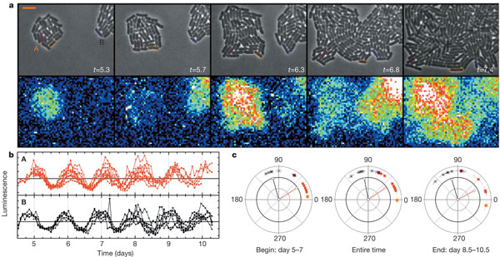
Gene Expression in Cyanobacteria
(Mihalcescu, Hsing, Leibler, Nature 2004)
a, Upper part shows the phase-contrast snapshots of colonies A and B; lower part shows the related bioluminescence images. Scale bar, 5 microm. b, Normalized density of bioluminescence of individual cyanobacterial cells. Each colour corresponds to the progeny from one of the initial cells: red line, colony A; black line, colony B. c, Phase of individual oscillators as a function of their original colony and their evolution in time: red square, colony A; asterisk, colony B. An example of the exact location for three of the cells tracked and their phase evolution is shown, marked by the corresponding coloured lines: magenta, orange and purple. The change of the phase in time was quantified by a fit over a different period of time: the first 2 days (days 5–7), the entire time (days 5–10.5) and the last 2 days of the measurement (days 8.5–10.5). The fit function is left fenced(t)right fence = B + A cos(2pit/T0 + phi), with T0 = 24.78 h. The line segments in each graph, with corresponding colours, represent the resulting vector Pres = sumPi, where Pi is the unit vector whose orientation is the measured angle of the same colony cell i.

Slide 23
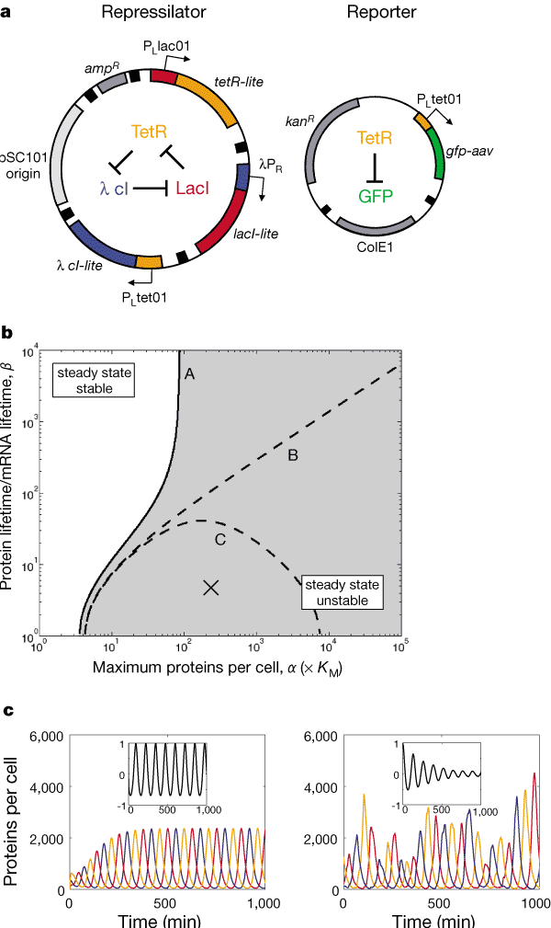
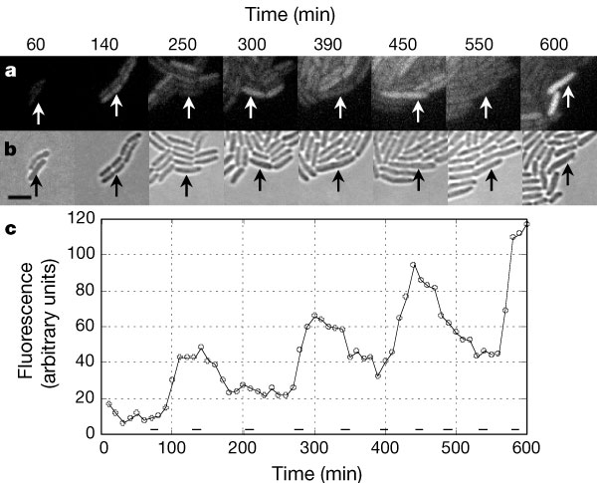
Synthetic Transcriptional Oscillator
(Elowitz, Leibler, Nature 2002)

Slide 24
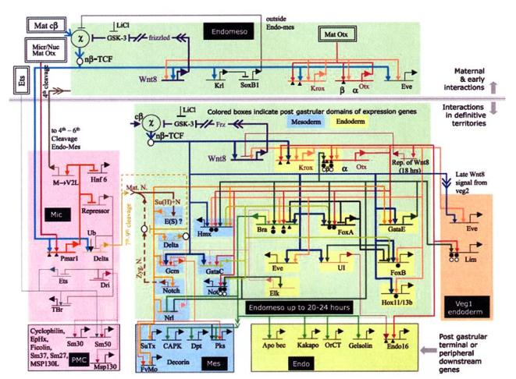
Coupling of Genes in Networks

