Slide 1
BE/APh161 – Physical Biology of the Cell
Rob Phillips
Applied Physics and Bioengineering
California Institute of Technology

Slide 2
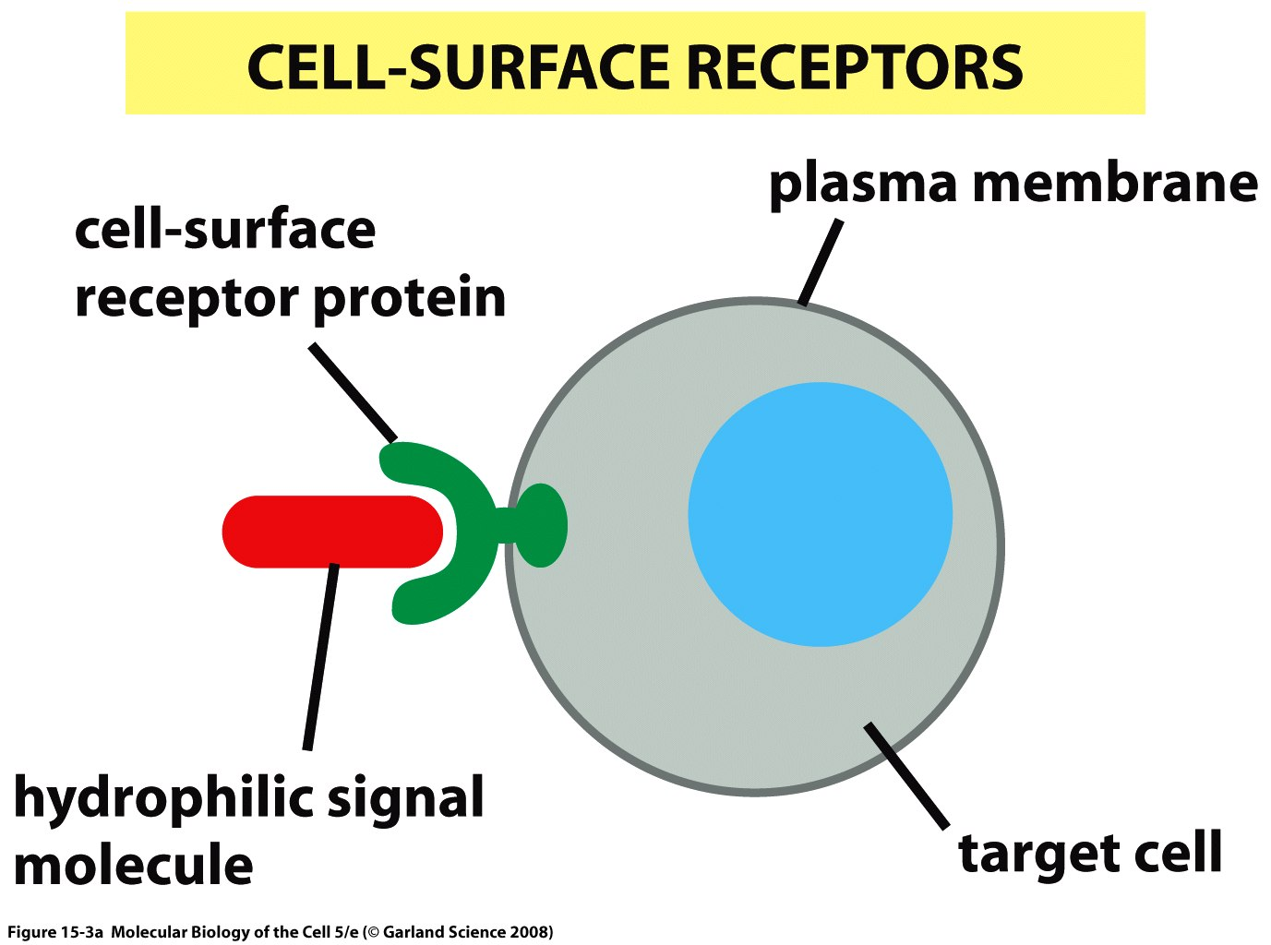
Life at the cell surface
We now undertake a real case study, that of cellular signaling. This will take us a few weeks.
The stars of the show will be membrane proteins.

Slide 3
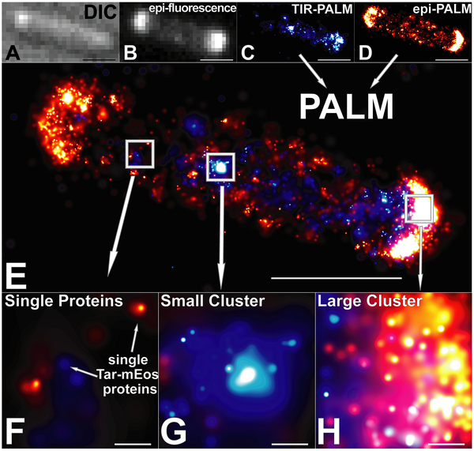
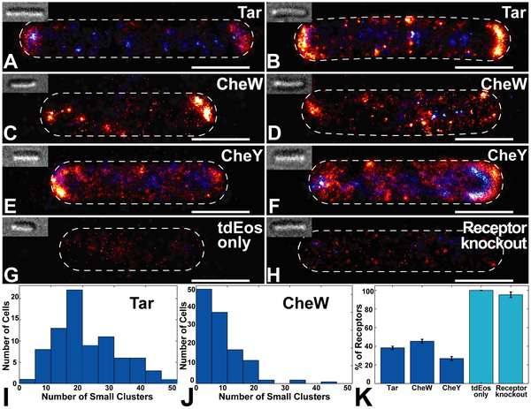
High resolution imaging of chemotaxis proteins
PALM is a high-resolution technique that permits beating the diffraction limit.
In this case, they are looking at chemotaxis proteins in E. coli.
(Greenfield, Liphardt et al, PLoS Biology, 2009.)

Slide 4
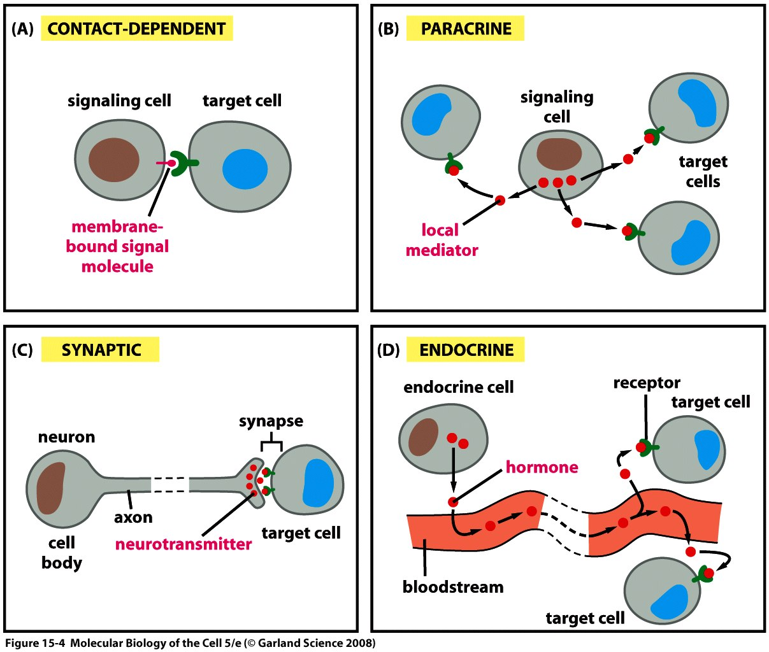
How do cells talk to each other?

Slide 5
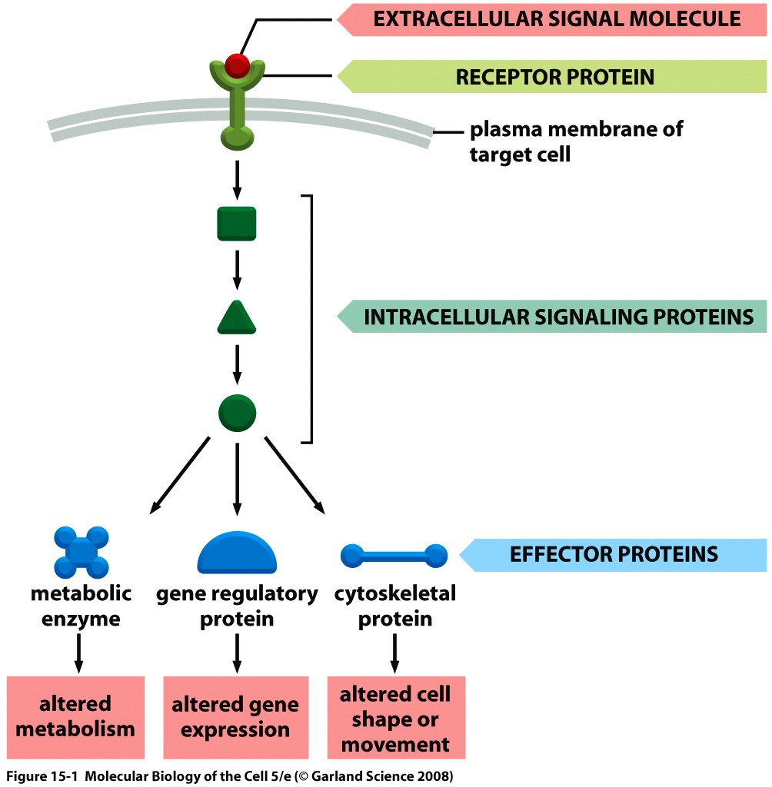
The signaling concept
Our goal will be to find out what kinds of measurements people can do about such systems and then how we can turn the cartoon into a mathematical description.

Slide 6
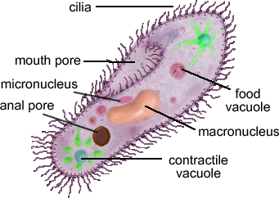
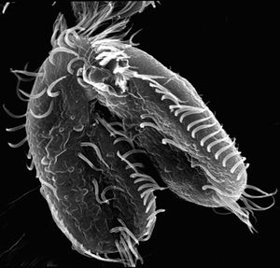
Paramecium and the avoidance response
We begin our story of signaling with the BEHAVIOR of Paramecium as manifested in its avoidance response.
H. S. Jennings, “The behavior of the lower organisms”, 1906.
Most of the figures on Paramecium are from “An Introduction to Nervous Systems” by Ralph Greenspan.

Slide 7
Paramecium and the tree of life
This diagram reiterates my earlier statements about the amazing diversity of life.
Note that in this case our tree only reflects on the relatedness of eukaryotes.
Question: how does one construct such a tree?
(Ralph Greenspan, An Introduction to Nervous Systems)

Slide 8
The avoidance response
These single-celled eukaryotes manage a sophisticated response to their environment.
One of the things I am most excited to tell you is that this response is mediated by similar tricks to those we are used to in the context of nervous systems.
We need to take a little detour and talk about ion channels. The first of the membrane proteins that we will study in some detail.
(Ralph Greenspan, An Introduction to Nervous Systems)

Slide 9
Reminder on Ion Distribution and Transport in Cells
Cells (eukaryotes) divided into a number of membrane-bound compartments.
Concentrations in different compartments can be orders of magnitude different.
Proteins (ion channels, transporters) mediate these concentration gradients.
Membrane proteins central to huge range of processes – cell signaling, nerve impulses, nutrient transport, etc.
Notes:
The goal of this slide is to remind the listener of some key points – ion gradients are a key means for performing a variety of tasks.

Slide 10
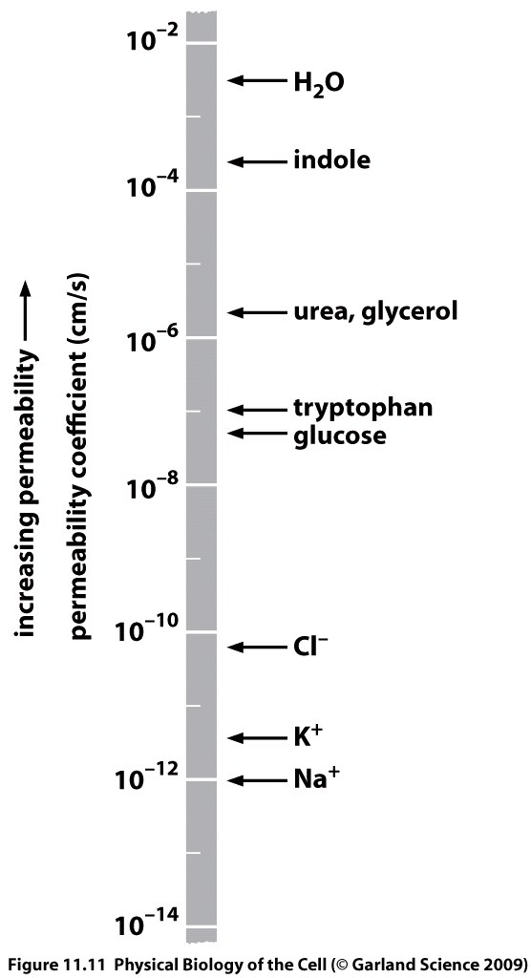
Membrane permeability
Membrane susceptibility to mass transport characterized by a “material parameter” known as the permeability.
Notice that the permeability ranges over 16 orders of magnitude.

Slide 11
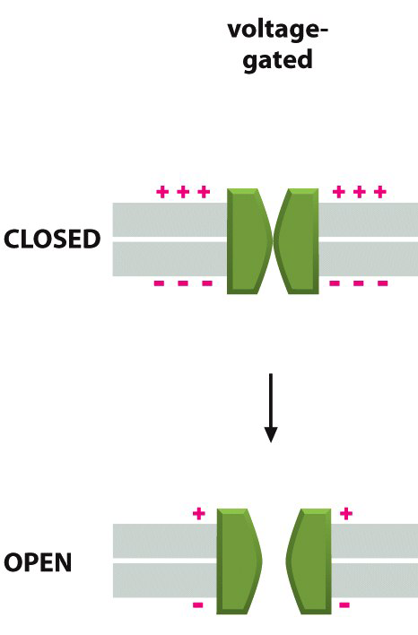
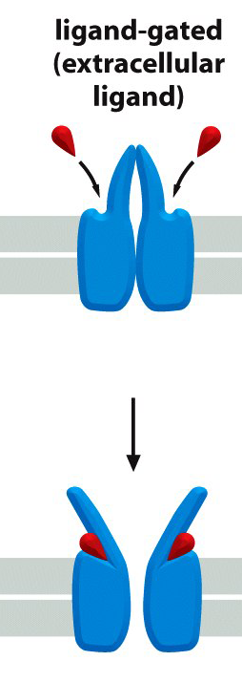
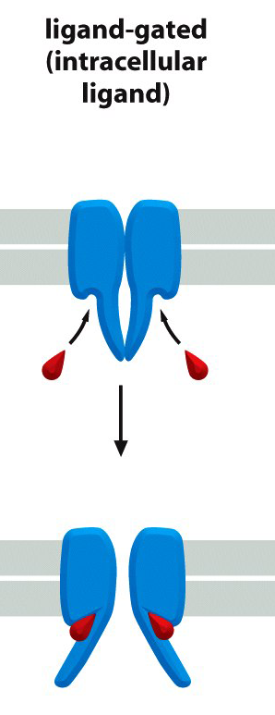
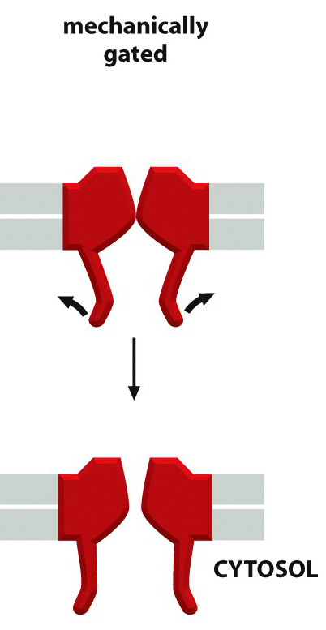
Ion channels under external driving force
The probability for ion channels of being in open or closed states can be tuned by various external agents:
Change of the V across the membrane
Binding of a ligand
A mechanical stress

Slide 12
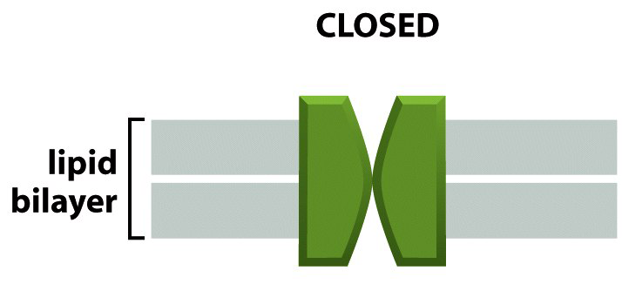
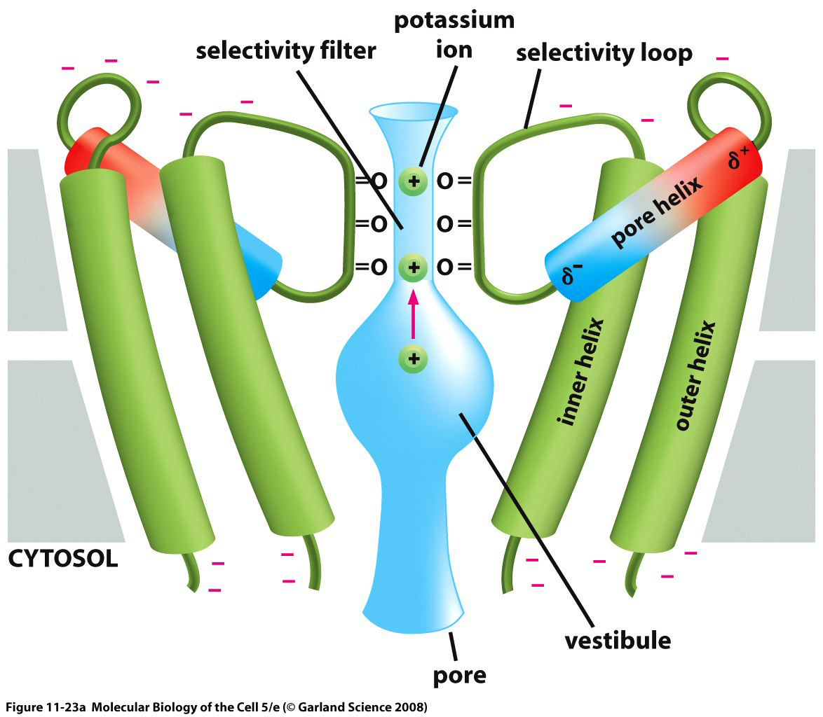
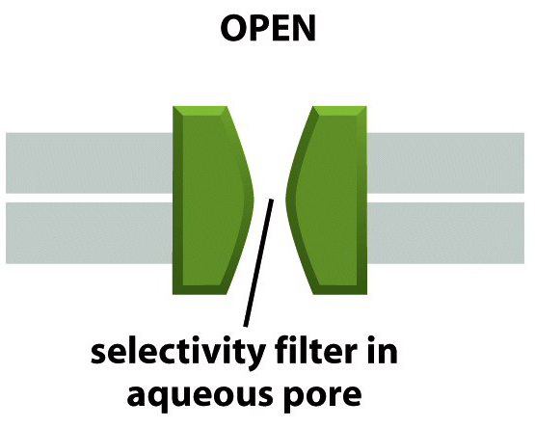
Ion channels
Ion channels - transmembrane proteins that mediate the transport of ions in and out of cells
Structure of a bacterial K⁺ channel. The channel is made from 4 identical transmembrane subunits (only 2 are shown) which together form a central pore through the membrane

Slide 13
How We Know: Structure
Knowledge of the structures of different membrane proteins gives us a substrate to reason on about how they work.
Synchrotron
(Rees et al.)
Nicotinic
acetylcholine
receptor
EM & X Ray structures
K Channel
MscL and MscS
(Unwin et al.)
Notes:
This slide: what has been learned about ion channels from structural biology.

Slide 14
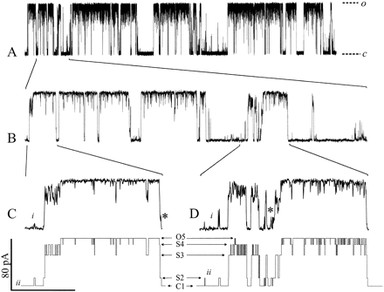
How We Know: Current-Pressure Relationship
The idea: grab a patch of membrane and apply a potential difference to measure the currents.
Fraction of time spent open depends upon magnitude of driving force.
(Sukharev et al.)
pA currents lasting several milliseconds.
Notes:
The idea here is to try and illustrate how channel function is studied by measuring the transient permeability.

Slide 15
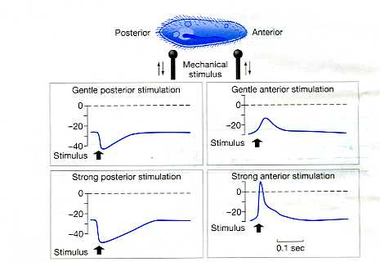
The avoidance response revisited
This schematic traces the series of processes that occur when a Paramecium is subjected to a mechanical stimulus.
(Ralph Greenspan, An Introduction to Nervous Systems)

Slide 16
Ion channels and the implementation of decisions
The particular scheme exploited by Paramecium has several facets involving both mechanosensitive and voltage-gated ion channels.
(Ralph Greenspan, An Introduction to Nervous Systems)

Slide 17
Which Ion species Mediates the Process?
The clever experiment involves tuning the extracellular concentrations of the different ion species in turn and then examining the resulting membrane potential.
(Ralph Greenspan, An Introduction to Nervous Systems)

Slide 18
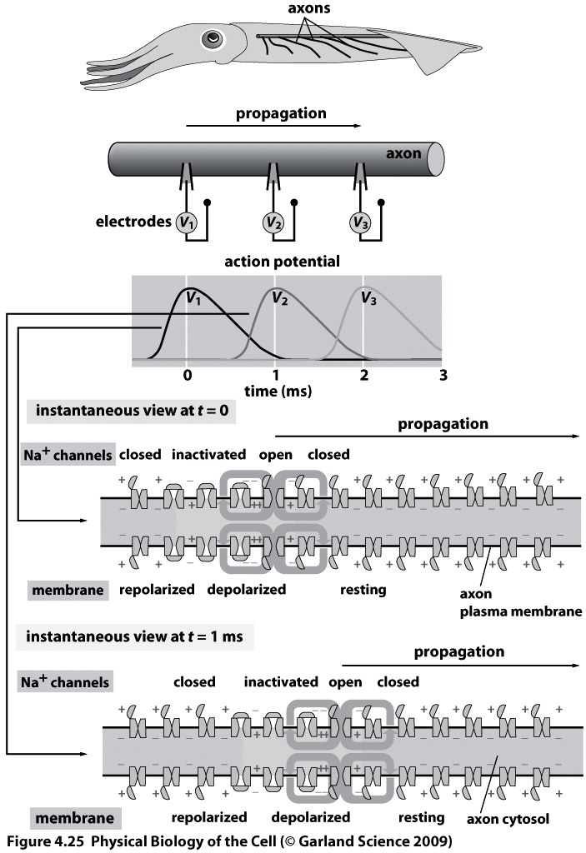
The action potential
Action potentials are a stereotyped response once a critical threshold has been crossed.
The shape and duration of the action potential are key variables.
NOTE: Helmholtz measured the velocity of propagation of nerve impulses.

Slide 19
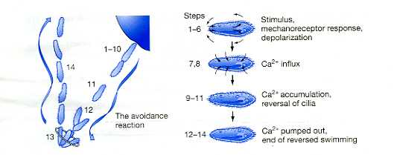
The avoidance response: details
These single-celled eukaryotes manage a sophisticated response to their environment.
One of the things I am most excited to tell you is that this response is mediated by similar tricks to those we are used to in the context of nervous systems.
(Ralph Greenspan, An Introduction to Nervous Systems)

Slide 20
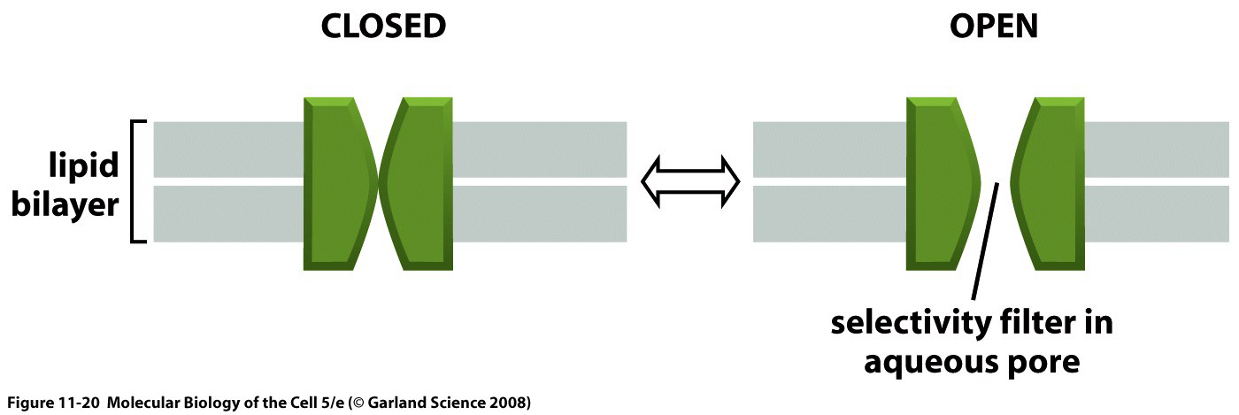
Ion transport rates in ion channels
Another way in which cells manipulate transport rates: selectively and transiently altering the permeability of cell membranes through protein channels and pumps
A typical ion channel, which fluctuates btw closed and open conformation
Estimate the flux of ions trough the channel, assuming purely diffusive motion
Ion channel =
D_{small ions} ≈ 2000 μm²/s (e.g., Na⁺)
Fick’s law (details - later):
where Δc = difference in ion c across the cell membrane, l = distance btw the two “reservoirs”
mammal.cell: Δc ≈ 100 mM (≈ 6×10^{–2} molecules/nm³); l ≈5 nm
A_{channel} = d²π/4 ≈ 0.2 nm² => N of ions traversing the membrane per second:
5 nm (width of lipid bilayer)
0.5 nm (size of hydrated ion)

Slide 21
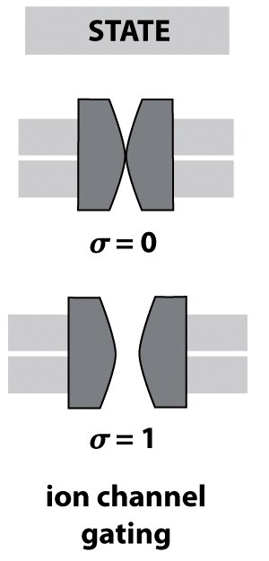
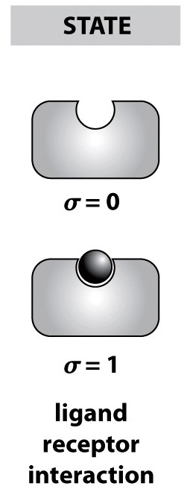
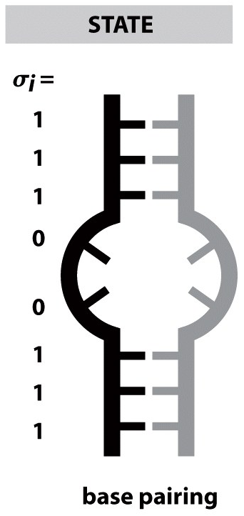
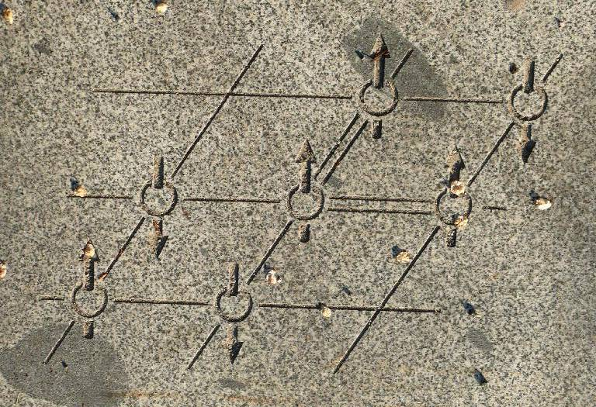
Two-state systems
There are two models that a statistical mechanician is interested in, the one they are working on and the Ising model.
A Statistical Mechanician
In many bio problems, the state of the system is described by one or several simple two-state variables (σ ), each of which can only take the values of 0 or 1
Examples of the internal state variable description of macromolecules:
Overall state of the DNA is described by the vector
where σ_{i} refers to the state of hybridization of the i^{th} base pair
A paving stone at UBC: Ising model of spins on a regular lattice

Slide 22
Ion channels
Aim: compute the probability of finding the channel open, p_{open}
Boltzmann distr.: the probability of finding a state with energy E is
If there is no external driving force, the energy as a function of σ is
where ε_{open} (ε_{closed}) is the energy of the open (closed) state
E = E(σ) =?

Slide 23
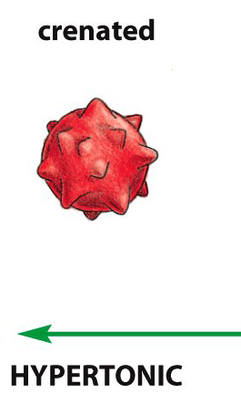
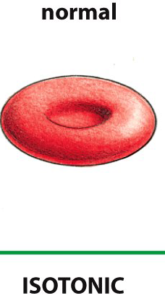
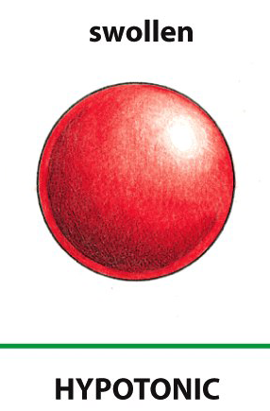
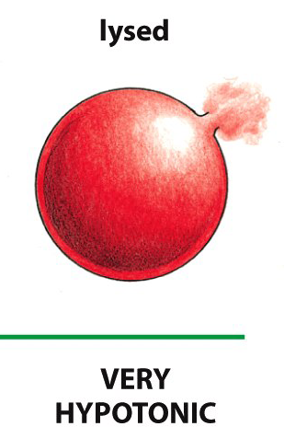
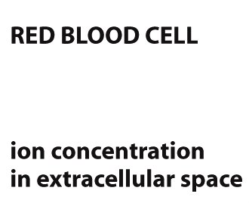
Ion channels under applied tension
For concreteness, we begin by considering the case of mechanosensitive channels. Driving force: the tension in the membrane
Mechanosensitive channels have been hypothesized to serve as safety valves to protect cells against membrane rupture due to osmotic imbalance.

Slide 24
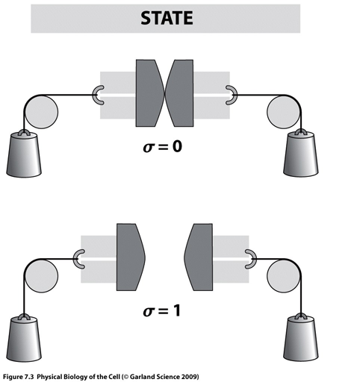
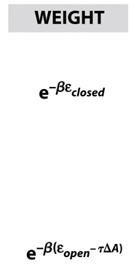
Energy of Ion channel under applied tension
In open state, the energy of the loading device is reduced
=> energy as a function of the applied tension τ
where ΔA is the area change upon gating.
favors the open state

Slide 25
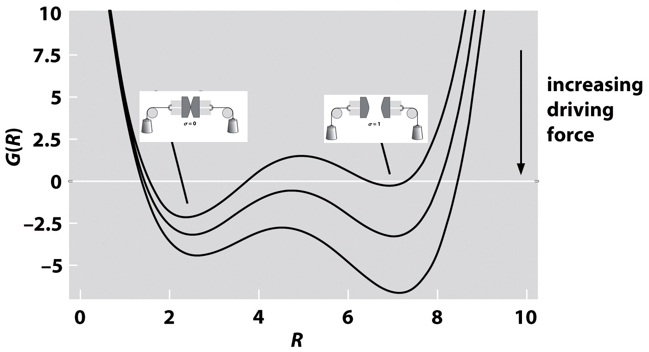
Energy landscape for an ion channel
The entire energy landscape for a channel as a function of the radius for different choices of external gating parameter (membrane tension, ligand concentration, or applied voltage):
Presence of the driving force shifts the balance between the energies of the closed and open states.

Slide 26
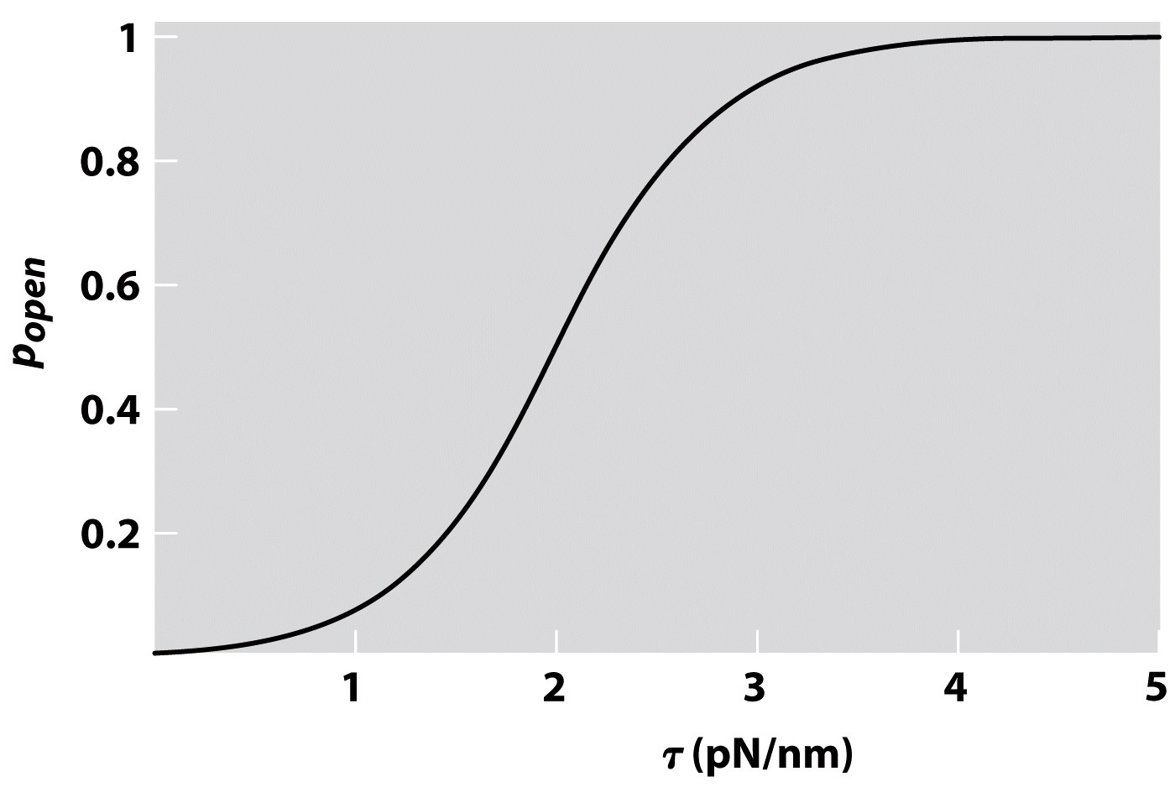
Open probability of the ion channel
Compute the open probability of the channel. The energy is
The partition function:
=> the open probability:
To understand how a channel will behave under a driving force we need to know 2 things:
(1) The intrinsic preference for each of its 2 states
(2) how the external driving force alters the relative energies of these 2 states
=> stat. mech. allows us to compute the behavior of the channel under a range of driving forces
Parameters: Δε = –5 k_{B}T, ΔA =10 nm²

Slide 27
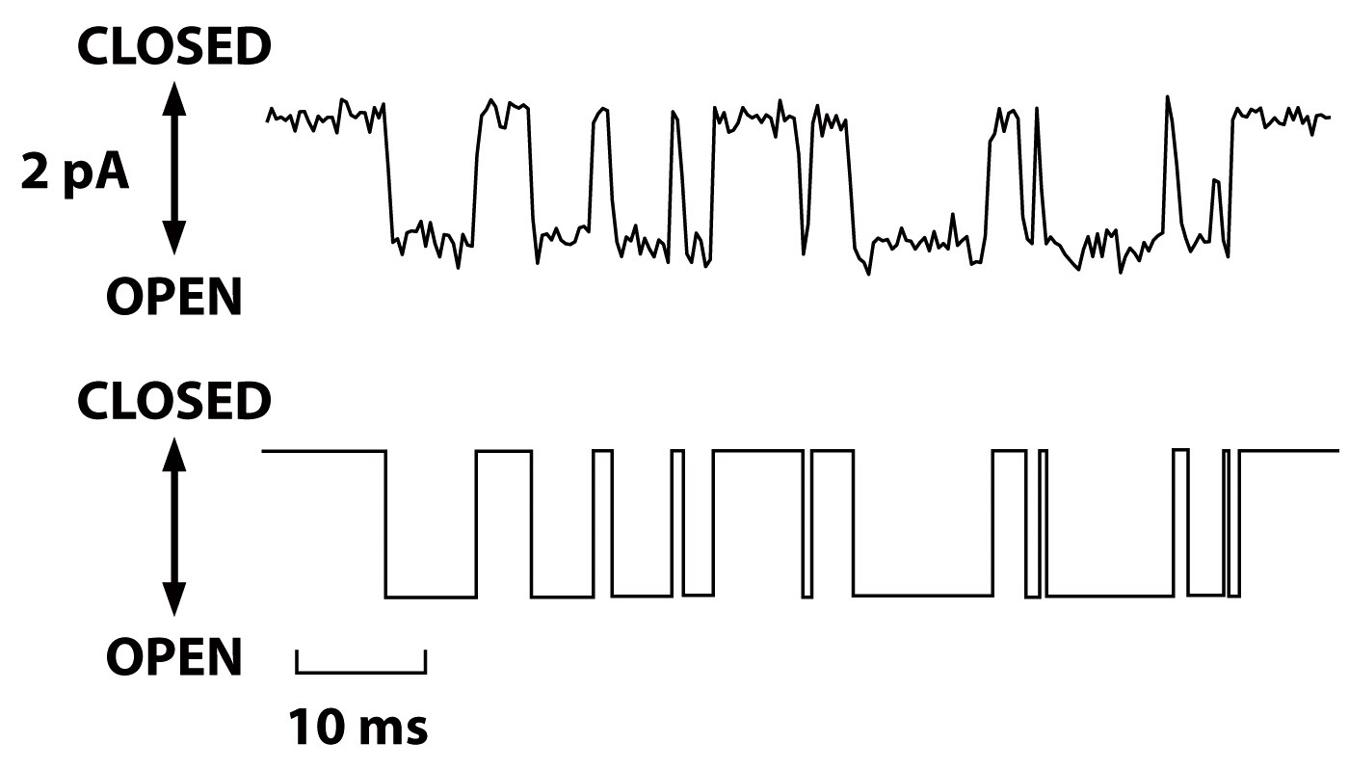
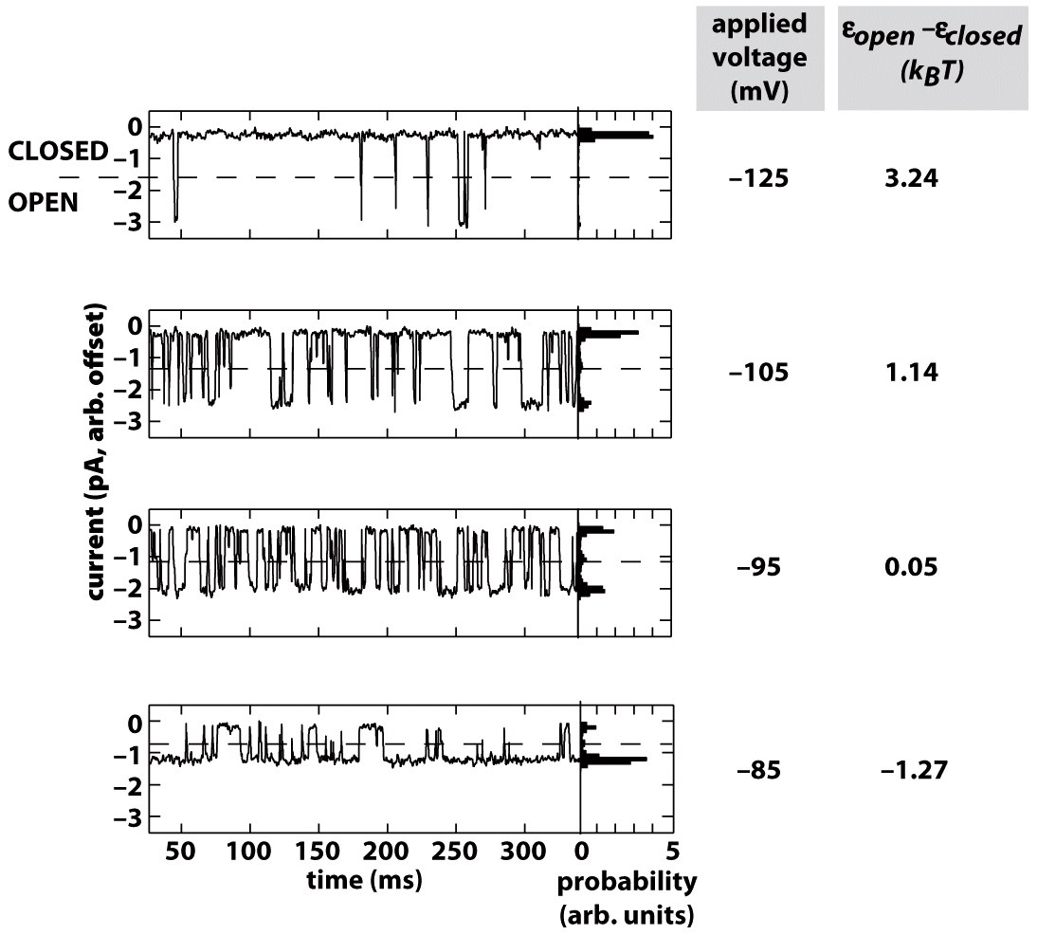
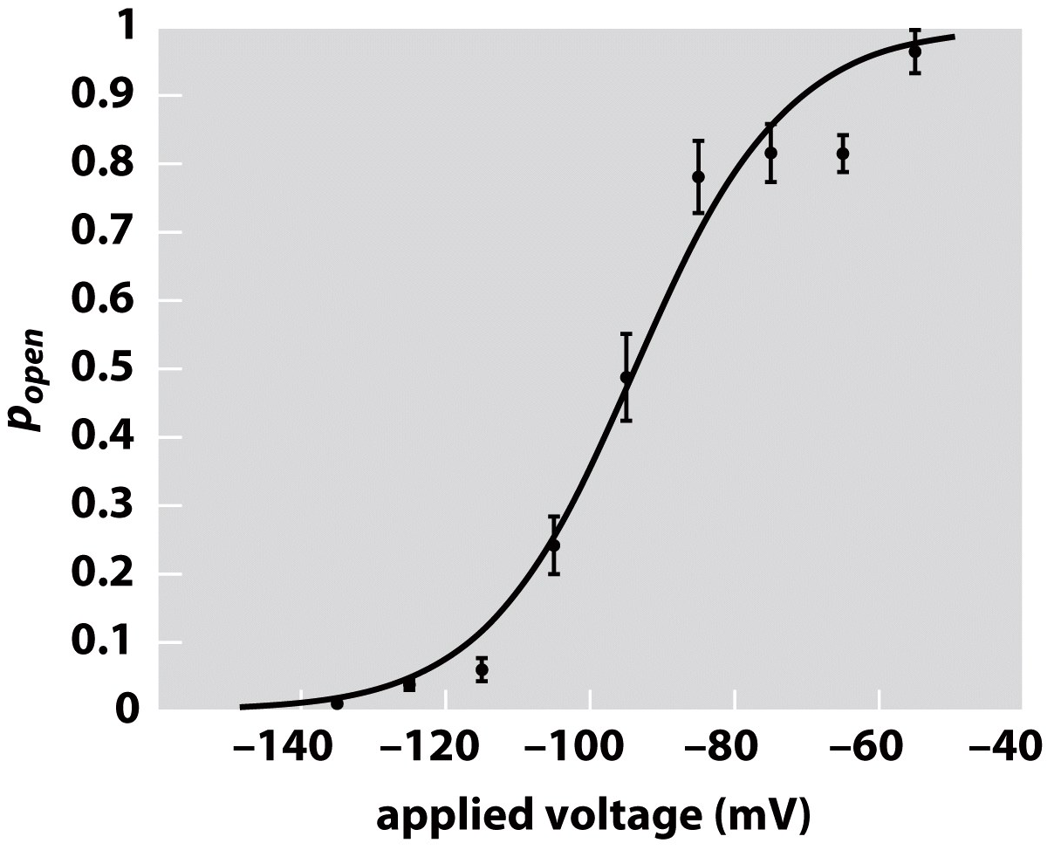
ion channel gating: experimental data
Current trace
2-state idealization of the current trace
A single channel incorporated into a pure lipid bilayer is subjected to different voltages. The resulting current is measured. Tuning the driving force for gating only changes the relative dwell time and not the existence of the states themselves.
Keller et al., J.Gen.Physiol. 1986

Slide 28
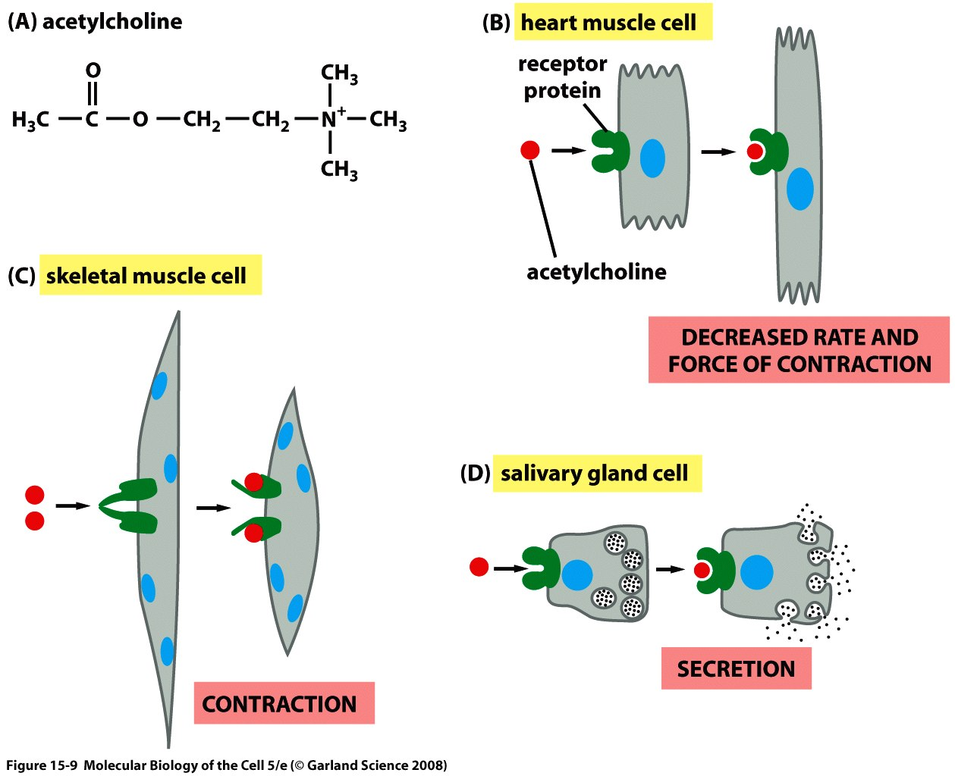
Ion gated channels: Acetylcholine

