Slide 1
Nucleosomes: what, why and where?
Rob Brewster

Slide 2
Outline
What is a nucleosome?
- how is DNA packaged/organized in Eukaryotes?
Why do nucleosomes form?
  - DNA is stiff, how do ~100 bp loops form so readily?
Where do nucleosomes form?
    What controls the spacing and structure of nucleosomes on the chromosome?
Accessibility of DNA in the nucleosomes
- How is DNA inside a nucleosomes accessed?

Slide 3
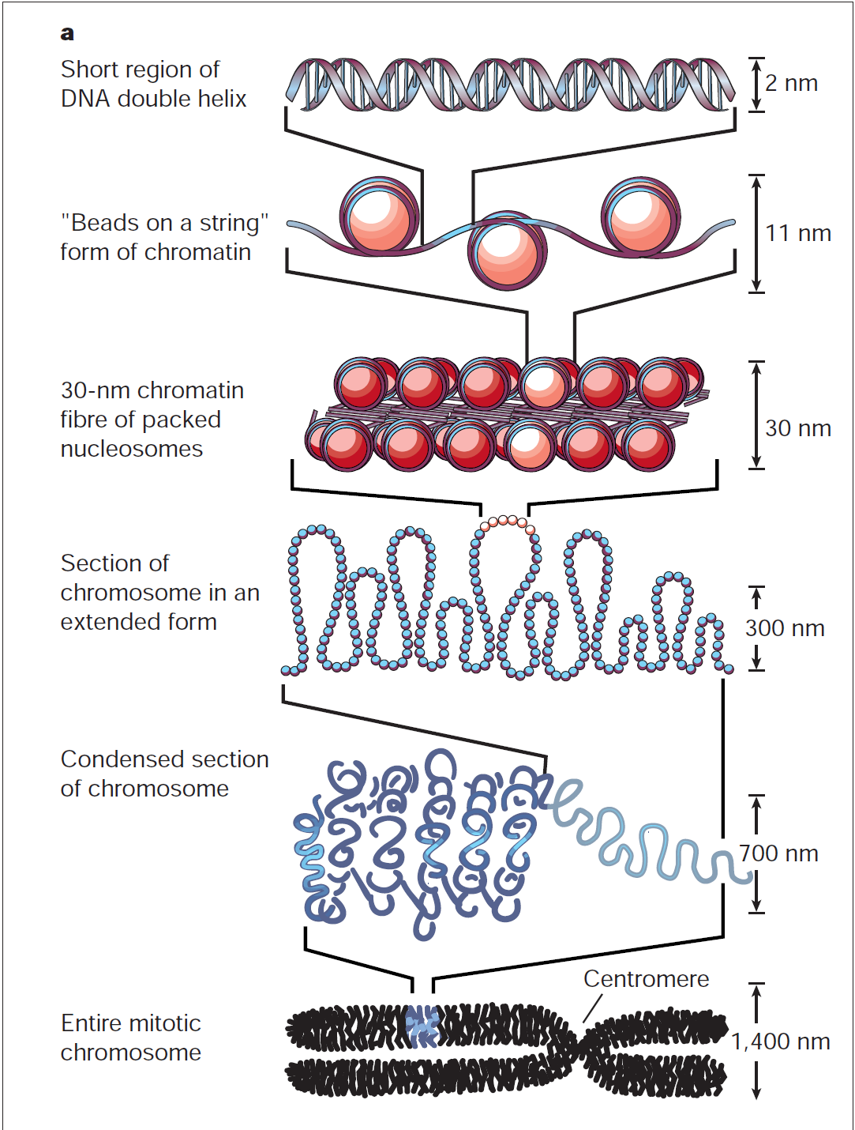
DNA Organization in Eukaryotes
DNA is packaged and condensed into chromosome
Human genome is big, nucleus is small
  ~ 2 billion basepairs ≈ 2m
  nucleus radius ~ 6 µm
Many different levels of organization
  Compacts chromosome
  Regulates transcription by making
  portions of the chromosome
  more/less accessible (up to 80%
  is inaccessible to protein binding)
We will focus on nucleosome
formation
(Lee W et al., Nat. Genetics 2007)
(Alberts, Essential Cell Biology 1998)
Notes:
Motivate regulation better

Slide 4
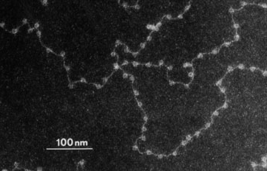
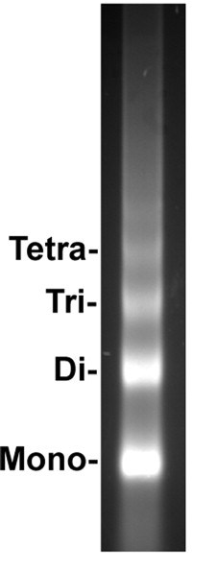
What is a nucleosome?
Electron micrograph of chromatin at low ionic strength
- Nucleosomes appear as “beads on a
string
Basic repeating structure can be probed (protect and seq method)
- Digestion enzyme cuts accessible regions of DNA
- DNA protected by nucleosome is not cut
(Electron Micrograph from Olins and Olins)
Mono
Dual
Mono
Mono
(Furuyama and Biggins ,PNAS)
Notes:
Split into two slides

Slide 5
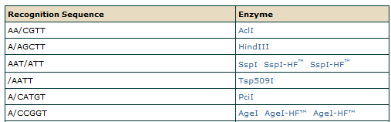
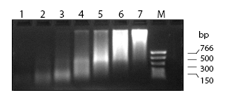
Enzymatic digests
Particular enzymes can cut double stranded DNA between basepairs
- Most have specific recognition sites
- Micrococcal nuclease cleaves everything it can (no specific seq.)
Dilution of nuclease 1:3
(pictures from NEB)

Slide 6
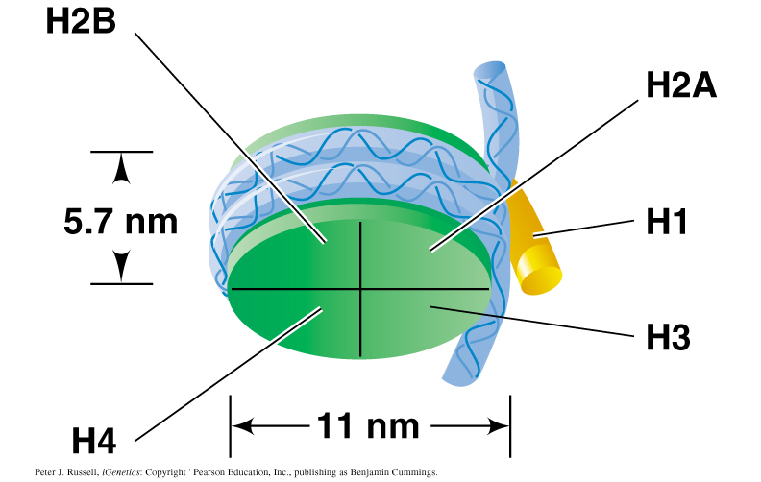
Structure of individual nucleosome
Repeating structure contains 5 different proteins
- Main body is an octomer formed from:
two copies each of H2A, H2B, H3, H4
- DNA wraps 147 bp (1.75 turns) around
the core
-14 non specific adhesive contacts with histone (major groove – histone)
- H1 attaches to the linker region and
changes the conformation; required
for chromatin formation
- H1 covers 30-50bp
(Peter J. Russell, iGenetics)

Slide 7
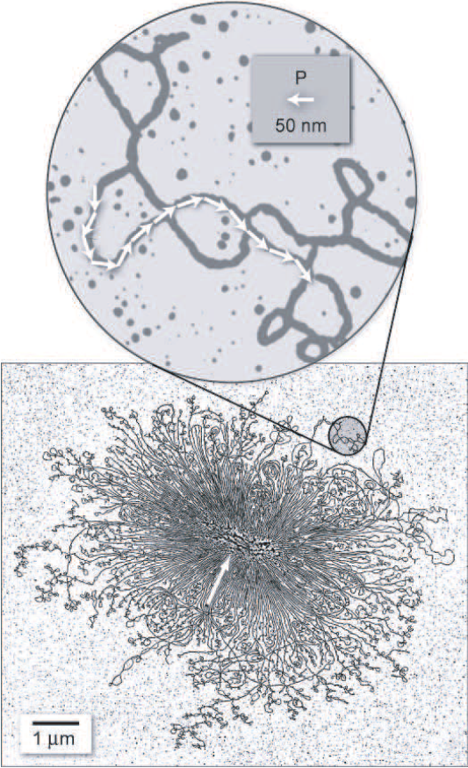
DNA rigidity
DNA is stiff…
- ~150bp persistence length, λ, for lysed bacterial genome
- loops smaller than λ should be rare
… but not that stiff
- single turn around histone core ~100 bp
Notes:
Bending energy

Slide 8
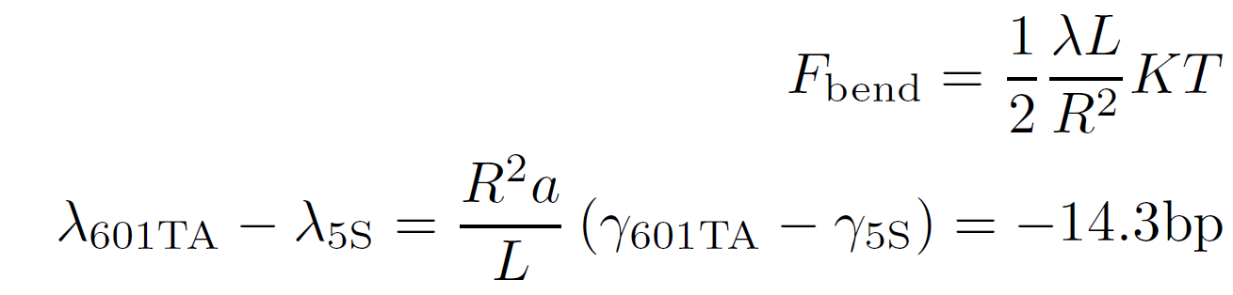
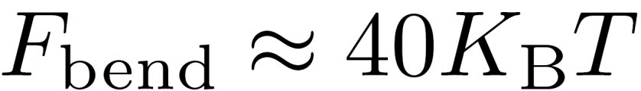
Back of the powerpoint calculation
Energy paid to bend loop of 147 bp DNA in 16.5 bp circle
Assume λ=150 bp then:
This cost must be balanced out (and then some) by the 14 contacts so each contact must contribute ~3 KT
However, nucleosome contacts are ~ 1.5 KT (Polach and Widom, 2005; Schiessel, 2003)
Reversing this and solving for maximum stiffness for stable nucleosomes, λ < ~ 80 bp
What gives?

Slide 9
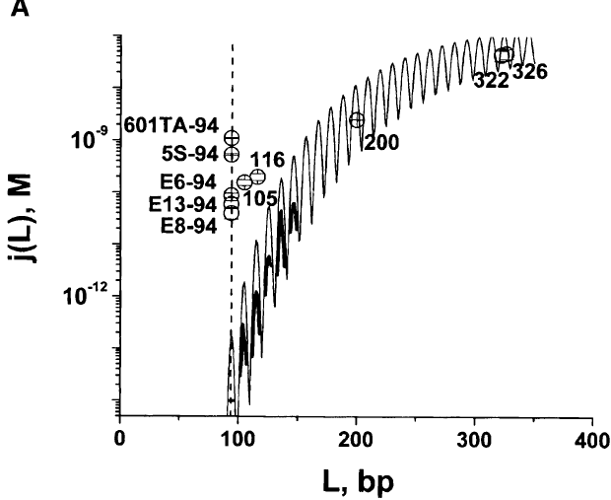
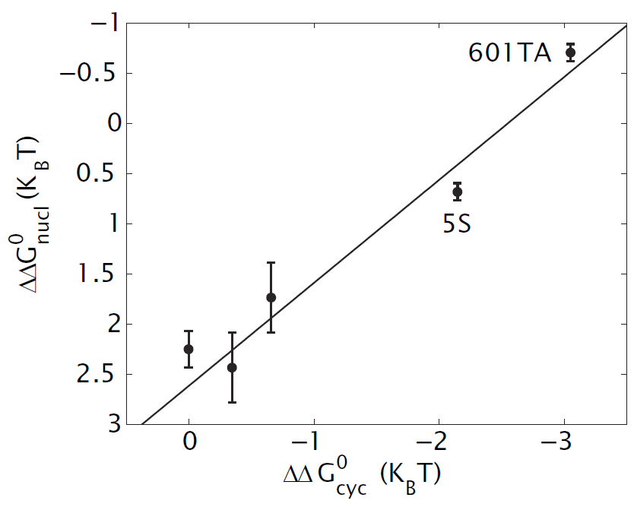
Bending of short DNA fragments
Looping probability for small fragments is larger than expected
- ~100 bp fragments form loops more readily than predicted
- certain sequences are more flexible than others
- sequences which loop more readily also more readily form nucleosomes
(as much as 10^3-fold difference)
Does this sequence dependence control where nucleosomes are positioned?
(Cloutier and Widom, Molecular Cell 2004)
Notes:
What is 5S

Slide 10
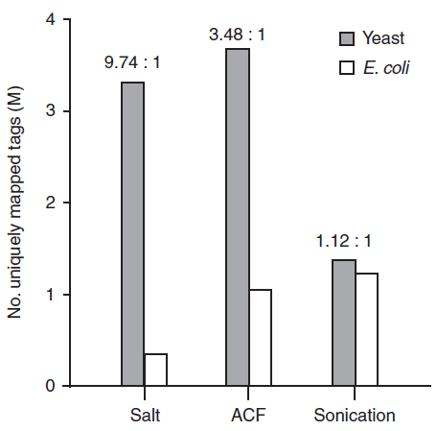
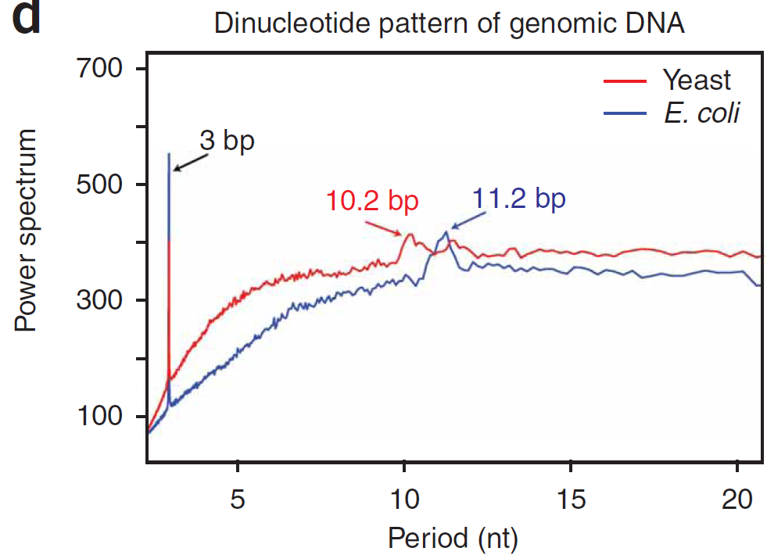
Where are Nucleosomes?
The Eukaryotic genome!
- Formation on Yeast genome is more probable than for e. coli genome
- Implies Euk. Genome has sequence preferential for nucleosomes
Eukaryotic genome shows specific patterns
- AA/AT/TT dinucleotide frequency
~10 bp (one DNA twist)
(Zhang et al., Nature struct. & mol. bio., 2009)
Power Spectrum of AA/AT/TT repeats

Slide 11
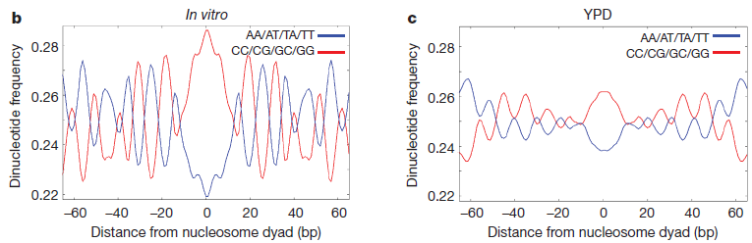
Nucleosome code
10bp Periodicity is evident both in vivo and in vitro
- GC is 5bp out of phase with AT dinucleotides
- due to bending differences in GC and AT?
(Kaplan et al, nature 2009)
Major groove
Wrap 5bp
Major groove

Slide 12
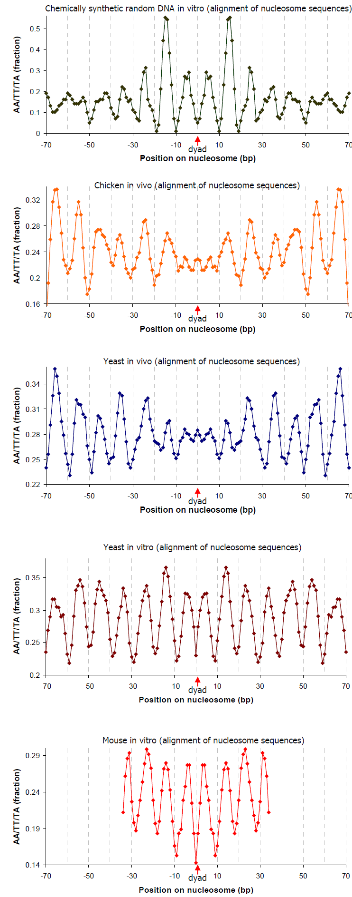
More examples
(Segal et al., Nature , 2006)

Slide 13
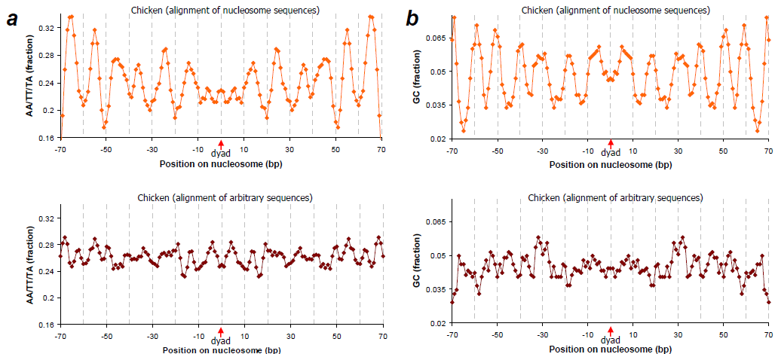
Nucleosome vs random sequence
Periodicity is missing from arbitrary sequences
(Segal et al., Nature , 2006)

Slide 14
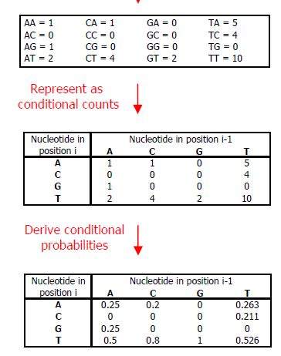
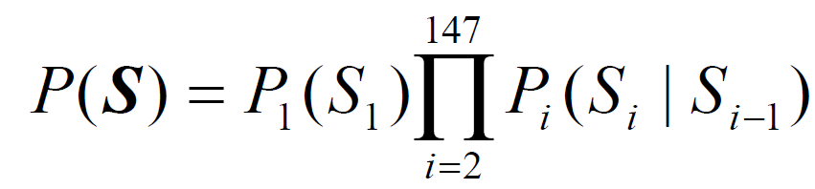

Probabilistic model of nucleosome occupancy
Method: From in vivo occupancy data, calculate the
probability of any dinucleotide pair at a given nuc.
position.
Probability that 147bp sequence S is wrapped:
The statistical weight of a longer sequence with multiple nucleosomes is just the product of the probability for every basepair to be in that state,
The probability must now be computed computationally due to the enormous number of possible configurations (C)
(Segal et al., Nature , 2006)
Notes:
MORE EXPLANATION

Slide 15
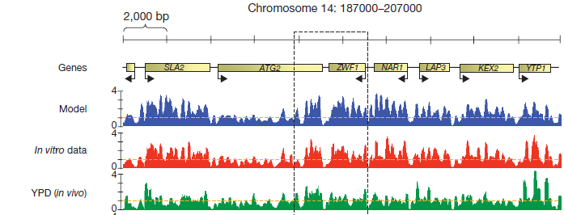
Probabilistic landscape for occupancy
At a particular nucleosomal coverage can predict where stable nucleosomes will be located
(Kaplan et al, nature 2009)

Slide 16
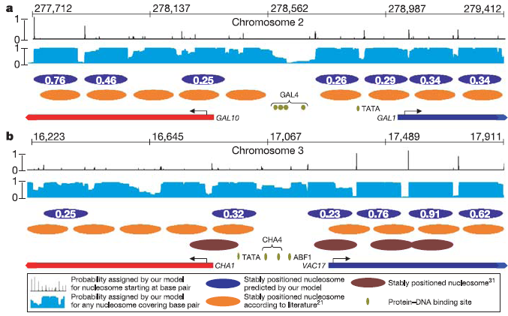
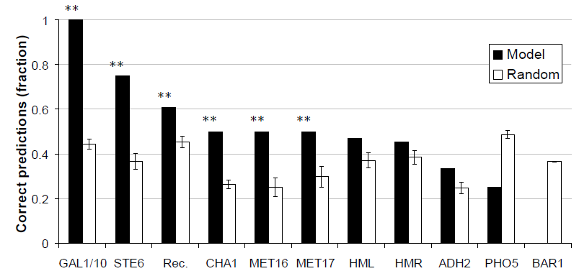
Predictions from thermodynamic model
Prob. of coverage by nuc
Predicted stable nuc
Exp. Determined nuc
Success rate within 32bp of predicted position

Slide 17
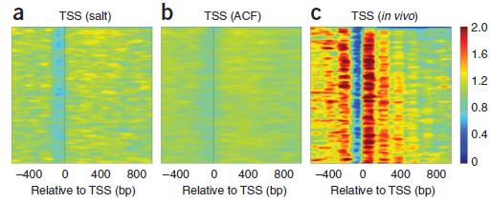
Statistical Positioning – A (semi)competing view
In Vitro
Less
Various Transcribed Genes
more
(Zhang et al., Nature struct. & mol. bio., 2009)
Nucleosomes pattern emerges from steric exclusion on a line
- Promoter region is always “nucleosome free”
- DNA sequence appears to play only a small role

Slide 18
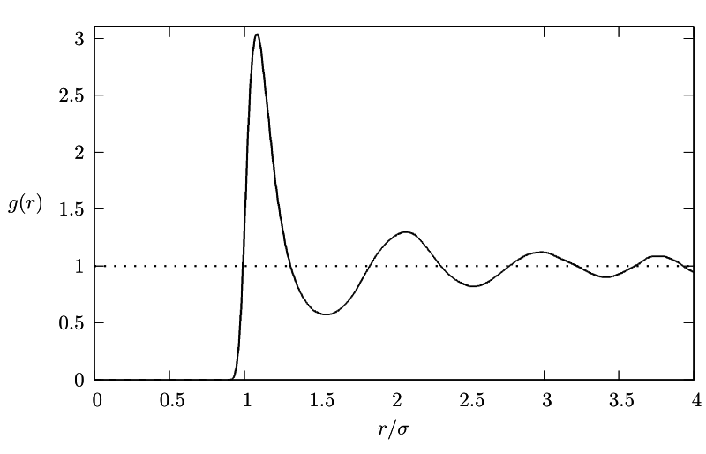
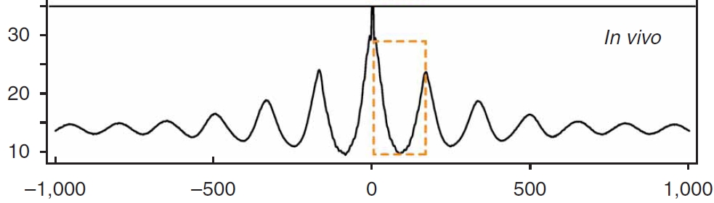
Random 1D hard sphere gas?
(Zhang et al., Nature struct. & mol. bio., 2009)
Occurrence
Distance from TSS
Phasing in vivo resembles RDF of (for instance) LJ Gas
Barrier
Hard Spheres
Can a simple model of a 1D hard sphere gas predict nucleosome positioning pattern?

Slide 19
Conclusions on positioning
DNA sequence matters for nucleosomes positions…
- preferentially bind to particularly repeating sequences
- avoid long tracks of A/T
… however, this effect seems to be minimized in vivo
- Simple 1D gas model fits in vivo nucleosome positions well
(data not shown)
How does one resolve the apparent conflict in these views?

Slide 20
Accessing nucleosomal DNA
How is protected DNA accessed?
- DNA replication, repair and transcription all require access to
occluded DNA
- Specialized motors called “remodeling factors” disassemble and perturb nucleosomes to allow access
-However, even without these motors, wrapped DNA has some accessibility
- Digestion assays probe equilibrium accessibility
- Fret probes dynamic accessibility

Slide 21
In vitro accessibility mechanism
What is the mechanism to access a site buried deep in the nucleosome?
?
?
?
Translation along dna
Bulged structures
Transient unwrapping

Slide 22
In vitro accessibility mechanism
What is the mechanism to access a site buried deep in the nucleosome?
?
?
Translation along dna
Bulged structures
In vitro accessibility does not show length dependence beyond ~100 bp
Transient unwrapping
(Anderson et al, 2002)

Slide 23
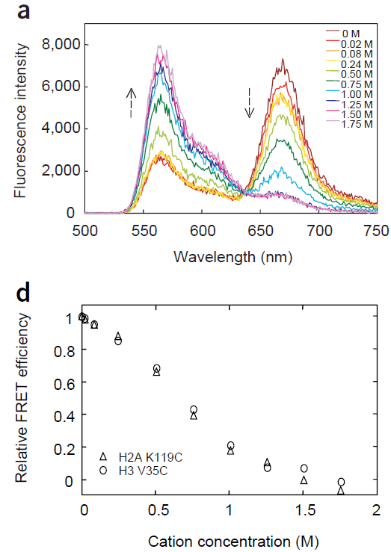
Fret on nucleosomal complex
One fret dye is put on the nucleosome, one is put on the end of the DNA strand
Excite at low wavelengths:
Dyes are far – signal ~680nm is low
Dyes are close – signal ~680nm is high
(Li and Widom, 2004)

Slide 24
In vitro accessibility mechanism
What is the mechanism to access a site buried deep in the nucleosome?
!
Translation along dna
Bulged structures
In vitro accessability does not show length dependence beyond ~100 bp
Transient unwrapping
FRET experiments by Li and Widom

Slide 25
Probing accessibility
Specific restriction enzyme binding site
DNA is cleaved when site becomes accessible from unwrapping
Measure probability for being cut as a function of burial depth
Accessibility is reduced (compared to naked dna)
sites buried shallow 10-100x, deep ~10⁵x
(Polach and Widom, 2000)

Slide 26
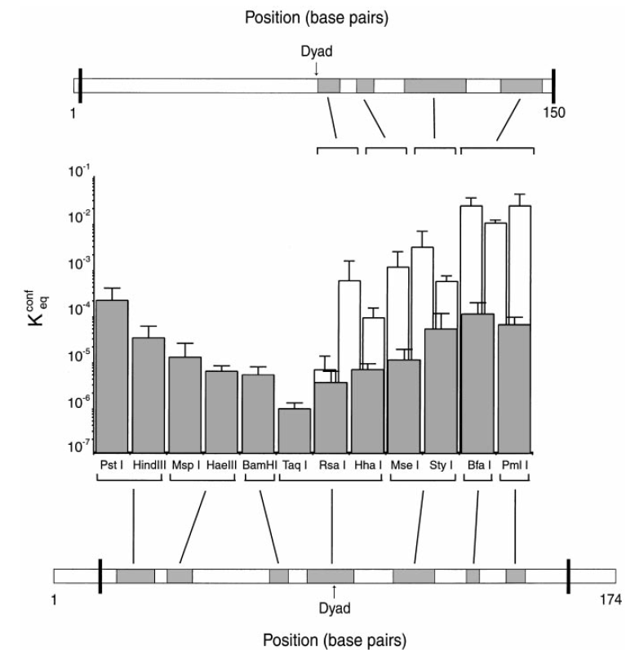
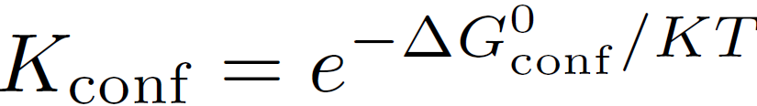
Measuring unwrapping
The more flexible sequence is less accessible!
Where ΔG is the change in free energy associated with opening the binding site

Slide 27
Theory Interlude
Nucleosome preference is entirely bending?!

Slide 28
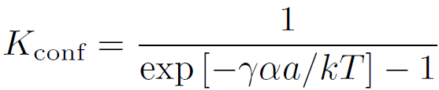
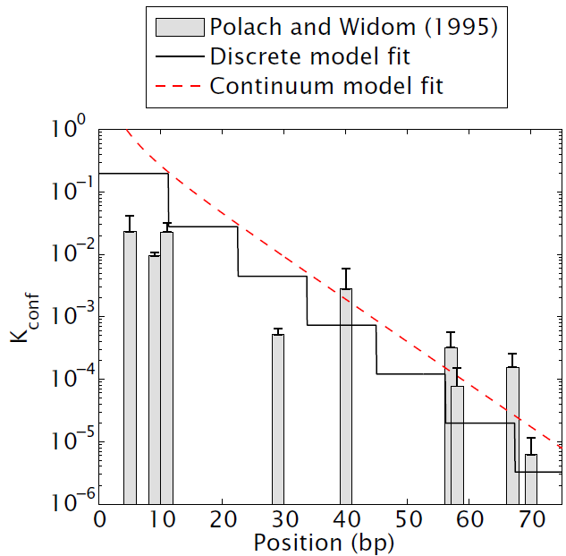
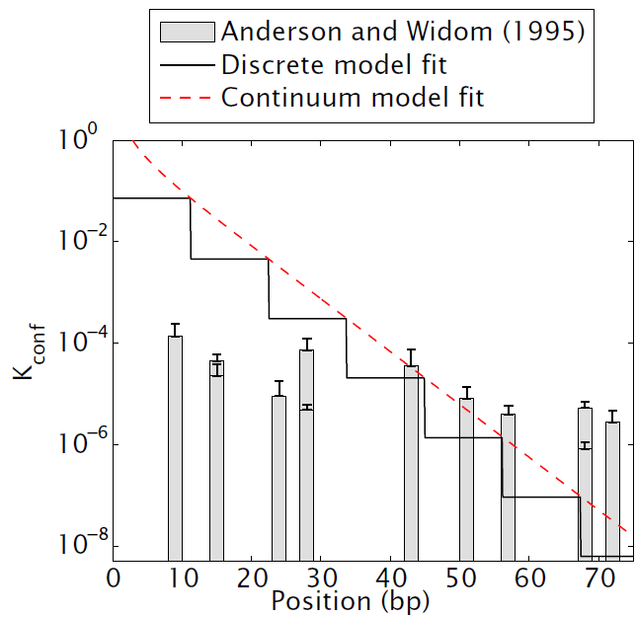
Fitting bending energy
More rigid sequence (5S)
More flexible sequence (601TA)
γ =- 0.16 kT/bp
γ = -0.24 kT/bp

Slide 29
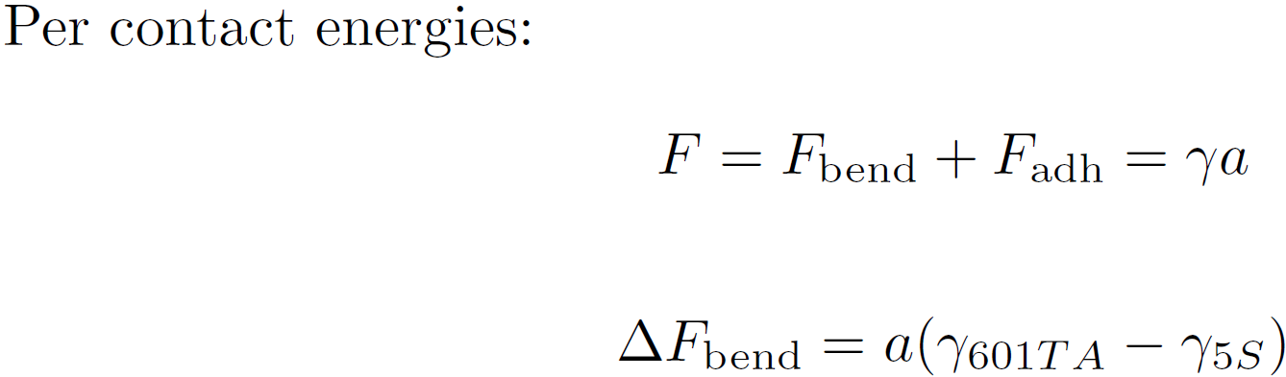
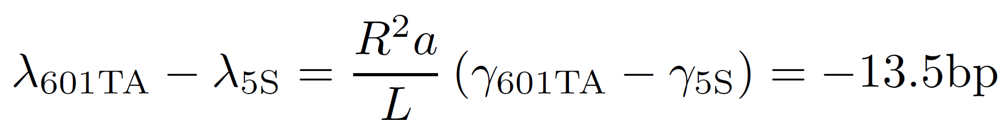

b
With R =13.5bp, a=10.5bp, L=147bp
However, for Cloutier and Widom data
bp

Slide 30
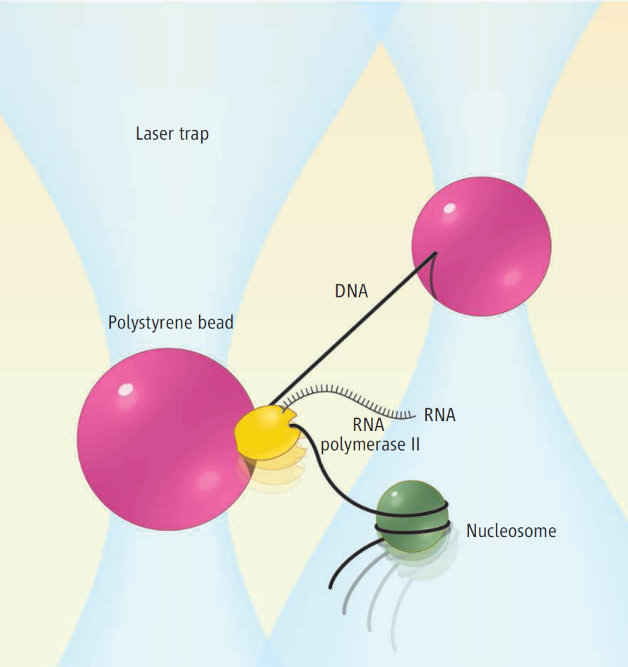
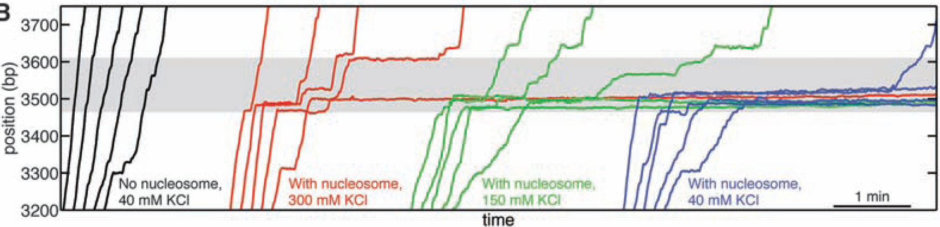
RNAP transcription through the nucleosome
Bead attached to end of DNA and RNAP
-RNAP movement through the nucleosome can be measured
- Distance between beads is a
readout for RNAP depth in
nucleosome
(Hodges et al, 2009)

Slide 32
Model for RNAP transcription through nucleosome

Slide 33
Conclusions

Slide 34
The End

Slide 35
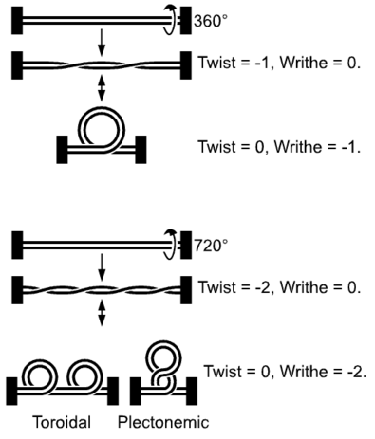
DNA organization
E. Coli genome ~ 4 million bp ≈ 1.2 mm
E. Coli dimensions ~ 2 µm^3
Human genome ~ 6 billion bp ≈ 2000 mm
Nucleus dimensions ~ 750 µm^3
(Matthews, DNA Structure Prerequisite Information. 1997)

Slide 36
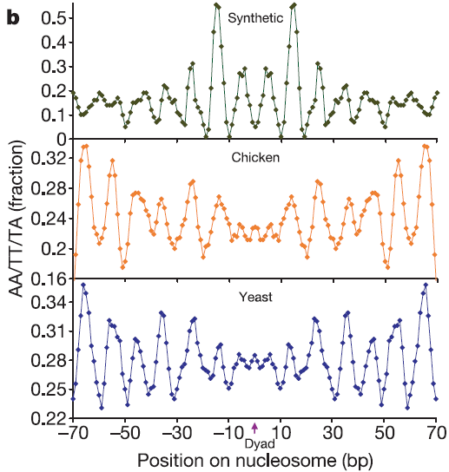
Sequence preference of nucleosomes
Nucleosome code
- AA/TT/TA dinucleotide repeats appear with 10bp periodicity
-GC repeats 5bp out of phase
Due to difference in bending of
dinucleotides?
- Helicity of DNA means bending
at major and minor groove is opposite
- Nucleosomes may position AA/TA/TT at minor/major, GC at
major/minor groove due to difference in bending
(Segal et al., Nature , 2006)

Slide 37
What is a Nucleosome (how do we know)?
Digestion with
Human genome is big, nucleus is small
  ~ 2 billion basepairs ≈ 2m
  nucleus radius ~ 6 µm
Many different levels of organization
We are interesting in Nucleosome
formation

Slide 40
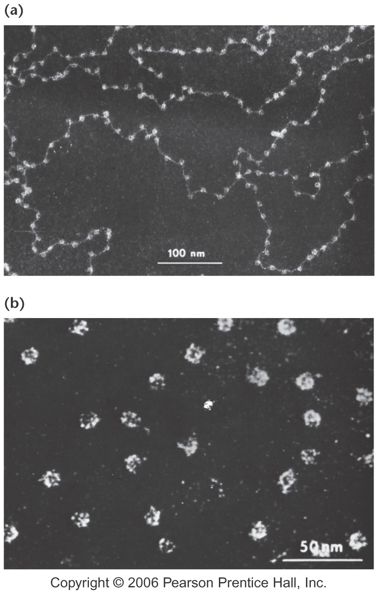
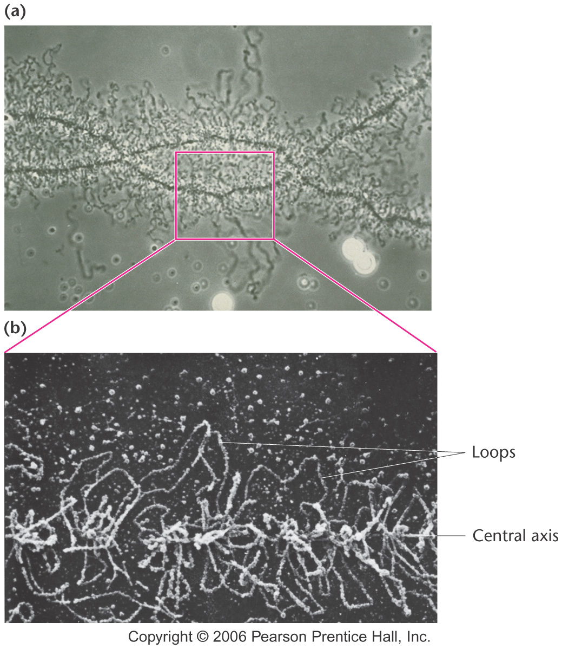
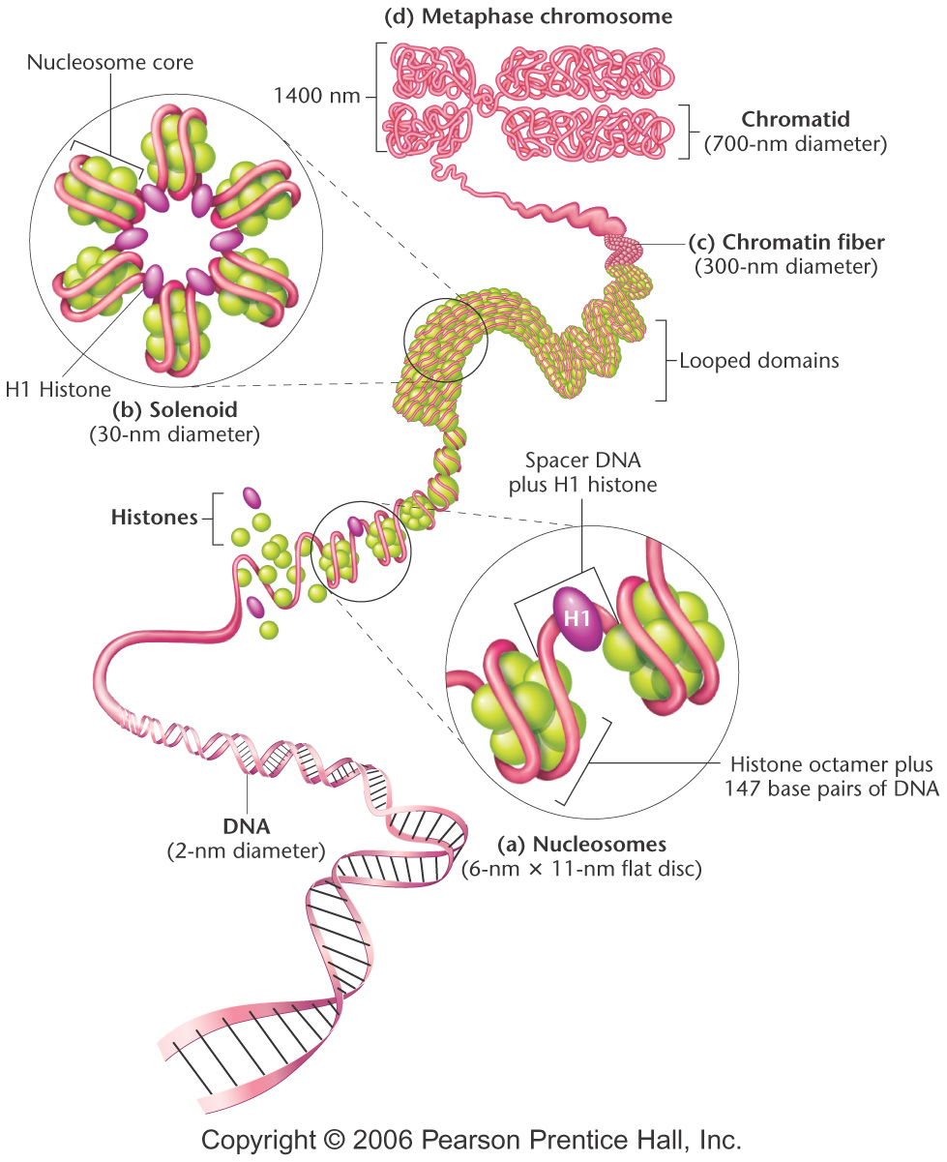
DNA organization in Eukaryotes
Olins and Olins

Slide 41
DNA organization in Eukaryotes

Slide 42
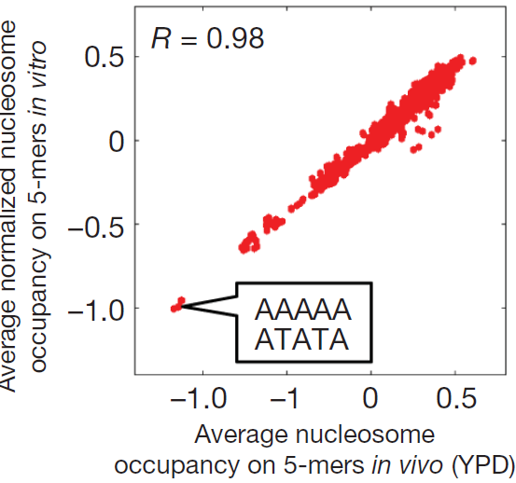
Topics:
-General introduction to Nucleosomes
-compaction computation?
-Protect and Seq: Widom http://www.wisdom.weizmann.ac.il/~eran/NucleosomeModel.pdf
weissman http://www.nature.com/nmeth/journal/v6/n4/full/nmeth0409-244b.html
-Lacra stuff, pulling exp
-Widom Accessibility

