Slide 1
BE/APh161 – Physical Biology of the Cell
Rob Phillips
Applied Physics and Bioengineering
California Institute of Technology

Slide 2
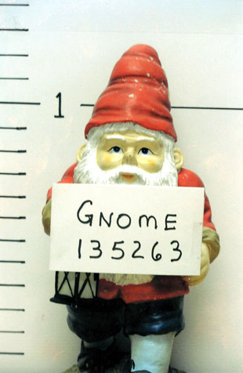
First topic
Gnome management: a feeling for the numbers

Slide 3
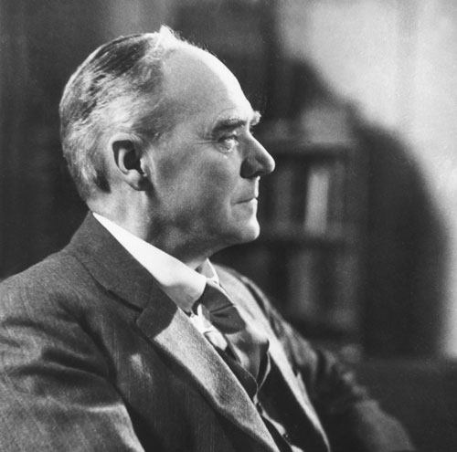
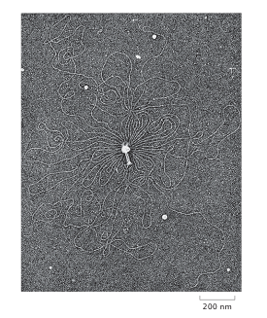
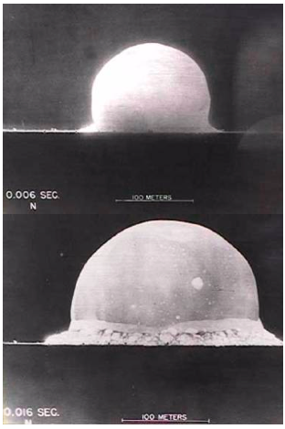
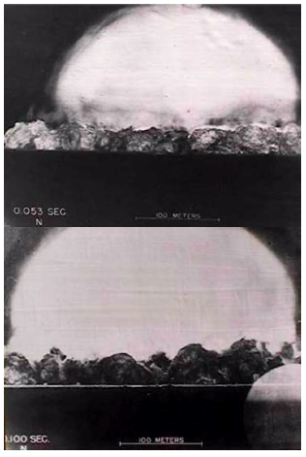
The Power of Estimation: An Analogy
Politicians and generals can make some information “classified” and it can be circumvented by cleverness.
Taylor made simplifying assumptions such as “spherical” blast.
This is a segue into our main topic: genomes and their use. Estimates on genome management.
Same idea could be used to estimate genome length.
The concept: figure out the length of the genome using a single picture and pure thought!
(G. Stent)
Notes:
RP

Slide 4
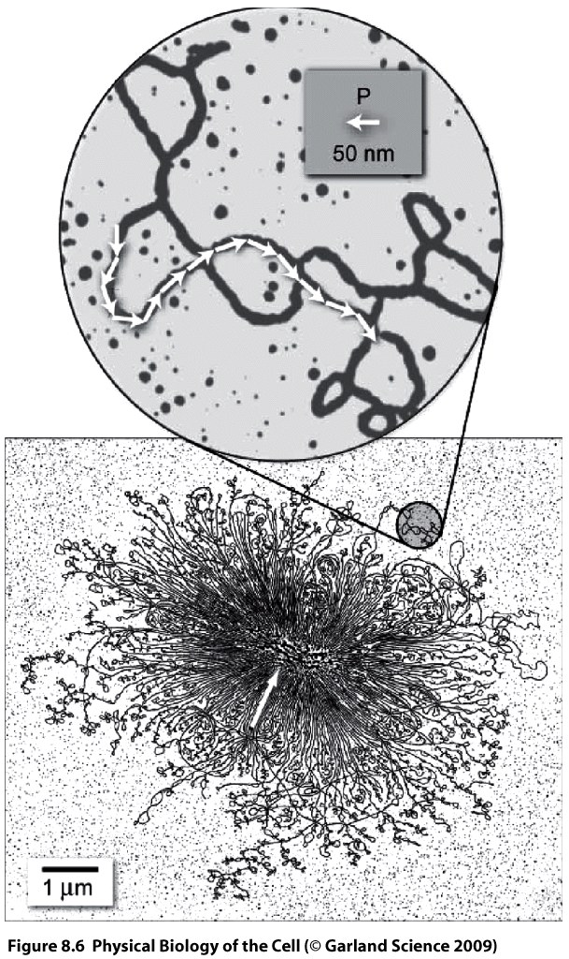
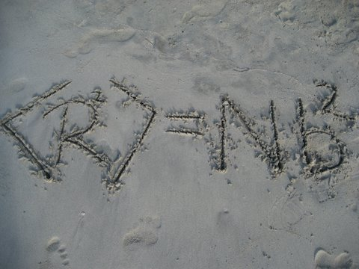
Estimations on Genome Management: How Big Are Genomes?
(G. Stent)
Use the simplest nunchuk physics of random walks to estimate the genome size.
What makes DNA different from some other polymer? The persistence length!
The radius of gyration scales as N^{1/2}, which allows us to estimate the number of such Kuhn segments and hence back out the genome length.
Note: This also tells us that work needs to be done to squish genomes into their hosts.
(R. Kavenoff)
Notes:
RP

Slide 5
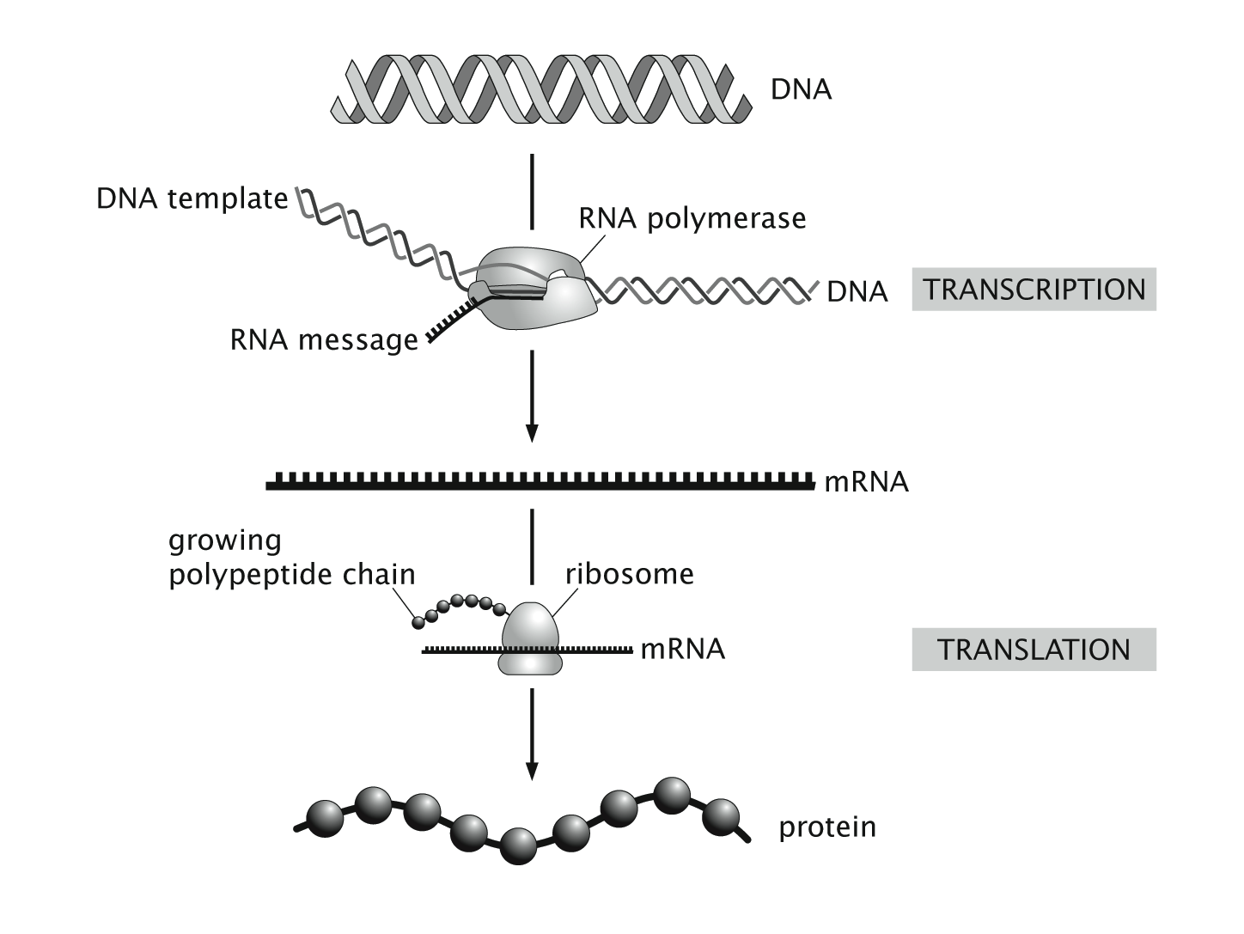
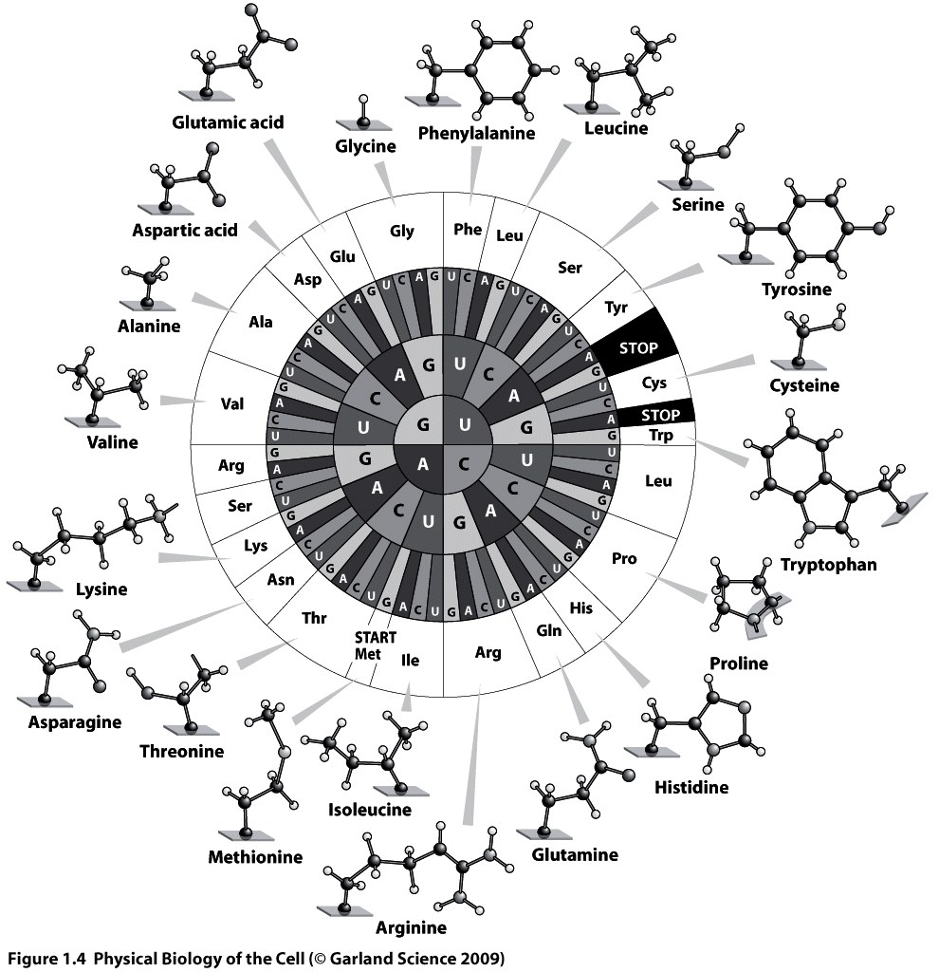
Putting Genomes to work: The Central Dogma
Francis Crick referred to nucleic acids and proteins as “the two great polymer languages”.
One of the great stories of modern biology is the working out of the mechanisms behind the way information read out in one polymer language (nucleic acids) is converted into information in the second polymer language (proteins).
A beautiful and key insight: the genetic code.

Slide 6
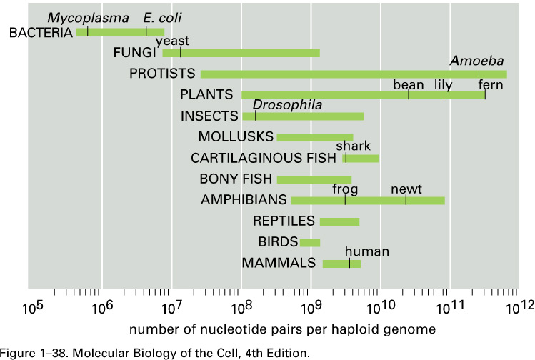
Thinking Up the Number of Genes: “What is true for E. coli is true for the elephant”
A betting pool (Las Vegas for estimates) was set up on the number of genes in the human genome and responses varied from 25,000 to 150,000.
A winner was declared, but the issue remains unsettled.
Simplest logic: use “typical” protein size of 300 amino acids, which requires roughly 1000 nucleotides to code for them. This naïve estimate says:
(Berman et al.)
Works great for E. coli, fails miserably for humans (and elephants).
The bet: genesweep pool- Science 6 June 2003:
Vol. 300. no. 5625, p. 1484
A Low Number Wins the GeneSweep Pool
Elizabeth Pennisi
COLD SPRING HARBOR, NEW YORK--The human genome has been sequenced, but calculating the number of genes it contains is taking more time. DNA experts have nonetheless decided they know who made the best prediction.
Notes:
Anﾊintriguing aspect of multicellular organisms is the fact that there are a wide variety of different cell types, this despite the fact that each and every cell carries the same genetic information.ﾊ ﾊOne of the key mechanisms giving rise to distinct cellular identities is particular ``decisions'' that are made about which genes to express at different times and places in an organism's history.ﾊ Interestingly, decision making is not restricted to multicellular organisms, nor even to eukaryotic cells.ﾊ Indeed, the modern theory of gene regulation was born out of efforts to understand how bacterial cells decide which sugars to utilize at any given time.ﾊ In this talk, I will describe the ways in which statistical mechanics can be used to examine the regulatory processes that take place in the lives of cells.ﾊ These simple models result in surprising predictions and I will also describe our experimental efforts to probe this rich behavior both in test tubes and in living cells.ﾊ

Slide 7
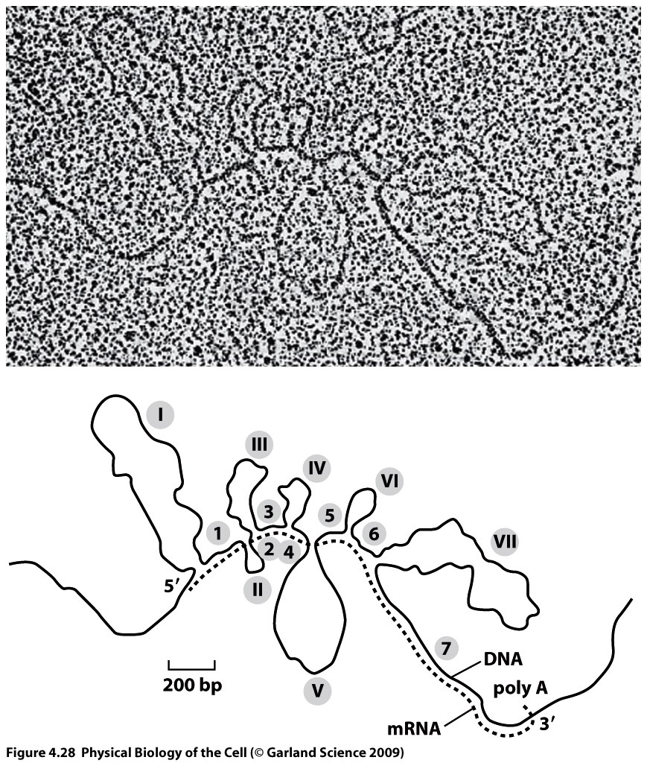
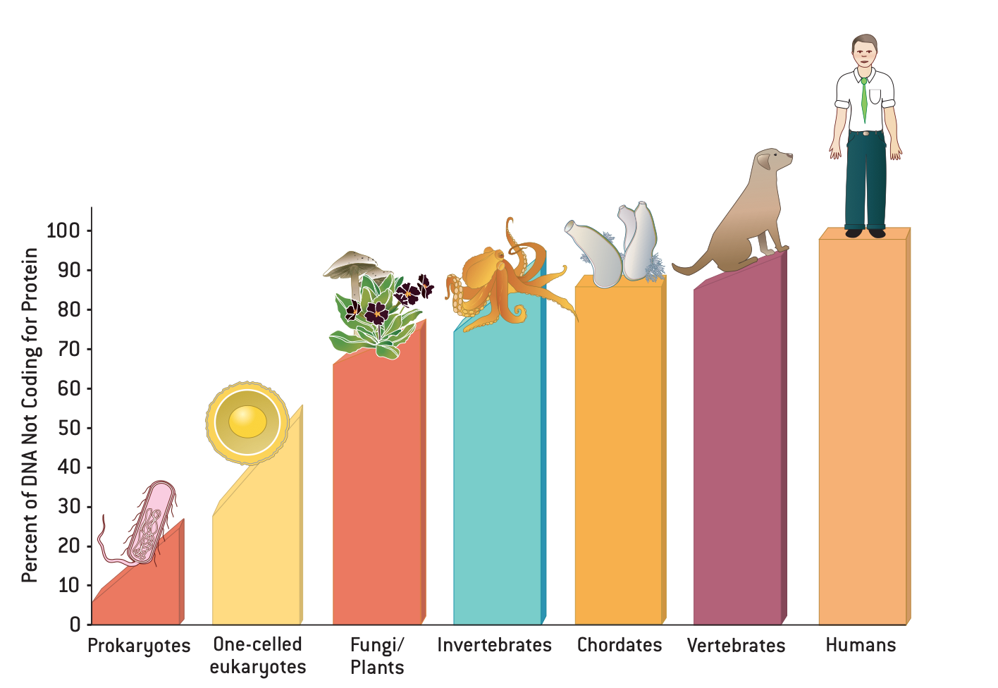
The Problem With Eukaryotes
Conundrums and surprises are a great way to learn things. The failure of the simplest estimate for eukaryotes reveals the important concept of “split genes”, referring to the fact that the coding regions are riddled with “introns”.
The failure of our estimate also reflects the existence of endogenous retroviruses and all sorts of other interesting genomic stories.
(P. Chambon, Scientific American, 1981)
(Berman et al.)
(Mattick, 2004)
Notes:
Anﾊintriguing aspect of multicellular organisms is the fact that there are a wide variety of different cell types, this despite the fact that each and every cell carries the same genetic information.ﾊ ﾊOne of the key mechanisms giving rise to distinct cellular identities is particular ``decisions'' that are made about which genes to express at different times and places in an organism's history.ﾊ Interestingly, decision making is not restricted to multicellular organisms, nor even to eukaryotic cells.ﾊ Indeed, the modern theory of gene regulation was born out of efforts to understand how bacterial cells decide which sugars to utilize at any given time.ﾊ In this talk, I will describe the ways in which statistical mechanics can be used to examine the regulatory processes that take place in the lives of cells.ﾊ These simple models result in surprising predictions and I will also describe our experimental efforts to probe this rich behavior both in test tubes and in living cells.ﾊ

Slide 8
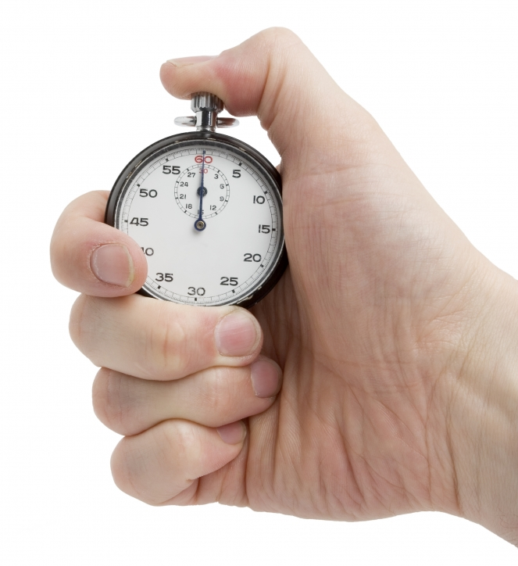
Second topic
How fast do biological processes occur

Slide 9
The rates of things in biology: A feeling for the numbers
Bio structures exist over a wide range of spatial scales…
…and bio processes take place over time scales from < ns to the age of the Earth.
A standard stopwatch: the cell cycle of E.coli
Cells strategy:
manage time by stringing together processes in succession;
manipulate time (e.g., using enzymes) to alter the intrinsic rates of processes
To some extent, coupling btw temporal and spatial scales (small things tend to operate at faster rates…)

Slide 10
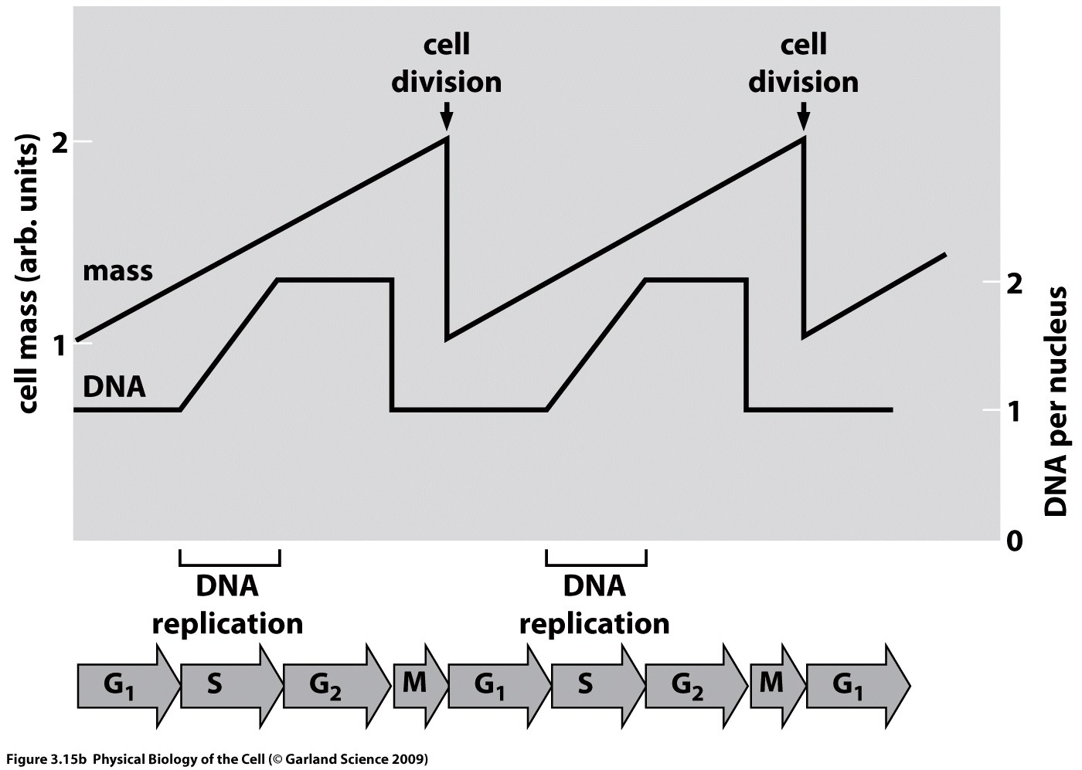
The standard stopwatch
Cell cycle = set of processes whereby a single cell becomes 2 daughter cells, through the process of cell division
(courtesy of Linda Song)

Slide 11
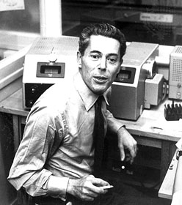
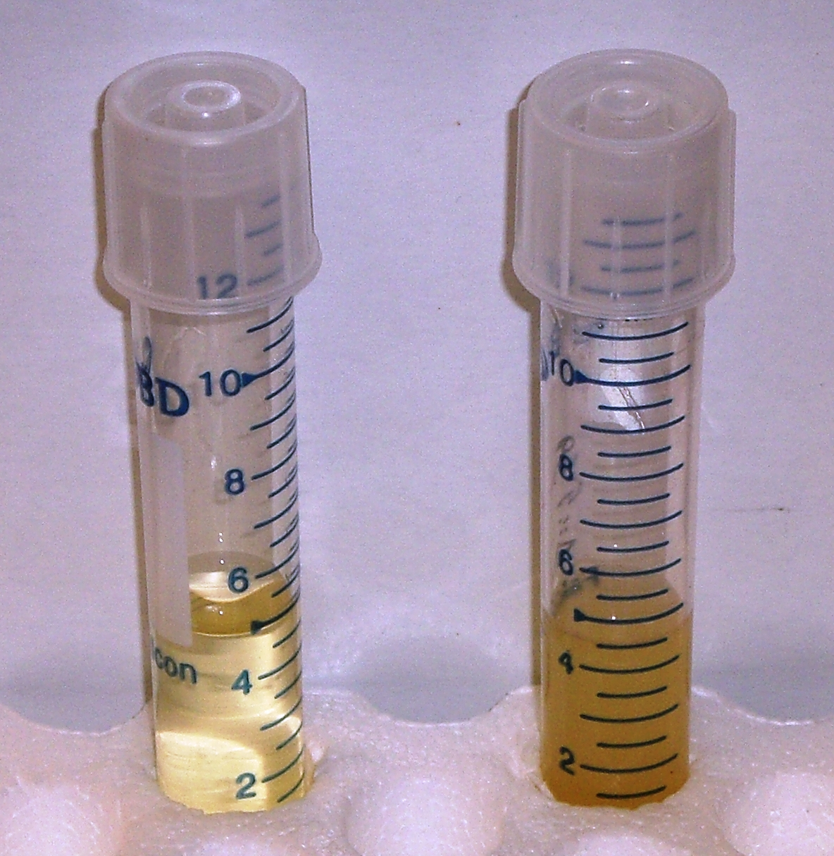
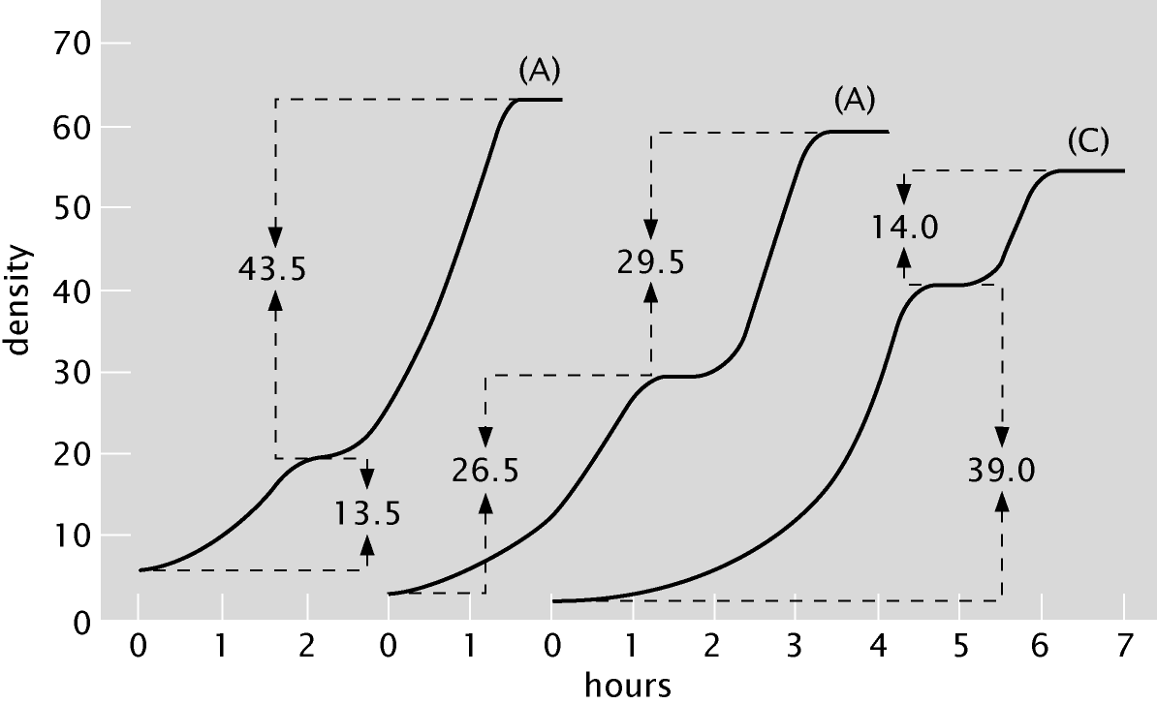
Growth Curves Reveal Cells Care What’s For Dinner
The fundamental mystery of life: Take 5 mL of solution with some salt and sugar, add a single cell, and 12 hours later you will have 10¹⁰ cells!
These growth curves tell the story of how genes are turned on and off in response to environmental cues.
(Berman et al.)
Bacterial growth curves
Notes:
Anﾊintriguing aspect of multicellular organisms is the fact that there are a wide variety of different cell types, this despite the fact that each and every cell carries the same genetic information.ﾊ ﾊOne of the key mechanisms giving rise to distinct cellular identities is particular ``decisions'' that are made about which genes to express at different times and places in an organism's history.ﾊ Interestingly, decision making is not restricted to multicellular organisms, nor even to eukaryotic cells.ﾊ Indeed, the modern theory of gene regulation was born out of efforts to understand how bacterial cells decide which sugars to utilize at any given time.ﾊ In this talk, I will describe the ways in which statistical mechanics can be used to examine the regulatory processes that take place in the lives of cells.ﾊ These simple models result in surprising predictions and I will also describe our experimental efforts to probe this rich behavior both in test tubes and in living cells.ﾊ

Slide 12
The hierarchy of temporal scales
Molecular motion of biochem. species as they interact and change identity
Unfolding of the lives of individual cells
Trajectories of entire species

Slide 13
To build a fly

Slide 14
Biological time scales in powers of 10: 10 days
Drosophila melanogaster: a workhorse of developmental biology
~ 10 days btw fertilization of the egg and the emergence of a fully functioning adult fly

Slide 15
Biological time scales in powers of 10: 10 hours
Development of the fly embryo: ~10 hrs
a single cell → 1000s of cells with particular spatial positions and functions
a dramatic part of embryonic development: the process of gastrulation (a series of folding events in the embryo → formation of the future gut)

Slide 16
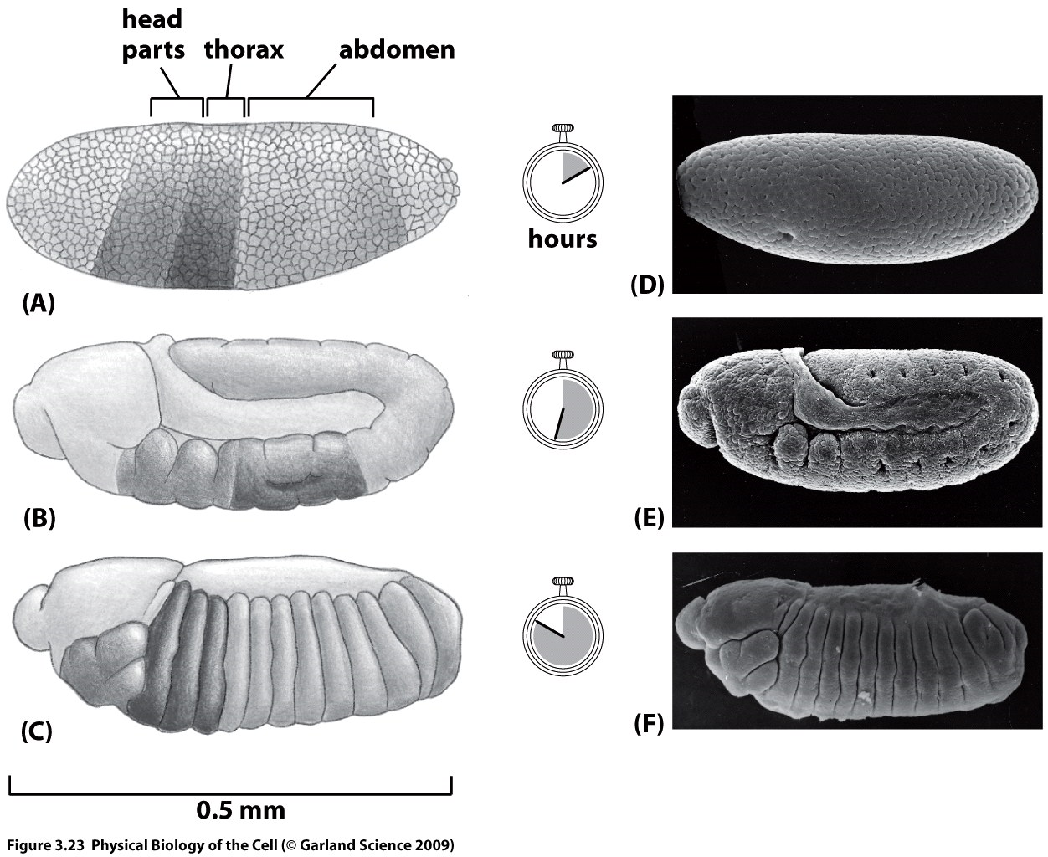
Time scales in embryonic development

Slide 17
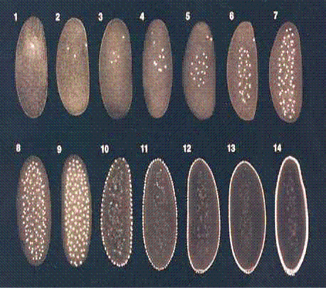
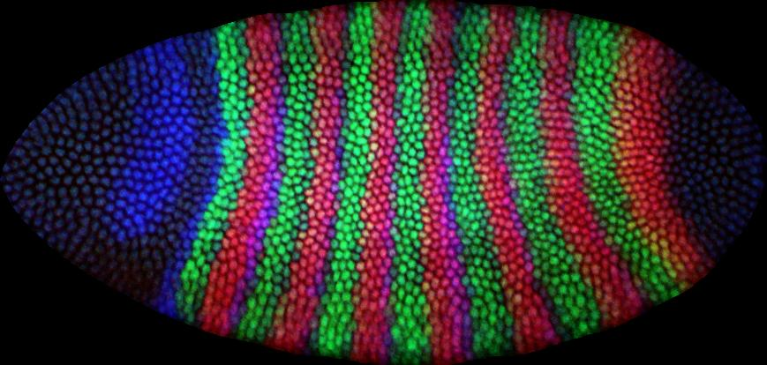
Patterns of gene expression in the fly embryo
Development in a box!
Doubling time = 8min
How are these spatial patterns of gene expression established?

Slide 18
Cell Division in the Fly Embryo

Slide 19
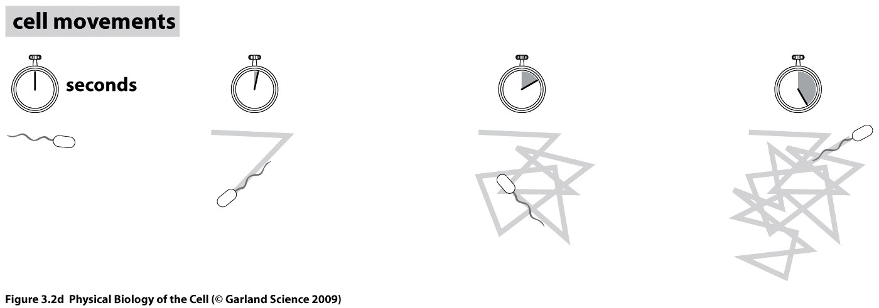
Biological time scales in powers of 10: 10s of seconds
(courtesy of Howard Berg)
a swimming E.coli: episodes of directed motion, punctuated by rapid directional changes

Slide 20
Biological time scales in powers of 10: deciseconds
AAs incorporation during protein synthesis
process which any cell must undertake to make a new cell

Slide 21
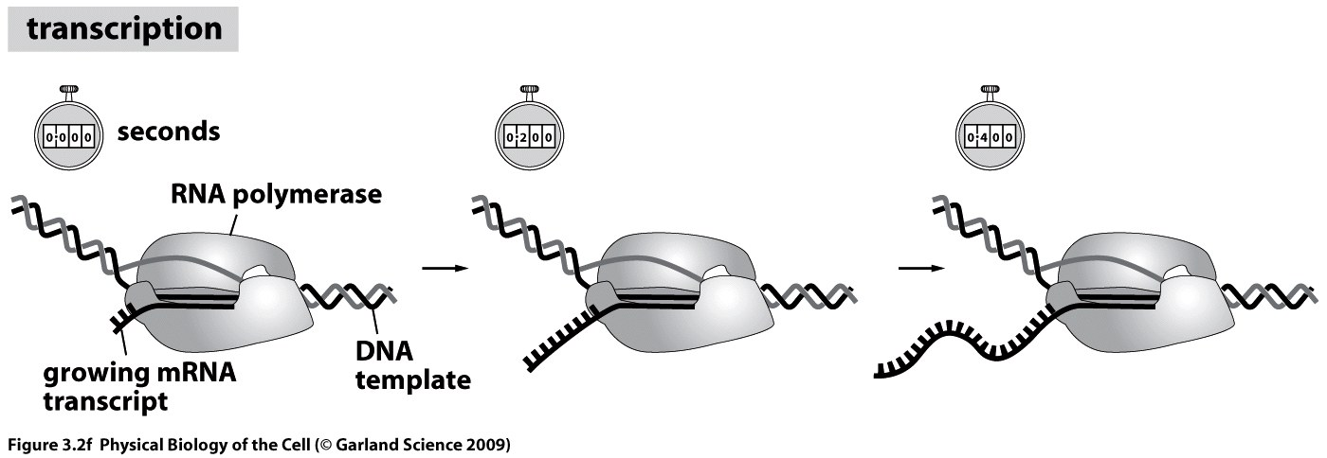
Biological time scales in powers of 10: deciseconds
synthesis of mRNA molecules as faithful copies of the nucleotide sequence in the DNA
polymerization process catalyzed by enzyme RNA polymerase
the incorporation by RNA polymerase of nucleotides onto the mRNA during transcription happens a few times faster than AA incorporation by ribosomes during protein synthesis

Slide 22
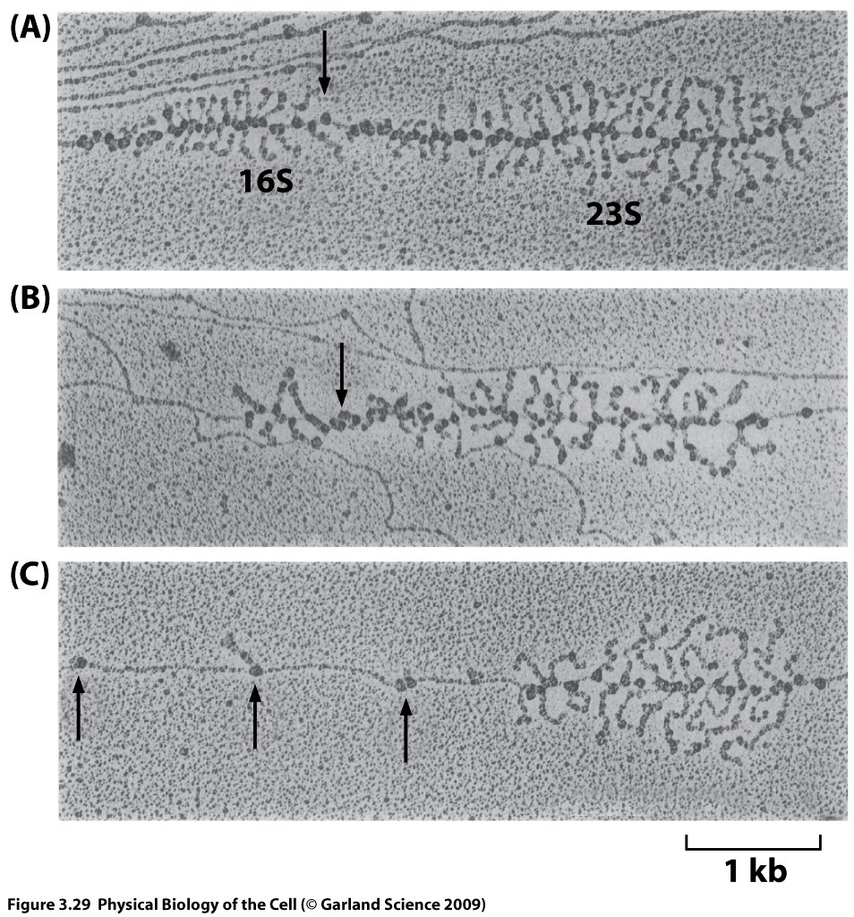
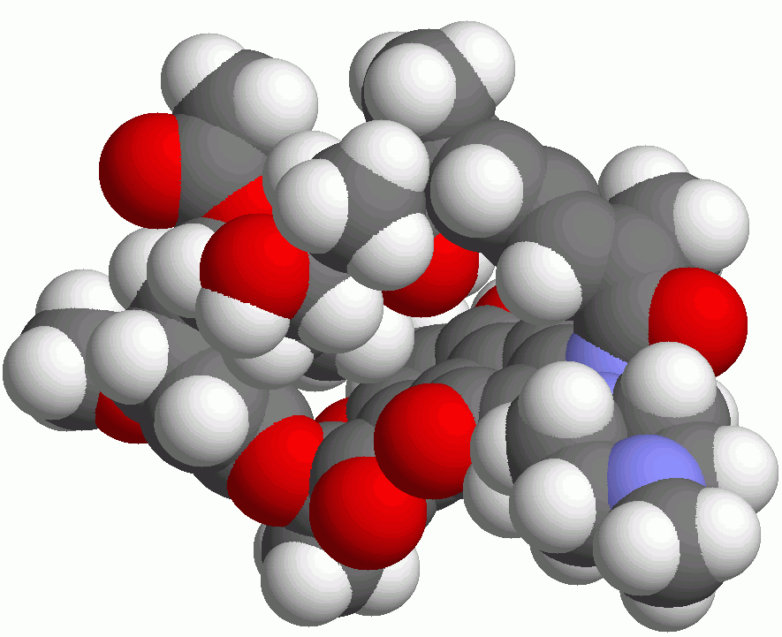
How Fast Is the Information Read Out?
Amazing microscopy images of transcription “Christmas trees” at various times after treatment with an antibiotic.
Rifampin stops transcription initiation, but not elongation.
This was used to estimate the rate at which RNA polymerase produces the messenger RNA molecule.
(L. S. Gotta et al, J. Bacteriol., 1991)
(Berman et al.)
Notes:
Anﾊintriguing aspect of multicellular organisms is the fact that there are a wide variety of different cell types, this despite the fact that each and every cell carries the same genetic information.ﾊ ﾊOne of the key mechanisms giving rise to distinct cellular identities is particular ``decisions'' that are made about which genes to express at different times and places in an organism's history.ﾊ Interestingly, decision making is not restricted to multicellular organisms, nor even to eukaryotic cells.ﾊ Indeed, the modern theory of gene regulation was born out of efforts to understand how bacterial cells decide which sugars to utilize at any given time.ﾊ In this talk, I will describe the ways in which statistical mechanics can be used to examine the regulatory processes that take place in the lives of cells.ﾊ These simple models result in surprising predictions and I will also describe our experimental efforts to probe this rich behavior both in test tubes and in living cells.ﾊ

Slide 23
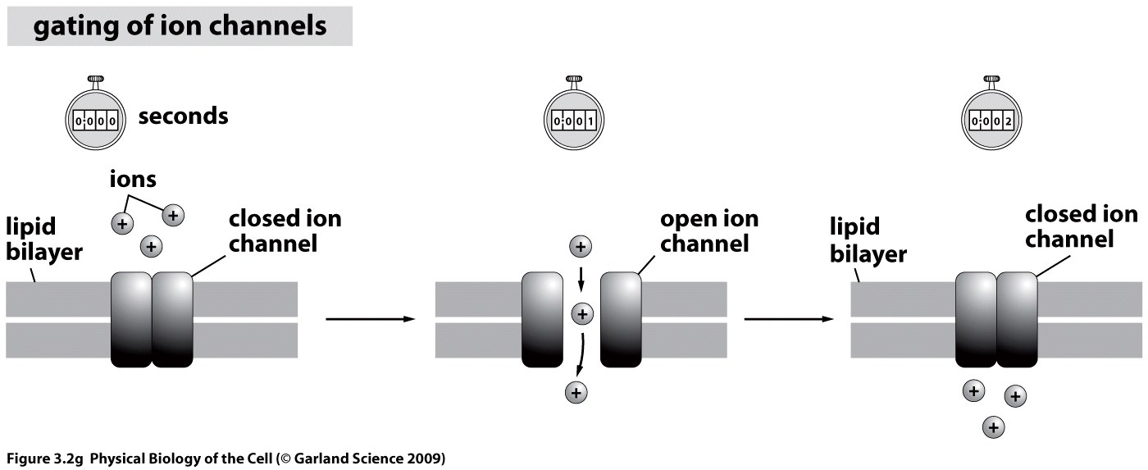
Biological time scales in powers of 10: milliseconds
many proteins are able to operate at time scales much faster than the machinery carrying out the central dogma operations
E.g., many bio processes are dictated by the passage of ions across ion channels (scale of msec)

Slide 24
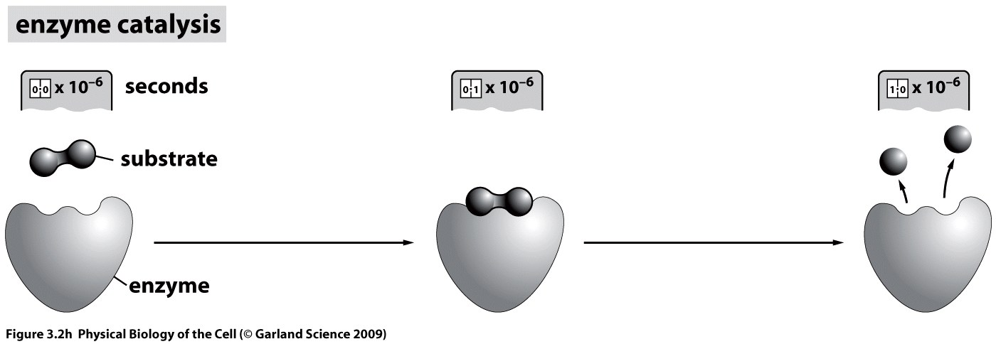
Biological time scales in powers of 10: μseconds
Enzyme kinetics (μsec and faster)
Note: these time scales represent a general rule of thumb; turnover rates for individual enzymes vary: 0.5 s⁻¹ to 600,000 s⁻¹

Slide 25
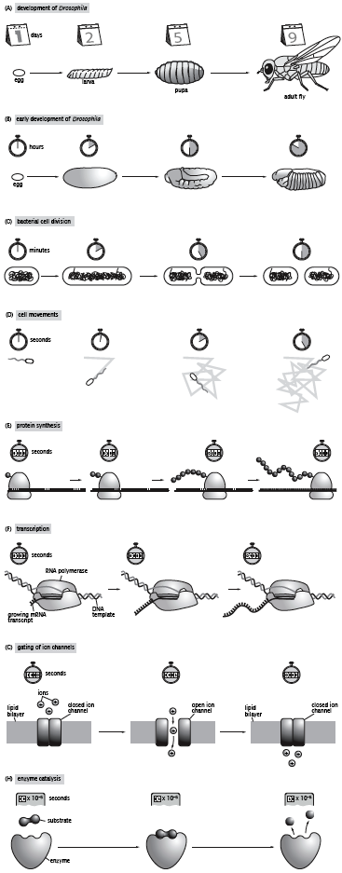
Hierarchy of Biological time scales: summary
days
hours
minutes
seconds
deciseconds
milliseconds
μseconds
Notes:
c=N/V=N/d^3, N=1 => d = c^-1/3

Slide 26
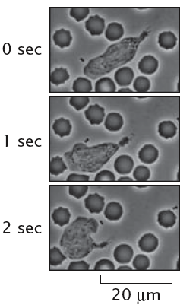
How do we know what we know? measurements of bio time
Exp. on the dynamics of cells & molecules populating them: tracking transformations.
Strategy 1
Typ’l time scale
Types of processes
Example
Direct observation
msec-hrs
Individual transformations
Cell crawling
red blood cell
observe the process unfold, record the absolute t at which transformation occurs
easy to do for time scales of min to hrs, spatial scales that can be observed with a light microscope or the unaided human eye
difficult to measure t for events that are very fast, very slow, very small, very large
past decade: vast exp.improvements in direct or near-direct observations of single molecules
bacterium
neutrophil
3 frames from a video sequence taken by D.Rogers in 1950s of a single white cell (n.) pursuing a bacterium through a forest of red blood cells

Slide 27
How do we know what we know? measurements of bio time
Strategy 1
Direct observation
Direct observation: a single white cell (n.) pursuing a bacterium through a forest of red blood cells

Slide 28
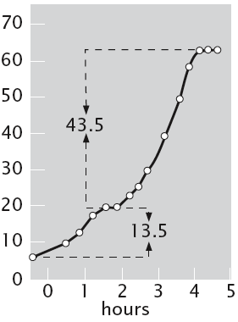
How do we know what we know? measurements of bio time
Strategy 2
Typ’l time scale
Types of processes
Example
Fixed time points
μsec-yrs
Population changes
Bacterial growth curve
draw individuals from a population at given time intervals, examine their properties at these fixed t points
E.g., bacterial growth (hrs to days)
E.g., embryonic development for model organisms (days to weeks)
Small spatial scale & fast time, method of stopped-flow kinetics: mix enzyme and substrate → squirt the mixture into a denaturing acid bath after fixed Δt => follow enzymatic events
Bacteria switched over into a new metabolic mode enabling them to use lactose
Cell density (arb.units)
All the available glucose is consumed, growth rate slowed
Exponential growth, consuming glucose
The experiment (by Monod) is a classic, tracked the growth of E.coli in a single culture when two diff. nutrient sugars were mixed together

Slide 29
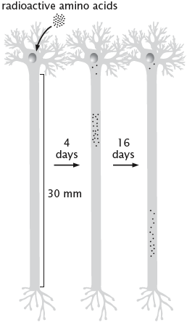
How do we know what we know? measurements of bio time
Strategy 3
Typ’l time scale
Types of processes
Example
Pulse-chase
min-days
continuous (e.g., metabolism, transport)
Axonal transport
Many bio processes operate in a continuous fashion
E.g., bacteria constantly take in sugar. Glycolysis: 1 molecule of glucose → 2 molecules of pyruvate
=> difficult to measure how long a conversion process takes
Pulse-chase: briefly feed glucose tagged with radioactive C, feed with nonradioactive glucose => examine cells at various Δt to see whether glucose or pyruvate contain radioactive C => t of conversion
The same strategy: transport in neurons
Label proteins at their point of synthesis in a neuron cell body with a pulse of radioactive AAs => a chase of unlabeled AAs => measure the rate of continuous transport in neurons

Slide 30
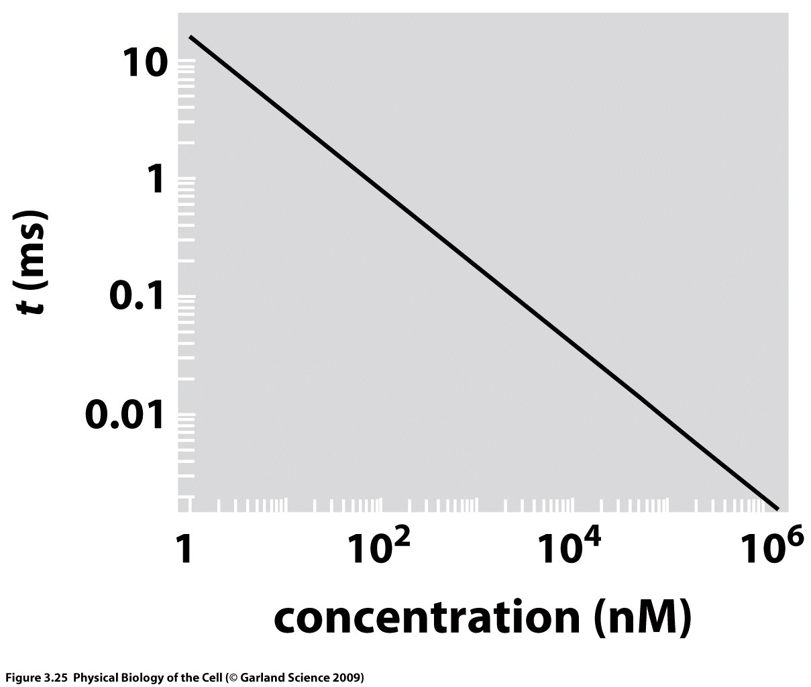
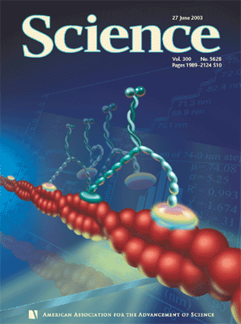
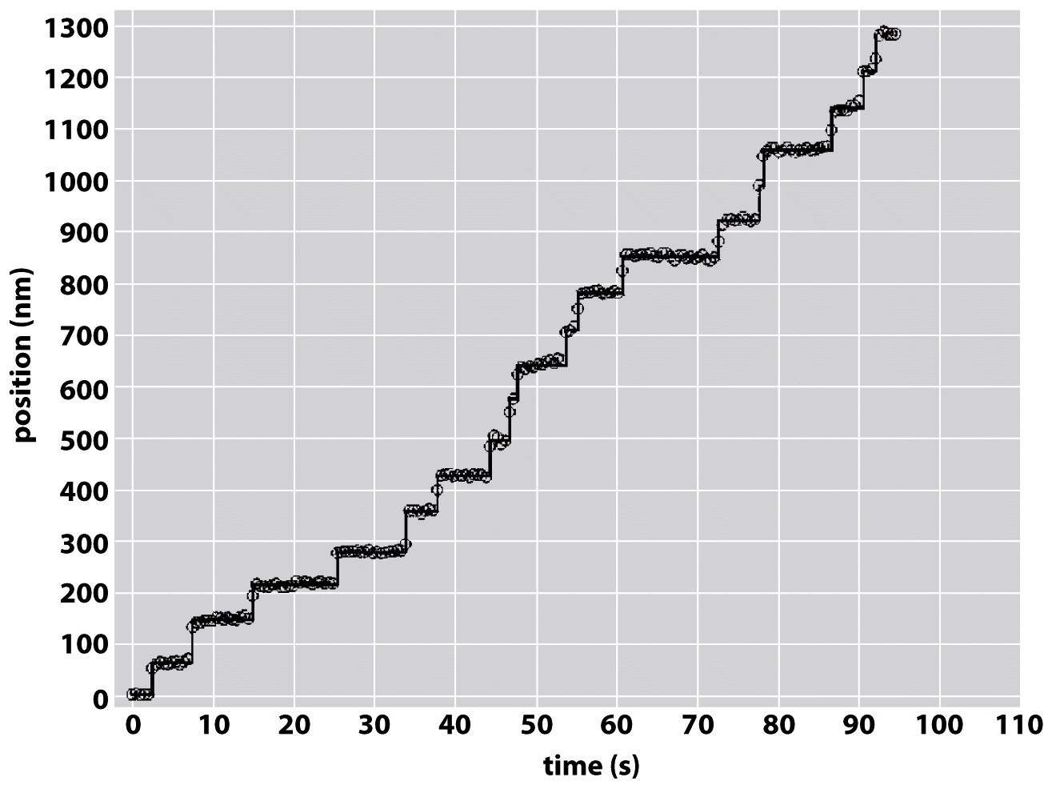
Beating the diffusion speed limit
=> impossibly long time scales associated with diffusion over large distances
Nature’s solution: active transport
Mechanism #1: passive diffusion
Mechanism #2: active transport
ATP consumed => motor molecules carry out directed motion
Myosin V carries cargo within cells by moving along actin filaments. 37-nm steps, “hand-over-hand” fashion, as revealed by a fluorophore tag.
Yildiz et al., Science 2003
c measured in diffusion times. The characteristic t for diffusion-mediated molecular encounters depends upon the c of the diffusing species

Slide 31
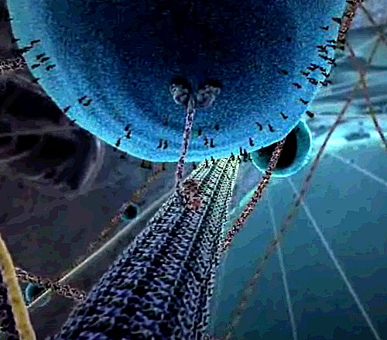
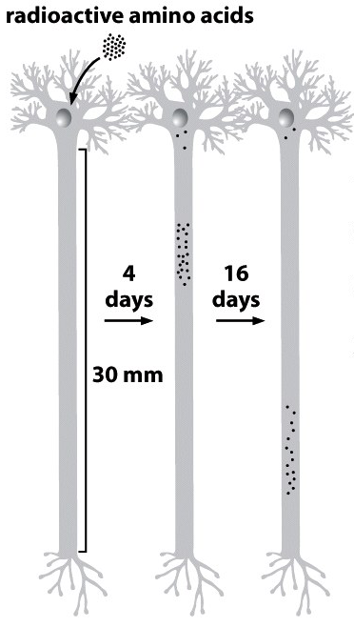
Moving proteins from here to there (part 2)
Estimate the transport time for kinesin motor moving on a microtubule over the distance of 10 cm:
speed of kinesin in a living cell: 1 μm/s
=> t_{axon} ≈ 10⁵ μm / (1 μm/s) = 10⁵ s ≈1 day
comp. with passive diffusion: 3 yrs
Classic experiment traces the time evolution of radioactively labeled proteins in a neuron
www.studiodaily.com/
Fig.: radio-labeled proteins travel ≈18 mm in 12 days
=> <v> ≈ 20 nm/s
Observed axonal transport speed for single motors: 200 nm/s or more
=> Motors are not perfectly “processive” (fall off) => <v>↓

Slide 32
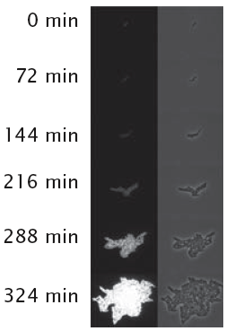
How do we know what we know? measurements of bio time
Strategy 4
Typ’l time scale
Types of processes
Example
Product accumulation
min-days
Biosynthetic or enzymatic
GFP expression
Idea:
can be used for performing rate measurements in living cells
E.g., expressing GFP downstream of a promoter of interest
When the promoter is induced (<=> the gene of interest is turned on) GFP begins to accumulate => amount of fluorescence can be converted into N of GFP molecules => reporter for promoter activity
+ Enzyme →
colorless substrate
colored product
The rate of gene transcription in a bacterial cell is inferred by measuring the amount of GFP present as a function of t. Rosenfeld et al., Science 2005
fluorescence
phase contrast

Slide 33
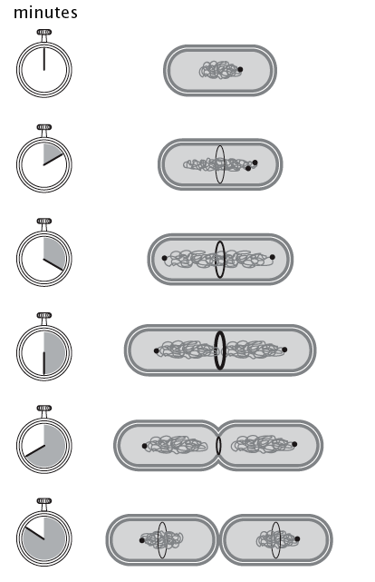
An idealized bacterial cell cycle
a newborn cell has a single chromosome with a single origin of replication
duplication of the origin, DNA replication around the circular chromosome, proteins FtsZ form a ring (future septum site)
DNA replication proceeds, the cell elongates, two origins take up residence at the opposite poles
the septum begins to close down
the two chromosomal masses are physically separated into two daughter cells…
… where the cycle can begin anew
A_{cross-section} ≈ const,
l_{f} ≈ 2l_{i}
=> V_{f} ≈ 2V_{i}
τ_{Binary fission} ~ 1 hr

Slide 34
The e.coli cell cycle as the standard stopwatch
E.coli: standard measuring stick, standard stopwatch
Standards for bacterial cell cycle:
minimal medium (glucose as the sole C source)
37°C
3000 s (=50 min)

Slide 35
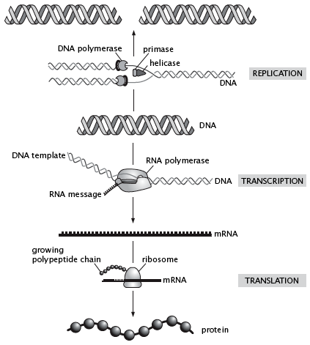
The machines of the central dogma
Prime example of procedural t: the processes of the central dogma.
DNA → RNA → proteins
Replication: copying genome (DNA → DNA)
must take place before a cell divides;
mediated by the replisome (= enzyme DNAP [incorporates new nucleotides onto a nascent DNA] + helicases [unwind DNA] + primases [prime the polymer-n reaction])
Transcription: synth.of mRNA (DNA → RNA)
template for protein synthesis;
carried out by RNAP
euk.: occurs in the nucleus => mRNA export
Translation: (RNA → protein)
Mediated by the ribosome (RNA+protein comp.);
Transfer of AAs from tRNA onto polypept. chain

Slide 36
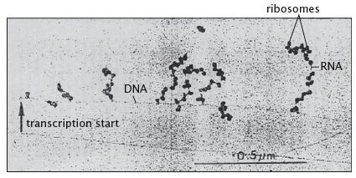
The machines of the central dogma
Nascent mRNA molecules in bacteria are immediately engaged by ribosomes: protein translation occurs before transcription is even finished.
Electron microscopy image of simultaneous transcription and translation.
(Miller et al., Science 1970)
Timing of the replication, transcription and translation is dictated by the intrinsic rate at which the machines carry their polymer-n reactions.
Each of the processes: N “identical” reactions, each takes Δt on average to perform

Slide 37
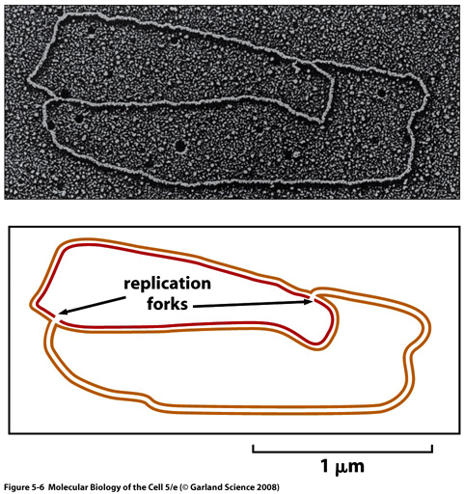
Timing The machines of the central dogma
DNA replication in bacteria is undertaken by 2 replication complexes which travel in opposite directions away from the origin of replication on the circular chromosome.
Estimate the rate of the DNA polymerase complex:
E.coli genome ≈ 5 × 10⁶ bp, τ_{cell} ≈ 3000s => rate of DNA synthesis: 2000 bp/s <=> 1000 bp/s per replisome
(biochem.experiment: 250-1000 bp/s)
Parental strands: orange, newly synthesized strands: red

Slide 38
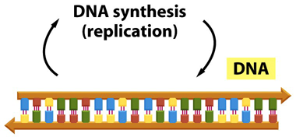
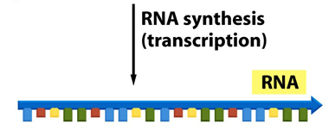
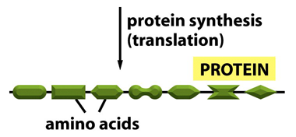
Timing The machines of the central dogma
Estimate the time to make a transcript (mRNA) in bacteria.
Typical protein: 300 AAs, 3 bases needed to specify each AA => l_{mRNA}~1000 bp
Characteristic transcription rate (exp.): ~ 40 nucleotides/s
=> t_{mRNA} ≈ 25 s

Slide 39
Timing The machines of the central dogma
Estimate the mean time to synthesize a typical protein.
E.coli: N_{protein} ≈ 3 × 10⁶ , each protein: 300 AA,
τ_{cell} ≈ 3000 s
=> Rate of AA incorporation by the ribosome:
dN_{AA}/dt ≈ (9 × 10⁸ AA) / 3000 s ≈ 3 × 10⁵ AA/s
N_{ribosome} ≈ 20,000 => rate per ribosome: 15 AA/s (exp.: 25 AA/s)
=> t_{protein} ≈ 20 s
Translation in Eukaryotes
Rate of protein synth. by the ribosome < rate of mRNA synthesis by RNA polymerase.
Simultaneous translation of a single mRNA by multiple ribosomes
=> When considering the net rates of processes in cells: N of mol. players + the intrinsic rate.

Slide 40
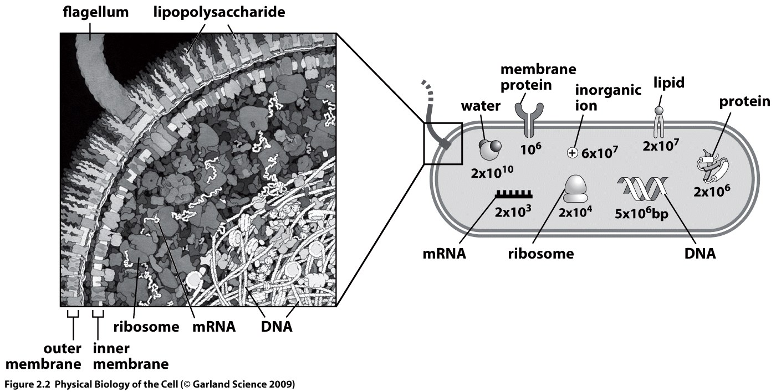
Timing e.coli
Estimate the rates of various processes in the E.coli cell cycle
E.coli genome: 5 × 10⁶ bp
time of the cell cycle: τ_{cell} ≈ 3000 s
Rate of replication:
dN_{bp} /dt ≈ N_{bp} / τ_{cell} ≈ 5 × 10⁶ bp/ 3000 s ≈ 2000 bp/s
Rate of protein synthesis:
dN_{protein} /dt ≈ N_{protein} / τ_{cell} ≈ 3 × 10⁶ protein/ 3000 s ≈ 1000 proteins/s
Rate of lipid synthesis:
dN_{lipid} /dt ≈ N_{lipid} / τ_{cell} ≈ 2 × 10⁷ lipids/ 3000 s ≈ 10,000 lipids/s

Slide 41
Timing e.coli (cont’d)
Control of the water content within the cell - ?
Estimate the rate of water uptake during the cell cycle:
dN_{H2O} /dt ≈ N_{H2O} / τ_{cell} ≈ 2 × 10¹⁰ waters/ 3000 s ≈ 7 × 10⁶ waters/ s
Estimate the average mass flux across the cell membrane:
Flux = amount of m crossing unit A per unit t <=>
j_{water} ≈ (dN_{H2O} /dt ) / A_{E.coli}
Note: This mass transport is mediated primarily by proteins which are distributed throughout the membrane.
≈ ( 7 × 10⁶ waters/s ) / (6 × 10⁶ nm²)
≈ 1 water/(nm²s)

Slide 42
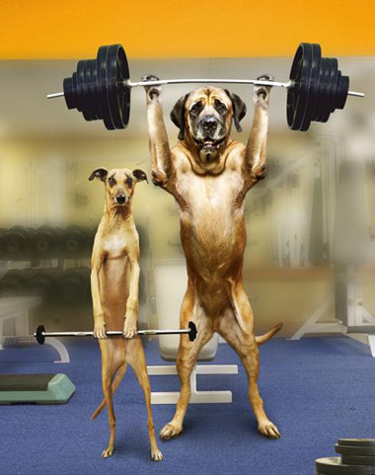
third topic
Energy and force scales in biology
http://media.bigoo.ws/content/image/funny/funny_407.jpg

Slide 43
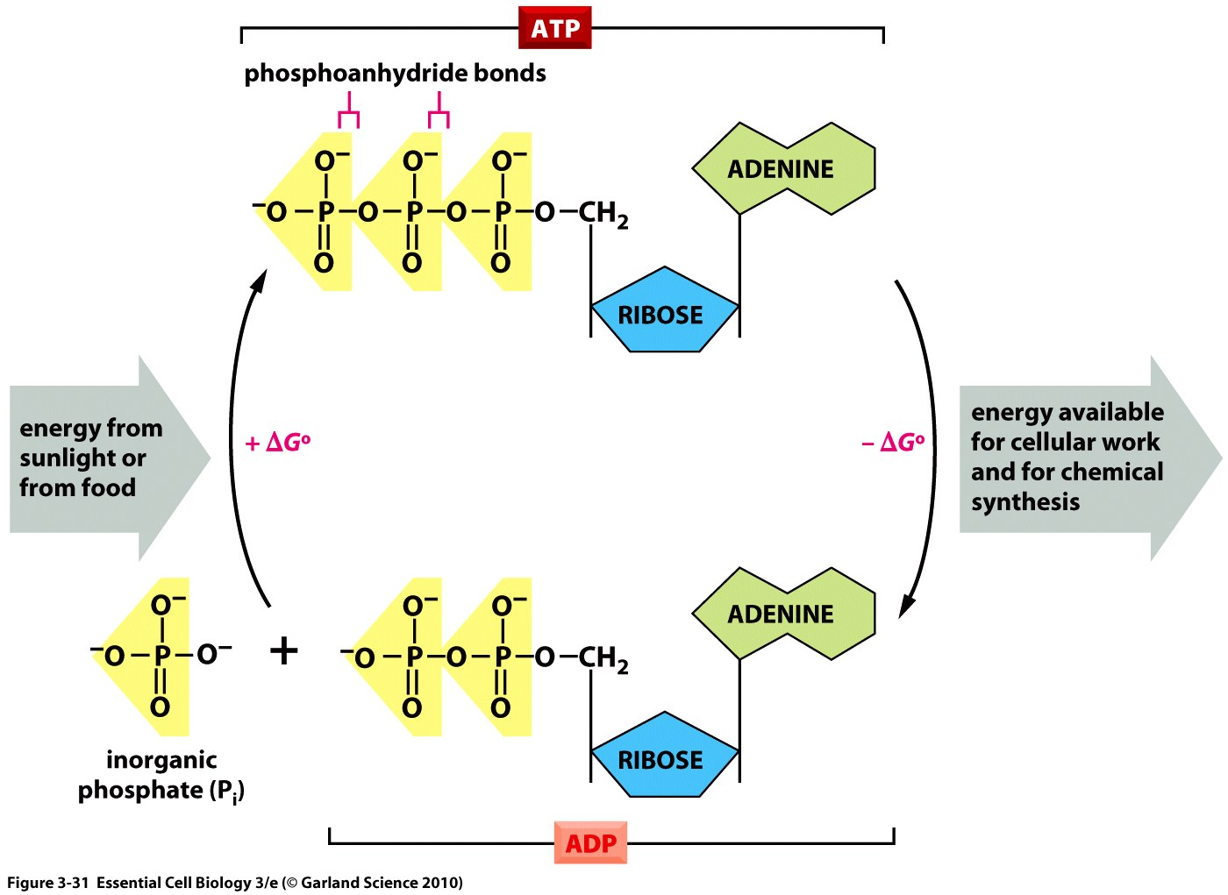
Atp as the energy currency
Cells have a few special tricks for storing and accessing energy.
ATP hydrolysis releases of order 20 kT of energy (note: depends upon concentrations of reactants and products).

Slide 44
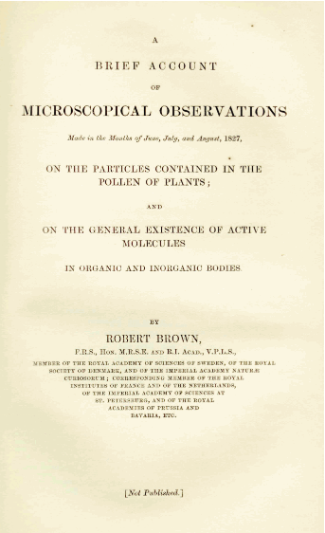
Thermal energy
Microscopic particles have an intrinsic energy as a result of their contact with the surrounding medium (thermal reservoir).
k_{B}T is the thermal energy scale – 4.1 pN nm.

Slide 45
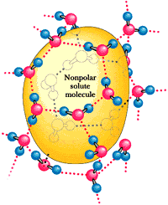
Water and hydrophobicity
Key point is a broader message related to thermal energies: entropic contributions to the free energy are hiding everywhere.
See HW2 for estimates on this effect.

Slide 46
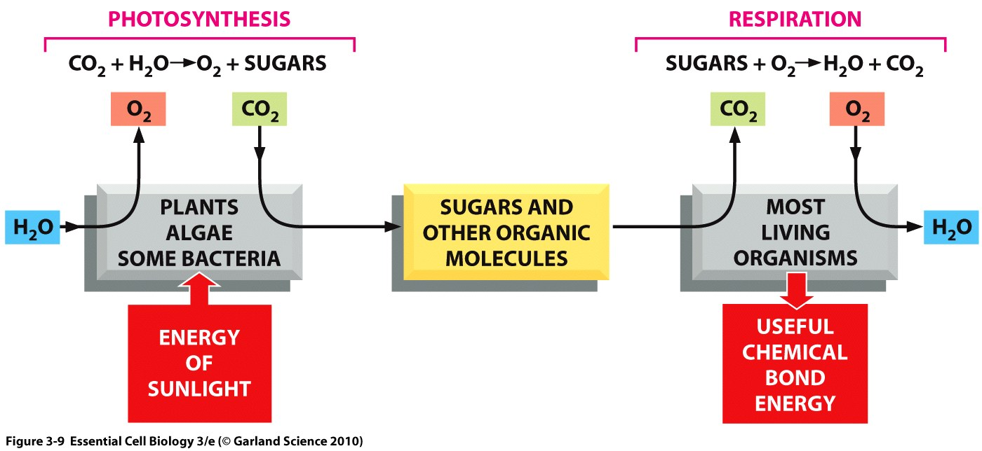
Photosynthesis and respiration
Energy scale of photons: see HW2.
Energy scale of combustion of a sugar: see HW2.

Slide 47
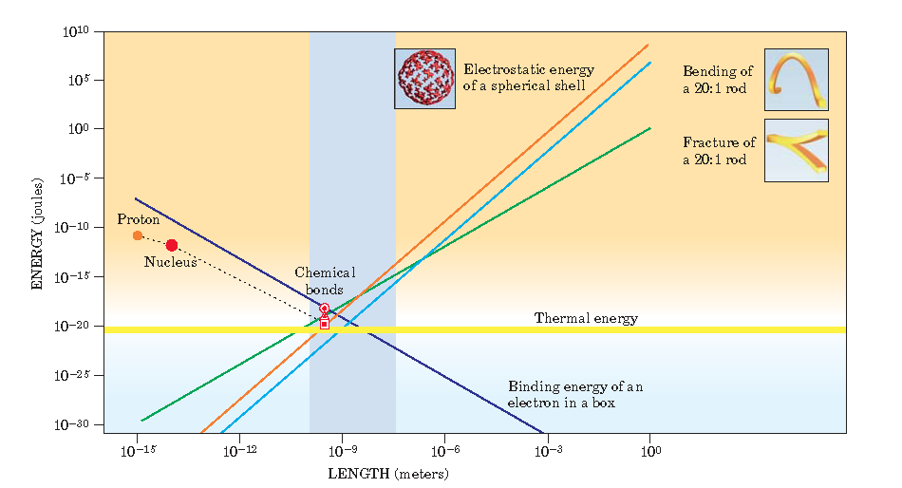
Imagine a World Where…
A confluence of energy scales
Mechanics is played out in a situation where thermal forces are equal partners with their more familiar deterministic counterparts.
Thermal energy scale – 4.1 pN nm!

Slide 48
Energy and Force Scales in Biology
Energy and force are central themes in biology, just like they are most everywhere else in science and engineering.
My focus will only be on cells and the molecules within them.

Slide 49
Lost in Translation
This example: deterministic and thermal put together.
Measured error rates of 10⁻⁴.
Correct and incorrect codons can differ by only a single hydrogen bond worth several kT of energy.
Key point: the thermodynamic picture of specificity flunks the quantitative sanity check.

Slide 50
Imagine a World Where…
A feeling for the numbers: summary
Barbara McClintock insisted on developing a “feeling for the organism”.
Our thrust in this course is to use biological numeracy as our vehicle for developing such a feeling for the organism.
So far, we have explored five big themes: sizes, concentrations, rates, information and energy.
With this intuitive foundation in hand, we now turn to the main business of the course which is the physical dissection of an array of interesting biological mechanisms.

