Slide 1
BE/APh161 – Physical Biology of the Cell
Rob Phillips
Applied Physics and Bioengineering
California Institute of Technology

Slide 2
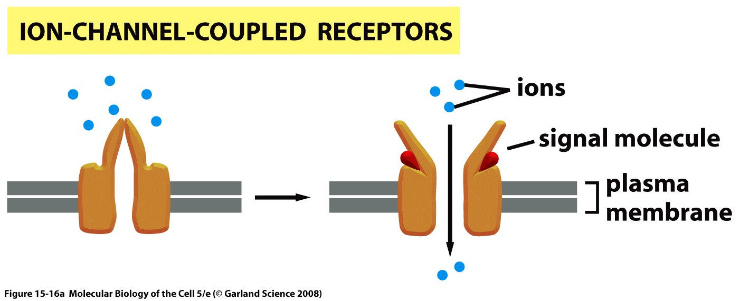
Ion gating driven by ligands
Ligand-gated channels.

Slide 3
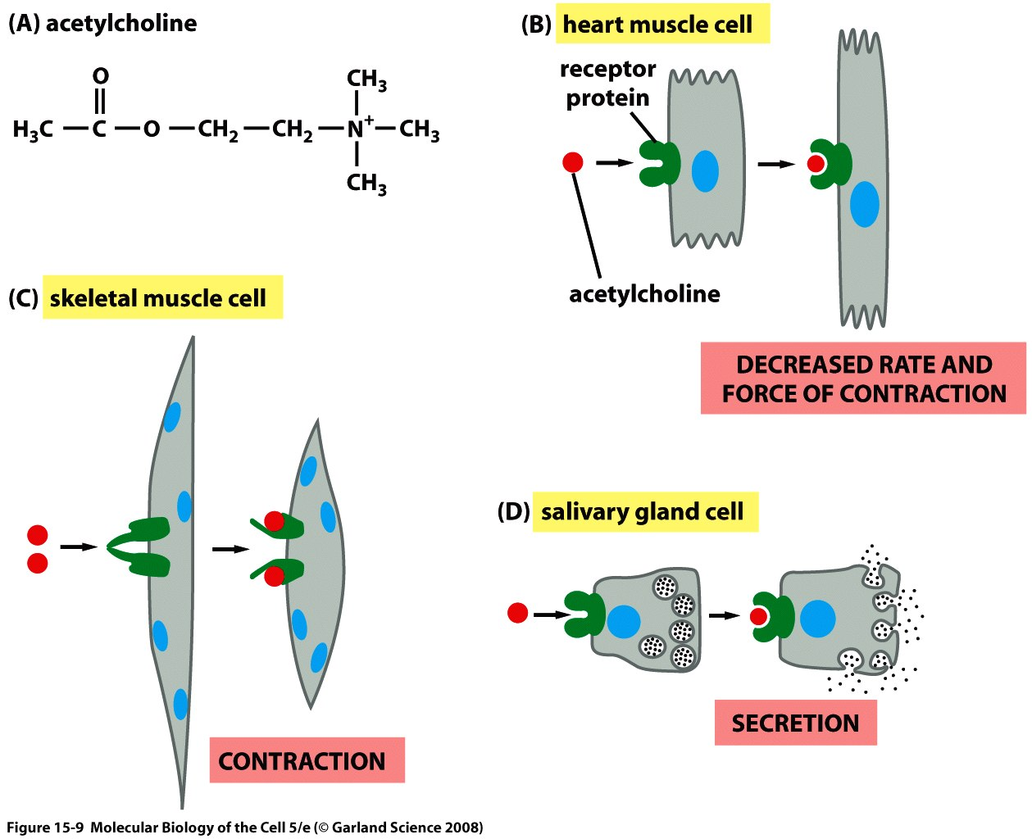
Ion gated channels: Acetylcholine

Slide 4
Data for the gating of nicotinic acetylcholine receptor

Slide 5
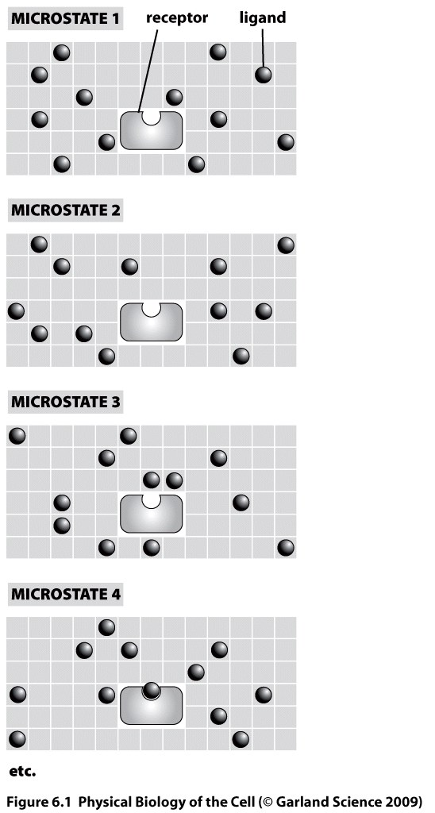
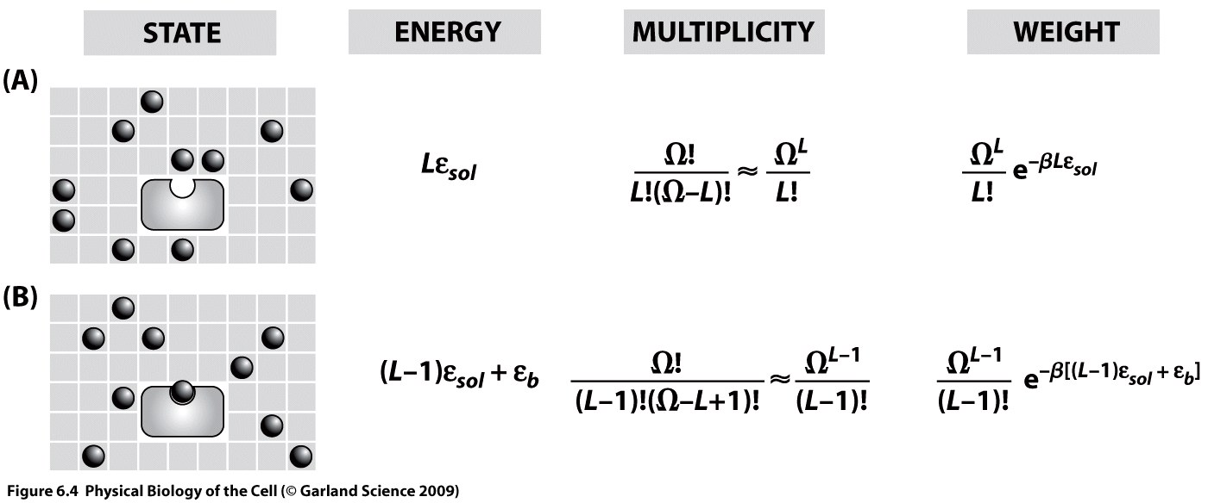
States and weights for binding problems
We work out the probability of the binding probability by making a model of the solution as a lattice.

Slide 6
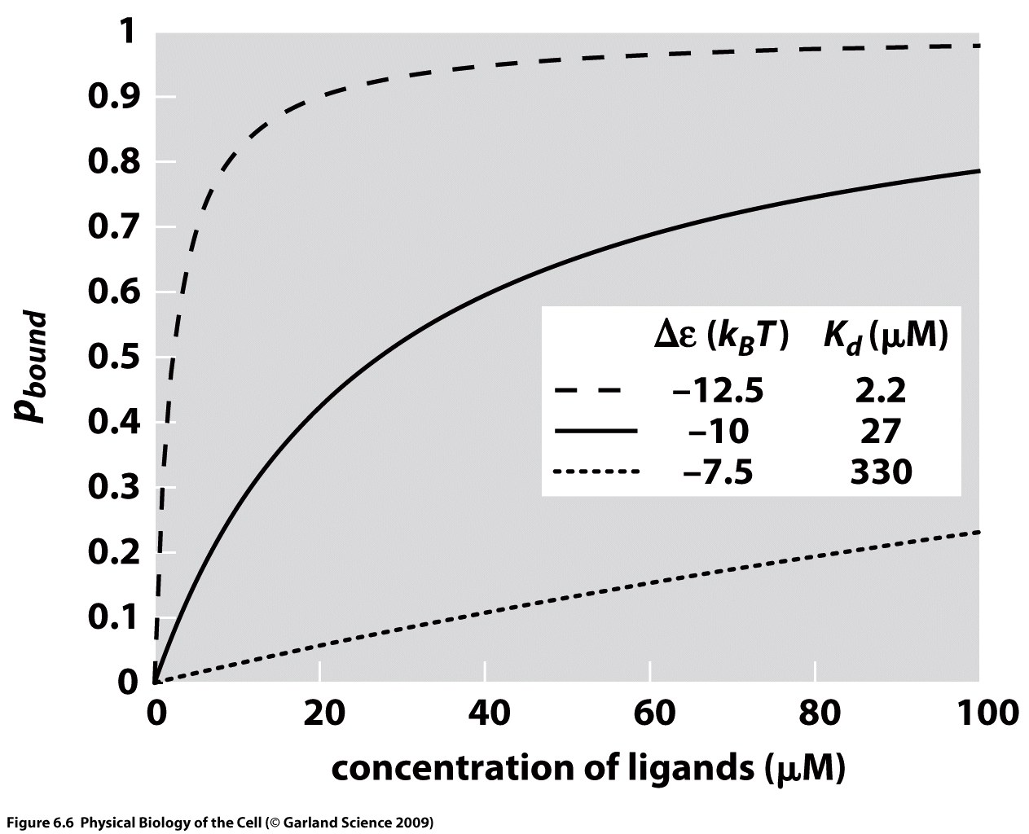
Binding curves and binding free energy
These simple binding curves illustrate the way in which the binding probability depends upon the Kd or the binding energy.

Slide 7
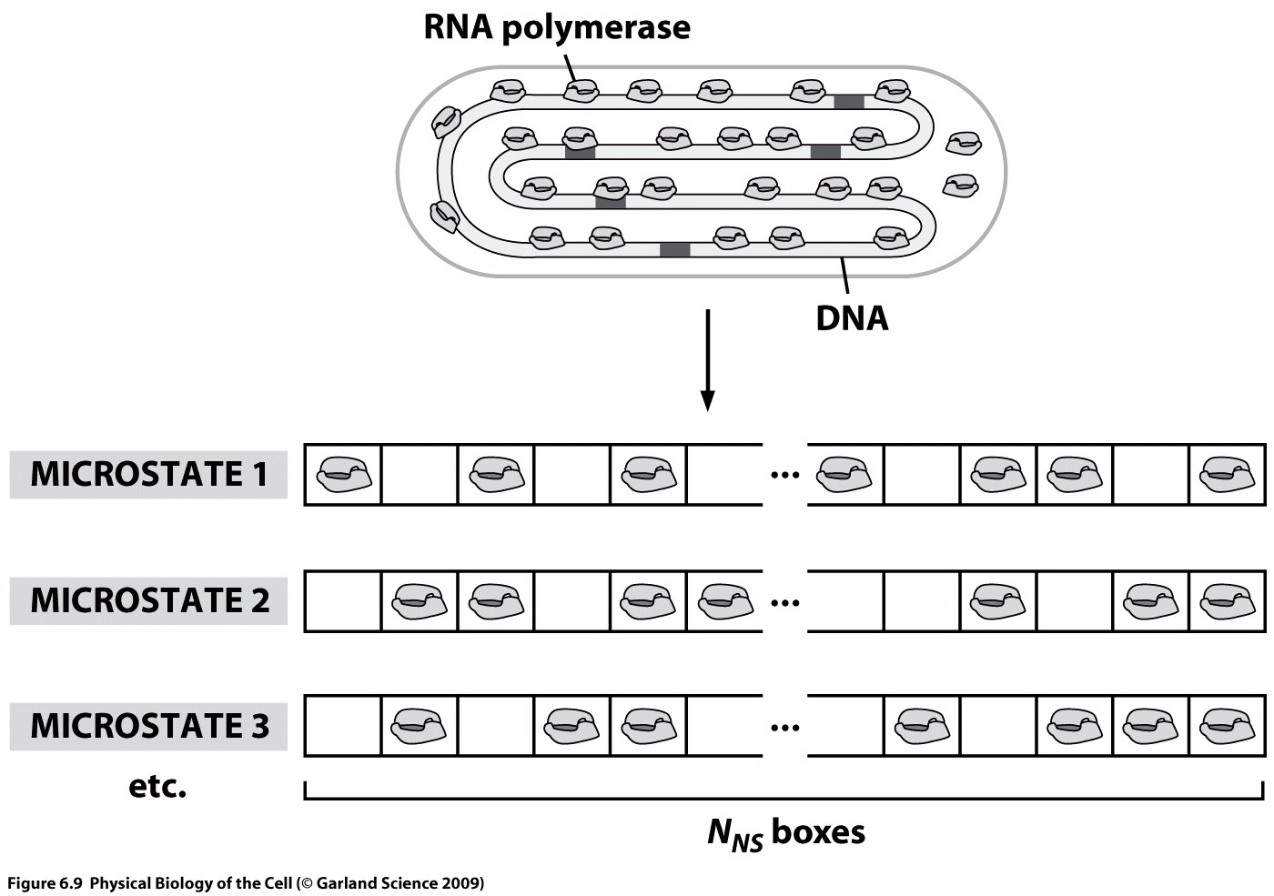
Exploring Promoter Architecture: Can We Compute How Cells Decide?
Notes:
Change one variable at a time. Explore the effect of changing that variable systematically.
We ended up caring mostly about repression for historical reasons. However it also makes sense because it’s a very simple architecture.

Slide 8
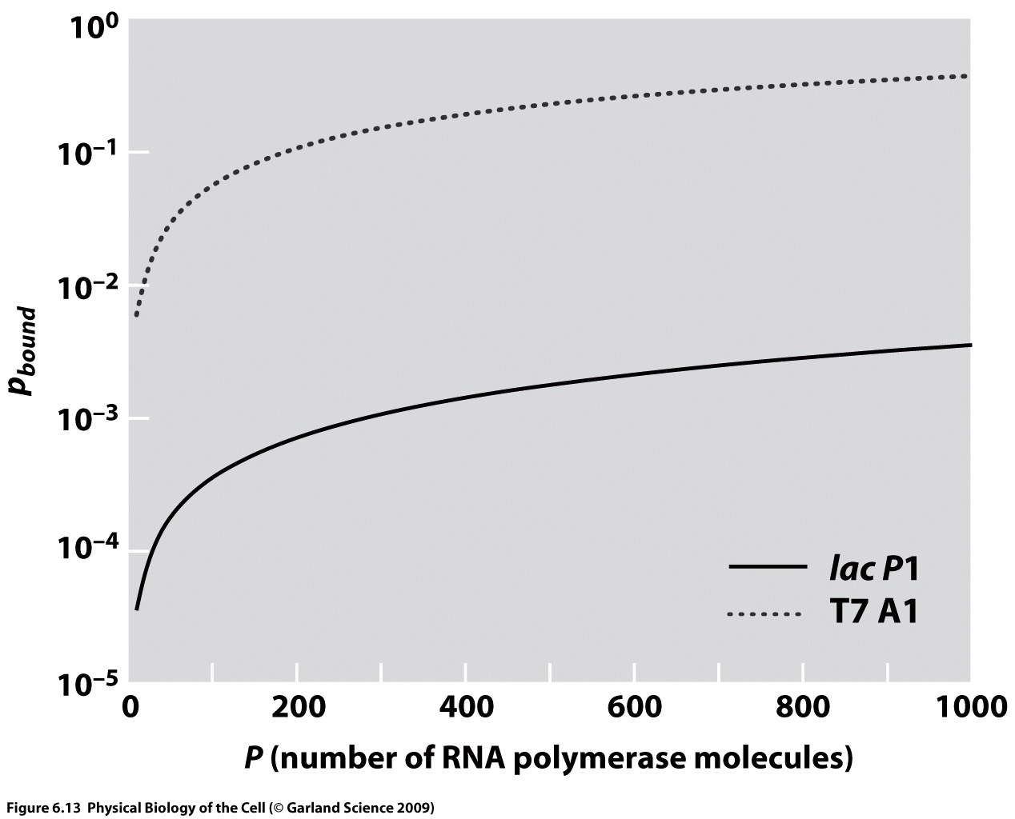
Exploring Promoter Architecture: Can We Compute How Cells Decide?
Notes:
Change one variable at a time. Explore the effect of changing that variable systematically.
We ended up caring mostly about repression for historical reasons. However it also makes sense because it’s a very simple architecture.

Slide 9
Where we are headed: Can We Compute How Cells Decide?
Bintu et al. (2005)
Notes:
Change one variable at a time. Explore the effect of changing that variable systematically.
We ended up caring mostly about repression for historical reasons. However it also makes sense because it’s a very simple architecture.

Slide 10
Some other examples
Data and fits using our binding formula.

Slide 11
Some other examples

Slide 12
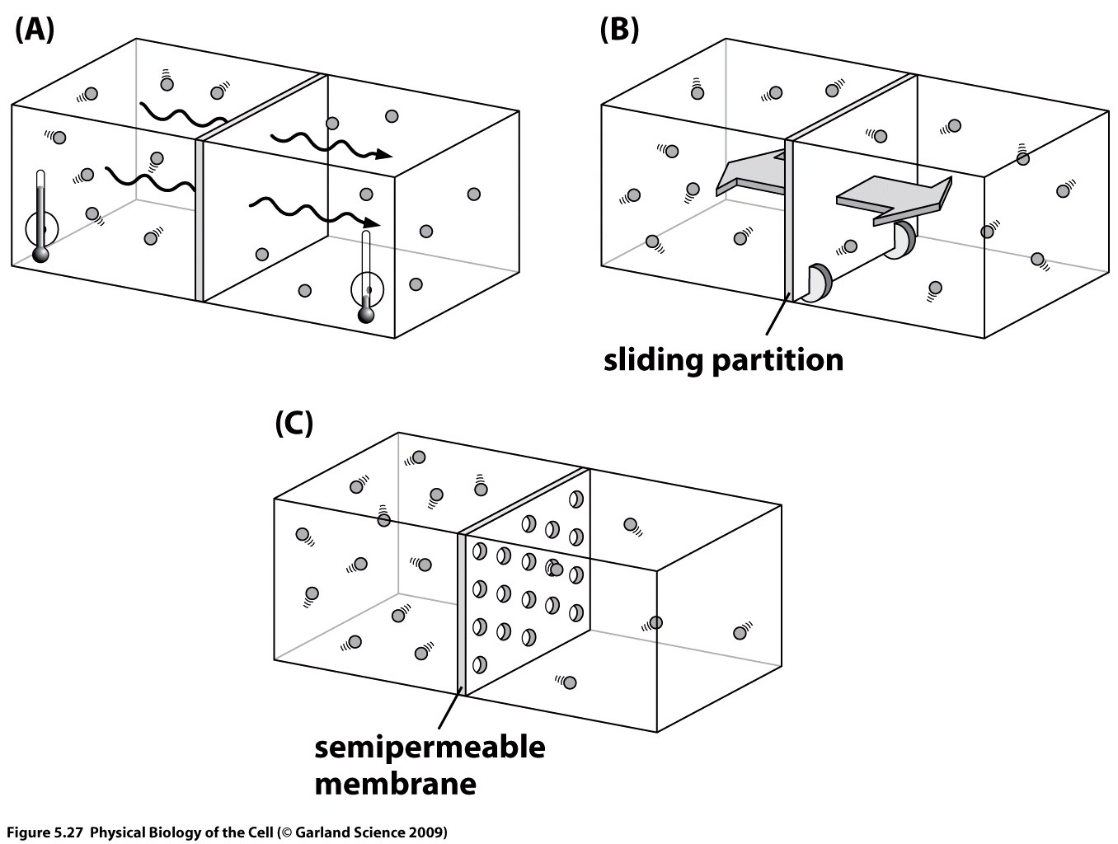
Gibbs’ second law
One idea only: to find the privileged terminal state of a system, maximize the entropy.
A corollary: minimize the free energy – this is for a system in contact with a heat bath.
My point here is to get us all to think about the chemical potential.

Slide 13
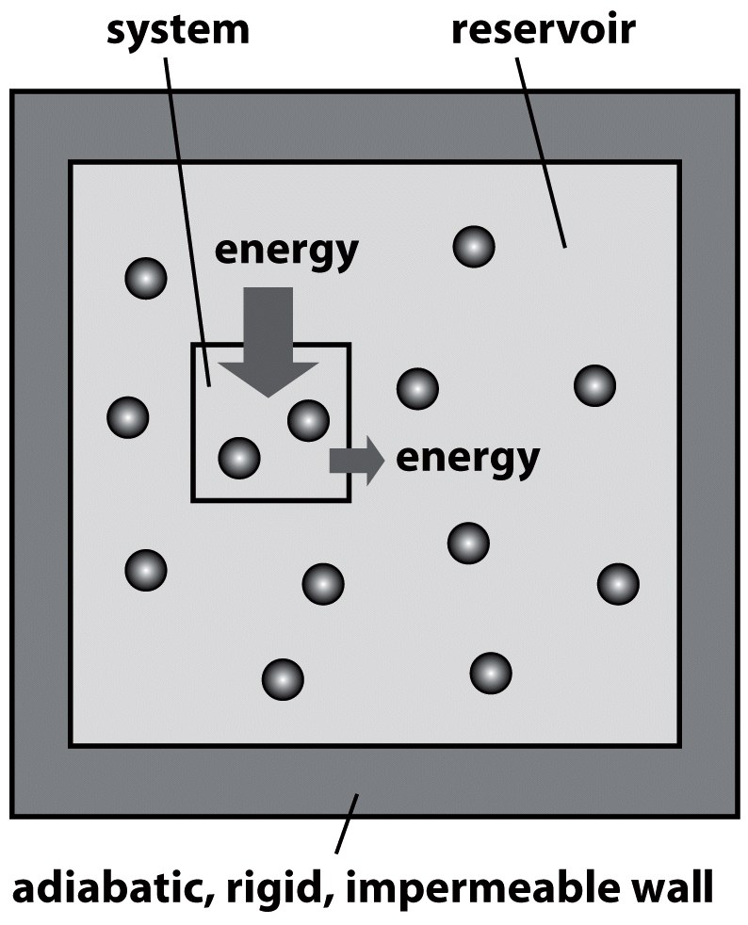
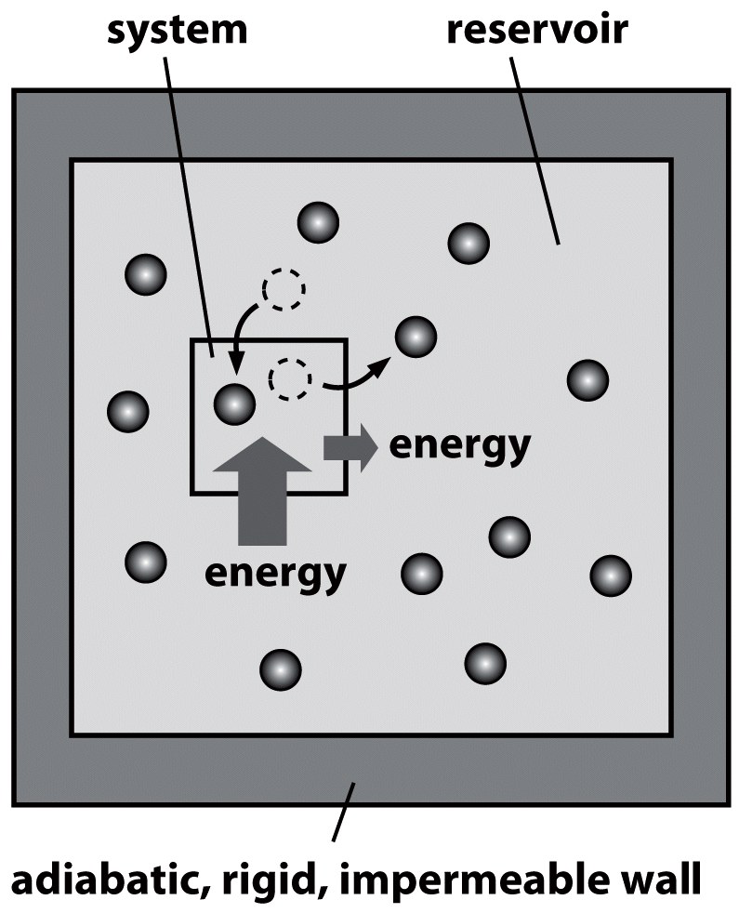
The gibbs distribution
System in contact with an energy reservoir
System in contact with a particle and energy reservoir
Probability for finding the system in microstate i:
Probability for finding the system in microstate i:
Boltzmann distr.
- partition f.
Gibbs distr.
grand partition f.
T_{reservoir} controls av.energy <E> of the system
μ_{res.} controls av. # of particles <N> in the syst.
Notes:
Boltzmann: E can flow across the S.-R. wall => E_{system} (and E_{reseroir}) fluctuates <=> system is free to occupy any of its different energy microstates.

Slide 14
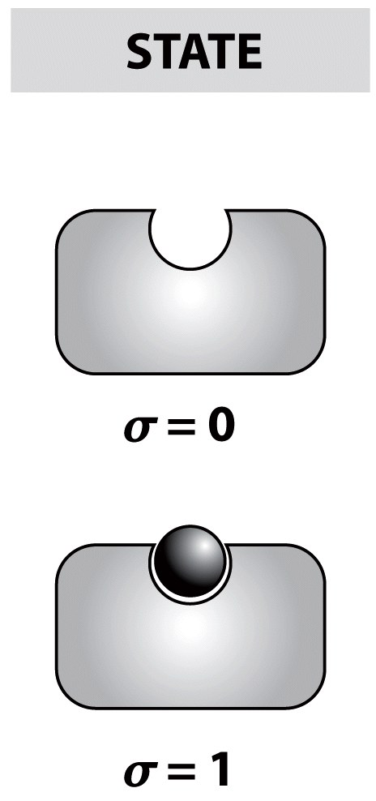
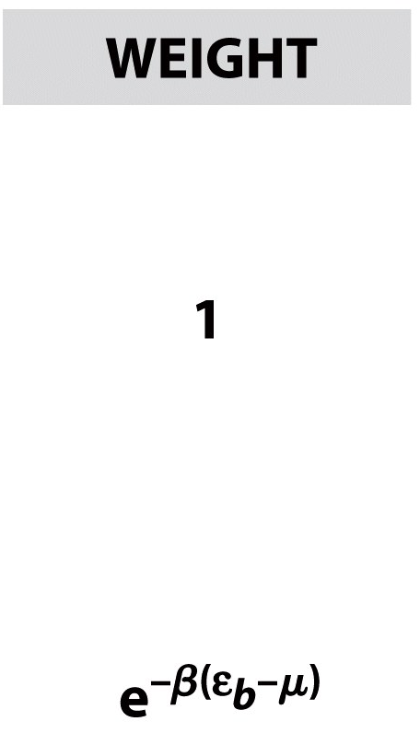
ligand-receptor binding: State variable description
Consider a single receptor in contact with the surrounding heat bath and particle reservoir.
Two-state (b/u), σ is an indicator of the state of binding
The energy is
Evaluate aver. # of ligands bound, <N>:
favorable interaction btw L and R
Contact of the system with a thermal reservoir
Contact with a particle reservoir
Recall that the chem.potential of an ideal solution is
=>
can also be computed as
is the energy difference upon taking the ligand from solution and placing it on the receptor

Slide 15
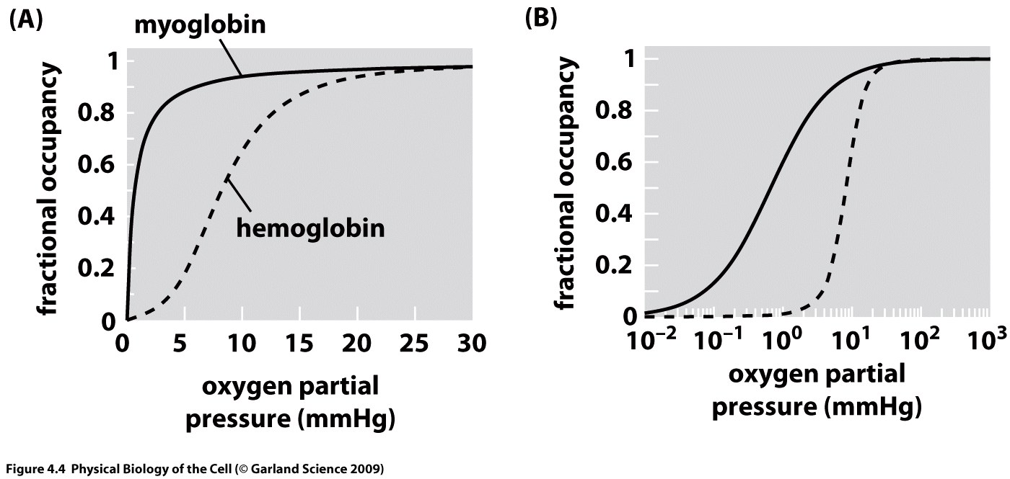
Cooperativity and binding
Interestingly, many (if not most) of the real world binding problems we care about in biology do not satisfy the simple binding model (sometimes called the Langmuir adsorption isotherm) we have worked out so far.
The classic example (i.e. the hydrogen atom of binding problems) is hemoglobin.

Slide 16
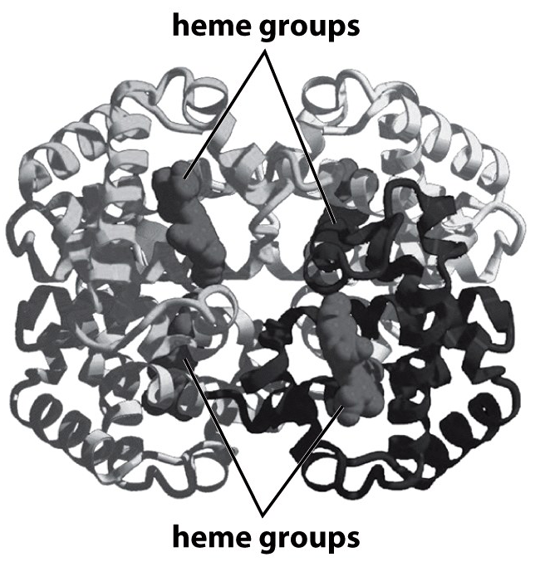
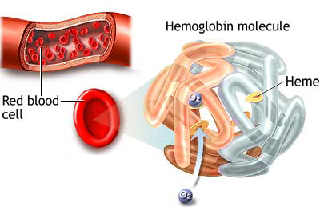
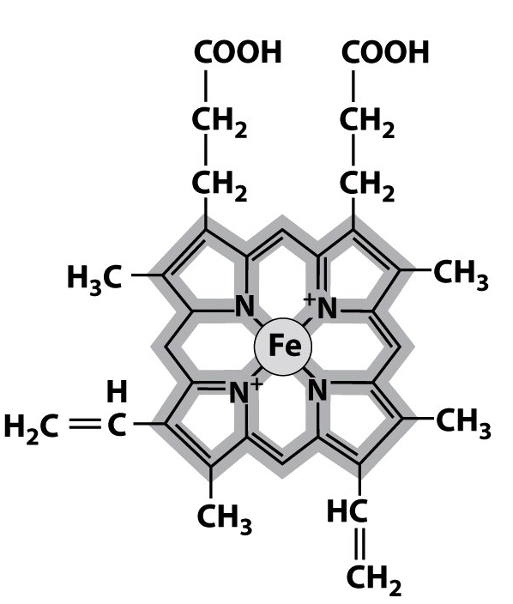
Hemoglobin as a case study in cooperativity
Hemoglobin - the classic example of ligand-receptor binding
Cooperativity: the binding energy for a given ligand depends upon the # of ligands that are already bound to the receptor
Intuitively: conformational change upon binding => the next ligand experiences a different binding energy
The protein hemoglobin: 4 polypeptide chains (2 α-chains, 2 β-chains), each carries a heme group => protein can bind up to 4 molecules of O₂
several 100s hemoglobin molecules
apps.uwhealth.org
Oxygen binds to heme on the hemoglobin molecules
The heme group includes a porphyrin ring (gray line) + iron

Slide 17
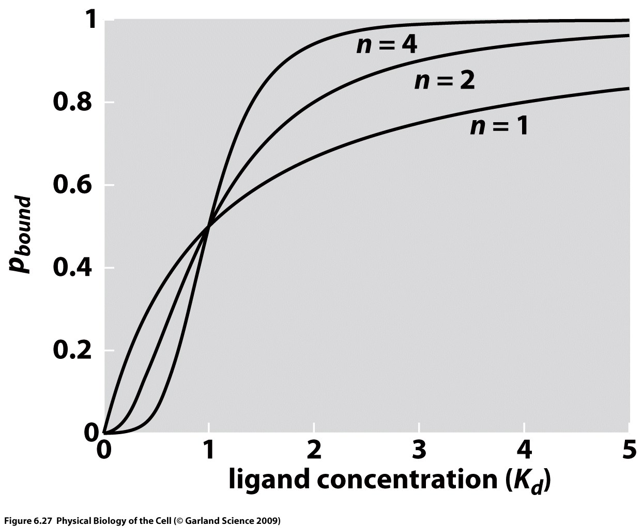
The nature of the Hill function

Slide 18
Hemoglobin as a case study in cooperativity
Hemoglobin-oxygen binding: language of two-states occupation variables. State of system is described with the vector
where σ_{i}: σ_{i} = 0 (unbound), σ_{i} = 1 (bound)
Q.: what is the average # of bound O₂ molecules as a function of the O₂ concentration (or partial pressure)?
A toy model of a dimoglobin
To illustrate the idea of cooperativity: imagine a fictitious dimoglobin [=dimeric hemoglobin] molecule which has 2 O₂ binding sites (e.g., clams)
=> 4 distinct states
The energy of the system:
Energy associated with O₂ being bound to one of the 2 sites
measure of the cooperativity

Slide 19
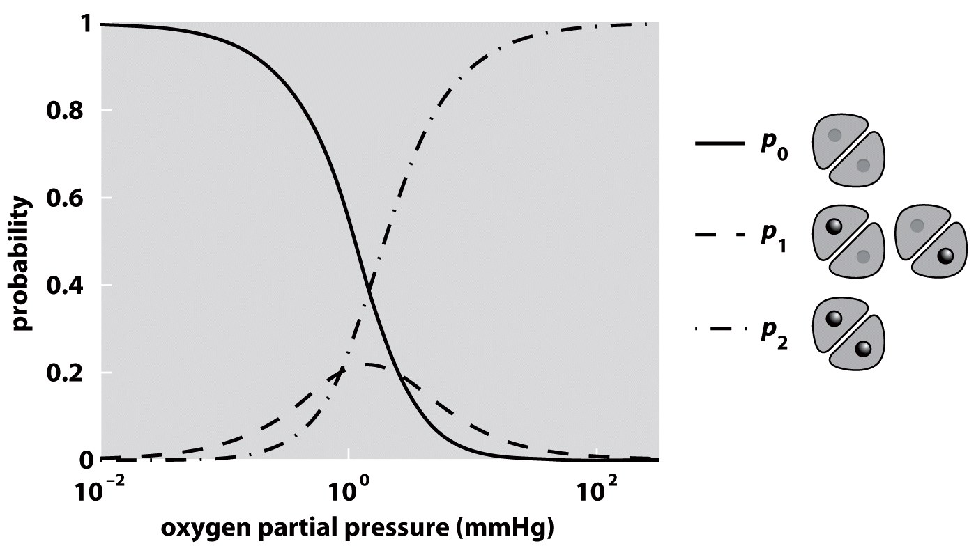
A toy model of a dimoglobin
The grand partition function (sum over the 4 states):
=> compute the probabilities for each classes of states: unoccupied, single occupancy, double occupancy
Single occupancy
Both sites occupied
Parameters used: Δε =–5 k_{B}T, J= –2.5 k_{B}T, c₀ = 760 mmHg

Slide 20
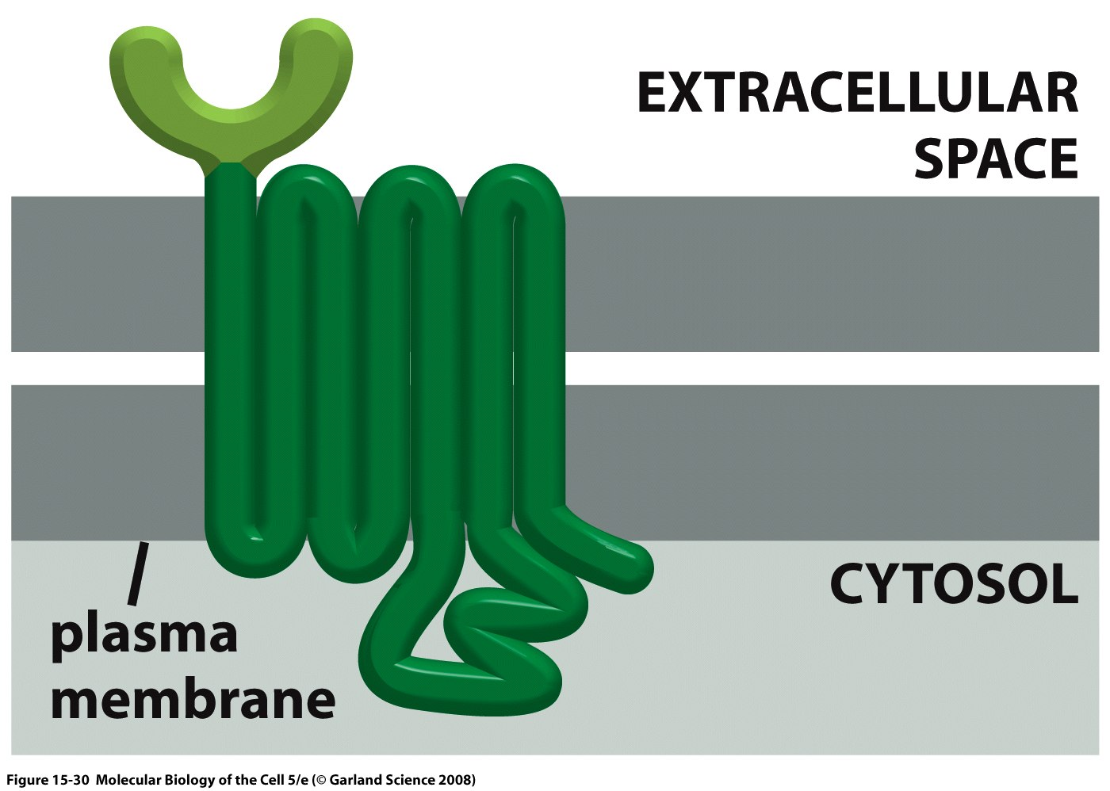
Talking across the membrane
Membrane proteins are characterized in some cases by transmembrane alpha helices and cytosolic domain that passes along the signal.

Slide 21
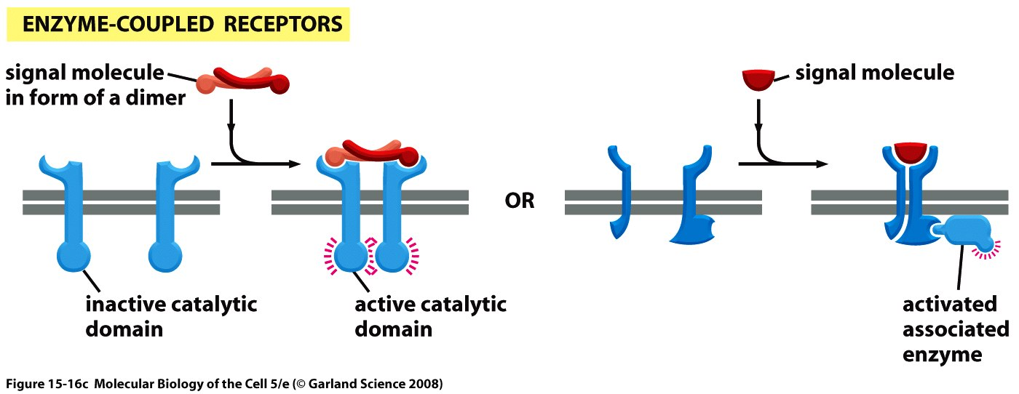
Coupling receptors to enzyme action
Receptor binding changes the probability of the “active” state.

Slide 22
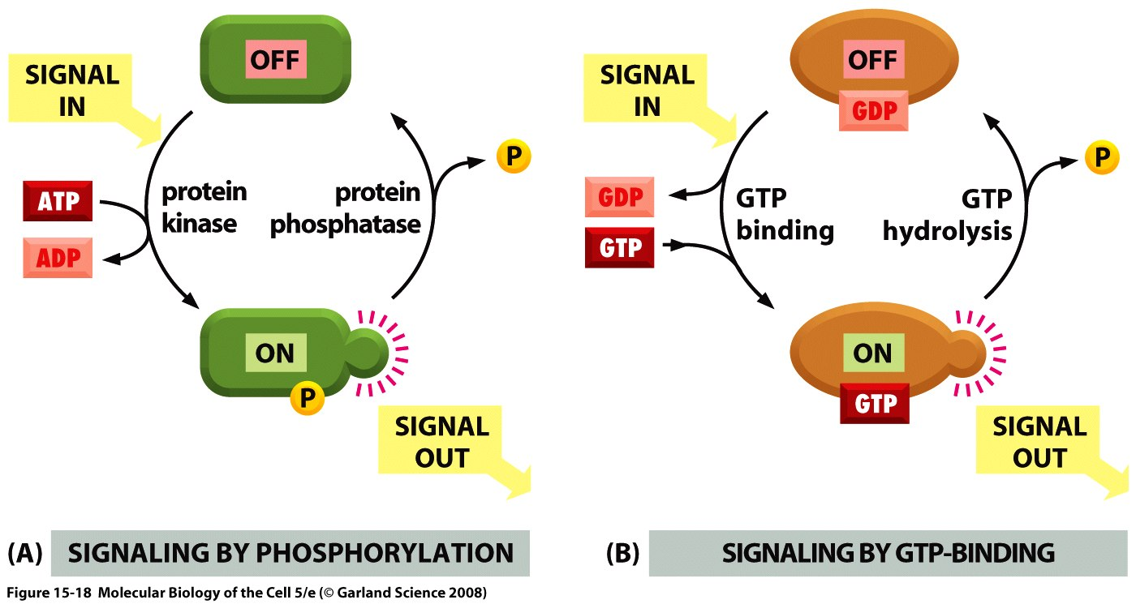
Doing work to change the protein state
A wonderful and important topic for our consideration is that of posttranslational modifications.
One of the tricks performed by the cytoplasmic side of a receptor (or its partners) is to do some posttranslational modification.

Slide 23
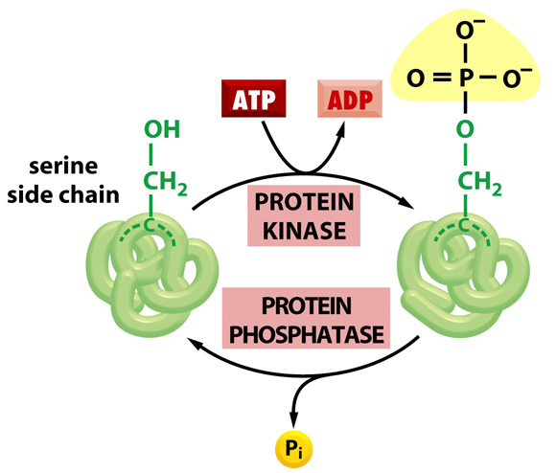
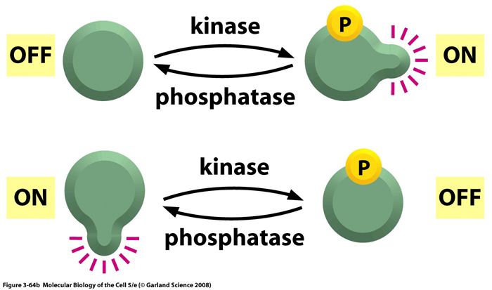
phosphorylation
In bio systems, changes in envir.conditions => the activity of an enzyme must be rapidly altered
One of the most important regulatory modes in all of biology: regulation of protein activity by covalent attachment of phosphate groups
The substrate for protein phosphorylation: target protein and ATP
The enzyme: protein kinase (transfers the terminal phosphate group from ATP to a chemical group on a protein)
A phosphate group carried 2 “-” charges => causes a dramatic change in the local charge distribution on the surface of the protein => drastic, large scale effect on protein structure and ability to bind
This alteration is reversible: protein phosphatase

Slide 24
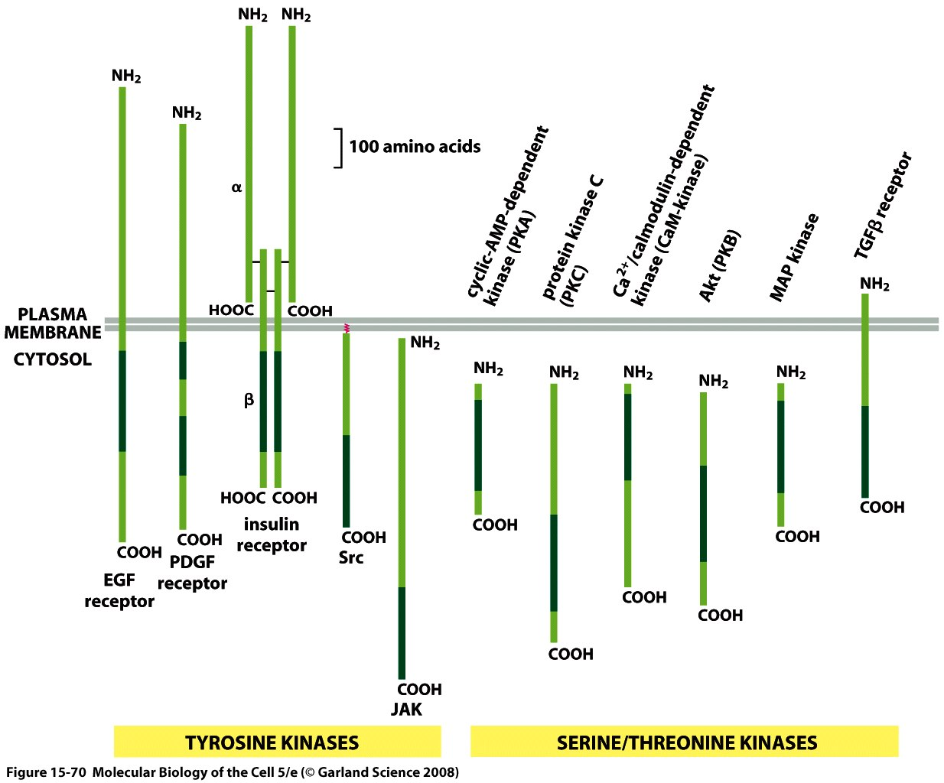
The diversity of kinases
“The whole molecular control network, leading from the receptors at the cell surface to the genes in the nucleus, can be viewed as a computing device; and, like that other computing device, the brain, it presents one of the hardest problems in biology.”
Catalytic domains shown in green Roughly 250 aa long.

Slide 25
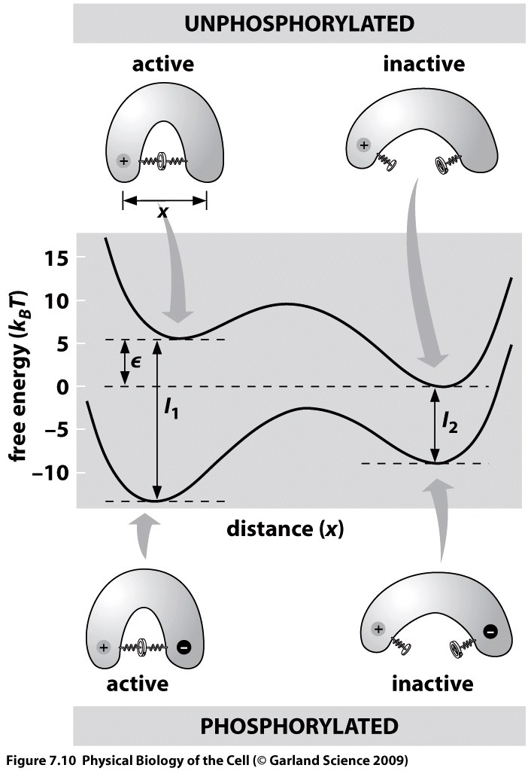
phosphorylation: two internal state variables
What is the fraction of activated proteins? How does it depend on the state of phosphorylation?
Model:
The “structural” state of the protein (active/inactive):
σ_{s}: σ_{s} = 0 => inactive, σ_{s} = 1 => active
The state of phosphorylation of the protein:
σ_{p}: σ_{p} = 0 => unphosphorylated, σ_{p} = 1 => phosphorylated
The state of phosphorylation can alter the relative energies of the active and inactive states => at equilibrium, most of the phosphorylated molecules will be in active form
I₁ and I₂ are the electrostatic interaction energies btw the two charges in the active and inactive states

Slide 26
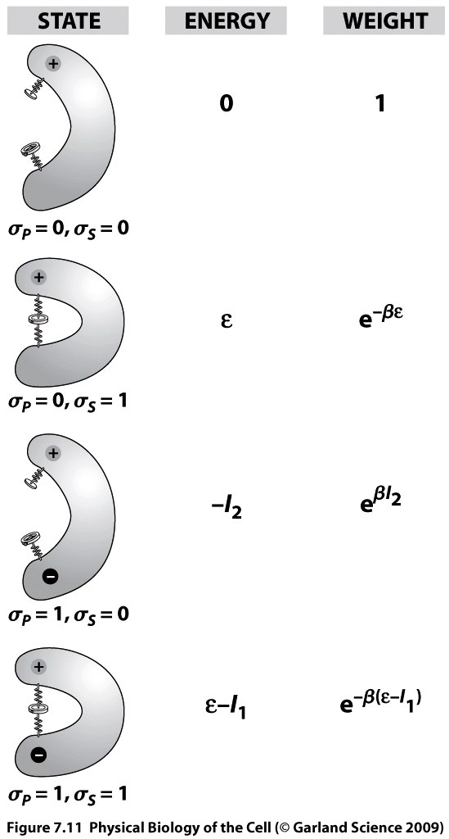
phosphorylation: two internal state variables
Using the σ variables, the free energy of the protein is
which simplifies to
=> states&weights:

Slide 27
phosphorylation: two internal state variables
From the states and weights:
Probability of the protein being in the active state, if it is not phosphorylated
Probability of the protein being in the active state, if it is phosphorylated
The change in activity due to phosphorylation:

Slide 28
phosphorylation: two internal state variables
In the toy model in the figure,
=>
-increase in activity upon phosphorylation
In the cell, the increase in activity upon phosphorylation spans from factors of 2 to 1000.

Slide 29
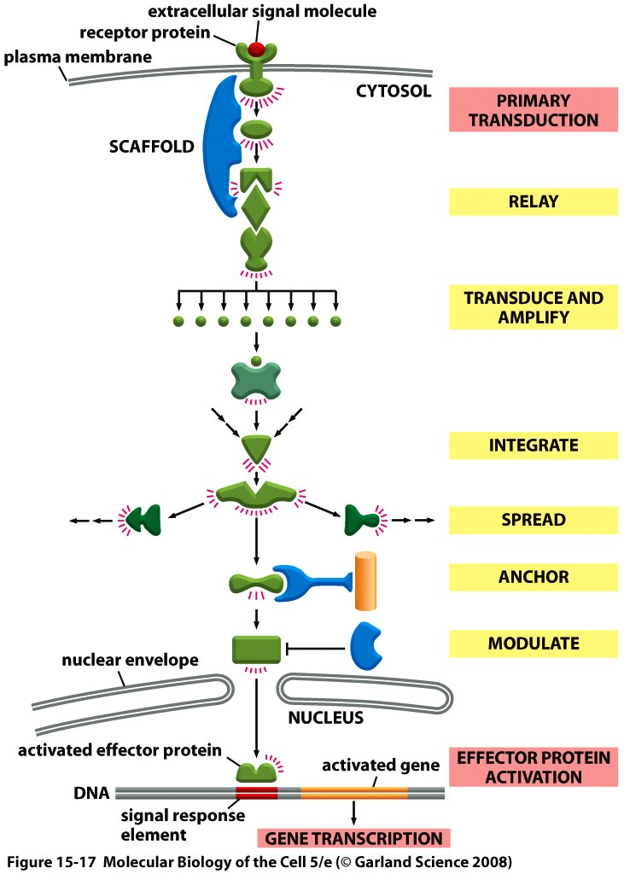
Eukaryotic signal transduction
A more precise realization of the implementation of signaling.
We begin with an example that is simple both conceptually and mathematically, namely, prokaryotic two-component signal transduction..

Slide 30
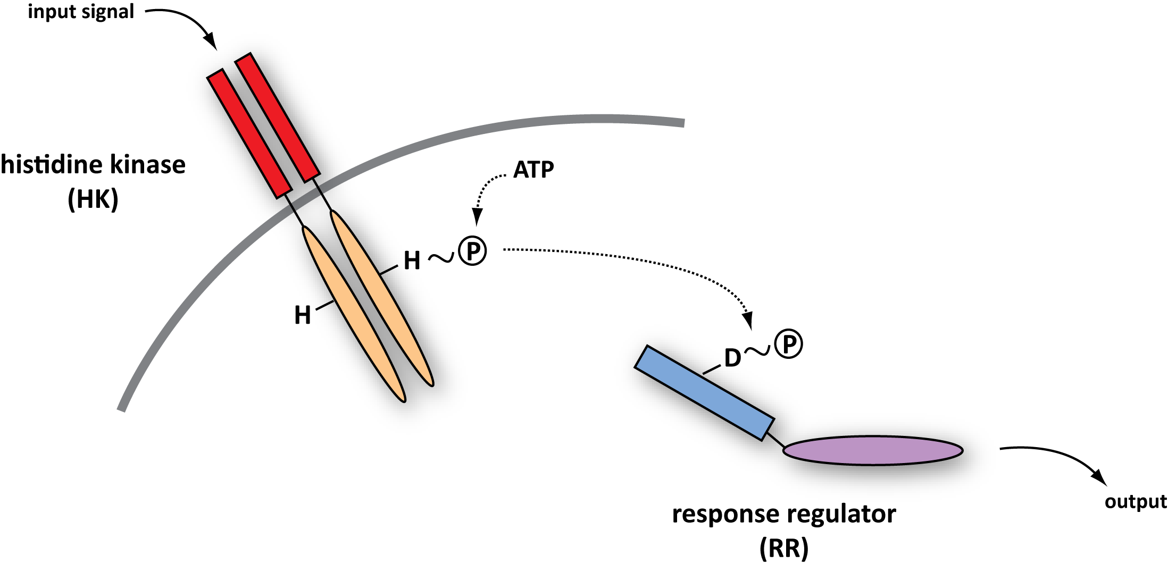
Two-Component Signal Transduction
Next few slides are courtesy of Michael Laub (MIT) and Mark Goulian (Upenn) – experts in the quantitative dissection of signaling networks.
This figure shows the generic features of the two-component signal transduction systems.
Notes:
30
30

Slide 31
Coordinating multiple signaling systems in a single cell
PhoR
EnvZ
CpxA
PhoQ
CusS
BasS
DcuS
TorS
NarX
PhoB
OmpR
CpxR
PhoP
UhpB
CusR
BasR
NarQ
DcuR
TorR
RstB
NarL
UhpC
KdpD
NarP
RstA
ArcB
KdpE
FimZ
OmpR
CheB
NtrC
NtrB
RcsB
RcsD
CheA
CheY
SprE
RcsC
AtoC
CreB
DpiB
YpdB
AtoS
EvgA
YehT
CreC
UvrY
YfJR
DpiA
HydD
BaeR
YedW
YpdA
EvgS
QseC
YehU
BarA
YfhK
HydG
BaeS
YedV
QseB
animation by Mark Gouilan
Notes:
31

Slide 32
Phosphotransfer profiling
HK + ATP* → HK~P* + ADP
(use complete set of purified RRs)
-
RR1
RR2
RR3
.........
RR44
incubate,
separate by
SDS-PAGE
HK~P* + RR → HK + RR~P*
HK~P
RR~P
Notes:
32

Slide 33
Assessing Specificity: Phosphotransfer Profiling
C. crescentus PhoR profile – 60 min phosphotransfer reactions
+PhoB
C. crescentus PhoR profile – 5 min phosphotransfer reactions
+PhoB
➔ histidine kinases exhibit a strong kinetic preference in vitro
for their in vivo cognate substrate
➔ specificity based on molecular recognition
Notes:
33
33
33

Slide 34
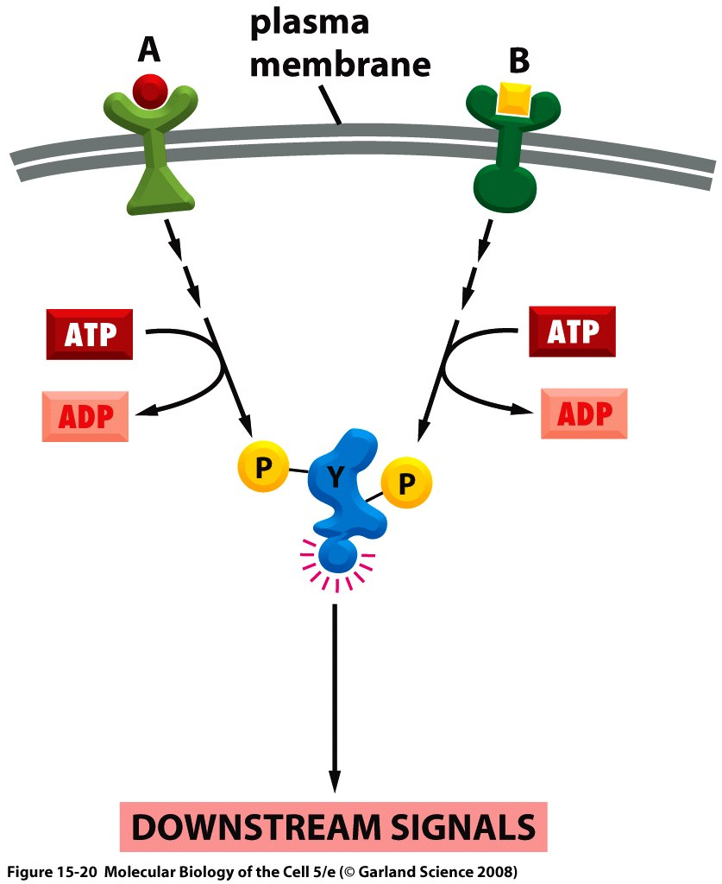
Signal integration
Once we finish with our concrete example of chemotaxis, we will turn to the way in which cells decide where to put new actin filament and that will make us face this question of signal integration.

Slide 35
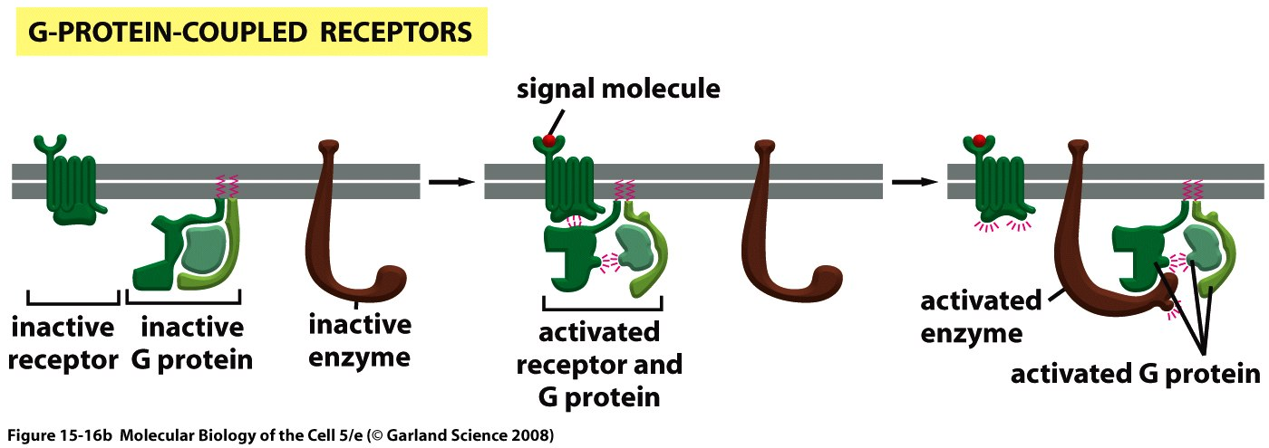
G-protein coupled receptors as an example

